Slide 1
How to Order Drive Up

Slide 2
How to Order Drive-up
Top things to look for during Site Survey
  Type of Drive-thru
  How many lanes
  Overhead / underground
Hamilton’s Drive-up methodology

Slide 3
Type of drive-thru
  Attached Canopy
  Remote Canopy
  Straight on
  Reverse
  MotorBank

Slide 4
How many Lanes
  Is there an ATM lane?
  Is the first lane going to be a deal drawer?
  Stacked?

Slide 5
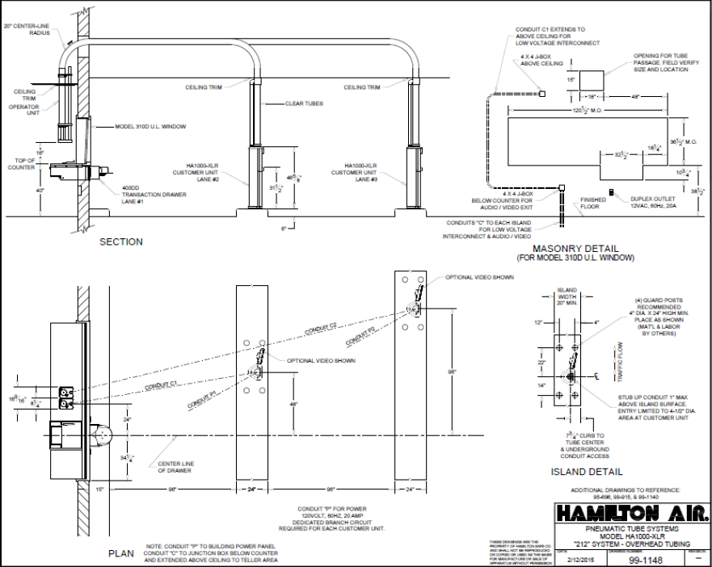
Use Overhead or Underground
  Overhead whenever possible!!!
  Underground only when required!

Slide 6
Drive up Methodology
XLR -111
Number of Audio Consoles
0 = No Deal Drawer Lane
1 = Deal Drawer Lane
Number of Customer Units
Type of Pneumatic Systems

Slide 7
Drive Up Methodology Cont.
XLR-111 XLR-112
XLR-202 XLR-212
XLR-302 XLR-312
XLR-402 XLR-412
Things to Know:
  First two numbers = total number of lanes
  May need to bump up to next matrix (2,4,8,12)
  Middle digit also provides additional tubing

Slide 8
Example 1 – XLR-212 (New Build)

Slide 9
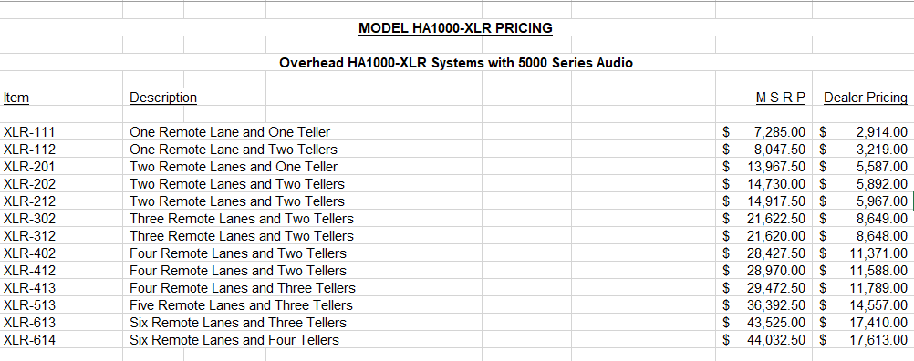

Slide 10
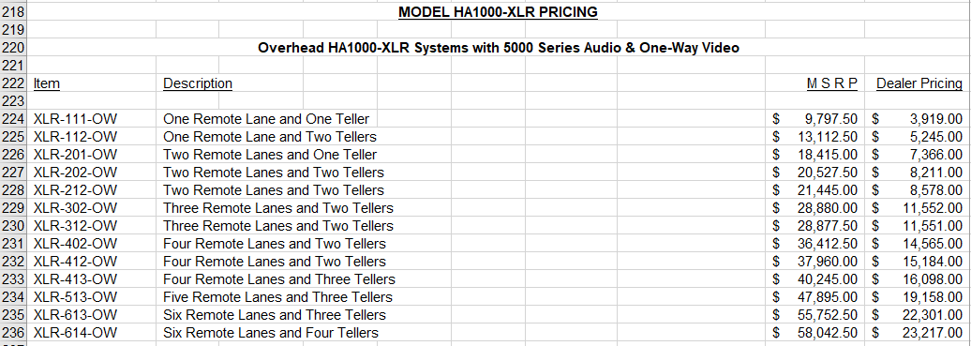
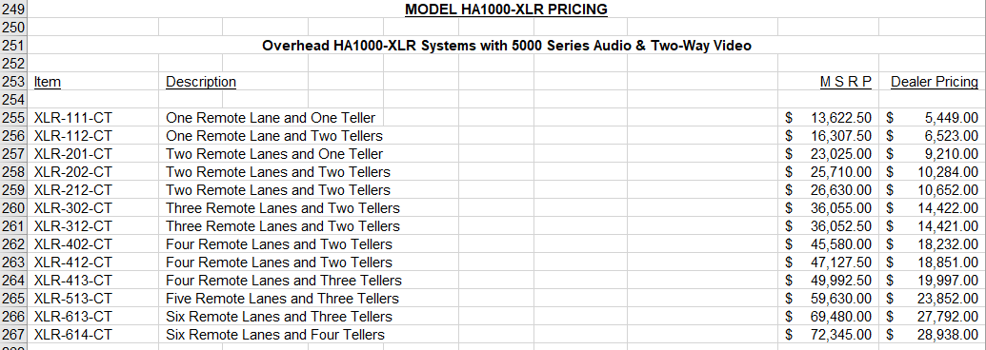

Slide 11
Example 2 – XLR-212 (RetroFit)
(using existing audio)

Slide 12
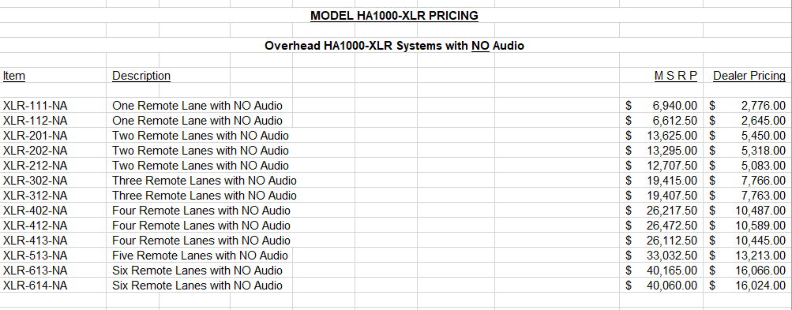
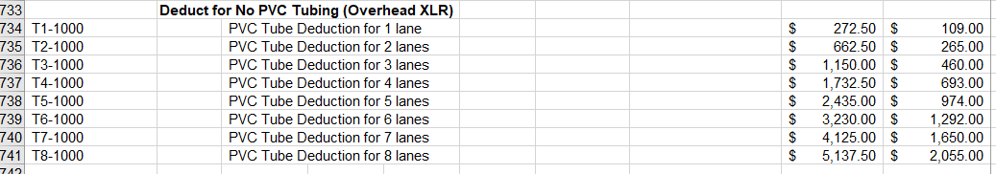
You take the XLR-212-NA and subtract the price for the T2-1000 (2 lane tube deduction):
$5,083.00 - $265.00 = $4,818.00

Slide 13
Example 3 – XLR-202 Overhead Customer to Underground Teller with 2 Way Video

Slide 14

You take the XLR-202-CT.
  CT= Two Way Video
You will need to subtract the tubing as you cannot use PVC in underground. You will either have to add Steel or Milwrapped Steel tubing (see next slide)
Next you will need to deduct the Overhead Teller Unit
Add in the standard Underground teller unit

Slide 15
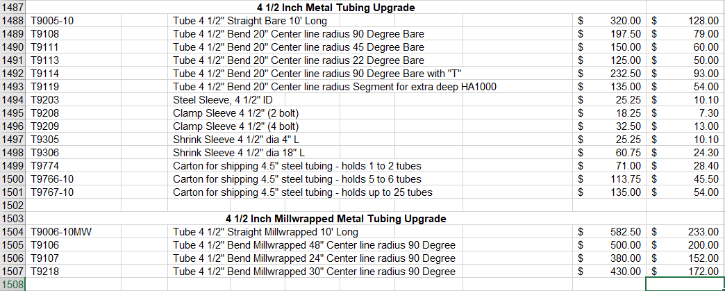
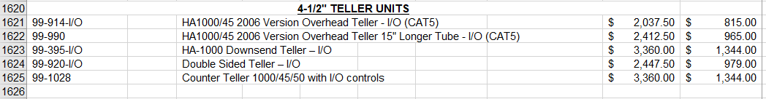
Add in the appropriate tubing
Remove the price for the Overhead Teller Unit (99-914-I/O) & Add Downsend Teller Unit (99-395-I/O)

Slide 16
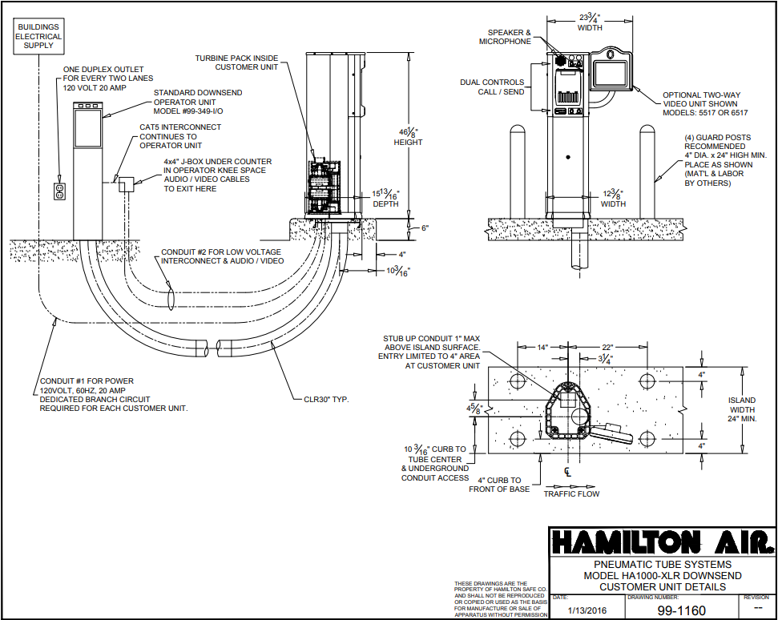
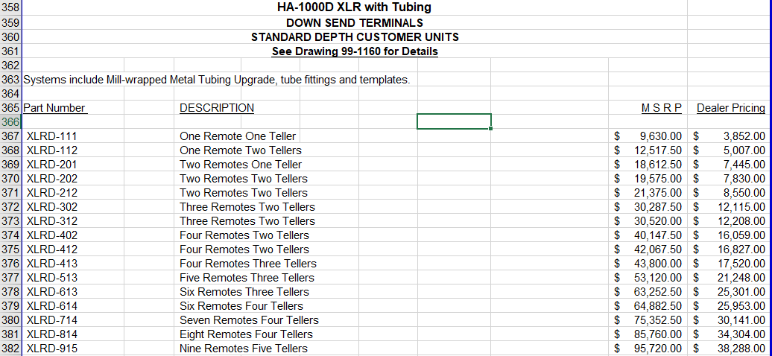
Downsend

Slide 17
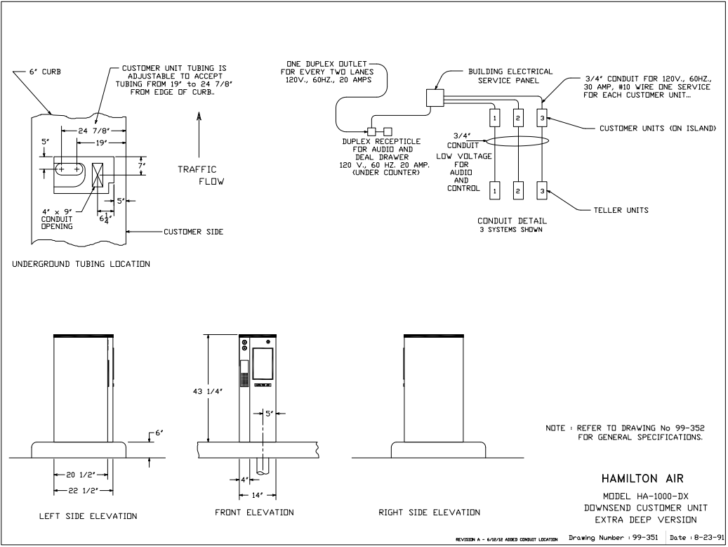
Downsend Options:
Must use old HA1000 downsend units when:
The tube comes through the island at 19”- 24 7/8” away from the edge of the island. Use the HA1000DX Unit
The existing underground tube is 4” and there is no way to go overhead. Use the HA1000D-4” unit

Slide 18
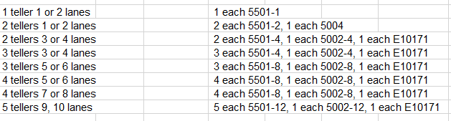
Audio

Slide 19
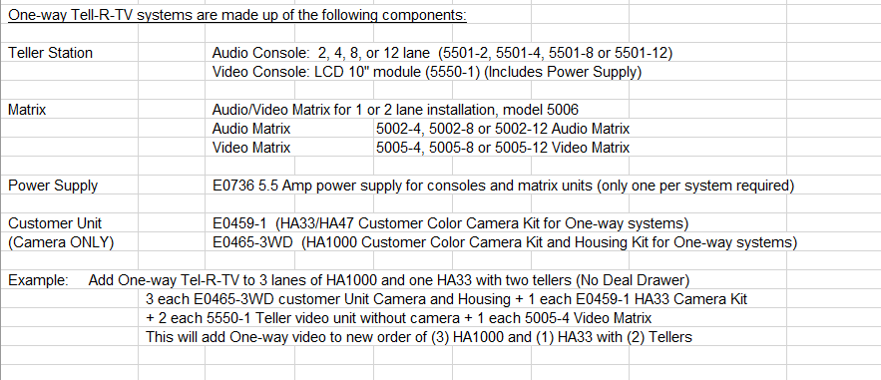
One Way Video

Slide 20
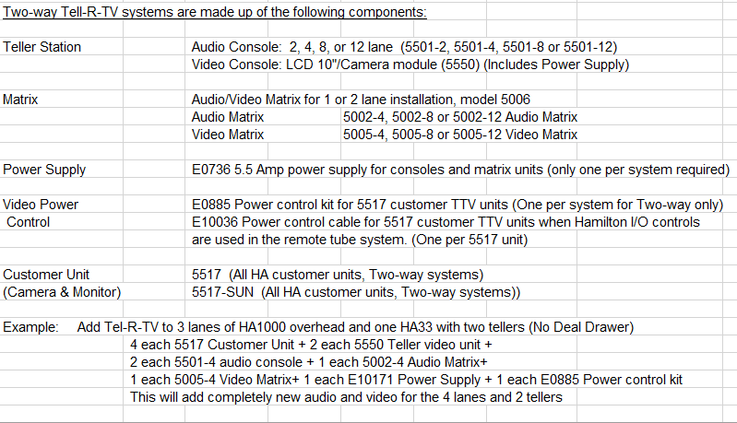
Two Way Video

Slide 21
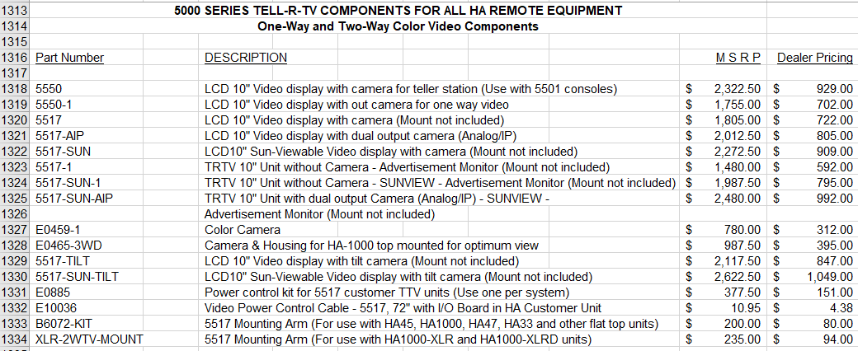

Slide 22
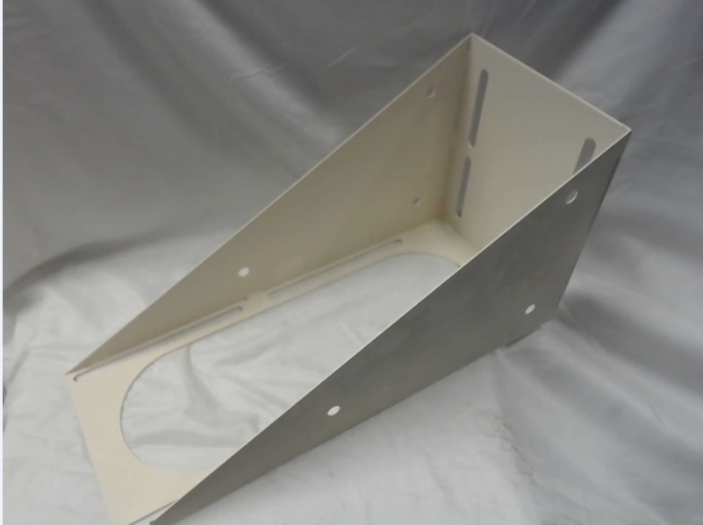
Accessories
Teller Wall Mount Bracket :
B5117 – QTY: 1 per overhead teller unit
Overhead Conduit Kits:
B6051 – QTY: 1 per overhead customer unit (Retrofits)
Riser Plates for Customer Unit
XLR-21K – QTY: 1 per customer unit (overhead)
XLRD-21K – QTY: 1 per customer unit (downsend)
Teller Wall Mount Bracket (pictured above)

Slide 23
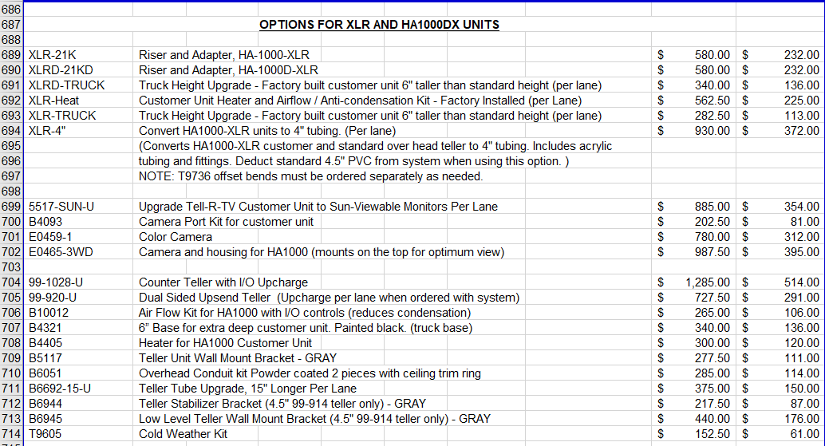

Slide 24
Questions

