Slide 1
Hamilton Update John Stroia

Slide 2
Agenda
COVID Impact
Hamilton United
Market
Innovation
Marketing
Focus Areas/Opportunities
Reminders

Slide 3
Hamilton Update – COVID Impact
Business in FI Market from Channel partners and National Accounts has been strong
Channel Partner Business up 10%!
National Account Business up 2%
Largest competitor is reeling
Have lost service contracts in several large accounts
Supply chain solid
Commodity/Steel Prices increasing

Slide 4
Hamilton United- Objectives
Locate a long-term site to centralize manufacturing and administrative activities in one location
Consolidate current three locations (total 206,000 sq. ft/19,138 sq. m) into one site (180,000 sq. ft/16,723 sq. m)
Choose location that would cause the least impact for associate drive time to work in order to reduce attrition
Create synergy with all associates working in the same location
Cost reductions and efficiencies gained from consolidation of departments (one sheet metal area, one welding area, etc.)
Secure long-term and predictable fixed costs on manufacturing and office facilities
Maintain a more stable labor force with a centralized long-term location, minimize attrition
Improved efficiencies driven by:
Purpose built facility with better flow and efficiency improvements built into design
Consolidate welding into one area – allows for cross training and better workforce flexibility
One metal fabrication area – consolidation of all metal machinery into one area
Crane consolidation – move from many cranes to three bridge cranes
More efficient concrete operation – more automation and better material handling
More efficient paint operation – consolidation of four different paint areas into one area
Elimination of shipping between plants
Conditioned/static reduced area for electromechanical assembly

Slide 5
Project Overview - Objectives
More sustainable facility
Cleaner air for associates (fume extraction, filtering and cleaner material handling)
Less emissions to environment (filtration)
Much higher energy efficiency (better insulation, more efficient HVAC and LED lighting, lower energy costs)
Improved LED lighting
More secure building – design will incorporate access control, intrusion detection and video (requirement for Hamilton Products Group (US Government business)).
Safer building – less accidents due to better flow and lighting
Improvements will result in better product quality
Improved customer experience
Hosting customers in our facility is an important part of our selling process
Building designed for efficient customer visits – customer meeting room, display area and factory overlook.
Move-in Dec. 2021

Slide 6
New Facility

Slide 7
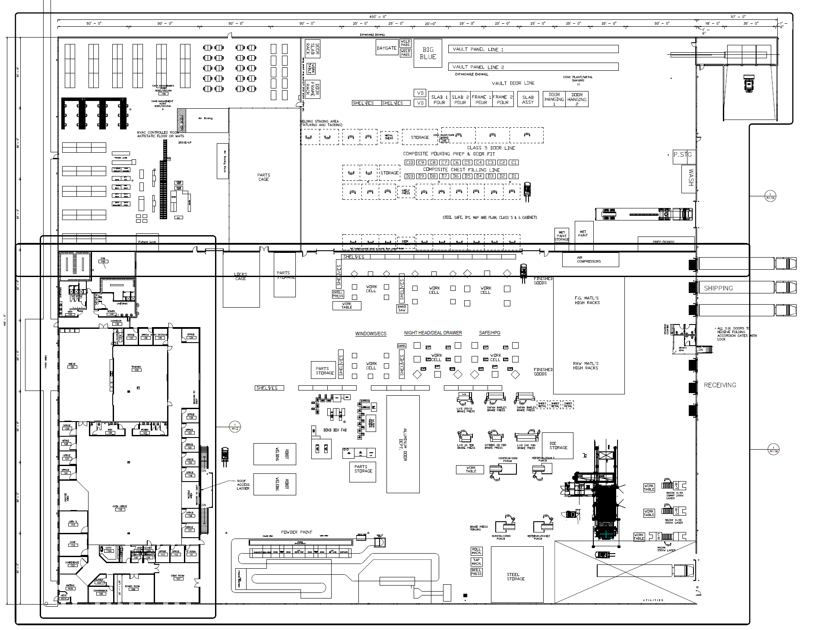
New Facility
Training
Room
Observation Deck
Customer Visit Area and Demo Center

Slide 8
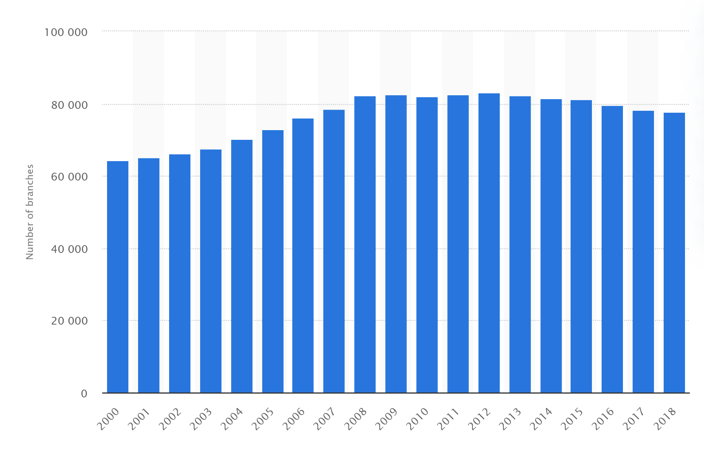
Market – Number of FDIC Branches
83,060
77,647
22,078 Credit Union Branches

Slide 9
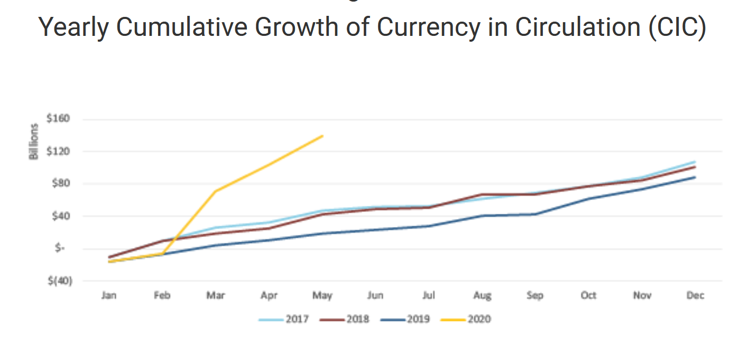
Market – Growth of Currency in Circulation
Federal Reserve Bank of San Francisco

Slide 10
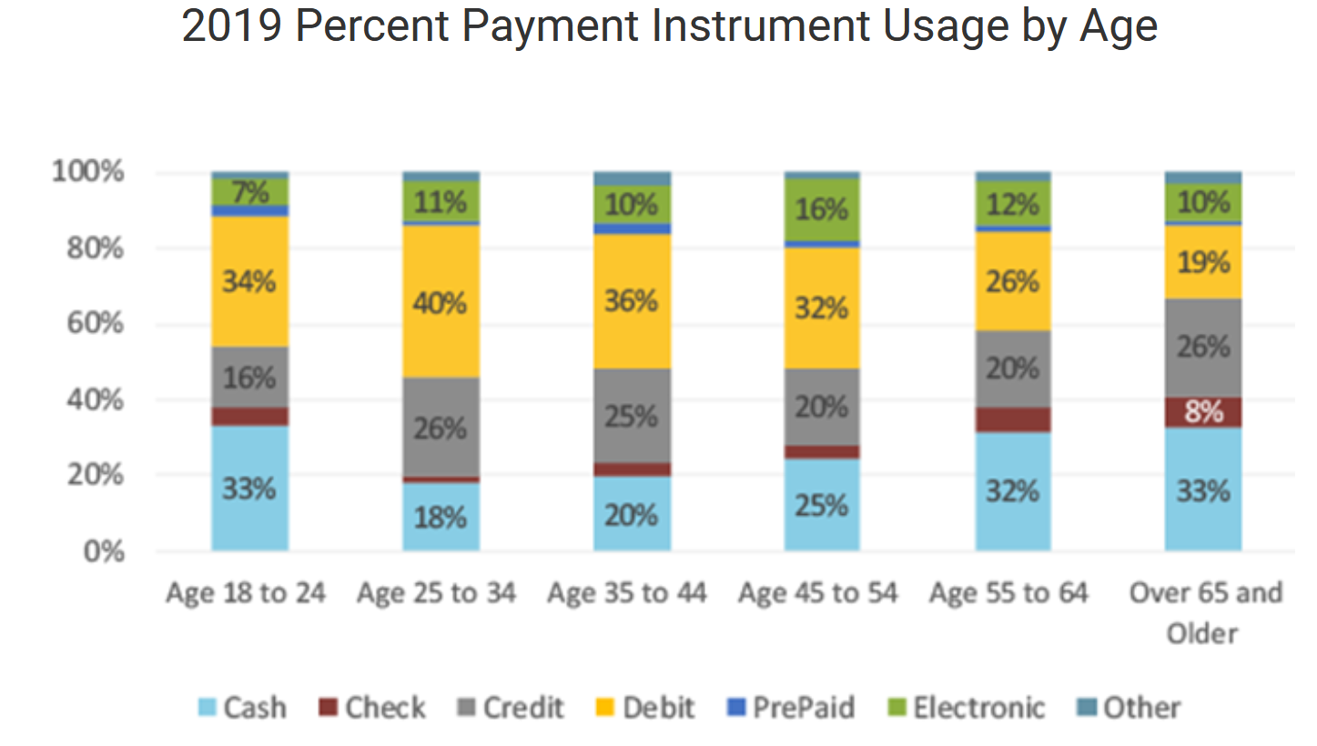
Market – Payment by Age
Federal Reserve Bank of San Francisco

Slide 11
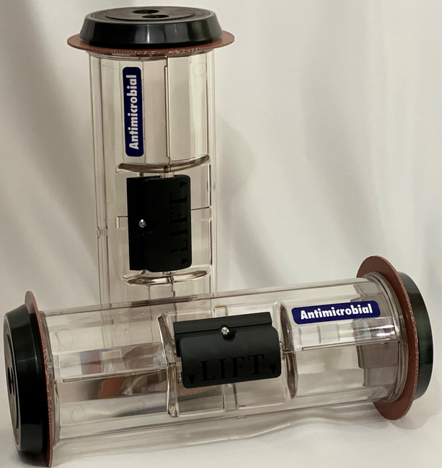
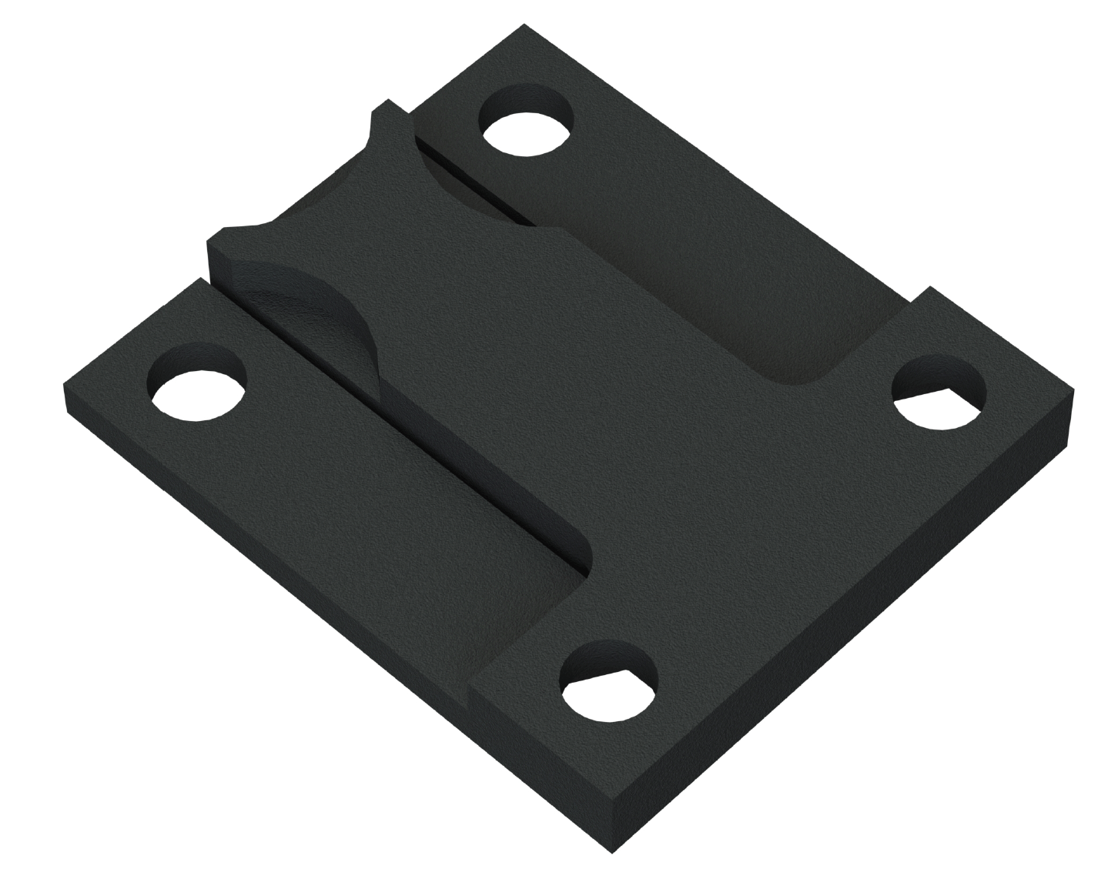
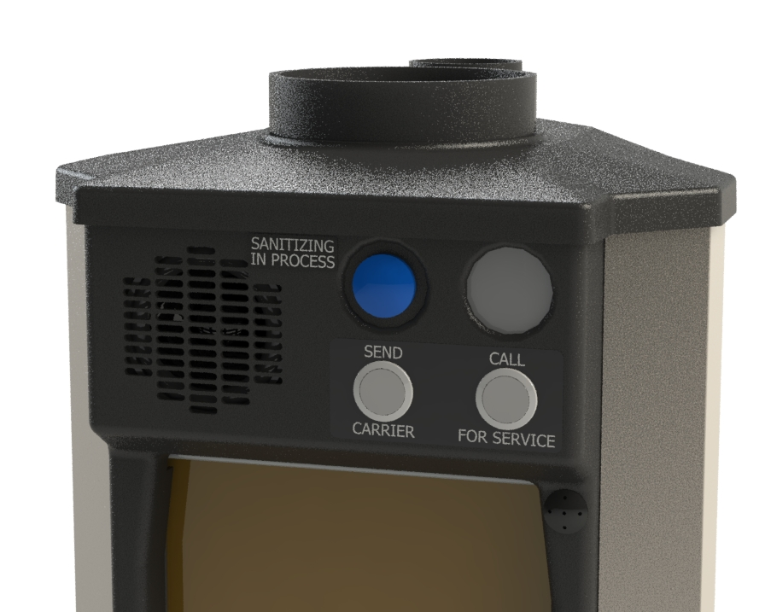
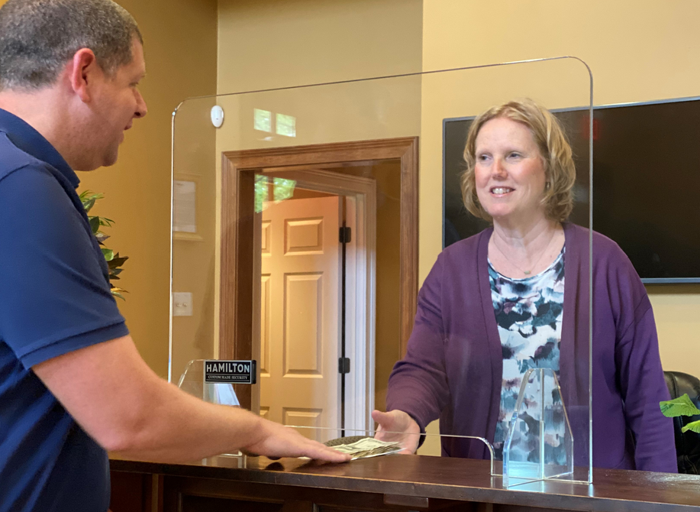
Innovation
COVID Solutions:
Anti-microbial drive-up carrier
Teller/Retailer sneeze guard
UVC drive-up solution – UVC light bathes carrier in between transactions
LED lights for Drive-up
ATM/Safe anchoring solution
Updated Safe boltwork
Decommissioning Plates
Door bucks
Diebold Parts – Audio/Video
Let us know what you need!

Slide 12
UVC Ultraviolet Light for HA-1000-XLR
Sterilization and Disinfection in a Short Time
80% Energy Savings
Environmental Protection
Service Life is 10,000 Hours
Instant Start
Field retrofittable
Replaces pocket with kit that include lights already installed – reduces on-site time
Notes:
Made for current and XLR in the field
Efficient: sterilization and disinfection effect can reach 99.9% in a short time
Energy saving: 80% energy saving compared to traditional cold cathode lamps – most out there are incandescent bulbs
Environmental protection: common harmful substances in metal-free gas illuminating technology
The service life is up to 10,000 hours. – 2 to 2 1/2 years
Instant start, high frequency switch. – wouldn’t work with an incandescent bulb

Slide 13
2021 Innovation
Intelligent Drive-up
EMP Safe
Redesign DD8 and 400DD
New Night Head
TL-15 Fire Door
New Safe Deposit Box design
Audio/Video Refresh
Vault Panel and Vault Door retest
Everyday Safe
New simple B-Rates safe with optional pharmacy interior
New replacement parts for existing competitive products

Slide 14
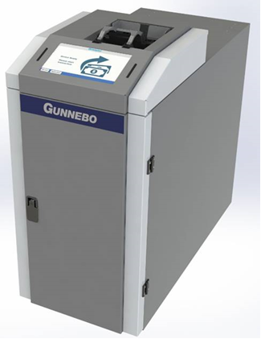
Cash Management – Saferecycling TCR-7
Continue to promote and offer support, to assist dealers with their sales opportunities
New Nexus integration expected by end of Q1
Stable and maturing product
Promotional Pricing from 2020
Can provide real time WebEx customer presentations
Growing install base

Slide 15
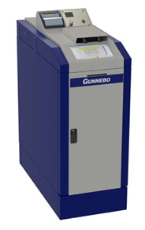
Cash Management – Saferecycling R7-L & R7-UL
As more opportunities arise with the cannabis space, continue to push this sector as this market grows.
More R7 sold in 2020 in the cannabis space, compared to TCR’s sold in Banking.
Stable and maturing product
Can be a stand along FI solution (not connected to core/teller)
Can provide real time webex customer presentations
Multiple dashboard options available

Slide 16
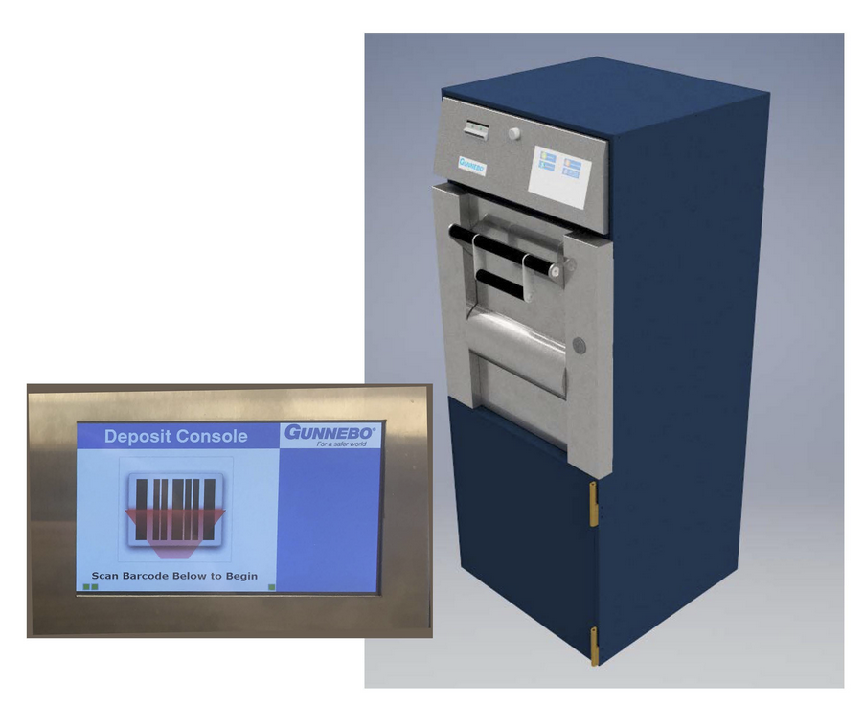
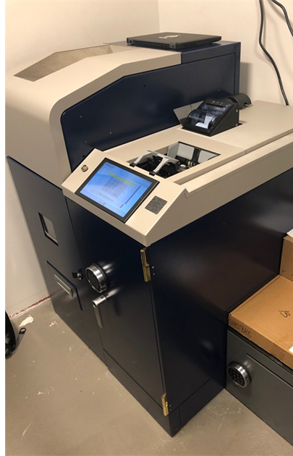
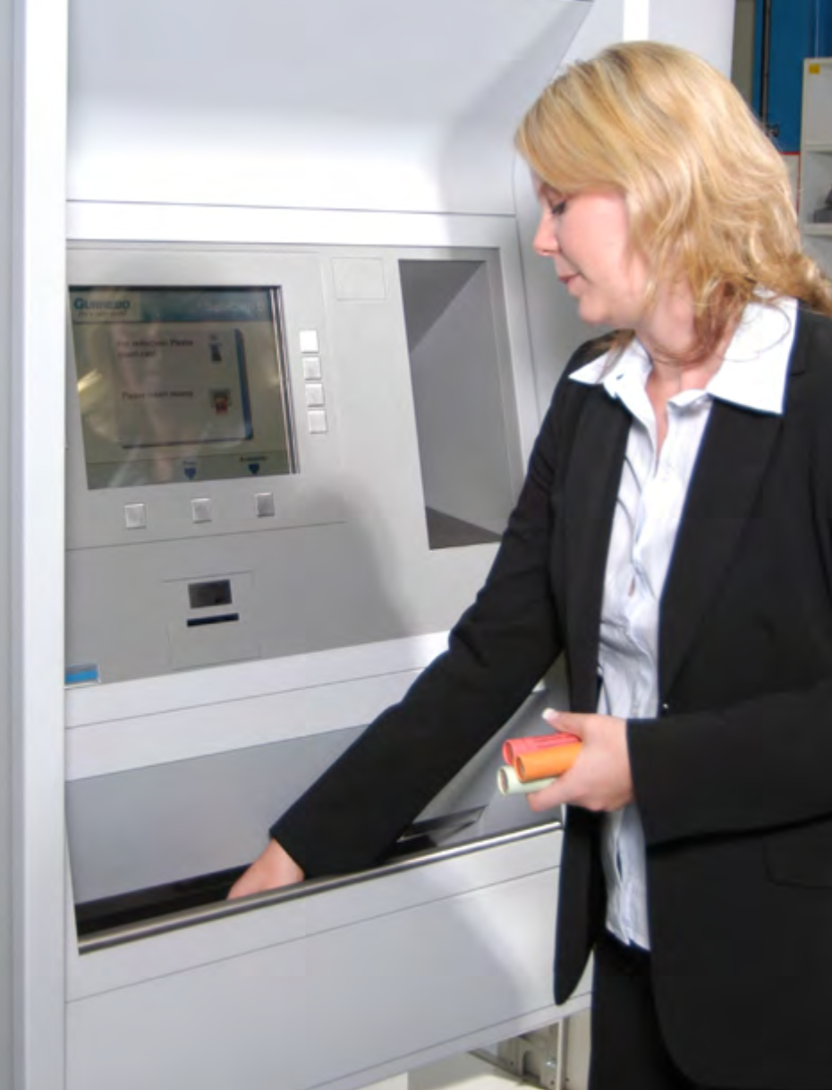
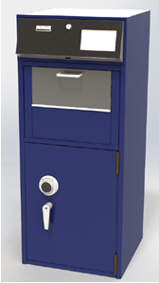
Hamilton Update Commercial Transaction Migration
RS7 Cash and Coin Recycling
Safe Deposit
D700 Coin Dispenser

Slide 17
Hamilton Marketing 2020
NEW Brochures
Drive-Up
Walk-Up
Transaction Drawers
Sneeze Guards (Infection Preventions Solutions)
Hamilton Security Cannabis Solutions
Gunnebo Cash Management Cannabis Solutions
Commercial Drive-Up
Social Media
Numerous posts on LinkedIn, Twitter for Hamilton Security, Gunnebo, Gunnebo Canada
Product Updates
Over 35 updates to date
Webinars (18 webinars on various topics including)
Sales Training
Entrance Control
COVID Solutions
Cash Management
Electronic Security
Drive-Up 101
Vaults, Vault Doors
Replacement Heads
Campaigns
Reactivated Drive-Up & Walk-Up Solutions
Sneeze Guards
Infection Prevention Solutions
Virtual Channel Partner Conference
Videos and Presentations

Slide 18
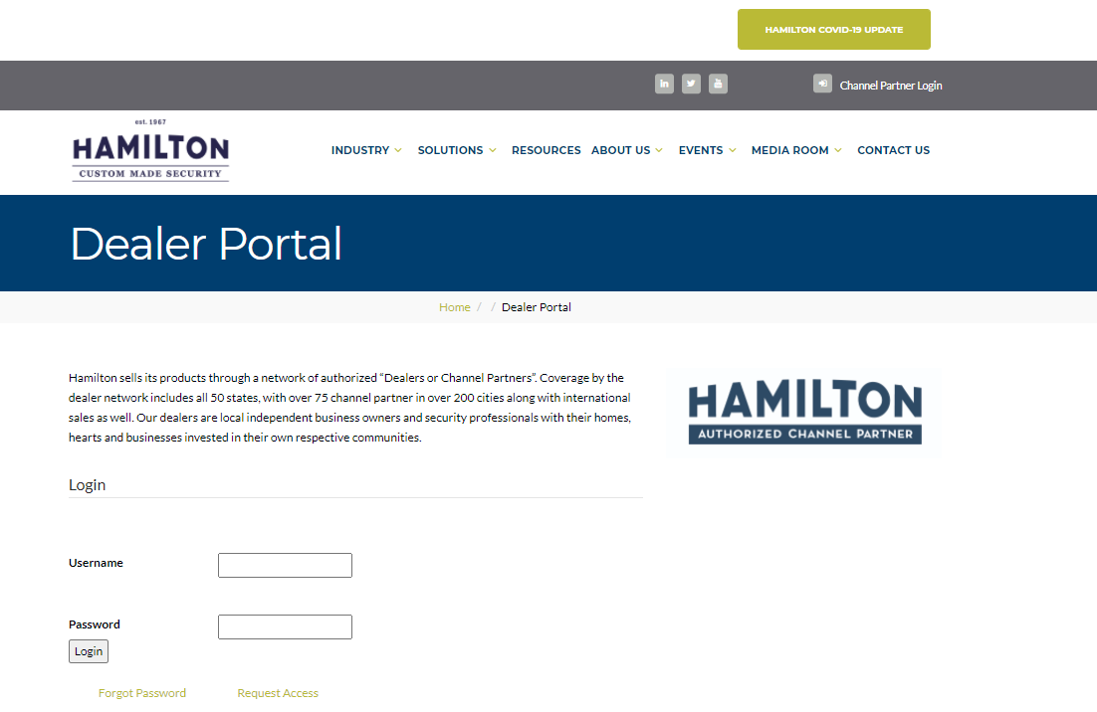
Dealer Portal Homepage
Request Access here
hamiltonsecuritysolutions.com/dealer-portal

Slide 19
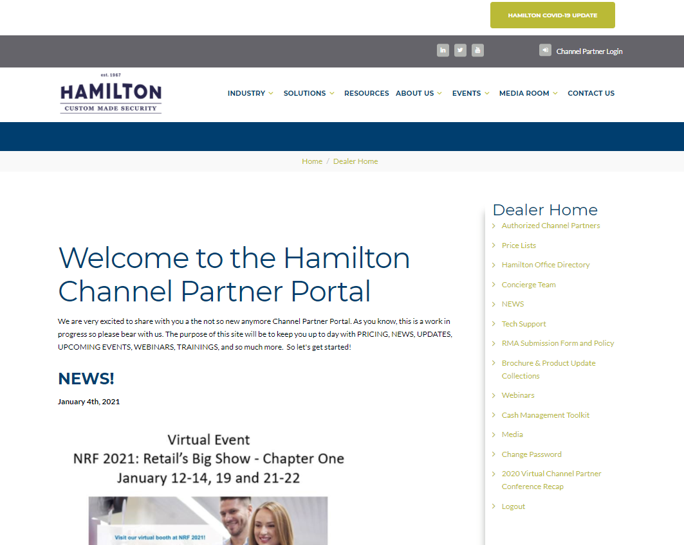
News
Price Lists
Tech Support Details
Marketing Toolkits
Updated Brochure
Product Updates
Webinar Links

Slide 20
Updates Brochures & Product Updates
White Papers & News

Slide 21
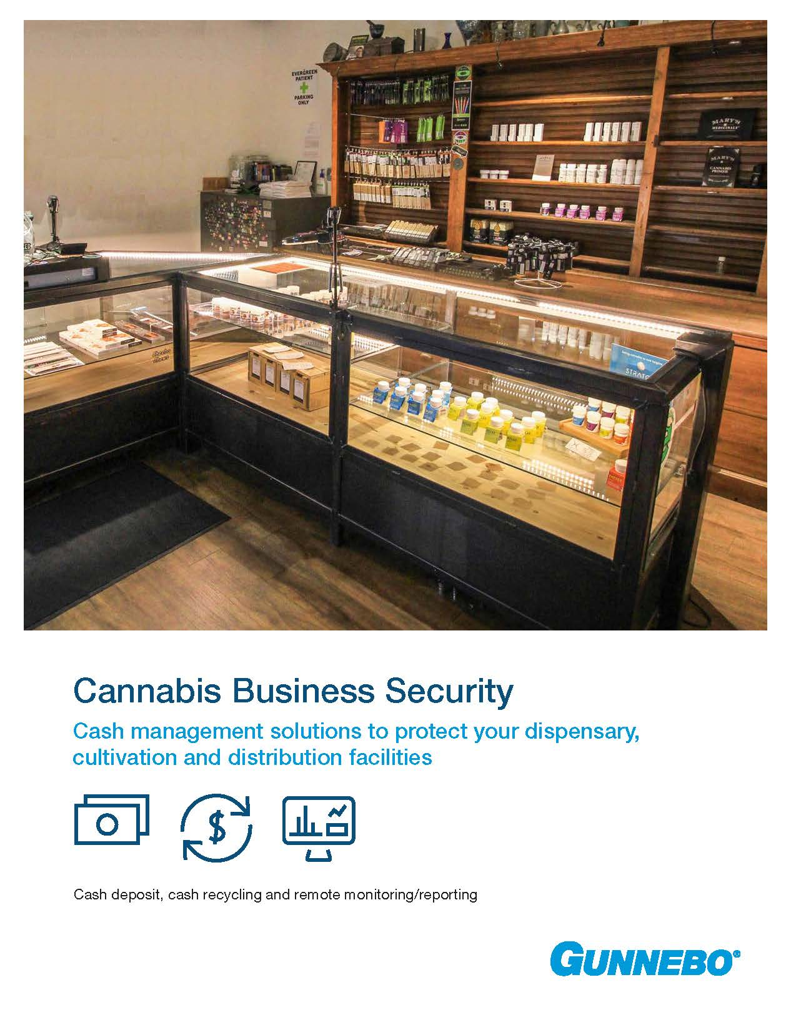
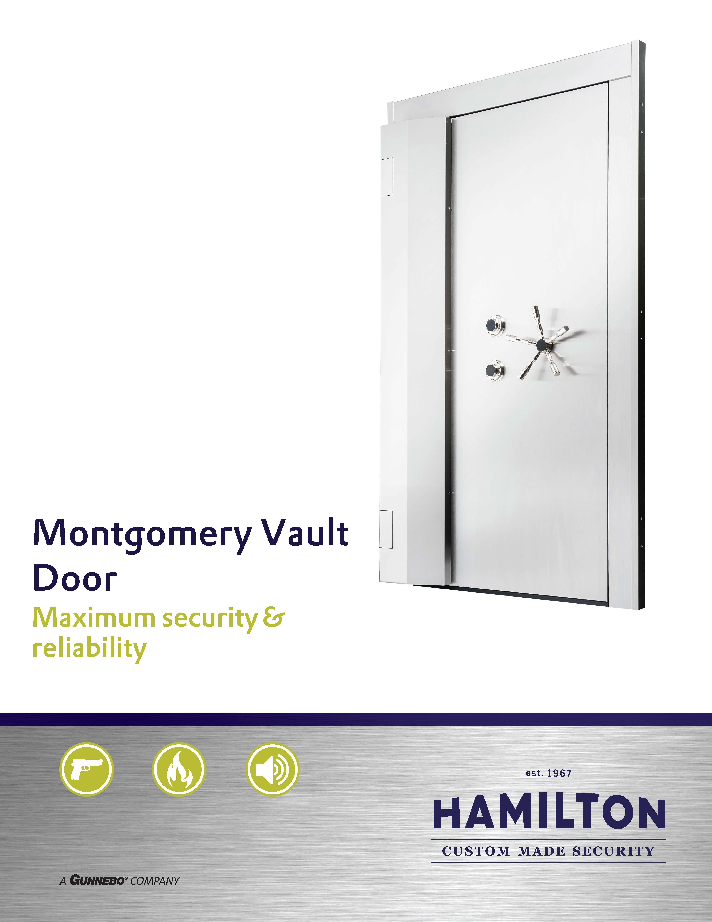
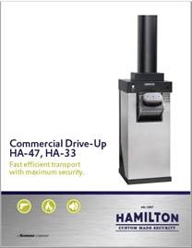

Slide 22
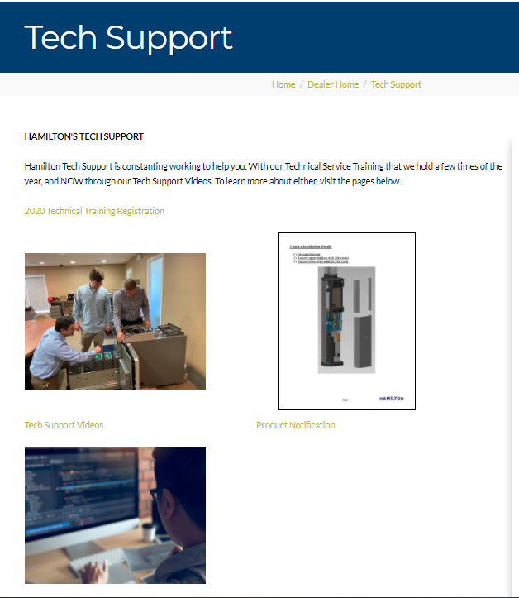
Hamilton Tech Support
Tech Support Videos
Technical Product Notifications and updates
Technical Training Class Registration (dates to come)

Slide 23
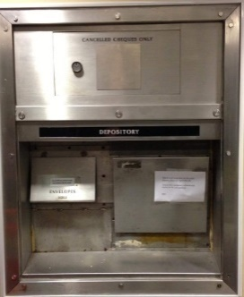
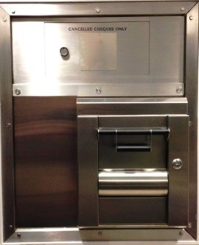
98 RH Retrofit – Your Competitive Advantage
Corporate Real Estate:
Cost efficient head end replacement solution ~ no structural or branch interior modifications required (maintain existing depository chest)
Eliminate need to manage multiple trade scheduling for replacement
Material return on investment realized versus full replacement
Clean modern appearance with the ability to incorporate logo branding
Security:
An ideal upgrade where UL specification is required
Old ND Head - Unknown level of security after decades of degradation and possible instances of inconsistent service events
Operations:
No disruption at branch level (staff or clients)
Installation completed from outside of building normally in 1 business day
All-weather stainless-steel construction
Full functionality / fewer customer complaints
Environmentally friendly ~ keeps 2 – 3 tons of unrecyclable materials out of landfill
Notes:
This checks boxes for many areas of the bank or CU
No matter who you are speaking with or their current responsibility, or area they take care of, there something in the solution that will speak to them
“Checks All The Boxes”
Note the line about managing multiple trades
In the coming slides try and keep track of the trades and individuals involved in a full ND replacement
Mention Real Estate and renovations. - many banks Cu not building new branches but sinking money into renovations
Many times a ND Head can be replaced at a historical building without a permit.
Operations – bank staff do no have to contact clients to redirect or come in for new keys
One of the things to take into account is that you may not know an older ND is encased in concrete.
You many not be aware until you start to peel back those layers of the onion.
This is a prime example of an unexpected cost mid way through a project.
See next slide

Slide 24
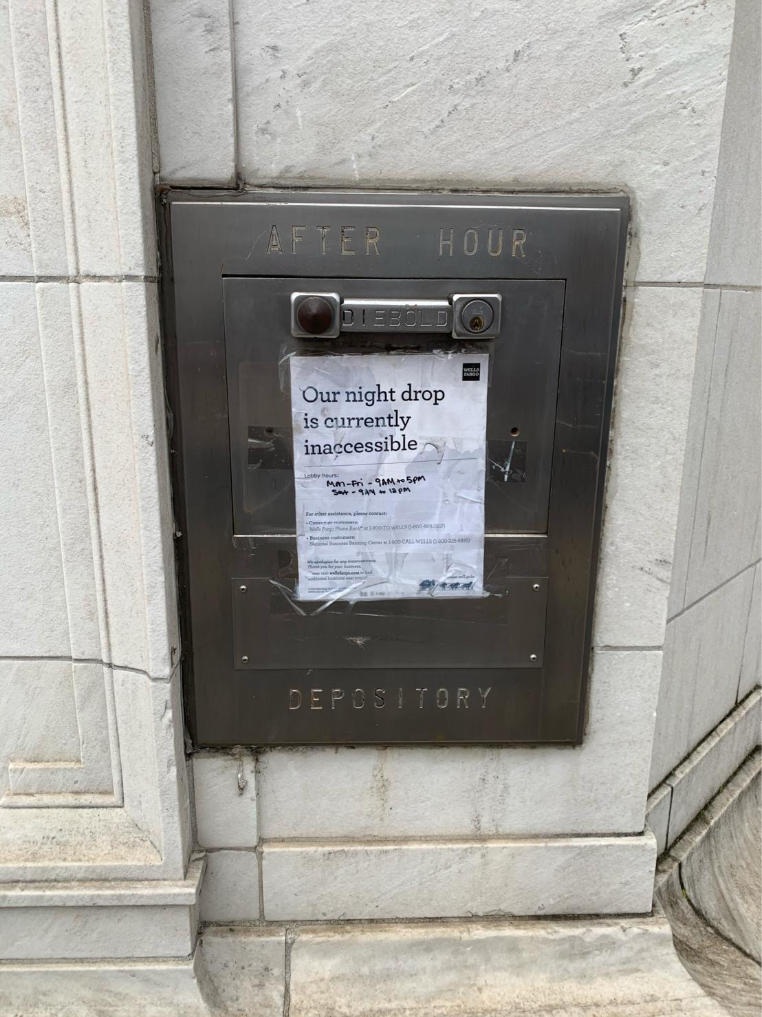
Here’s how the other guys do it…….
Notes:
This checks boxes for many areas of the bank or CU
No matter who you are speaking with or their current responsibility, or area they take care of, there something in the solution that will speak to them
“Checks All The Boxes”
Note the line about managing multiple trades
In the coming slides try and keep track of the trades and individuals involved in a full ND replacement
Mention Real Estate and renovations. - many banks Cu not building new branches but sinking money into renovations
Many times a ND Head can be replaced at a historical building without a permit.
Operations – bank staff do no have to contact clients to redirect or come in for new keys
One of the things to take into account is that you may not know an older ND is encased in concrete.
You many not be aware until you start to peel back those layers of the onion.
This is a prime example of an unexpected cost mid way through a project.
See next slide

Slide 25
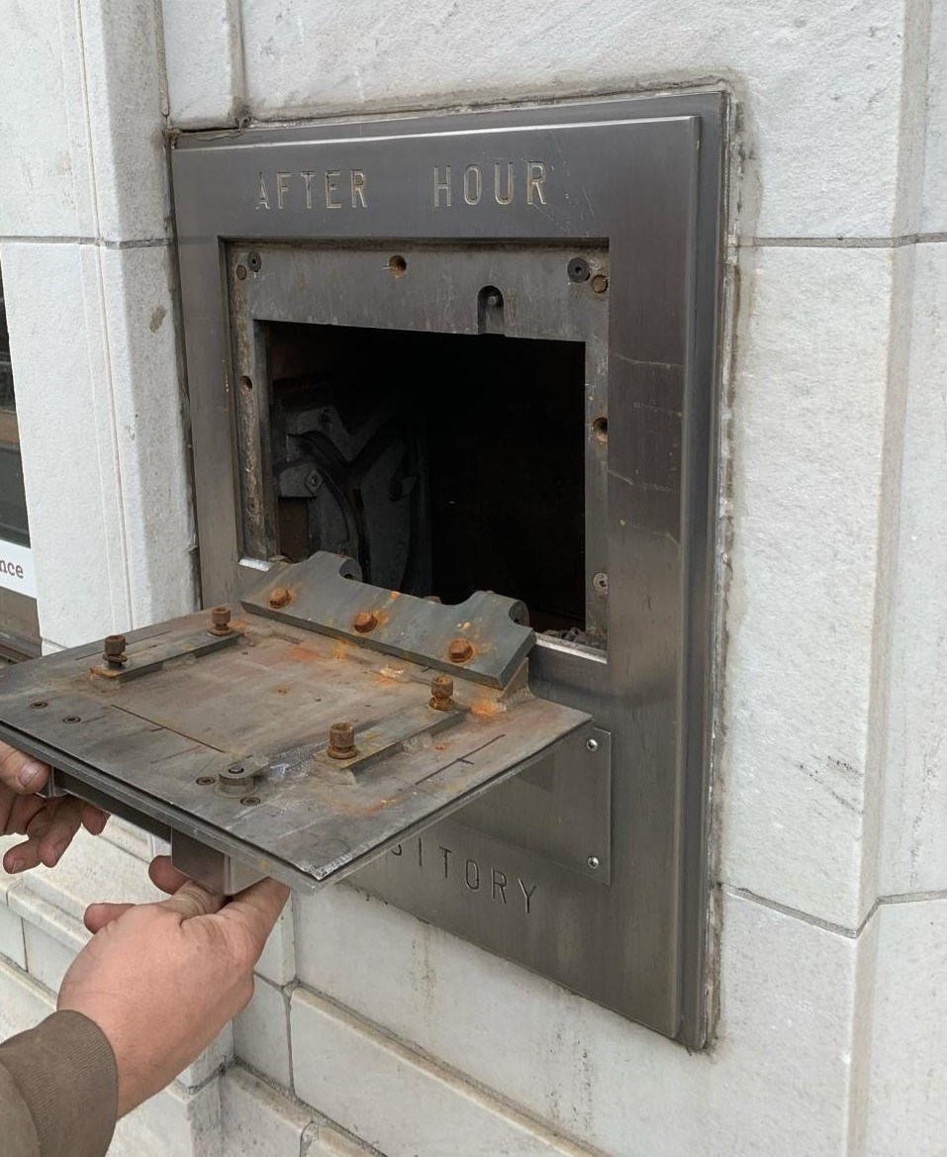
Here’s how the other guys do it…….
Notes:
This checks boxes for many areas of the bank or CU
No matter who you are speaking with or their current responsibility, or area they take care of, there something in the solution that will speak to them
“Checks All The Boxes”
Note the line about managing multiple trades
In the coming slides try and keep track of the trades and individuals involved in a full ND replacement
Mention Real Estate and renovations. - many banks Cu not building new branches but sinking money into renovations
Many times a ND Head can be replaced at a historical building without a permit.
Operations – bank staff do no have to contact clients to redirect or come in for new keys
One of the things to take into account is that you may not know an older ND is encased in concrete.
You many not be aware until you start to peel back those layers of the onion.
This is a prime example of an unexpected cost mid way through a project.
See next slide

Slide 26
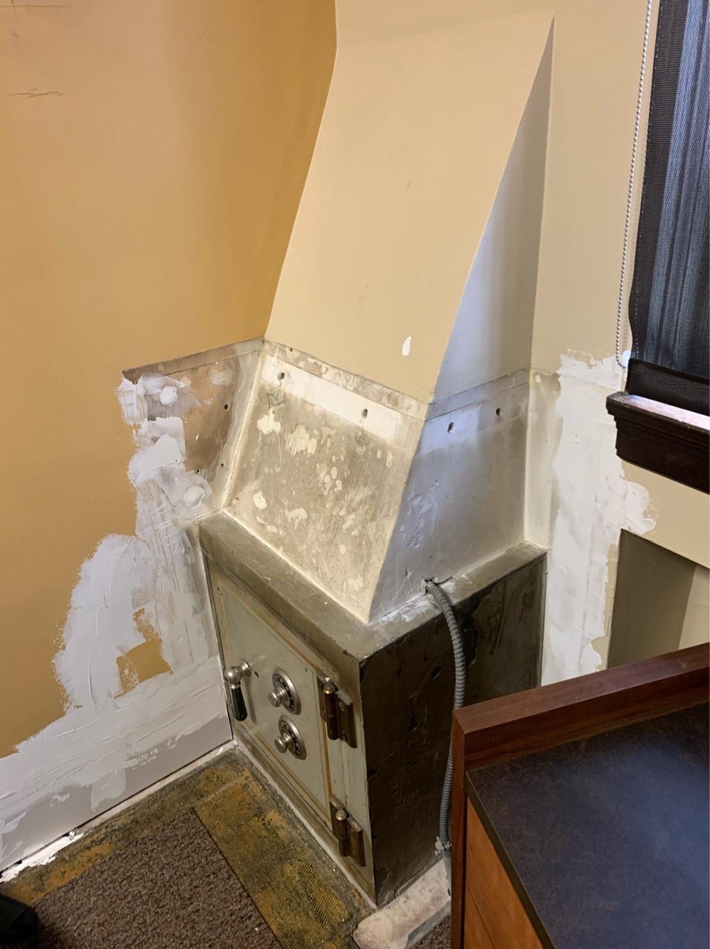
Here’s how the other guys do it…….
Notes:
This checks boxes for many areas of the bank or CU
No matter who you are speaking with or their current responsibility, or area they take care of, there something in the solution that will speak to them
“Checks All The Boxes”
Note the line about managing multiple trades
In the coming slides try and keep track of the trades and individuals involved in a full ND replacement
Mention Real Estate and renovations. - many banks Cu not building new branches but sinking money into renovations
Many times a ND Head can be replaced at a historical building without a permit.
Operations – bank staff do no have to contact clients to redirect or come in for new keys
One of the things to take into account is that you may not know an older ND is encased in concrete.
You many not be aware until you start to peel back those layers of the onion.
This is a prime example of an unexpected cost mid way through a project.
See next slide

Slide 27
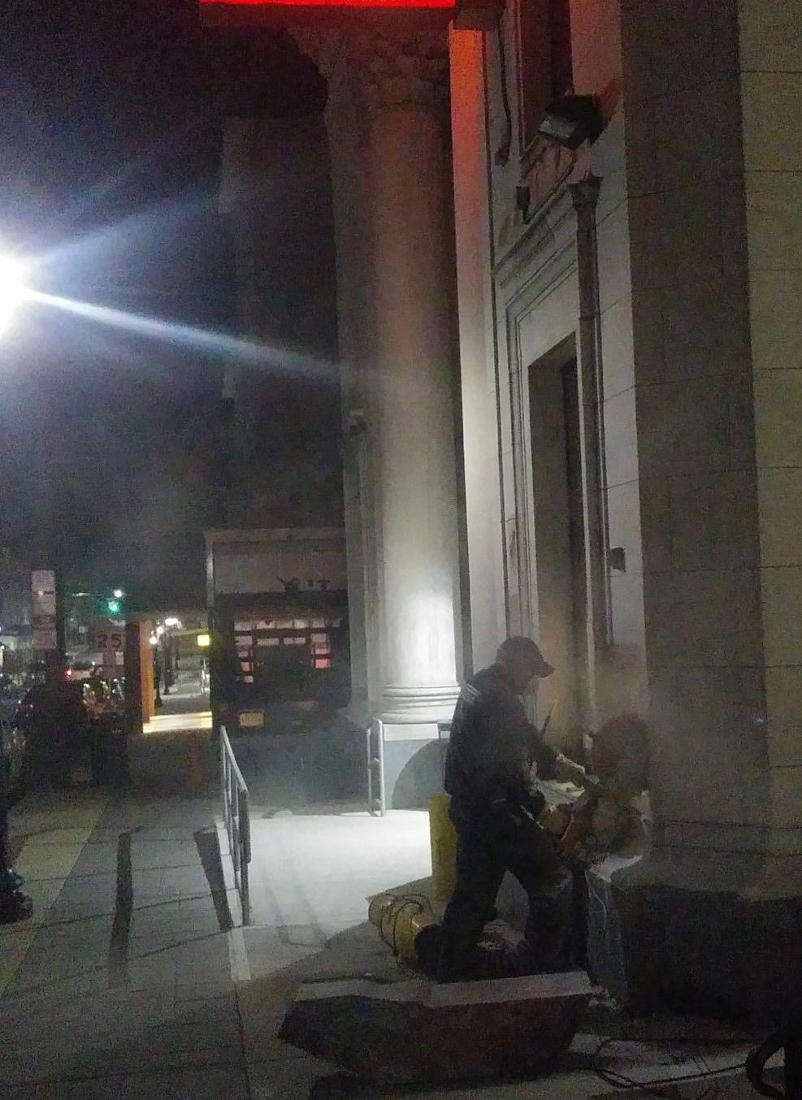
Here’s how the other guys do it…….
Notes:
This checks boxes for many areas of the bank or CU
No matter who you are speaking with or their current responsibility, or area they take care of, there something in the solution that will speak to them
“Checks All The Boxes”
Note the line about managing multiple trades
In the coming slides try and keep track of the trades and individuals involved in a full ND replacement
Mention Real Estate and renovations. - many banks Cu not building new branches but sinking money into renovations
Many times a ND Head can be replaced at a historical building without a permit.
Operations – bank staff do no have to contact clients to redirect or come in for new keys
One of the things to take into account is that you may not know an older ND is encased in concrete.
You many not be aware until you start to peel back those layers of the onion.
This is a prime example of an unexpected cost mid way through a project.
See next slide

Slide 28
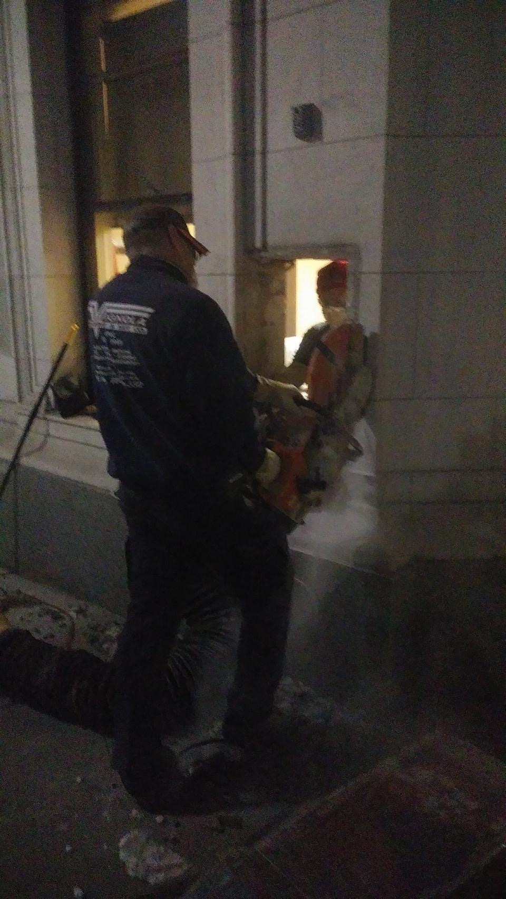
Here’s how the other guys do it…….
Notes:
This checks boxes for many areas of the bank or CU
No matter who you are speaking with or their current responsibility, or area they take care of, there something in the solution that will speak to them
“Checks All The Boxes”
Note the line about managing multiple trades
In the coming slides try and keep track of the trades and individuals involved in a full ND replacement
Mention Real Estate and renovations. - many banks Cu not building new branches but sinking money into renovations
Many times a ND Head can be replaced at a historical building without a permit.
Operations – bank staff do no have to contact clients to redirect or come in for new keys
One of the things to take into account is that you may not know an older ND is encased in concrete.
You many not be aware until you start to peel back those layers of the onion.
This is a prime example of an unexpected cost mid way through a project.
See next slide

Slide 29
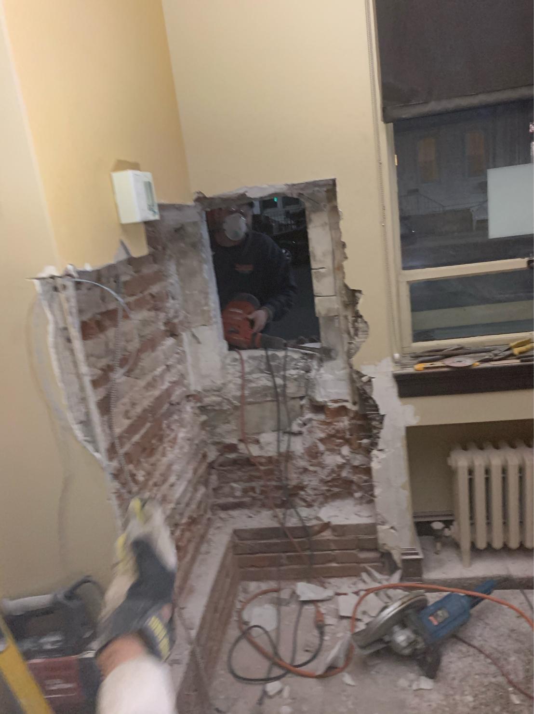
Here’s how the other guys do it…….
Notes:
This checks boxes for many areas of the bank or CU
No matter who you are speaking with or their current responsibility, or area they take care of, there something in the solution that will speak to them
“Checks All The Boxes”
Note the line about managing multiple trades
In the coming slides try and keep track of the trades and individuals involved in a full ND replacement
Mention Real Estate and renovations. - many banks Cu not building new branches but sinking money into renovations
Many times a ND Head can be replaced at a historical building without a permit.
Operations – bank staff do no have to contact clients to redirect or come in for new keys
One of the things to take into account is that you may not know an older ND is encased in concrete.
You many not be aware until you start to peel back those layers of the onion.
This is a prime example of an unexpected cost mid way through a project.
See next slide

Slide 30
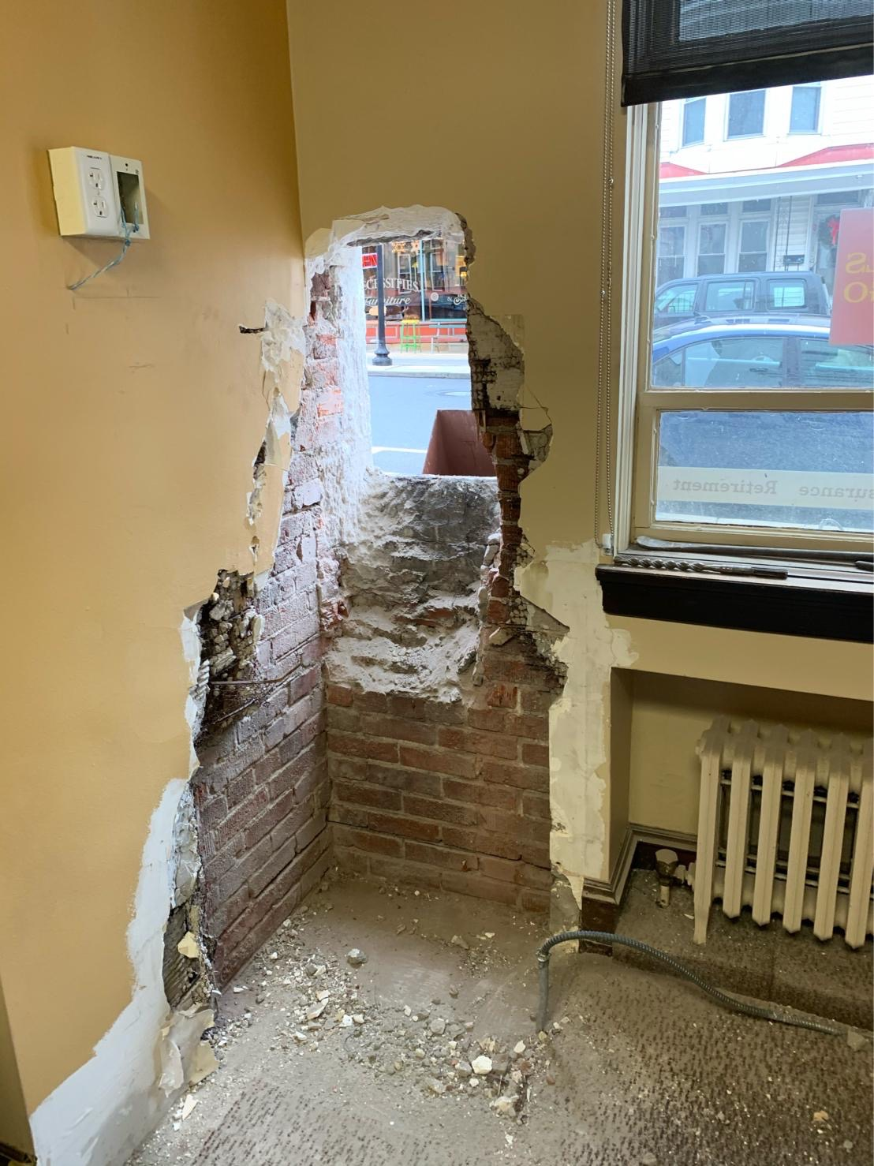
Here’s how the other guys do it…….
Notes:
This checks boxes for many areas of the bank or CU
No matter who you are speaking with or their current responsibility, or area they take care of, there something in the solution that will speak to them
“Checks All The Boxes”
Note the line about managing multiple trades
In the coming slides try and keep track of the trades and individuals involved in a full ND replacement
Mention Real Estate and renovations. - many banks Cu not building new branches but sinking money into renovations
Many times a ND Head can be replaced at a historical building without a permit.
Operations – bank staff do no have to contact clients to redirect or come in for new keys
One of the things to take into account is that you may not know an older ND is encased in concrete.
You many not be aware until you start to peel back those layers of the onion.
This is a prime example of an unexpected cost mid way through a project.
See next slide

Slide 31
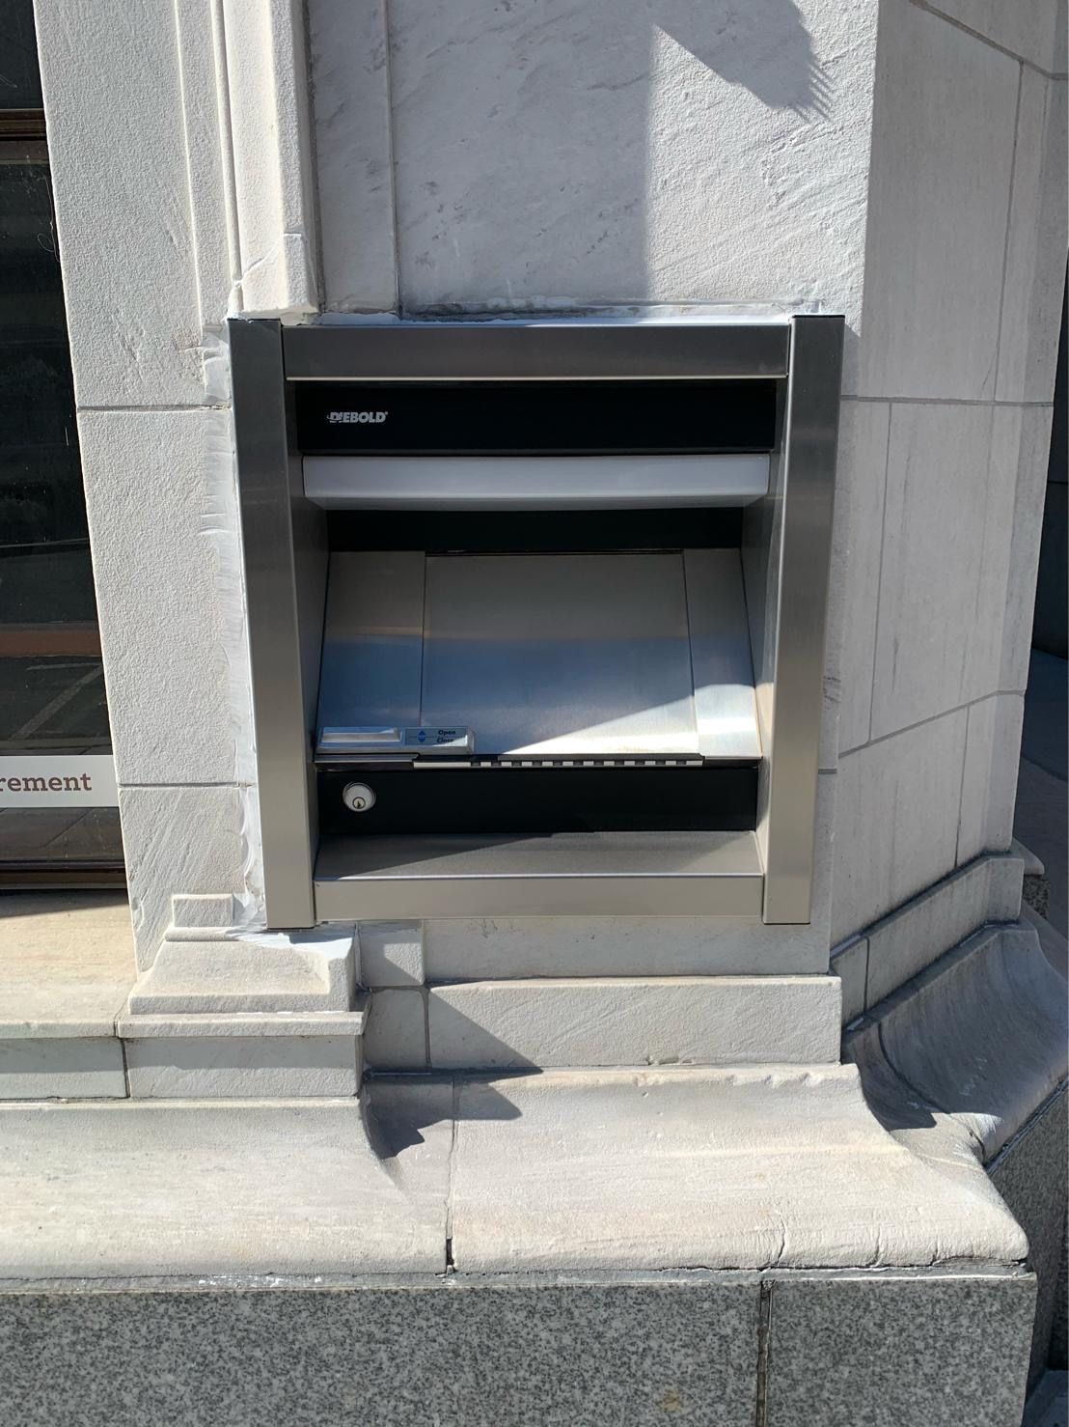
Here’s how the other guys do it…….
Notes:
This checks boxes for many areas of the bank or CU
No matter who you are speaking with or their current responsibility, or area they take care of, there something in the solution that will speak to them
“Checks All The Boxes”
Note the line about managing multiple trades
In the coming slides try and keep track of the trades and individuals involved in a full ND replacement
Mention Real Estate and renovations. - many banks Cu not building new branches but sinking money into renovations
Many times a ND Head can be replaced at a historical building without a permit.
Operations – bank staff do no have to contact clients to redirect or come in for new keys
One of the things to take into account is that you may not know an older ND is encased in concrete.
You many not be aware until you start to peel back those layers of the onion.
This is a prime example of an unexpected cost mid way through a project.
See next slide

Slide 32
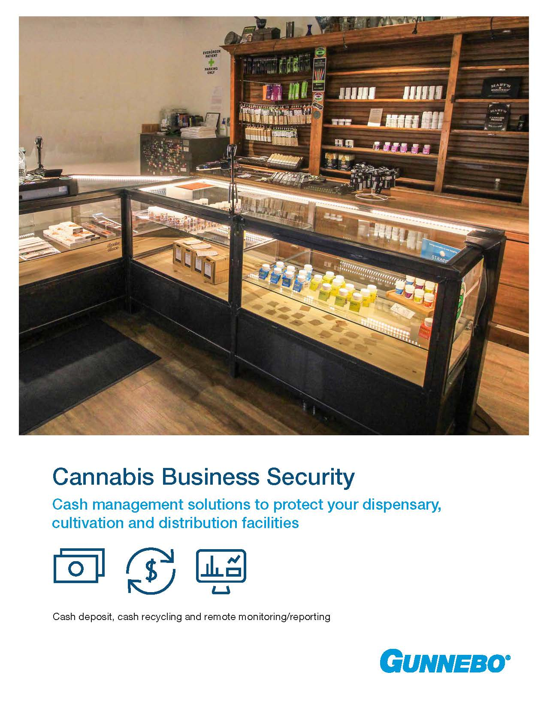
Growth Opportunities with Cannabis
Notes:
New Products coming in 2021
TL15 fire door
New Night Depository Head – new look and design
Channel Partner Conference in Cincinnati – May 3rd

Slide 33
Hamilton Parts
Restructured area - moved parts to Customer Service
Important Solution – Helps you win business
Large Inventory of Diebold Parts – let us know what you need
Same day turnaround – orders in by 1pm ship by 5pm
Notes:
Become a one stop shop
Take over competitive accounts – does your customer have legacy equipment? Trouble having it serviced?
October 14 – update to list with 25 new Diebold parts

Slide 34
Steel Prices
Notes:
Become a one stop shop
Take over competitive accounts – does your customer have legacy equipment? Trouble having it serviced?
October 14 – update to list with 25 new Diebold parts

Slide 35
Reminders
We want to be your parts supplier!
Training/support – web-based
Channel Partner portal
Keep looking for updated marketing materials
We continue to expand electronic security
Come visit us anytime!

Slide 36
Thank You For Your Business!

