Slide 1



New products update
Presented by: Todd Lefevers

Slide 2

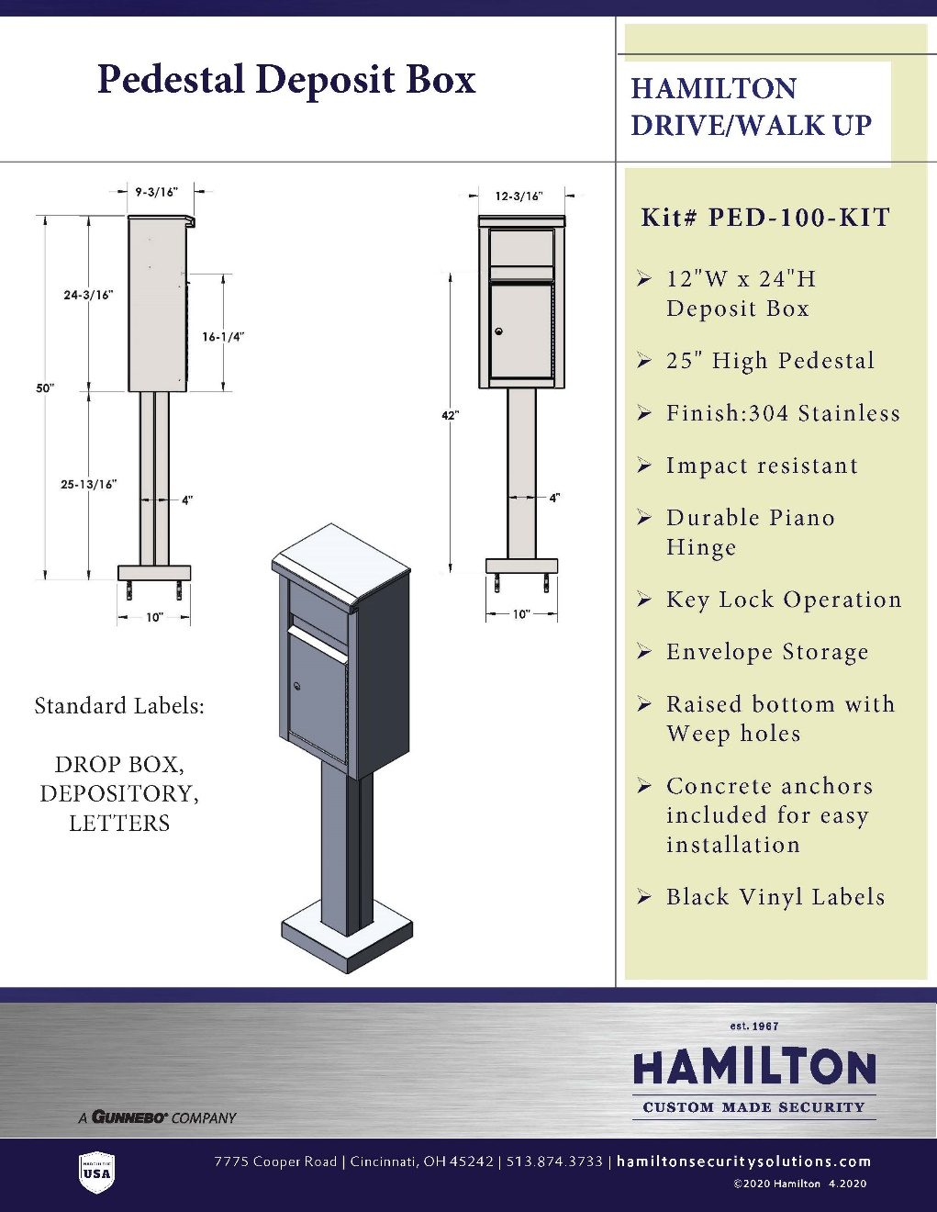
Pedestal Deposit Box
free standing deposit
Finish all stainless
walk up or drive up
key lock securing the deposits
envelope slot
flap conceals the slot & envelope storage
labels: drop box, depository, letters
concrete anchors are included

Slide 3

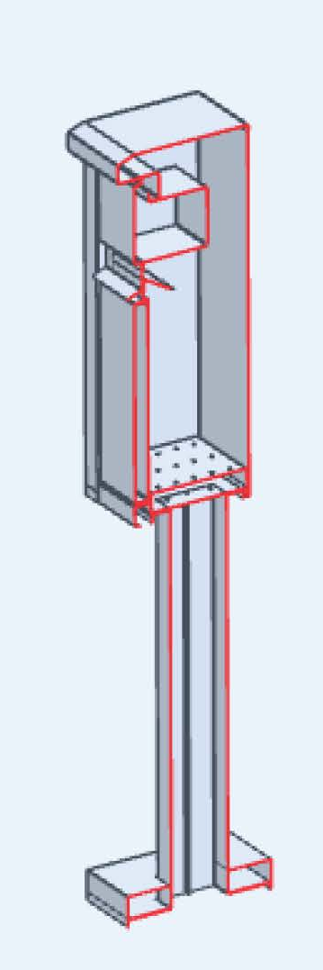
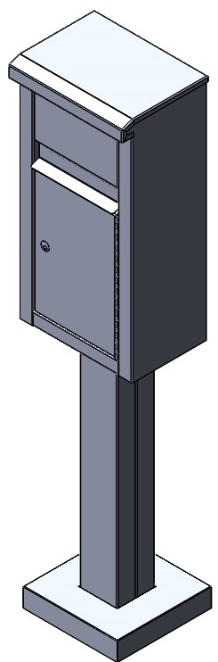
Pedestal Deposit Box – Kit # PED-100-KIT
Envelope Slot
Envelope Storage
Deposit Box Door
Raised bottom with Weep holes
Pedestal
Base with concrete anchors

Slide 4
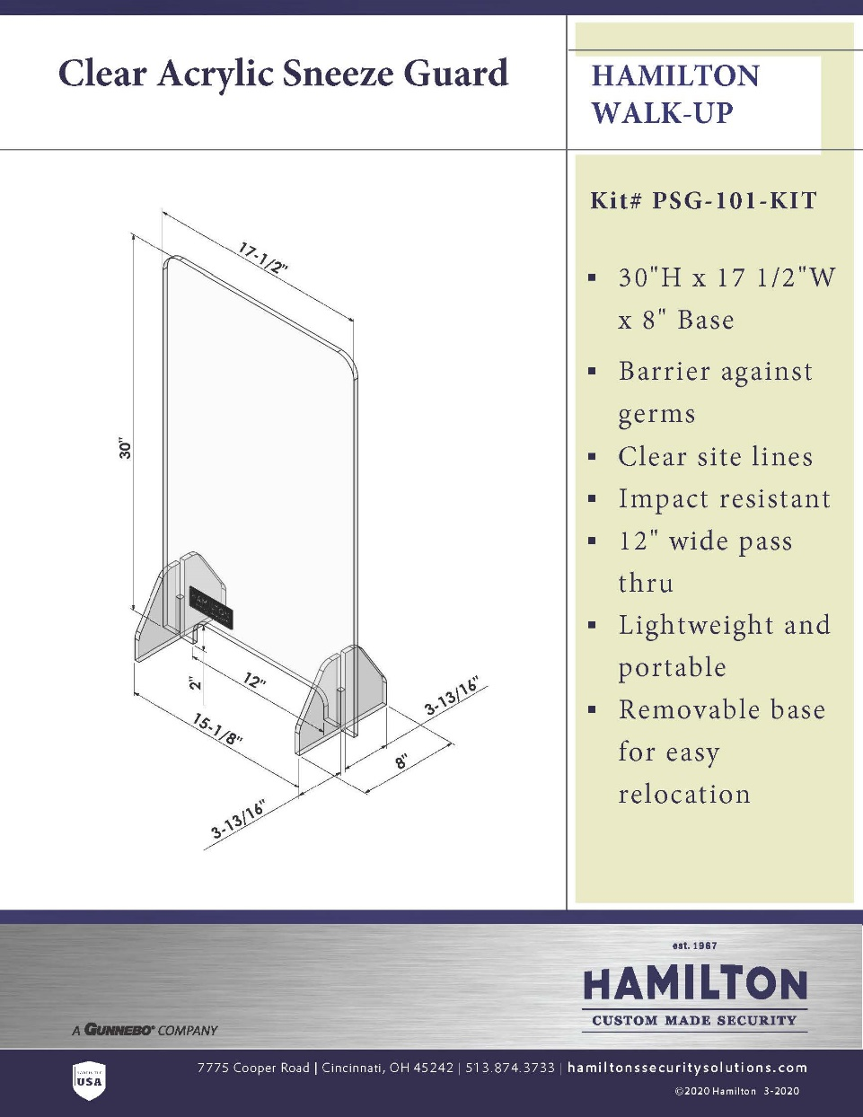
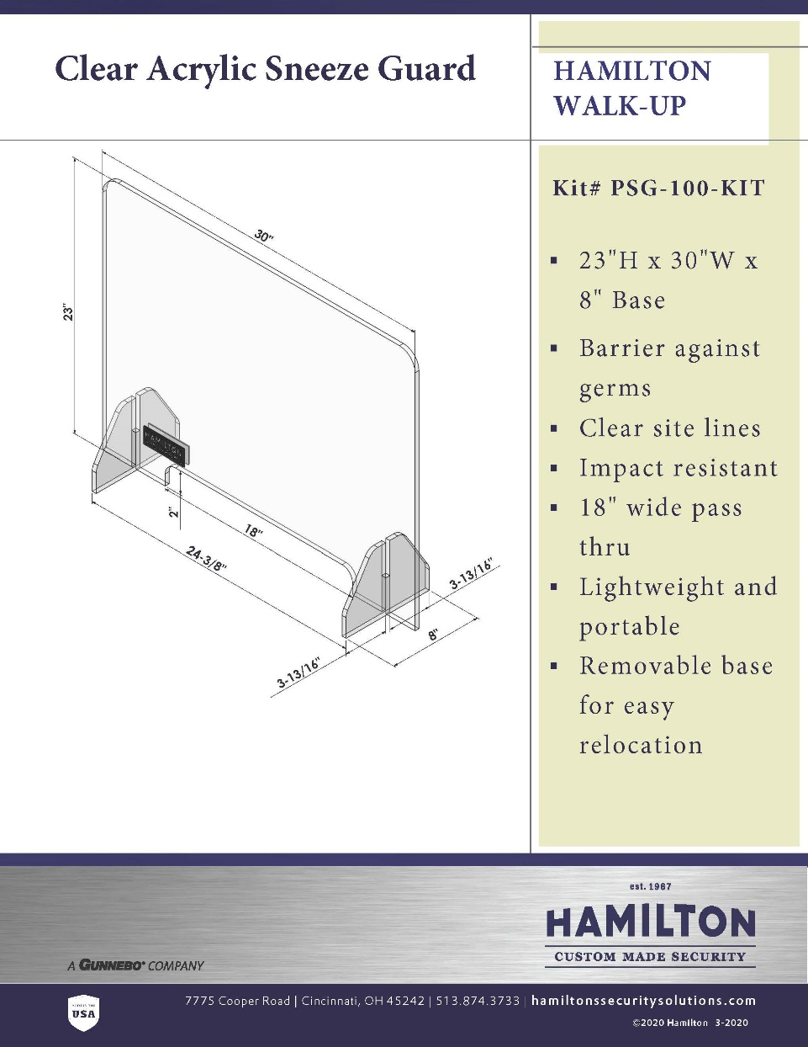
SNEEZE GUARD

Slide 5
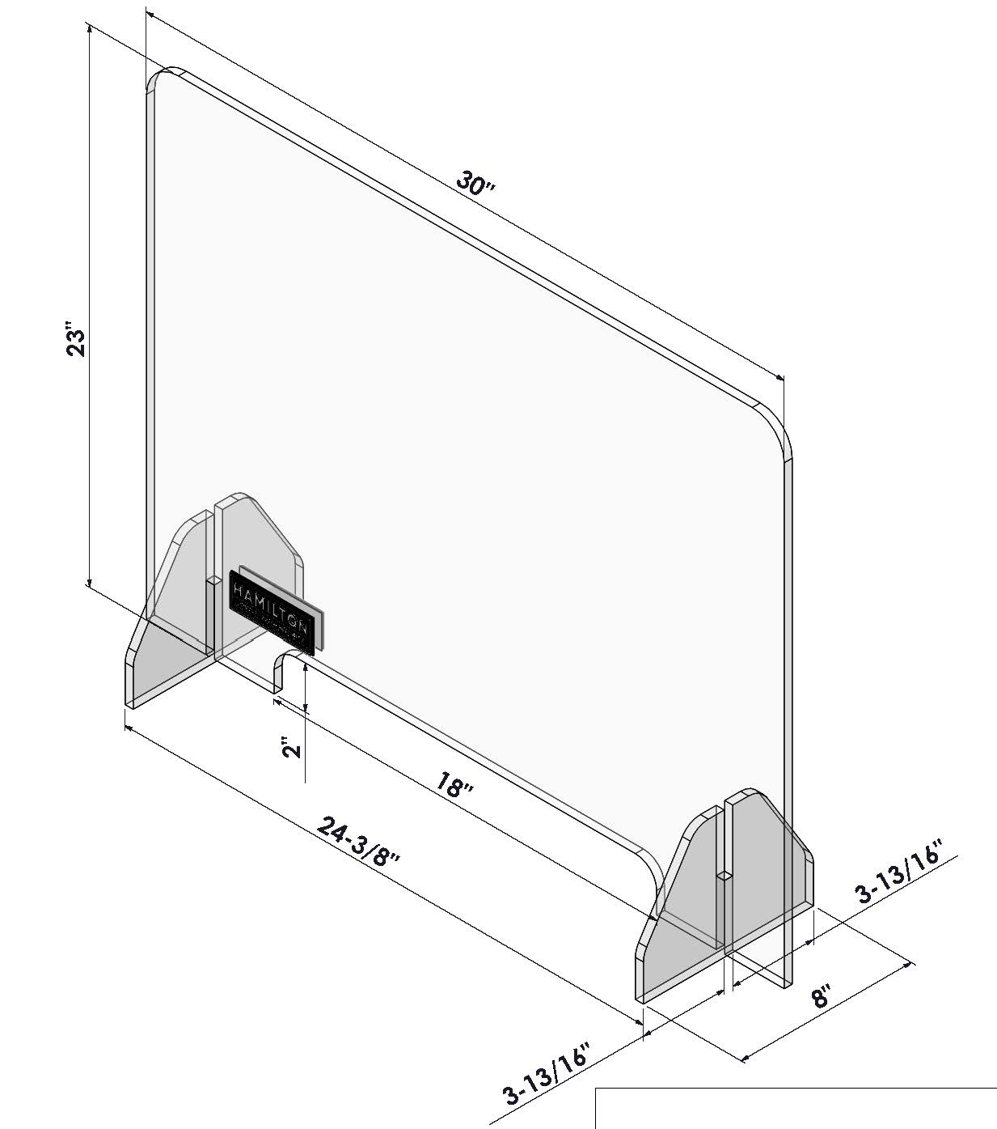

Sneeze Guards
Notes:
Hamilton is using a high-quality acrylic . Optix is a durable acrylic, but it can be scratched and will last a long time, not a throwaway sneeze guard. Oh, by the way, this is the same product we use in the day-gates, for the exception of being clear versus tinted.
The price is more, but some of the differences are Fenco is ¼," and we are 3/8". Hamilton version also has polished edges for a more finished look. I would also just look at them side by side the acrylic they are using is not as crystal clear as ours.
Crystal clear, impact- and weather-resistant, Optix is a continuously processed, high quality acrylic sheet. High molecular weight makes Optix ideal for almost any type of fabrication or glazing, while special UV stabilization protects the sheet from yellowing. Optix is available in a wide range of thicknesses and sizes.

Slide 6
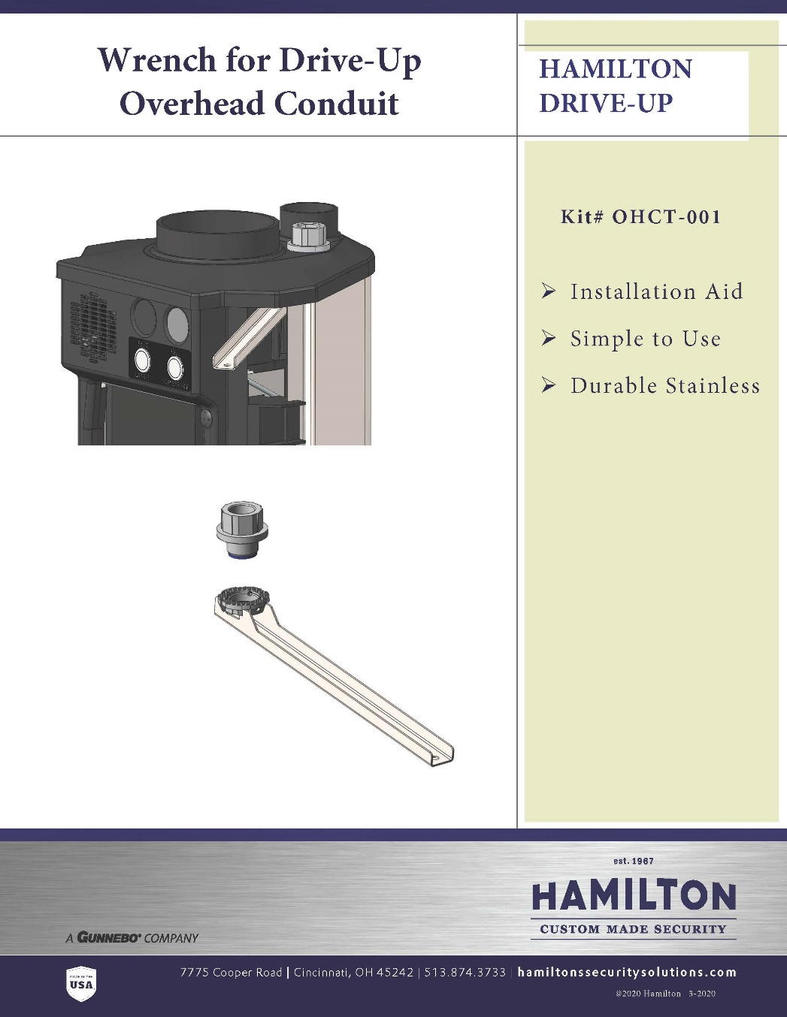
Wrench for drive-up overhead conduit
Input from Channel Partners needing a solution
Simple to use
Custom Made Stainless Wrench for years of service

Slide 7
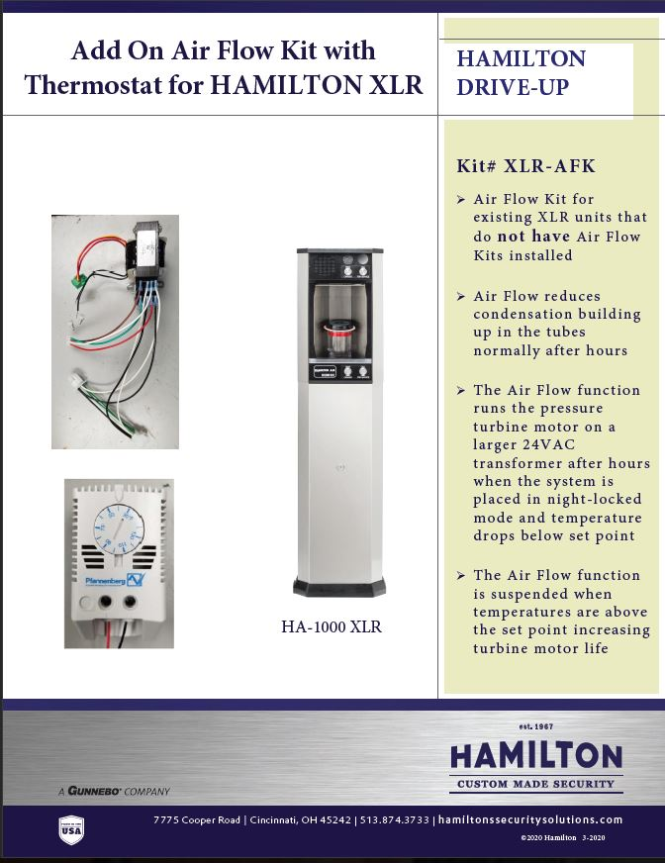
Add airflow kit to existing xlr units without air flow kit
Program change to only operate in night lock mode
Increase blower motor life
Reduce condensation build up
Notes:
With the new eProm chip installed with the latest program, the airflow operation is suspended when the system is in the normal running mode. This means with the lane is inactive and the door auto-closes (if set to do so), the airflow will not operate. Also, if the carrier is recalled or sent inside, the airflow will not operate. The system must be nightlocked before the airflow will operate. This means the airflow function will only operate when the lane is not being used regularly.
With the thermostat installed, the airflow operation is suspended when temperatures are above the set point. This means the airflow will not operate in warmer temperatures when tube condensation is not an issue. When the temperature drops below the set point, the airflow function is automatically restored to normal operation.
If the temperature is above the set point, the thermostat closes its contacts triggering the “Spare/Teller” input. If the temperature falls below the set point, the contacts open.
When the “Spare/Teller” input LED is lit, the airflow function will not operate.

Slide 8
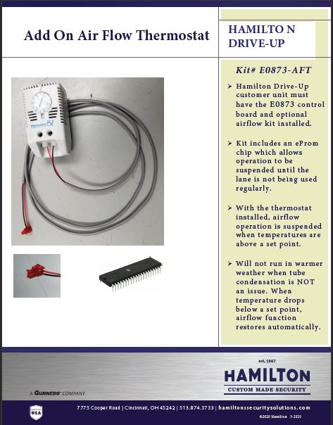
Add thermostat to existing airflow kits
The addition of thermostat will save energy
Increase blower motor life
This also includes a program change that only works when the unit is put in night lock mode

Slide 9
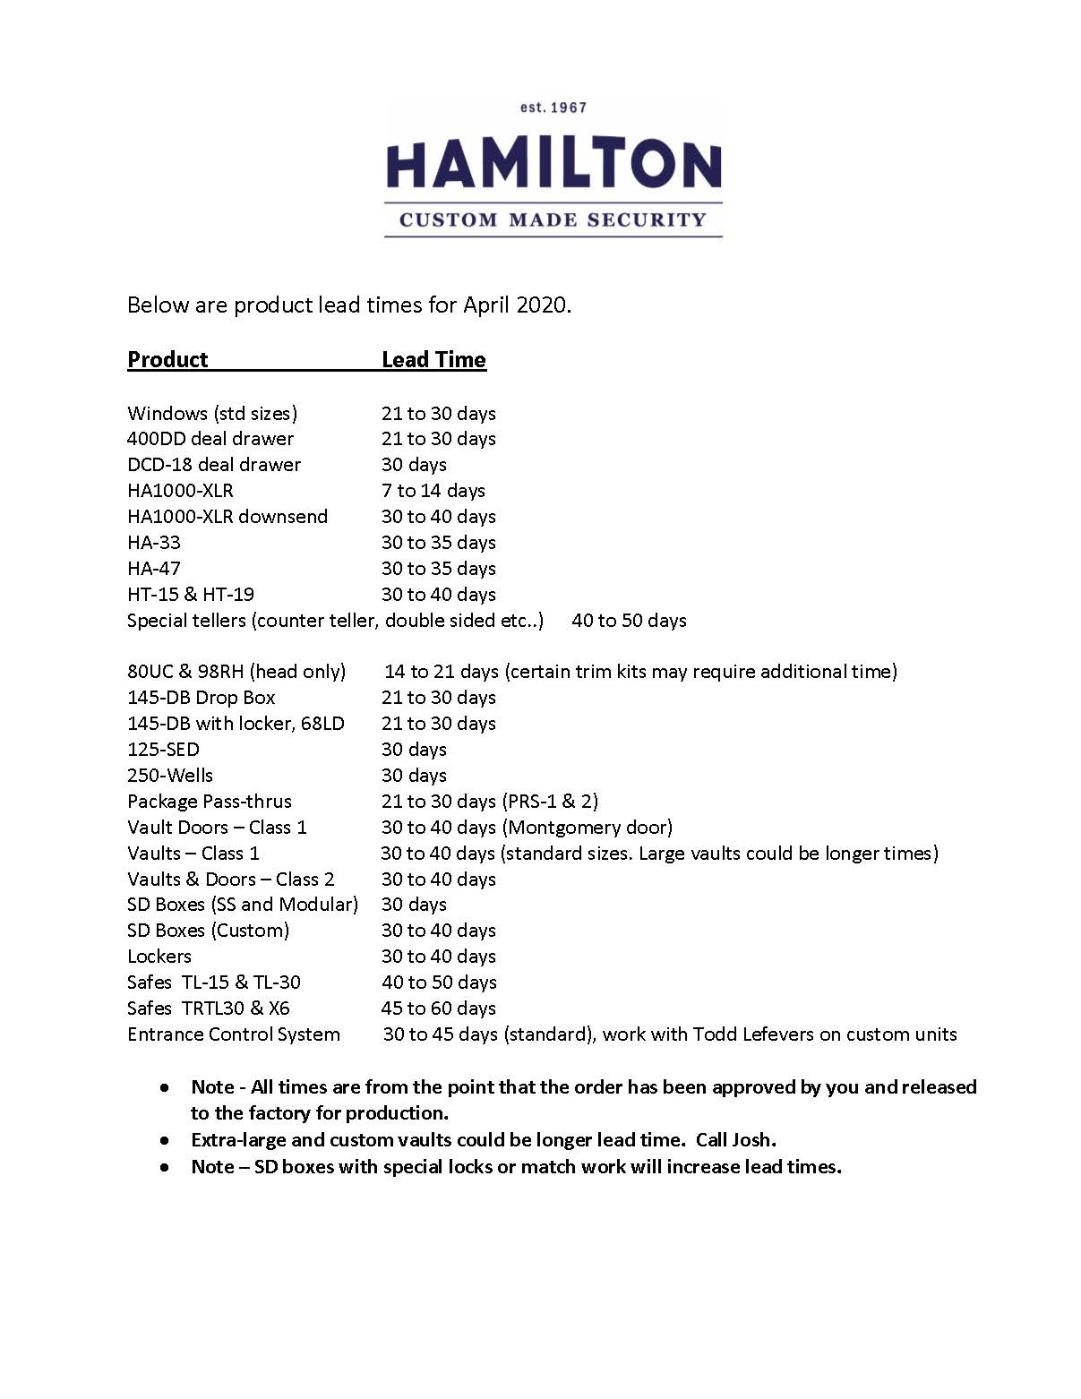
Product Lead Time
April 2020

Slide 10
INTERACTIVE REMOTE TELLER (IRT)
Presented by: Todd Lefevers

Slide 11
Why Interactive Remote Teller (IRT)
Improve branch efficiency by adding an IRT
Customer Experience Provide two way video between the employees and consumers for more personal interaction
Mitigated Risk Discourage fraud by letting customers know the drive-up area is being monitored remotely
Design Flexibility Allow operators to view customers from whatever location is more convenient
Video Advertising Deliver marketing messaging via video display to customers who may not enter the branch very often

Slide 12
Applications
Teller Line replacement within a bank branch
After hours banking within a secured lobby or vestibule
Outdoor walk-up transactions during normal business and after hours
Outdoor drive-up where IRT is built into the branch’s exterior wall

Slide 13
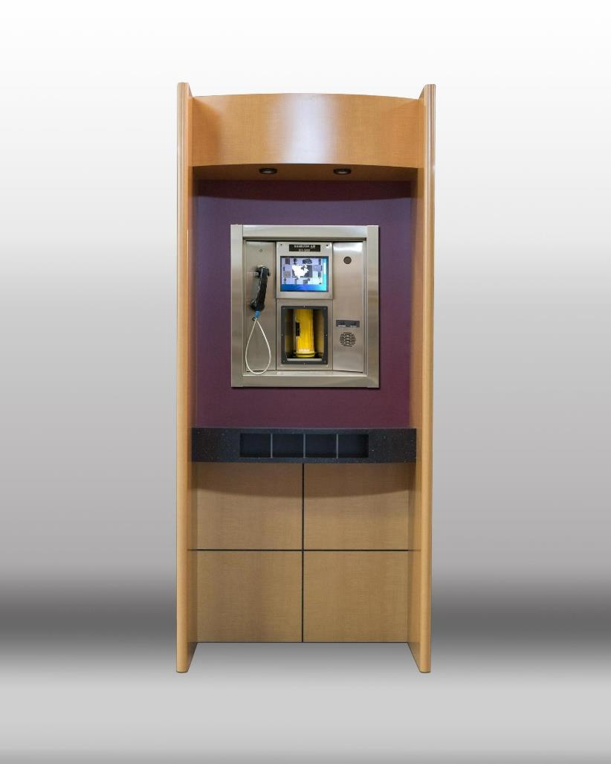
Features
IRT5 000 can be set within a custom designed cabinet or thru a wall
Hamilton pneumatic tubes system and audio/video component s are used within the IRT
Can share audio & video communications equipment with drive-up lanes
IRT video screen s can be utilized for showing marketing messages which can increase sales and reduce the customer’s perceived wait time
Easy to install and service
Increase security using IRT cameras connected to your video surveillance(DVR) system

Slide 14
Benefits
Stainless steel design allows for both indoor or
Outdoor applications
Flexible so that it can be easily adapted within an architect’s building design
Designed to help reduce staff requirements by allowing one customer representative in a remote area to serve multiple IRT stations plus drive-up lanes

Slide 15
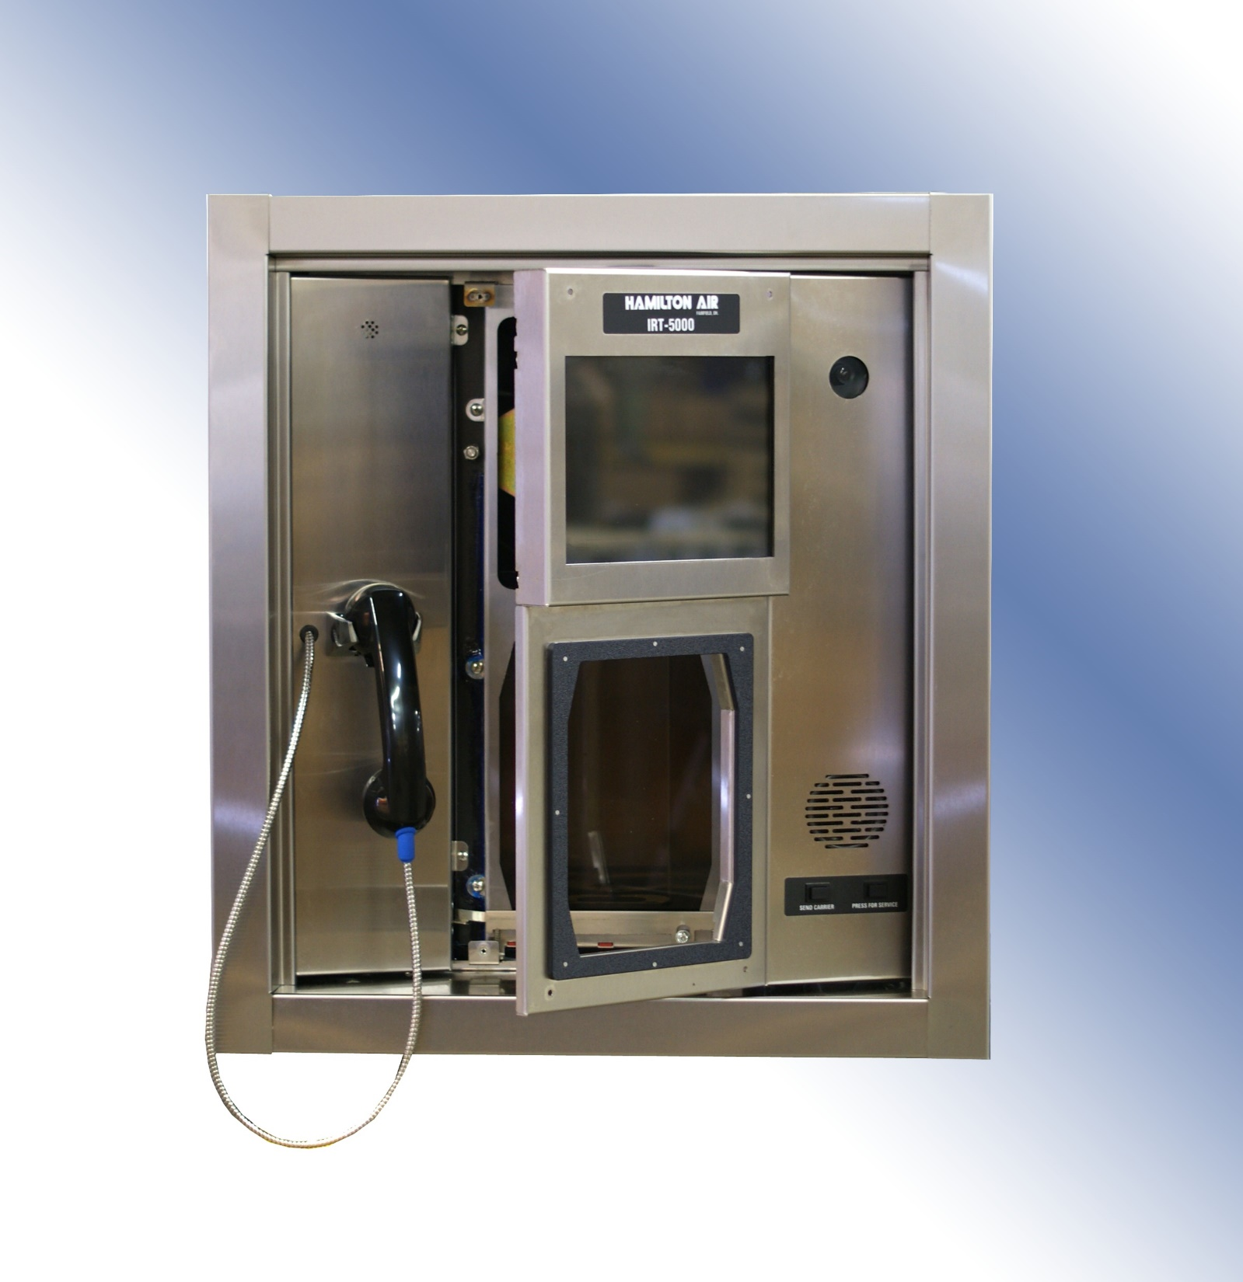

Slide 16
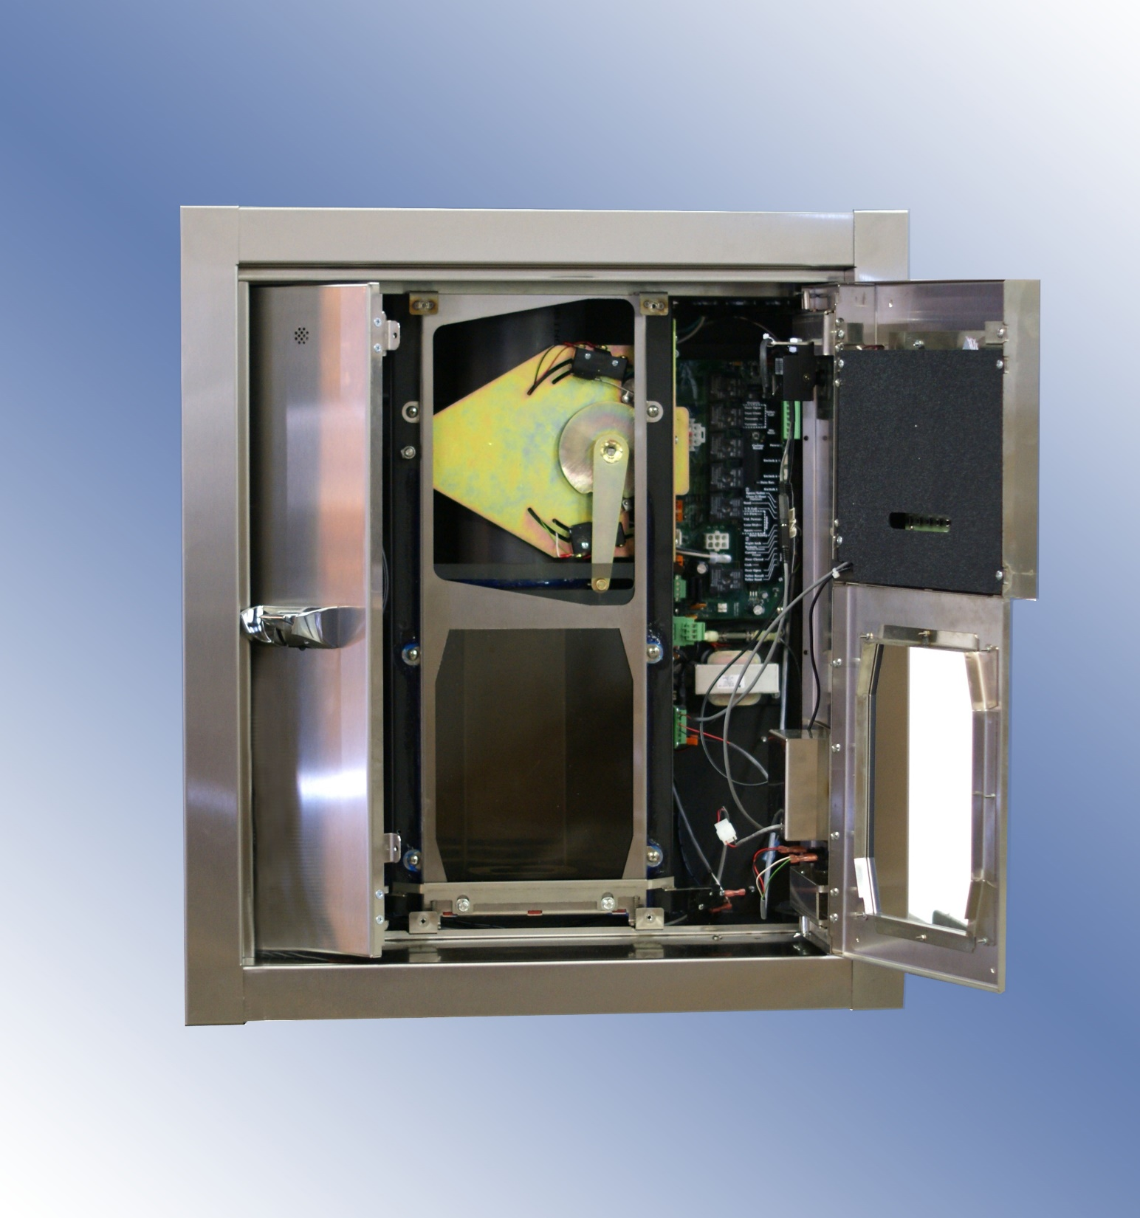

Slide 17
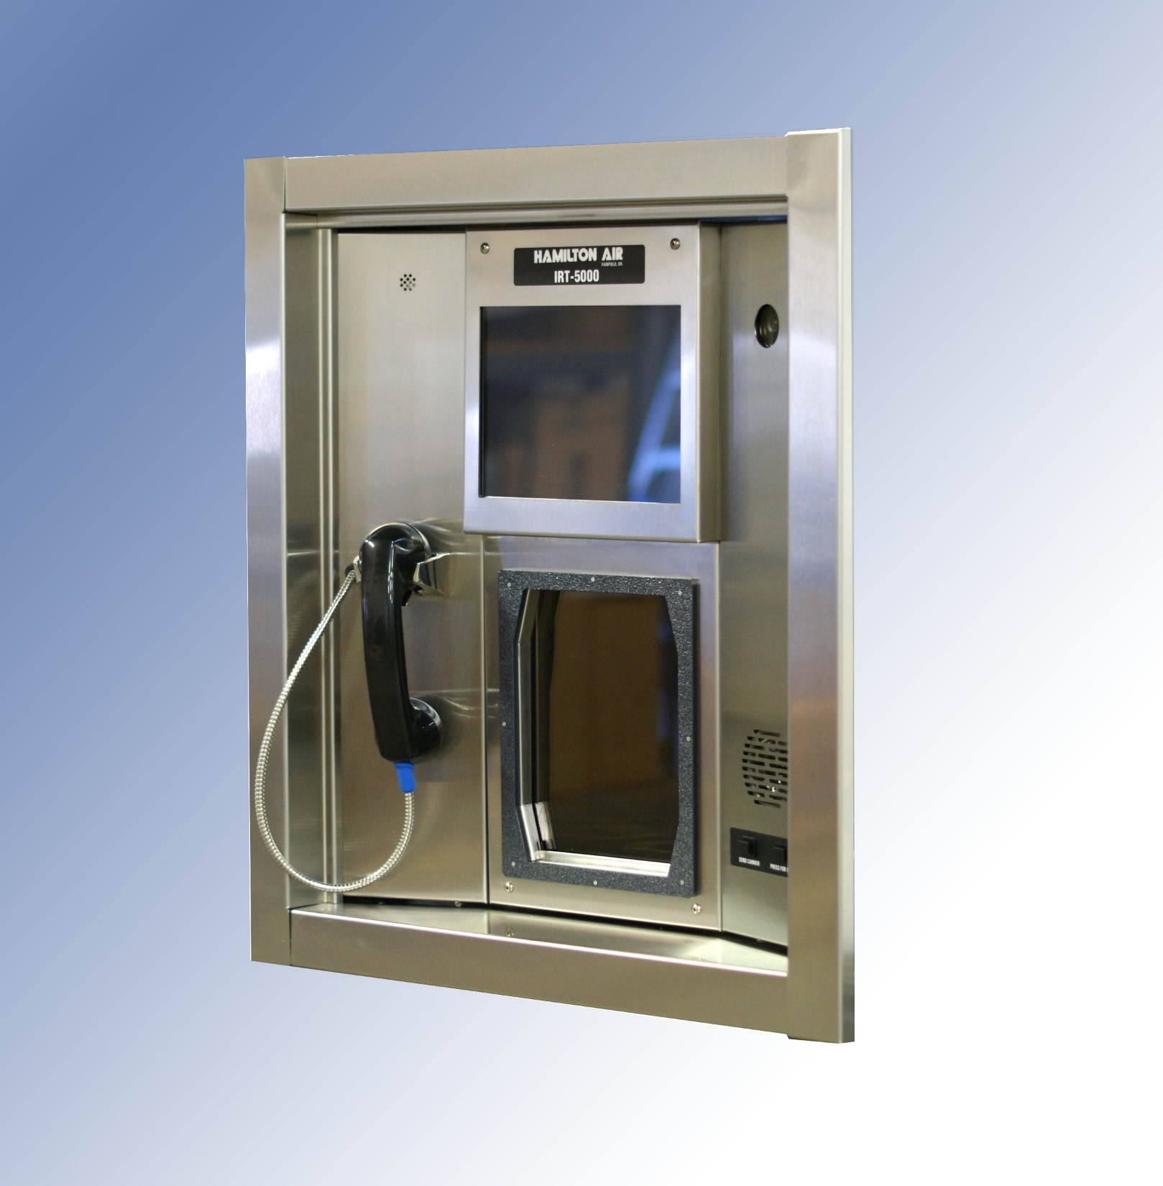

Slide 18
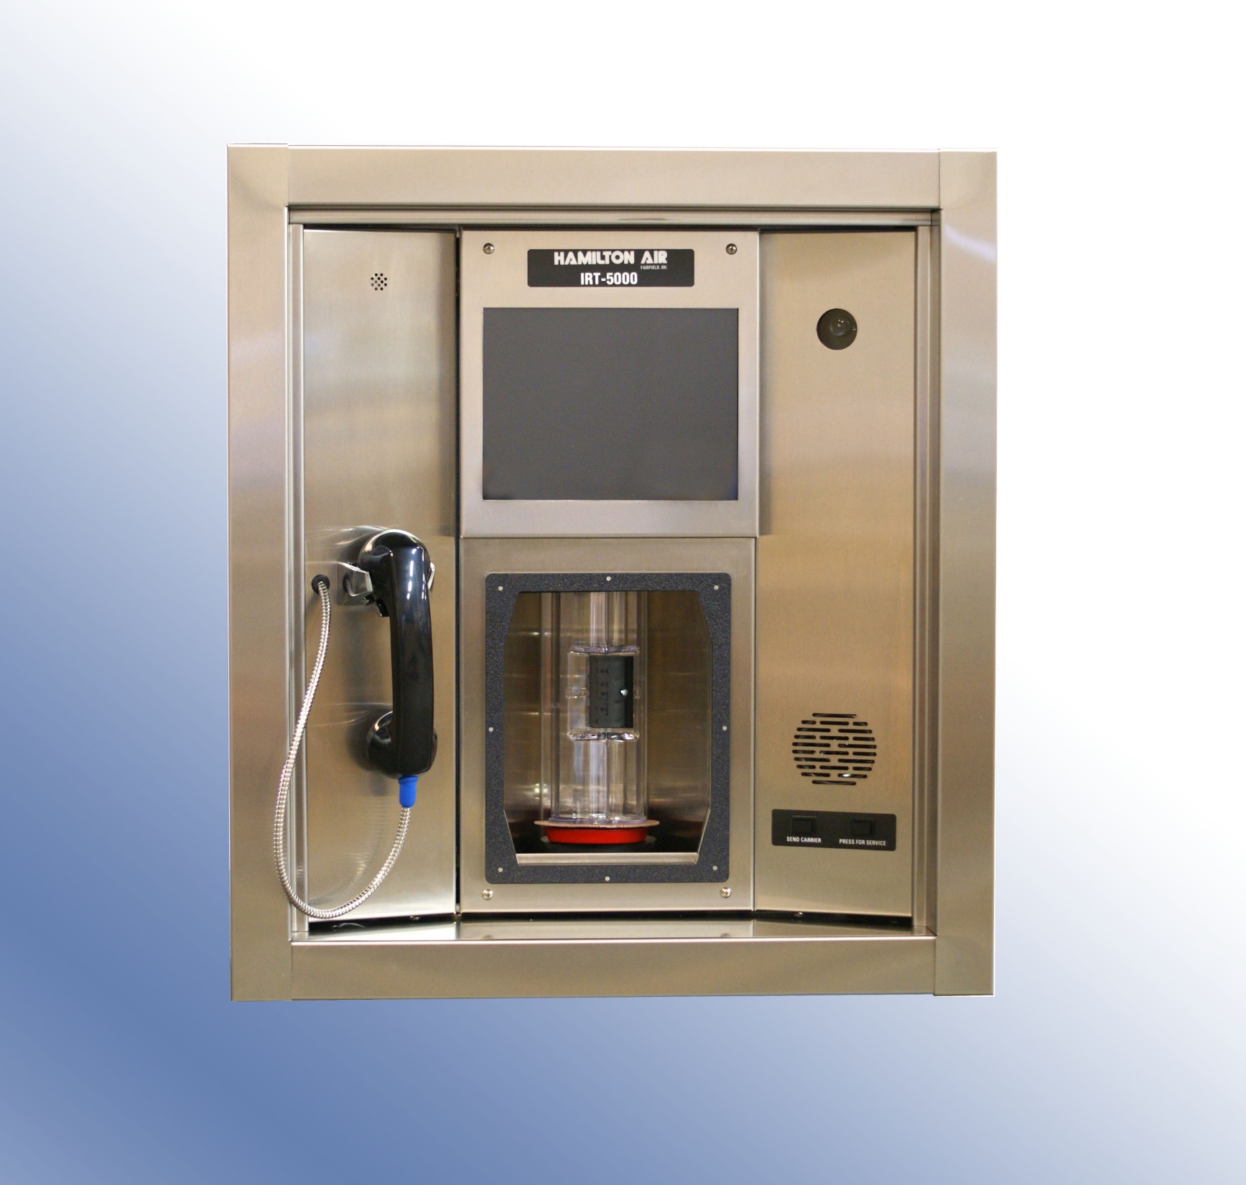

Slide 19
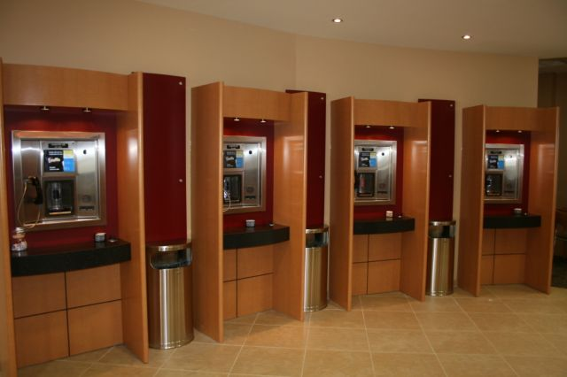

Slide 20
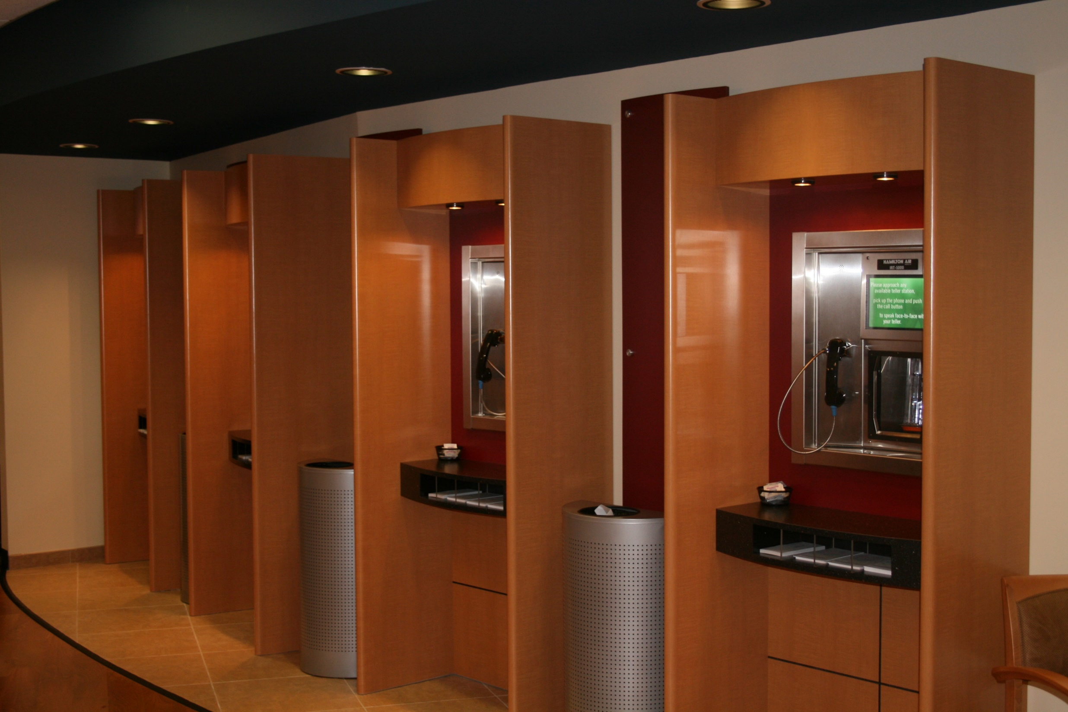

Slide 21
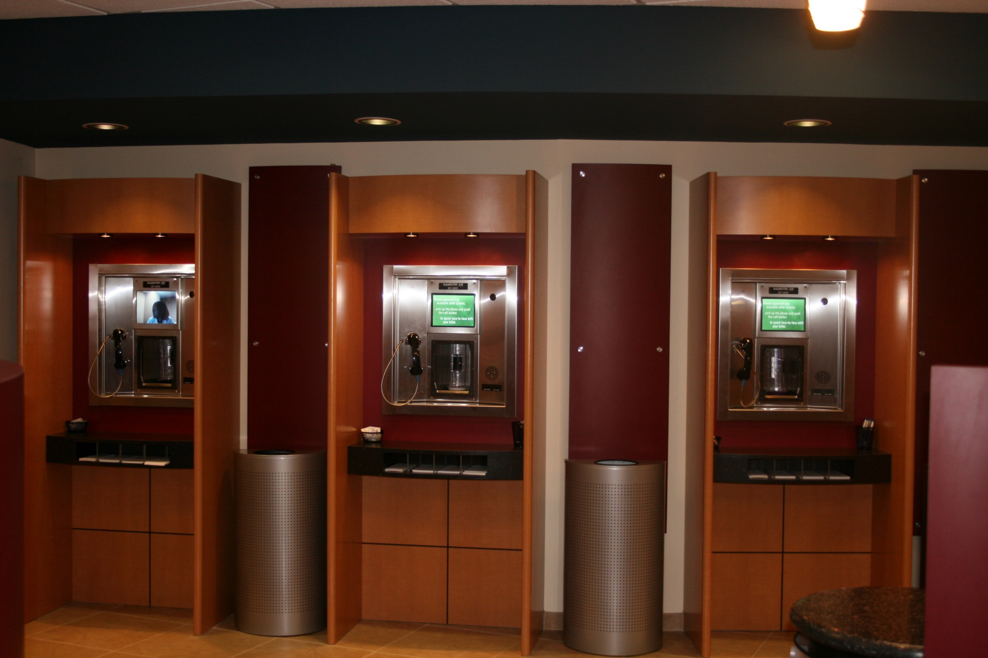

Slide 22
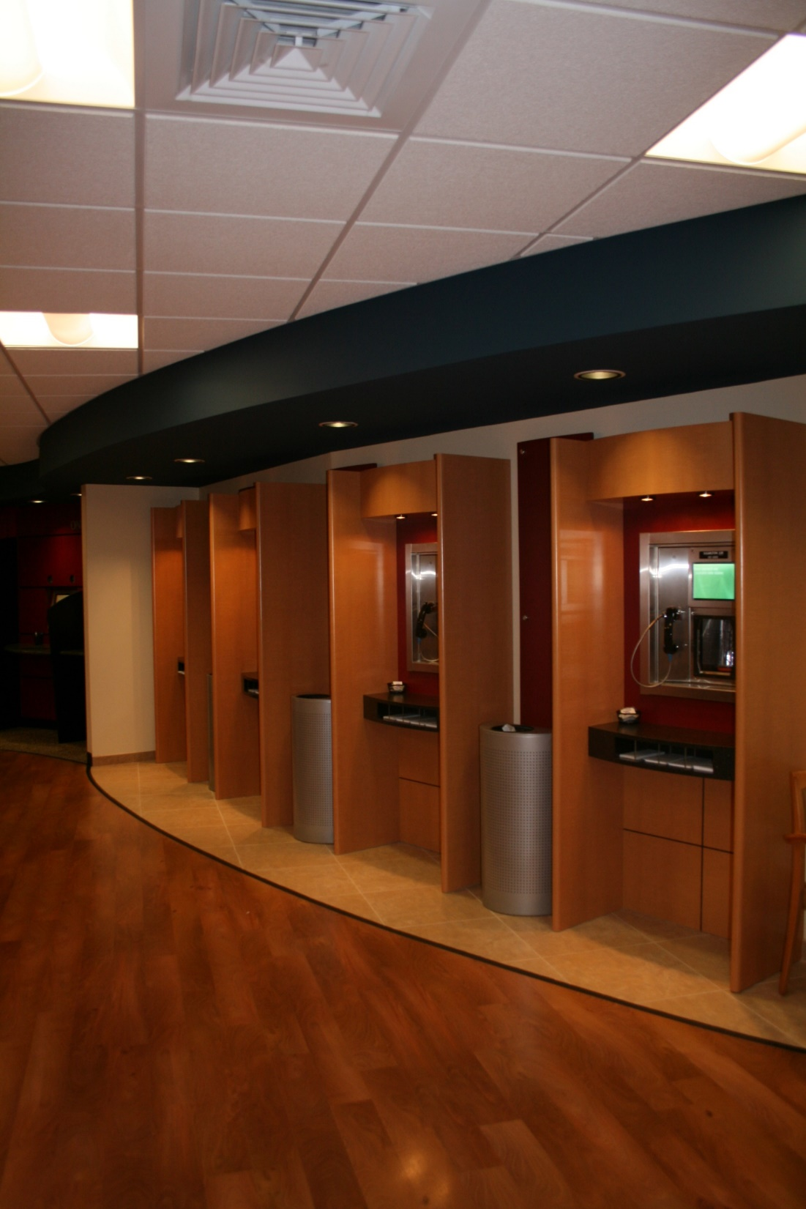

Slide 23
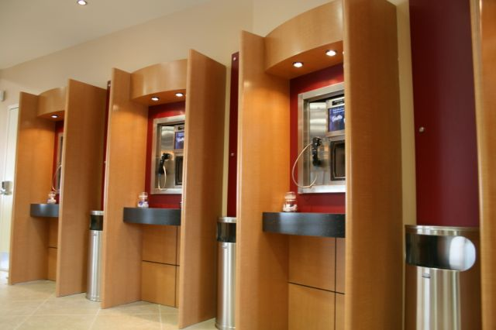

Slide 24
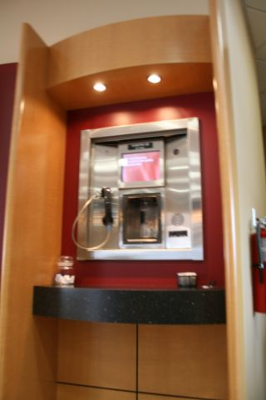

Slide 25
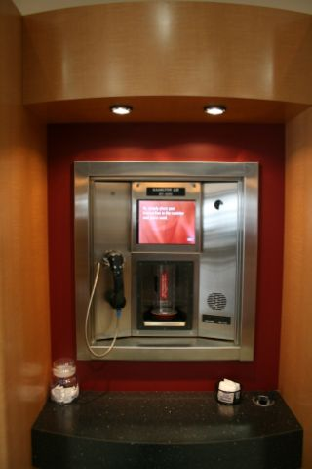

Slide 26
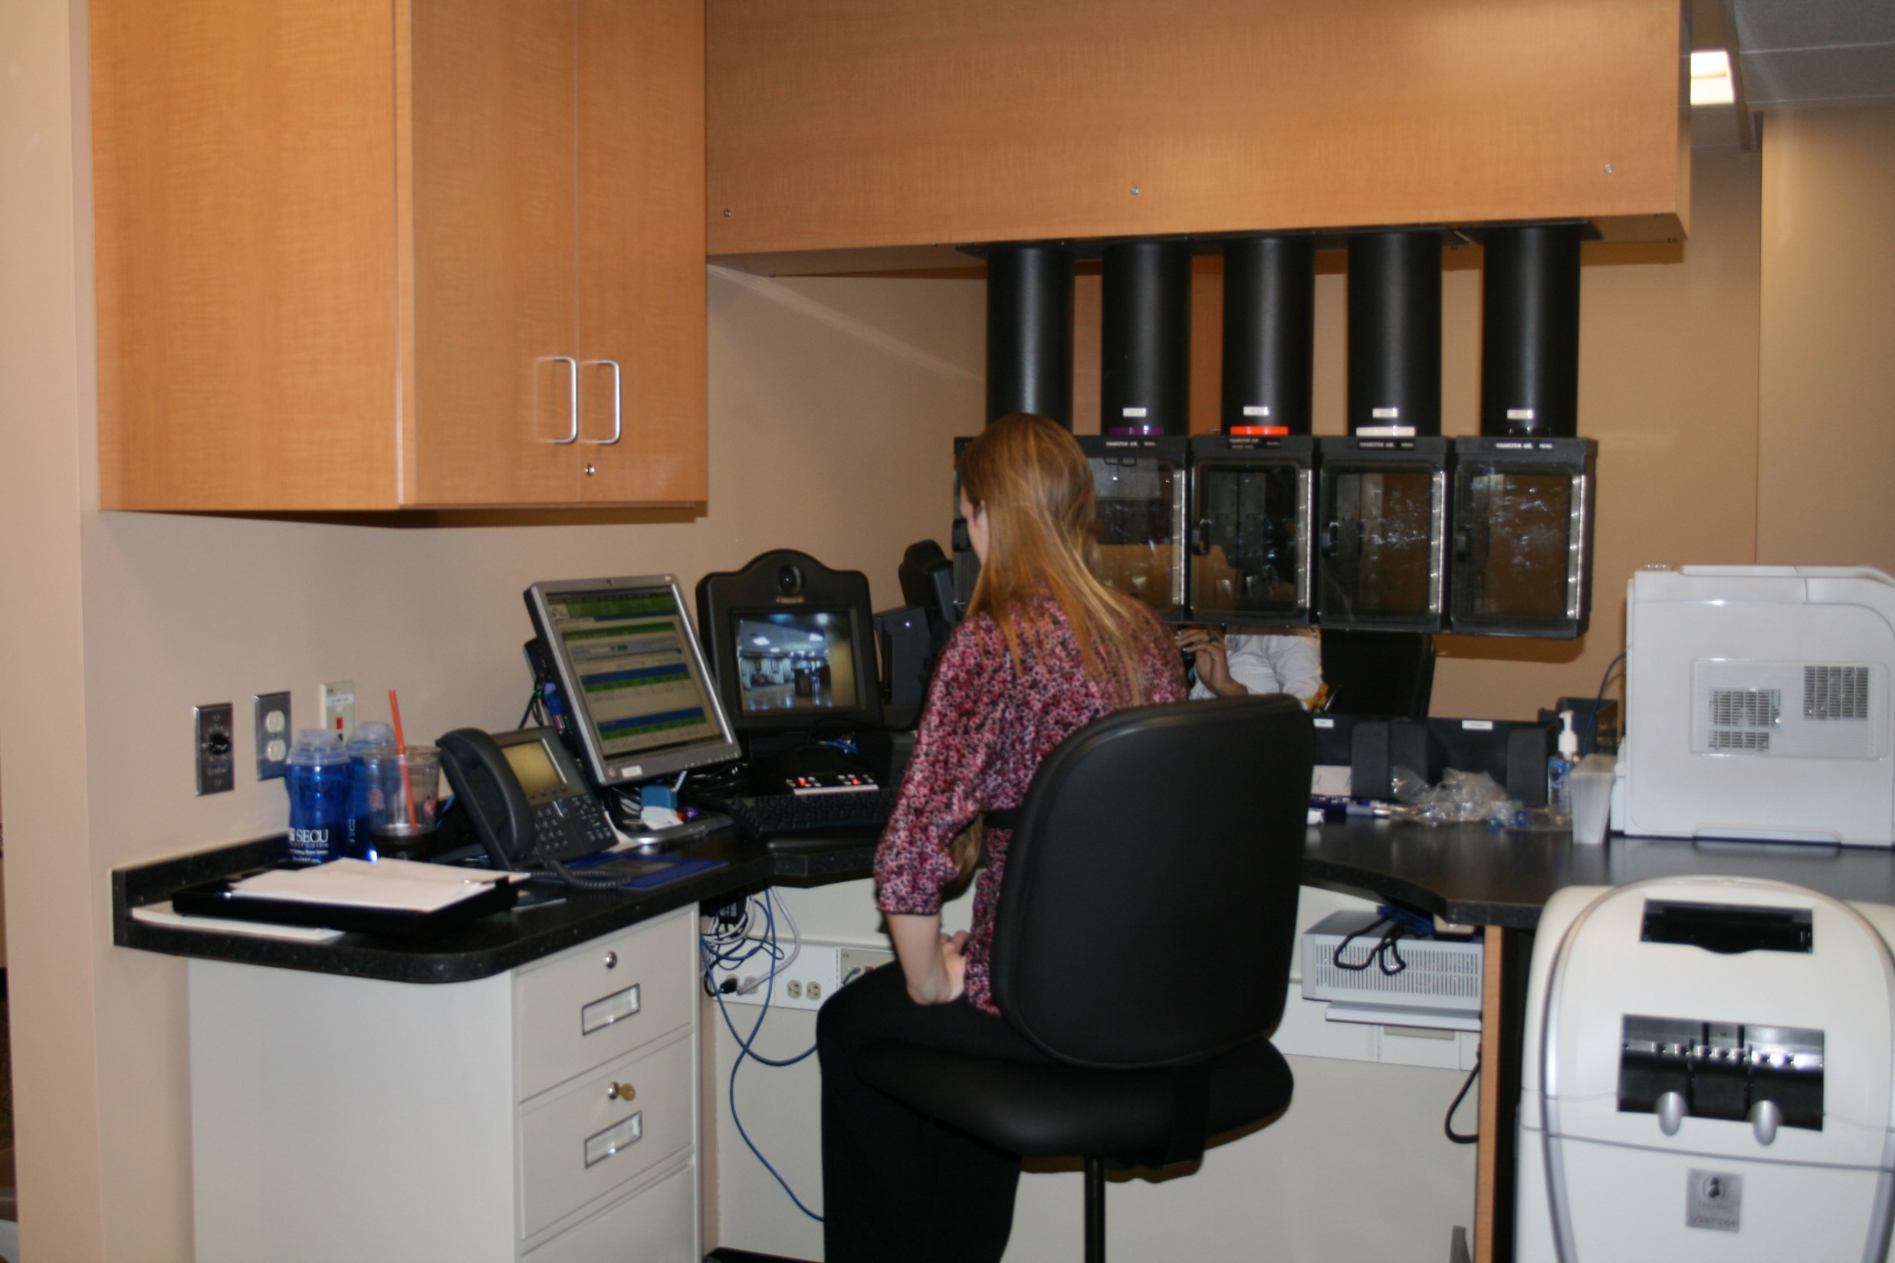

Slide 27
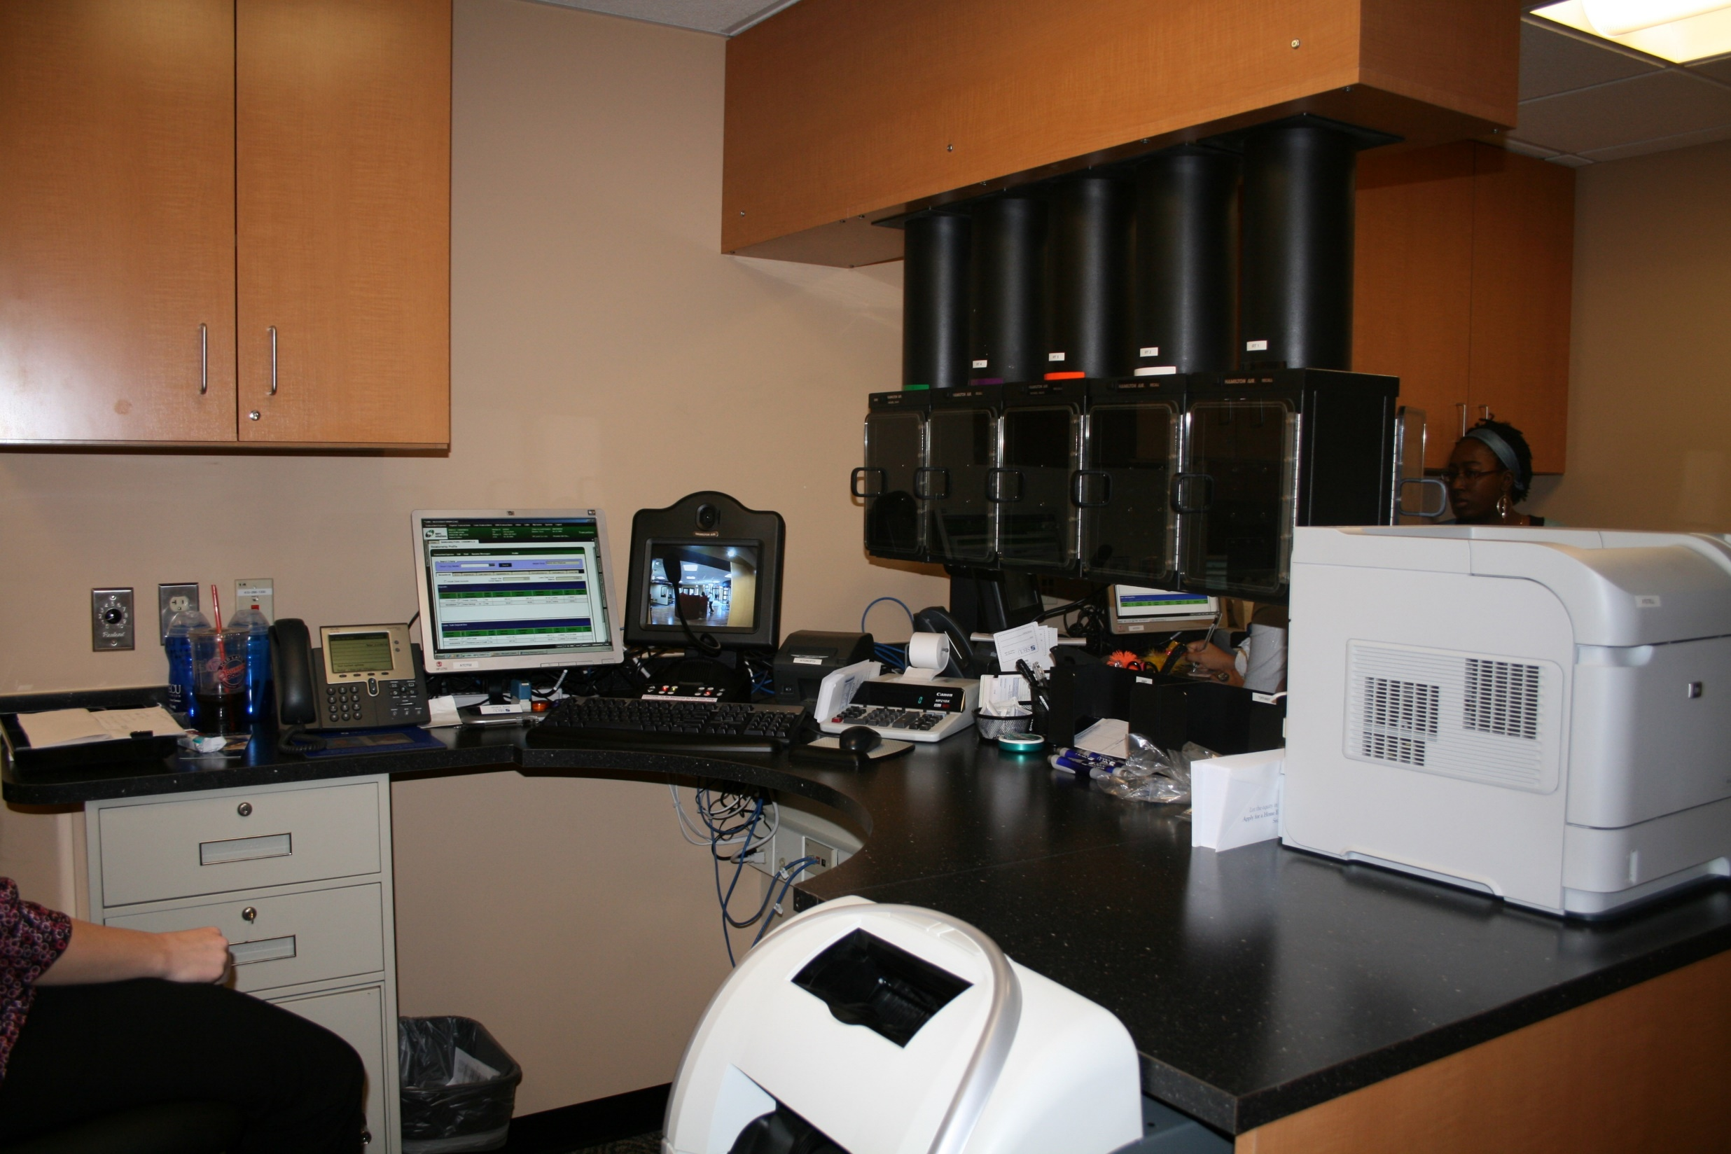

Slide 28
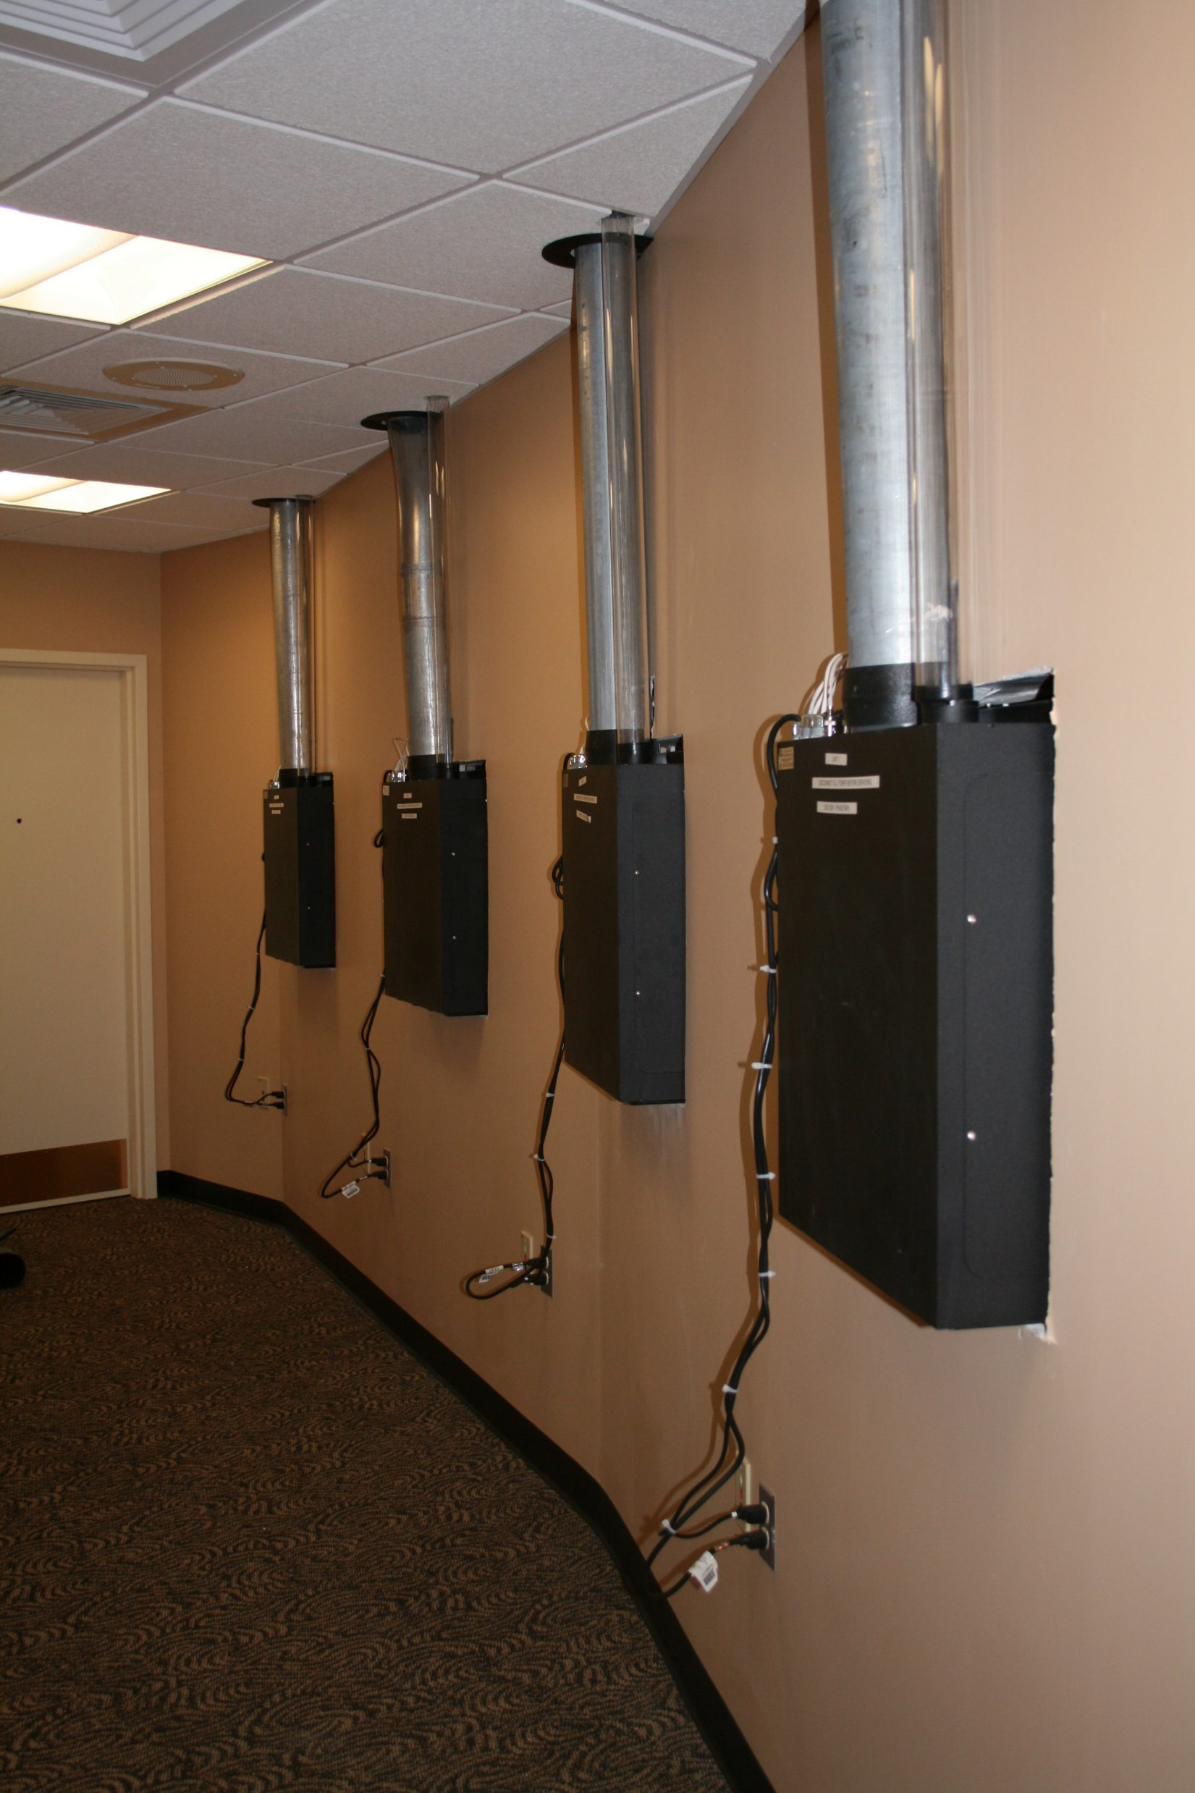

Slide 29
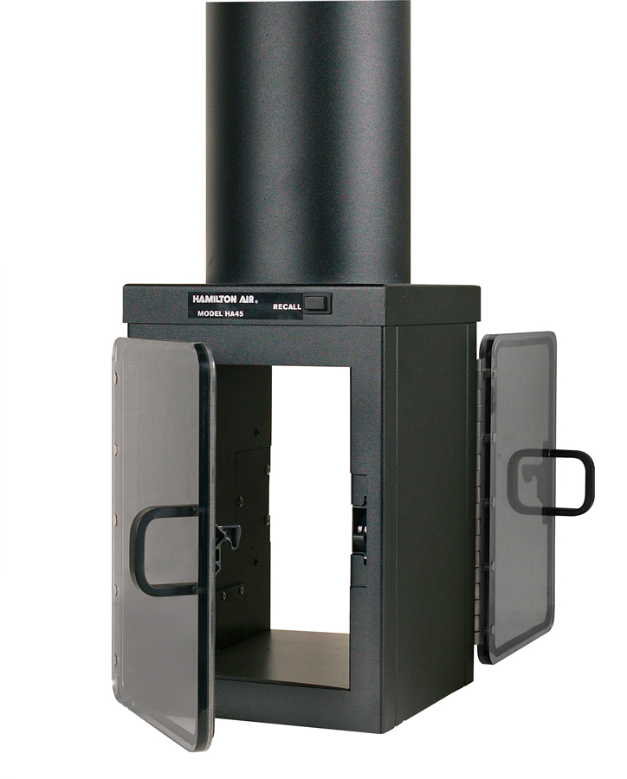
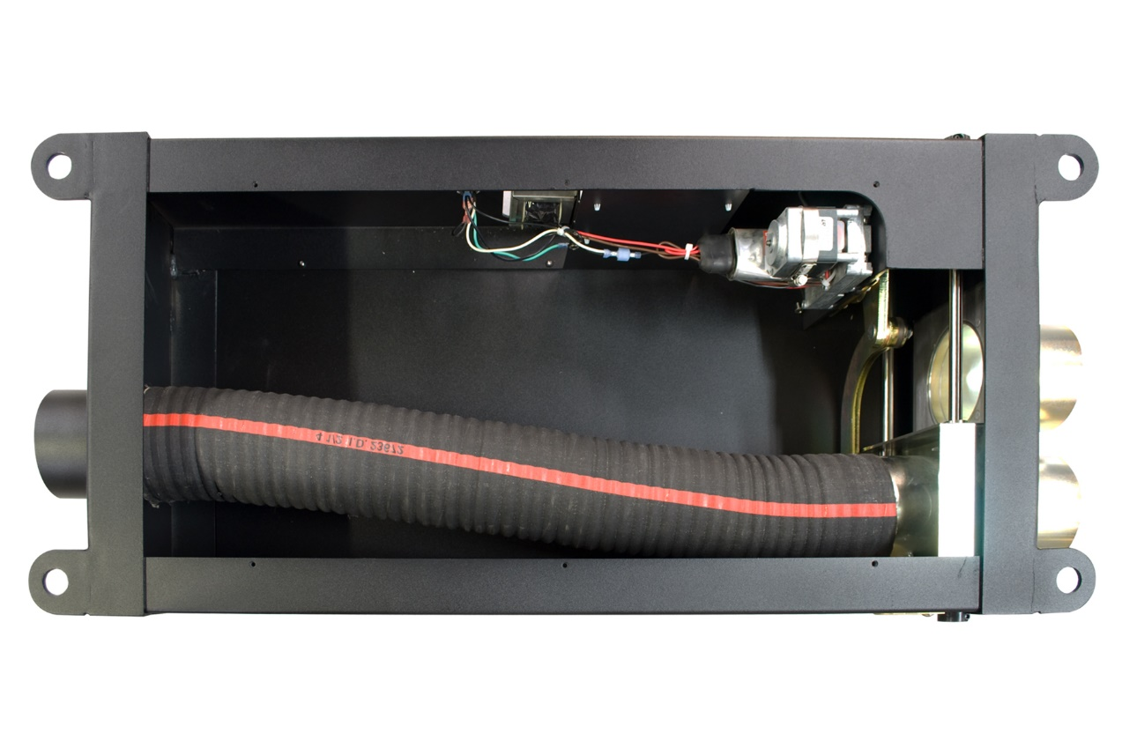
Tube Diverters

Slide 30
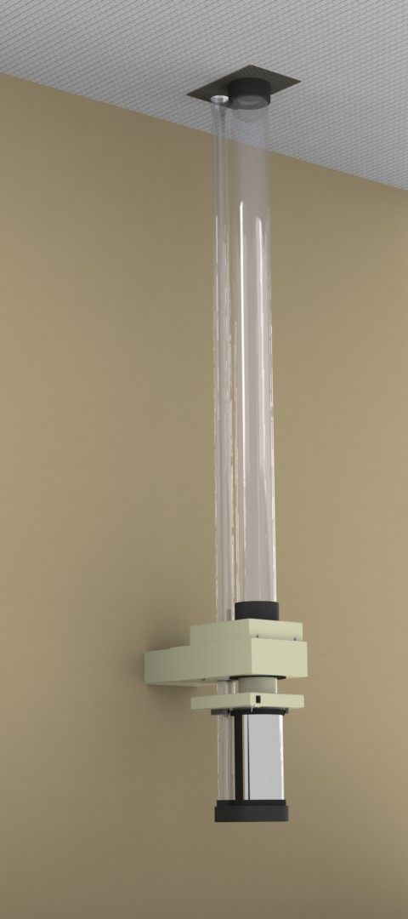
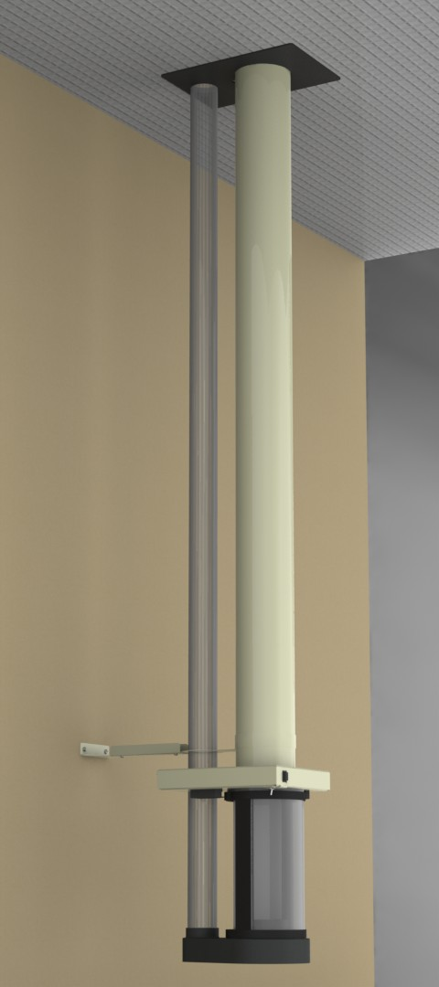
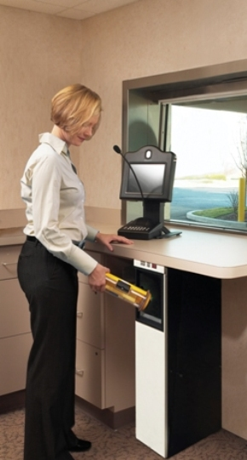

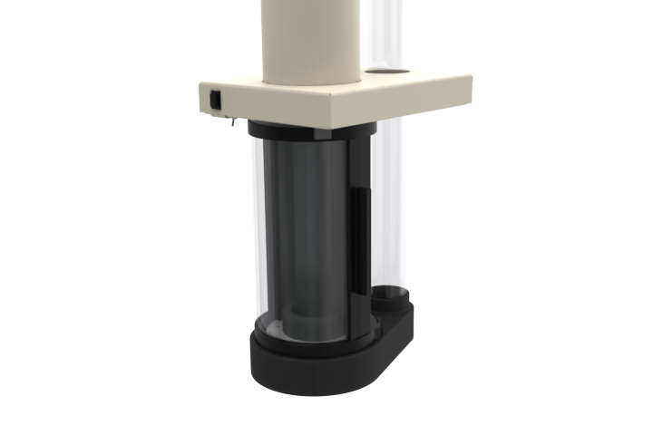
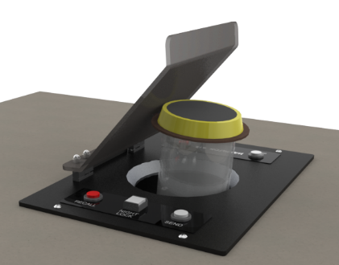
Teller Terminal Options
Downsend
Extended Teller with Stabilizer
Wall mount bracket with clear tube
Double sided teller
Standard overhead
Thru the counter

Slide 31
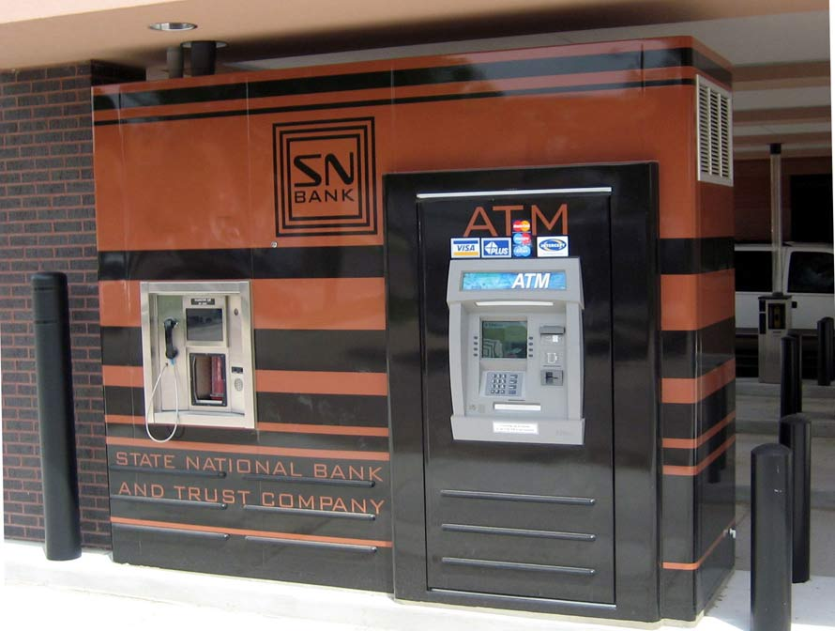

Slide 32
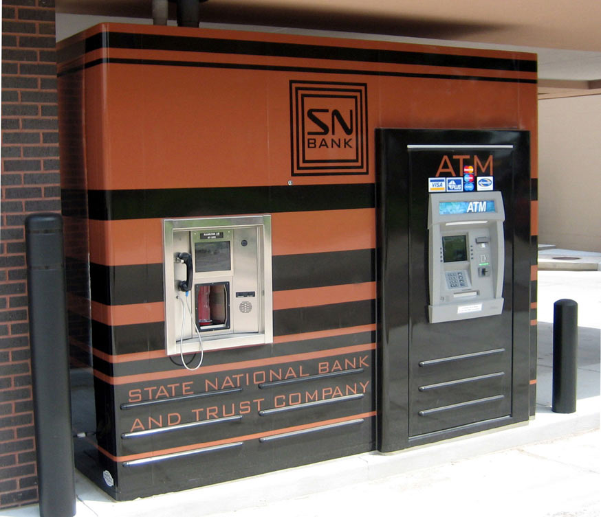

Slide 33
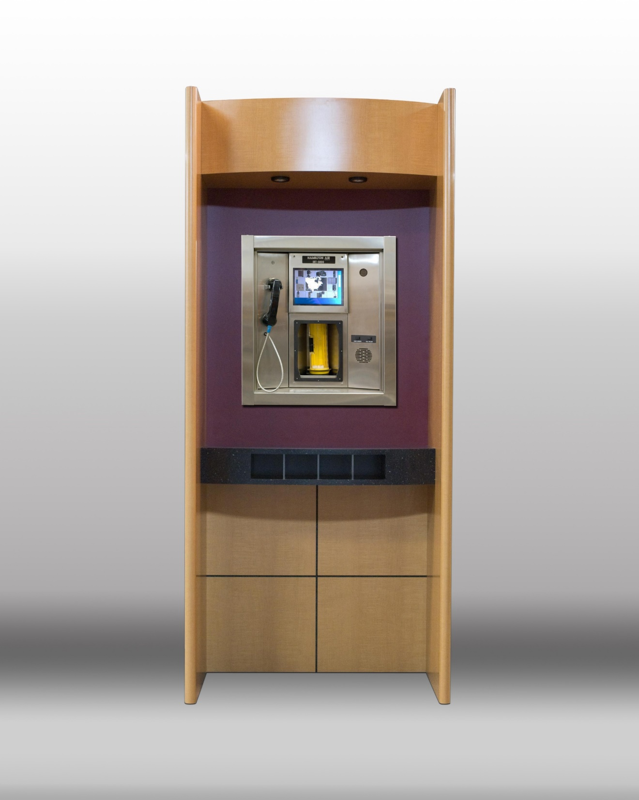

Slide 34
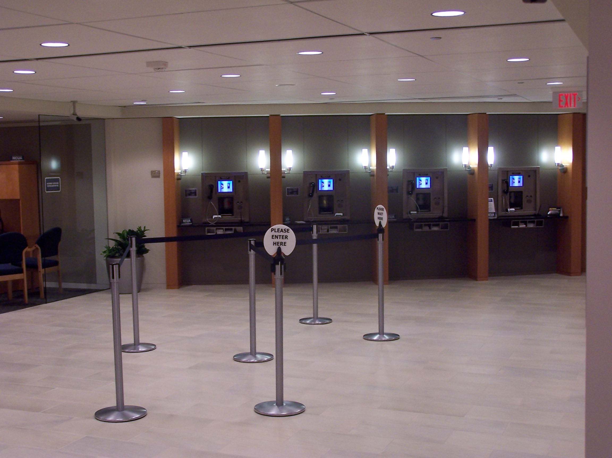

Slide 35
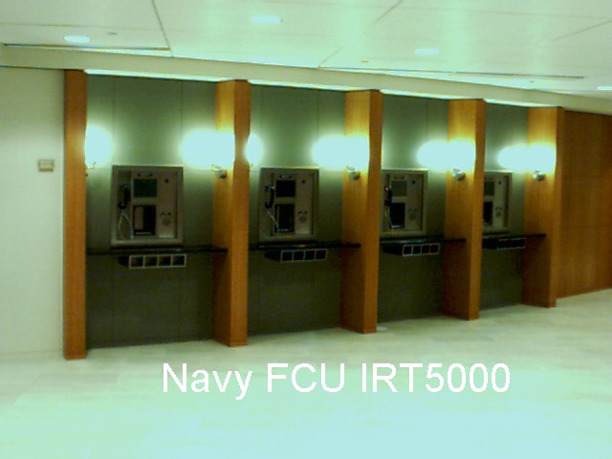

Slide 36
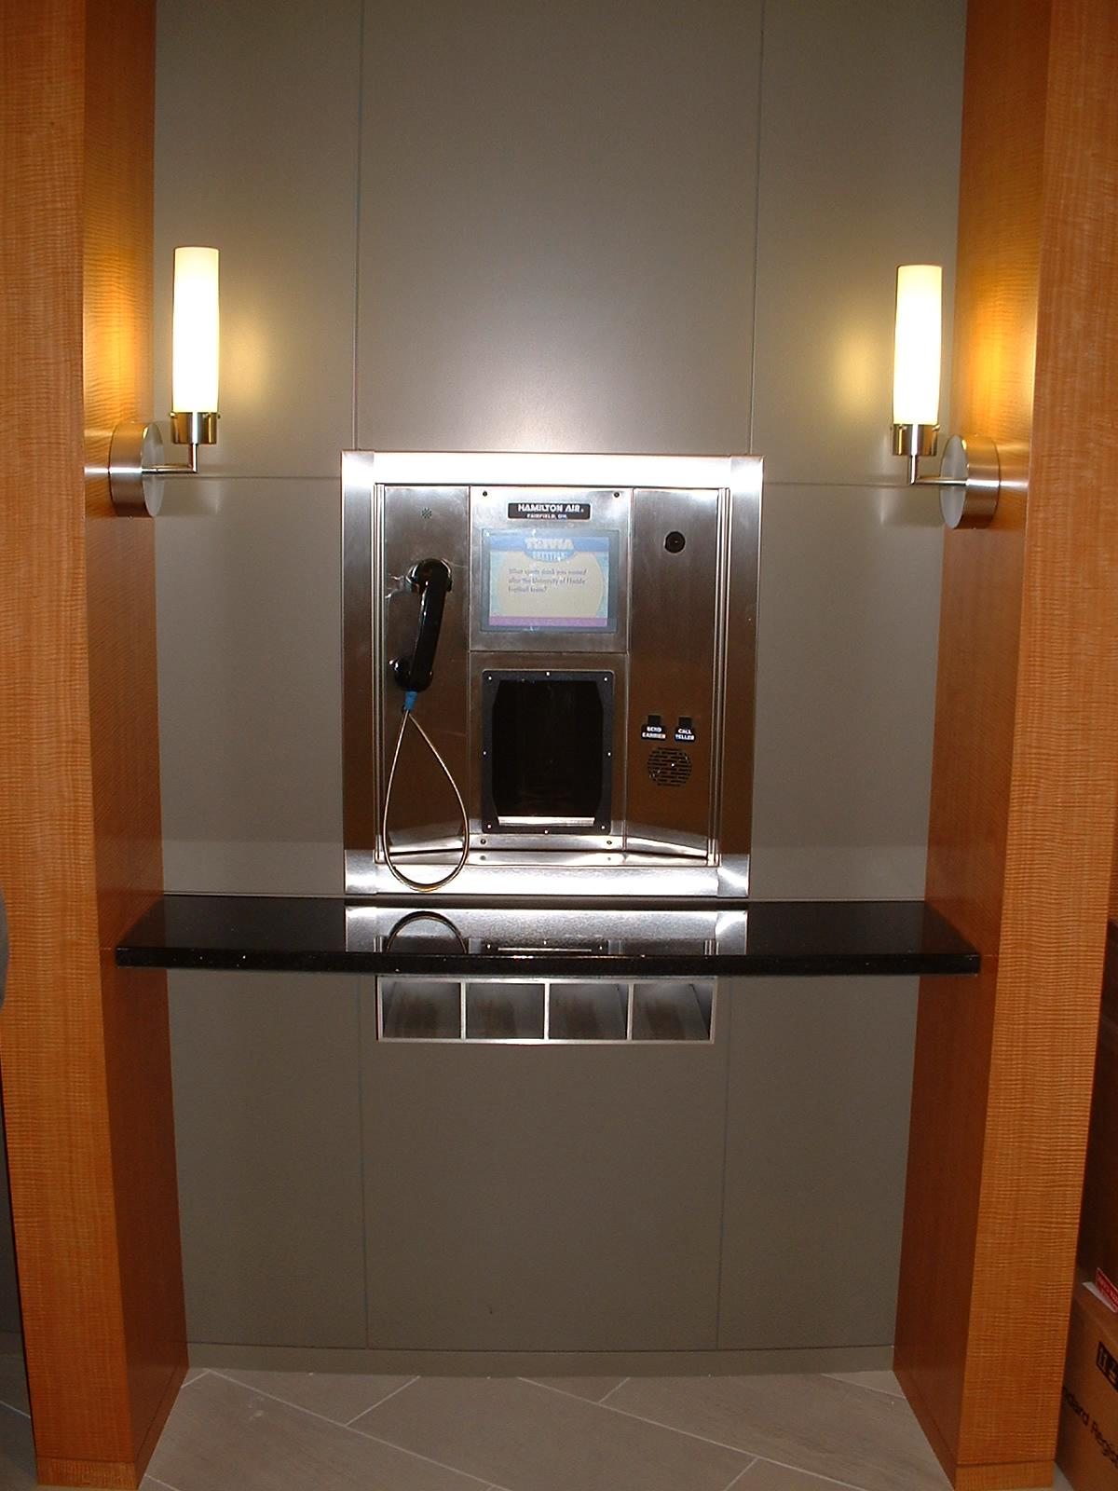

Slide 37
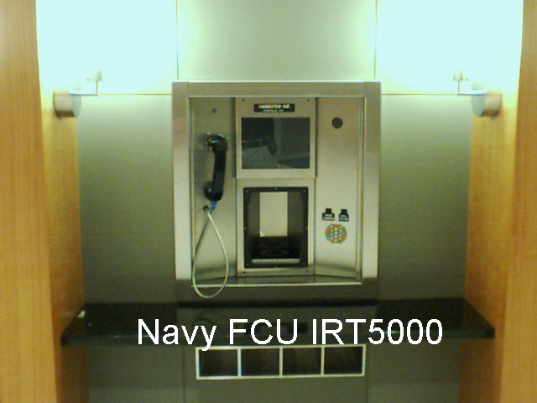

Slide 38
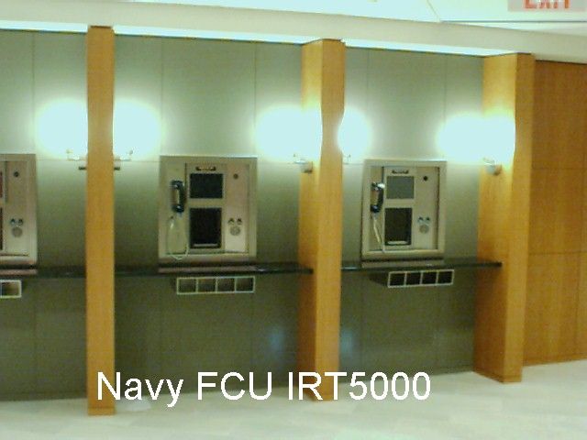

Slide 39
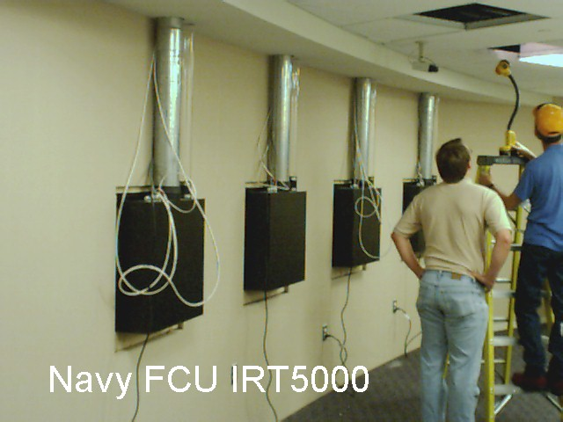

Slide 40
