Slide 1
Drive-up Basics
John Stroia
President, Gunnebo North America and Hamilton Security

Slide 2
Agenda
Introduction
Solution selling built around the branch
What’s happening with branches?
What’s happening with cash?
Drive-up 101
  Good Practices – “The Rules”
  Good Practices – Decisions
  Examples
The Hamilton Difference

Slide 3
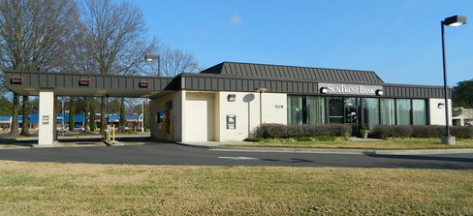
Solution Selling Built Around the Branch

Slide 4
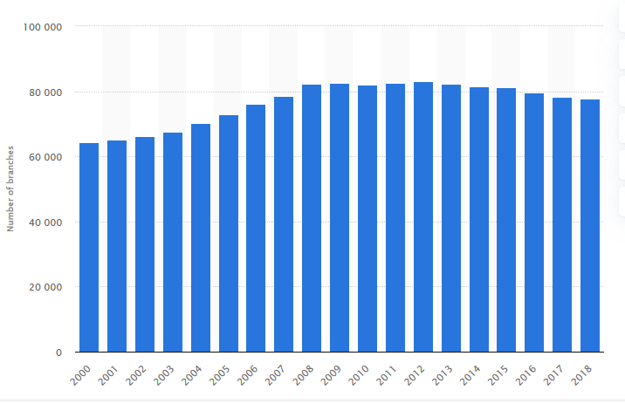
Number of Bank Branches of FDIC insured commercial Banks in US
21,122 CU
Branches
22,078 CU
Branches
82,425
77,647

Slide 5
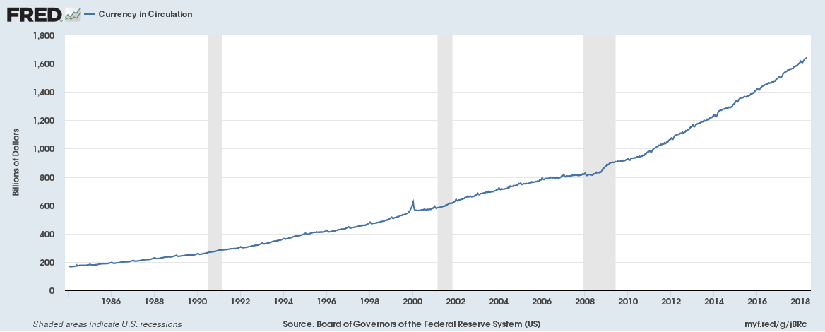
Volume of US Cash in Circulation

Slide 6
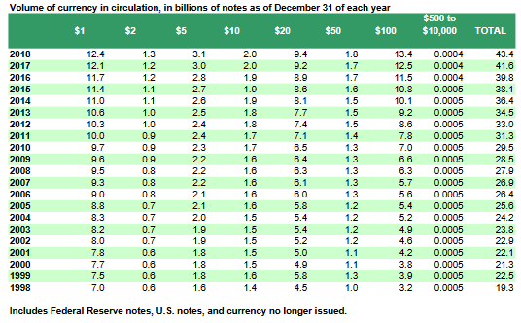
Volume of US Cash in Circulation

Slide 7
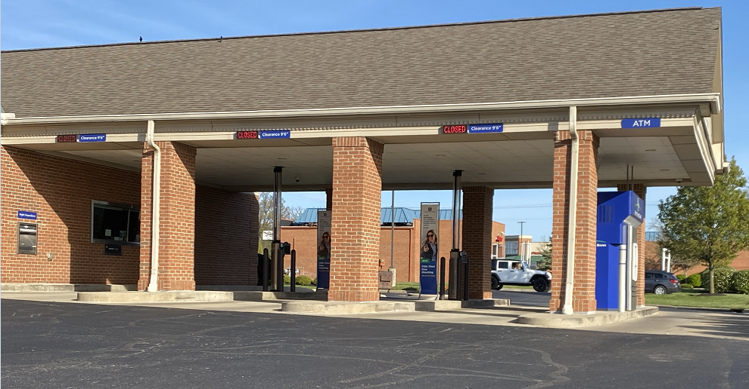
Why drive-up?
Overall convenience for customer
1.5 to 2 times more efficient than inside teller
Good alternative for low mobility customers
Can keep costly commercial transactions outside of branch
Supports American “drive-through/car” culture
Safer environment for tellers
Very convenient for parents

Slide 8
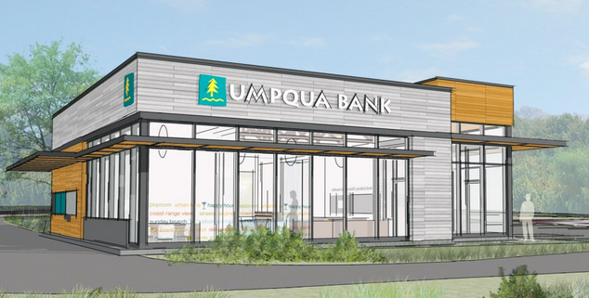
Branch Design Basics
Branch/Drive-up drivers: Cars and Cash
Sight Location/Planning
Deal or no deal drawer
General design rule for small/regional banks and credit unions - 50-60% drive-up traffic and 40-50% walk-in traffic
Determining placement of drive-up on site
  Deal or no deal drawer (yes I said it again!)
    Pros – commercial and customer traffic
    Cons – limits branch design, one-to-one customer ratio, if you have it customers will almost ALWAYS pick the deal drawer first, commercial customers will have to wait.
  Important to separate drive-up traffic from inside teller traffic
  Ingress/Egress from street
Determine how commercial customers will be served
How the branch and drive-up are designed is a series of comprises and blending of sometimes conflicting strategies

Slide 9
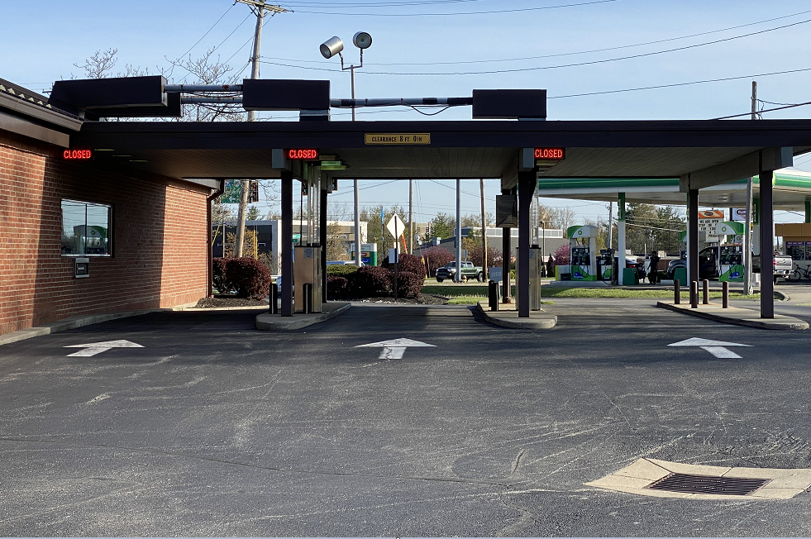
Drive-up Design Good Practices
Stacking four to five cars – 20’ per car
Good site lines – provide straight run; no severe turns

Slide 10
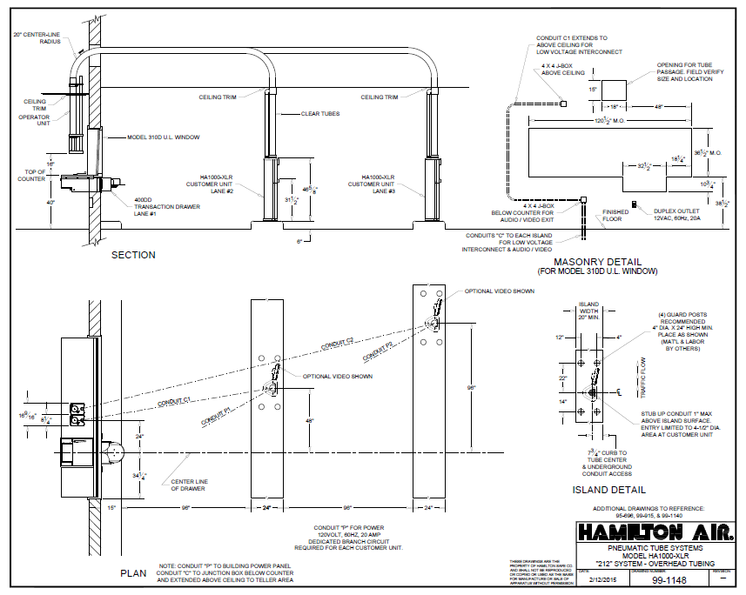
Drive-up Design Good Practices
Min. eight foot lane width
Min. six inch curb heights
Min. 24 inch islands

Slide 11
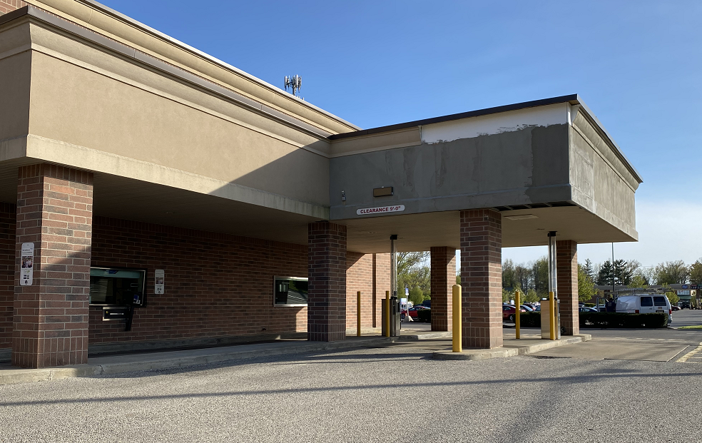
Drive-up Design Good Practices
Canopy as high as possible (will still get hit)
Bypass lane as wide as possible

Slide 12
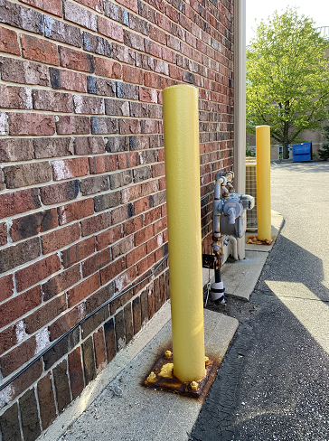
Drive-up Design Good Practices
Do not install other items in the lanes (gutters, spigots, electric/gas meters, venting, landscaping, etc.)
  Many of these items are NOT shown on elevations!
Have a plan for smoking and litter

Slide 13
Drive-up Design Good Practices - Decisions
Type of drive-up – Attached, Reverse, Remote, Head-on, MotorBank
Determine ATM Location (first lane, island, other site location)
Determine how commercial customers will be served (Deal Drawer, Night Head, Commercial pneumatic lanes)
Overhead, underground or combination tubes
First lane pneumatic system
Wide lanes, higher height customer units

Slide 14
Drive-up Design Good Practices - Decisions
Wide lanes, higher height customer units
Tandem lanes
Video – one or two-way (What does VAT stand for?)
Bollards
Local codes (design, stacking, noise, ingress/egress location, lighting, code study costs, etc.)
Bank security standards/cameras
Signage/Marketing
Open/Closed signs – Clearance Height signs – Labeling devices
Retrofit/Upgrade

Slide 15
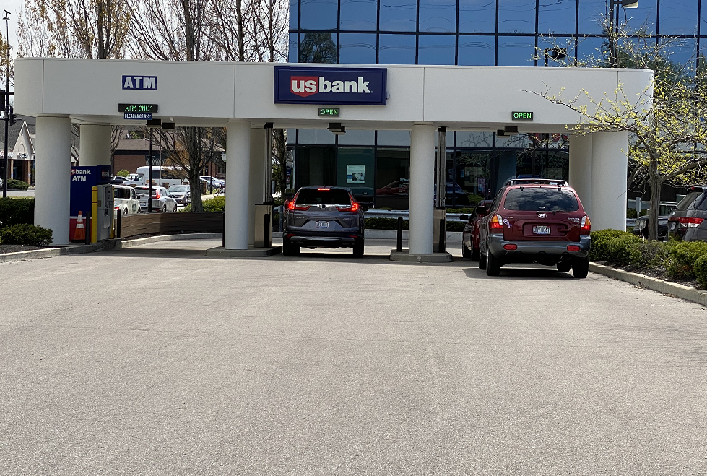
Drive-up Design – Head on

Slide 16
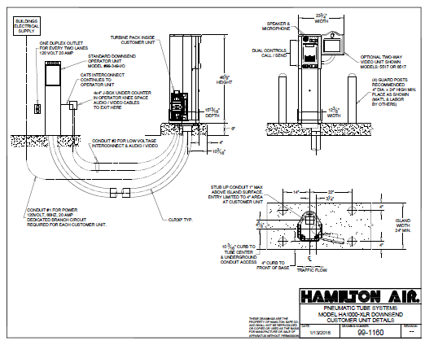
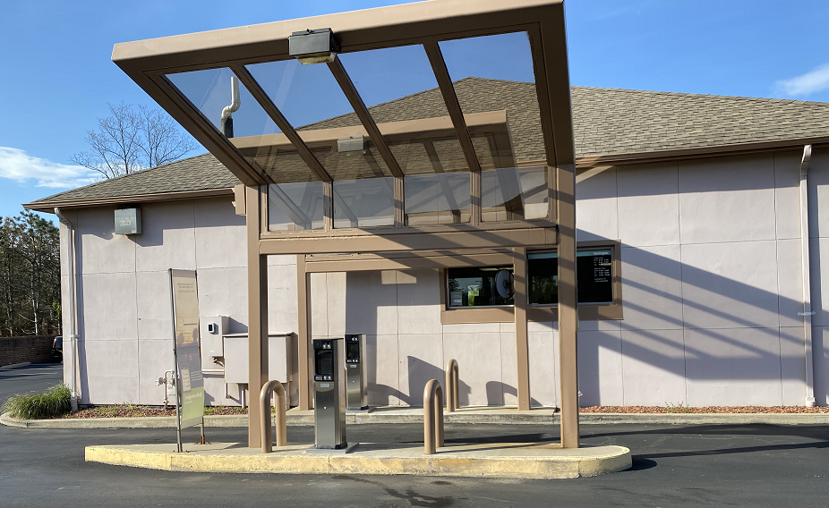
Drive-up Design –
Downsend Addition

Slide 17
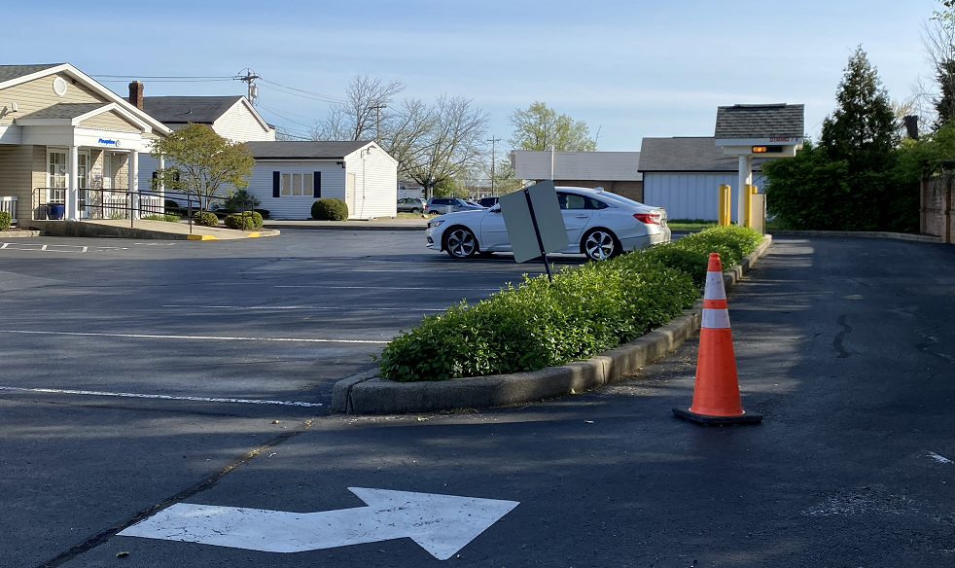
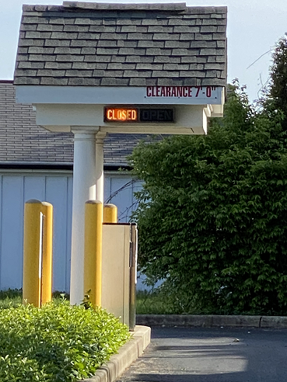
Drive-up Design - Remote

Slide 18
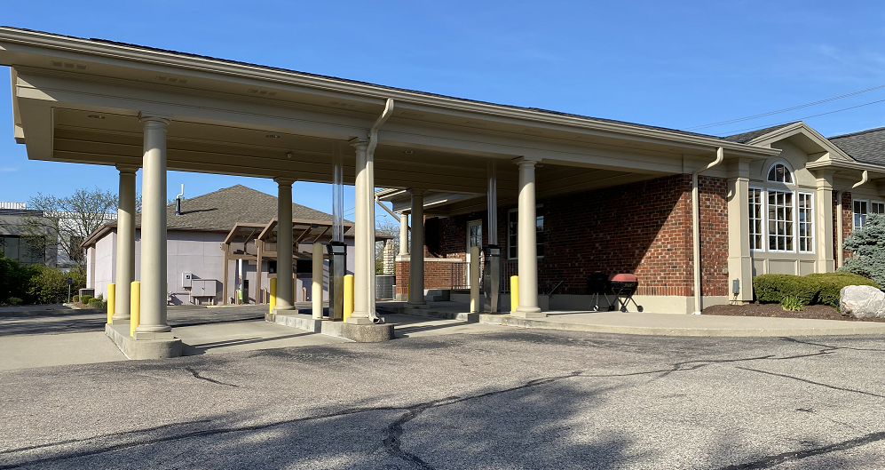
Drive-up Design – Pneumatic in first lane

Slide 19
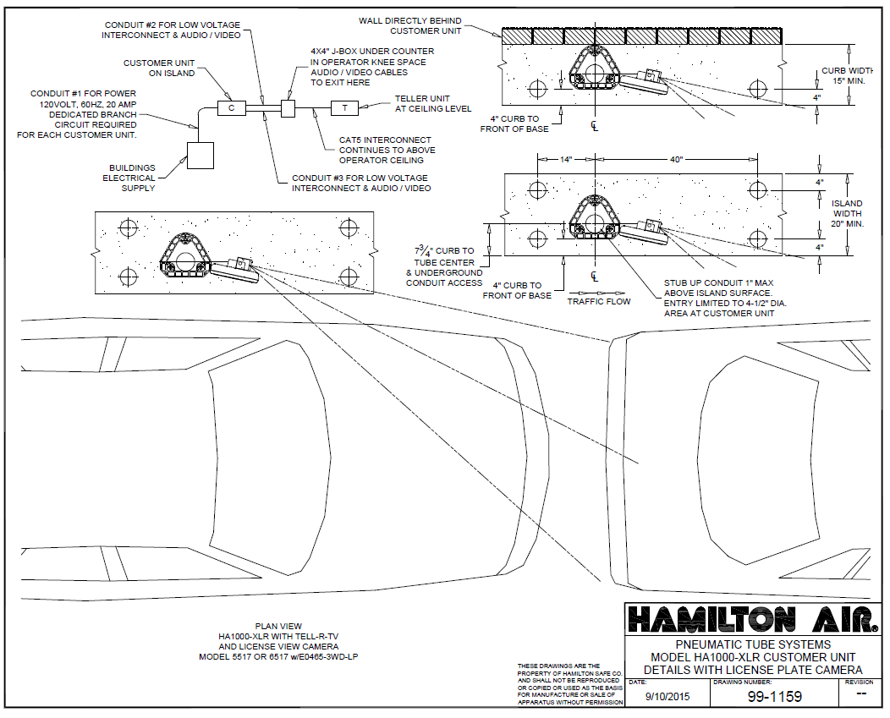
Drive-up Design – Lane with LP Camera

Slide 20
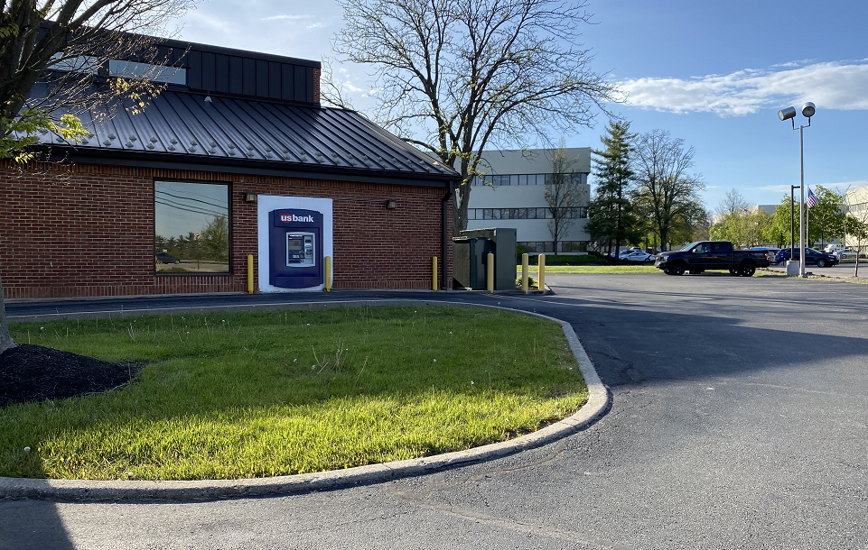
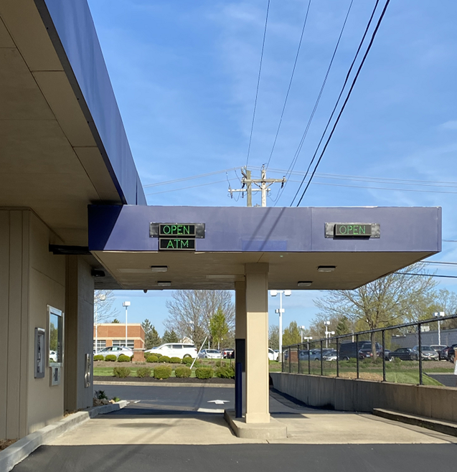
Drive-up Design –
Examples

Slide 21
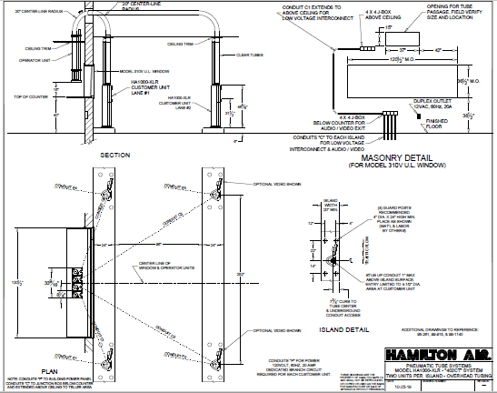
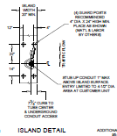
Drive-up Design – Tandem Lanes

Slide 22
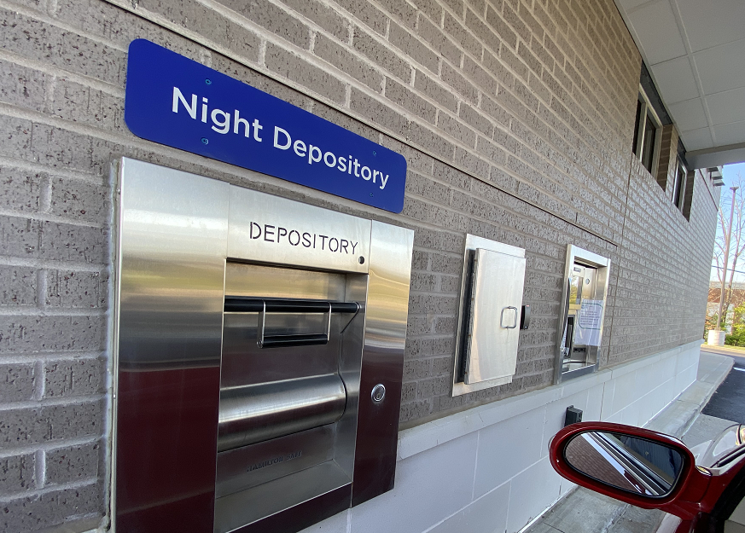
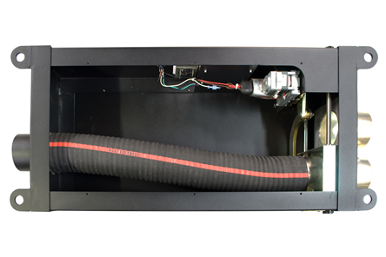
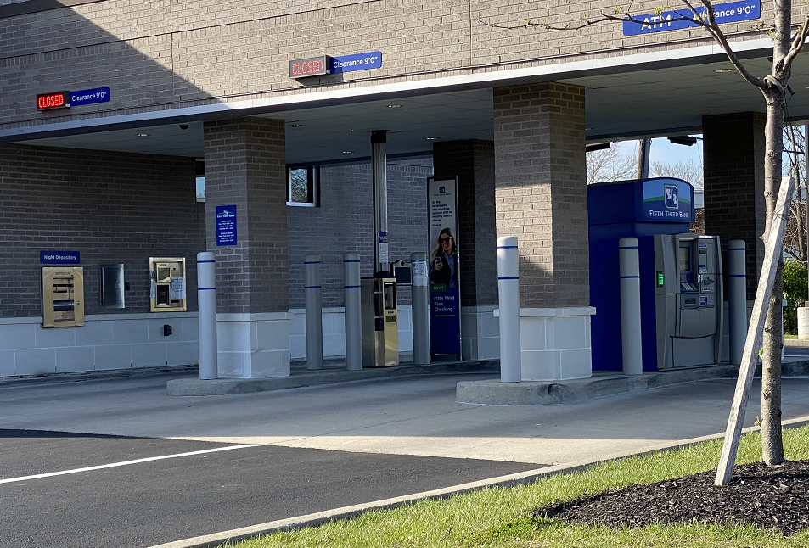
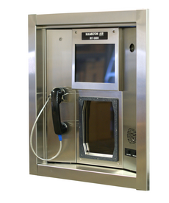
Drive-up Design
- IRT, Diverter

Slide 23
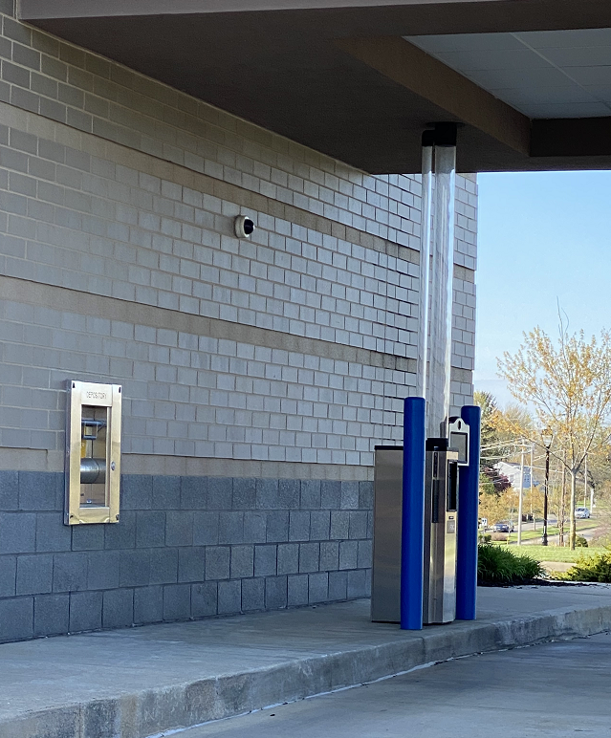
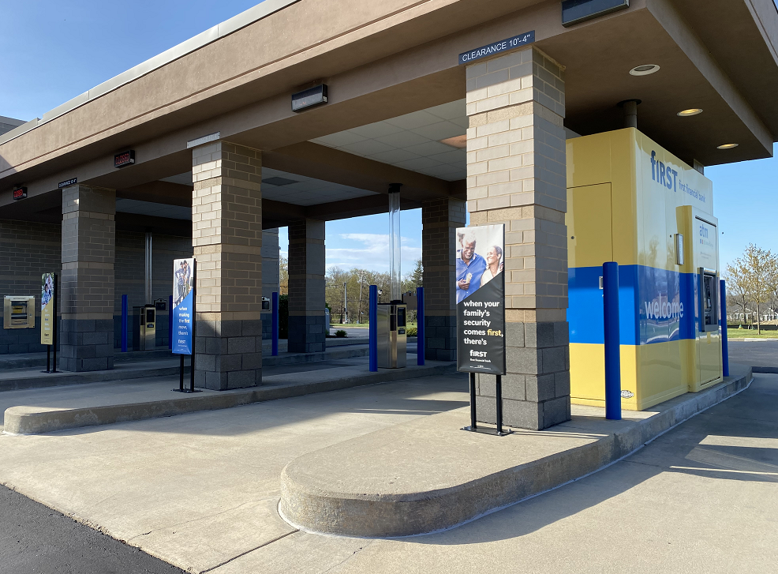
Drive-up Design –
First Lane Pneumatic

Slide 24
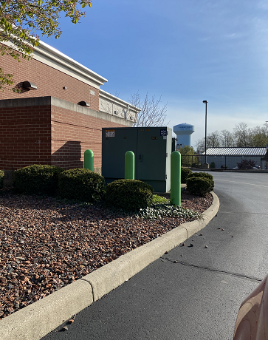
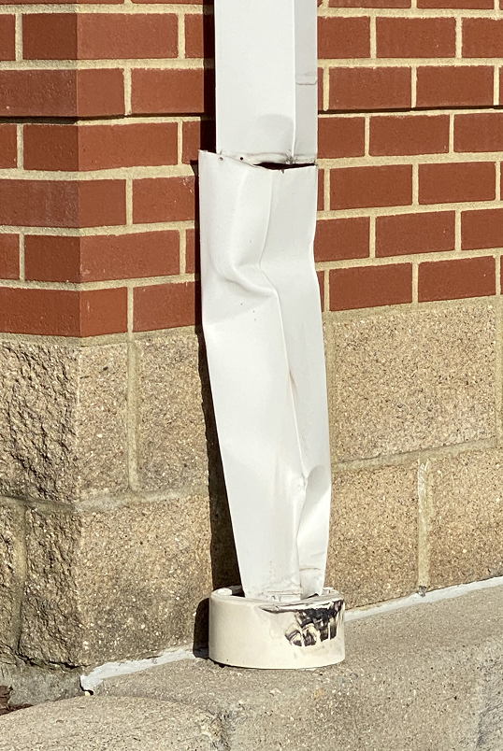
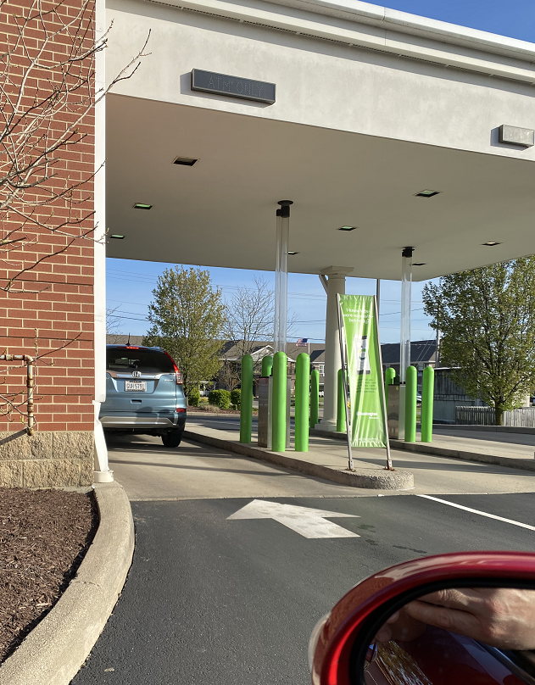
Drive-up Design – Sharp Left Turn

Slide 25
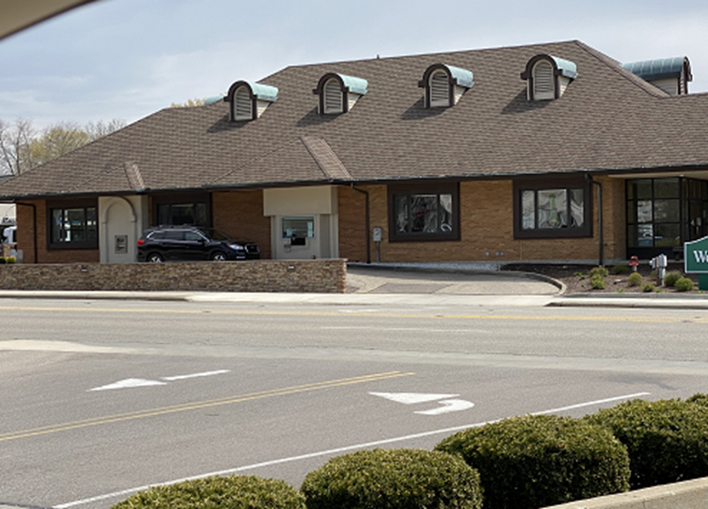
Drive-up Design – Poor Design

Slide 26
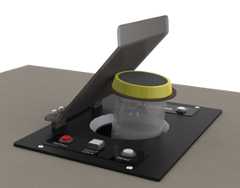
Drive-up Design Good Practices - Decisions
Location of teller units
  Drive-up area
  Work room
  Front counter (Overhead or through-the-counter)
Teller Cash Recycler

Slide 27
The Hamilton Difference
Broadest solution set
Built to Highest Standards

Slide 28
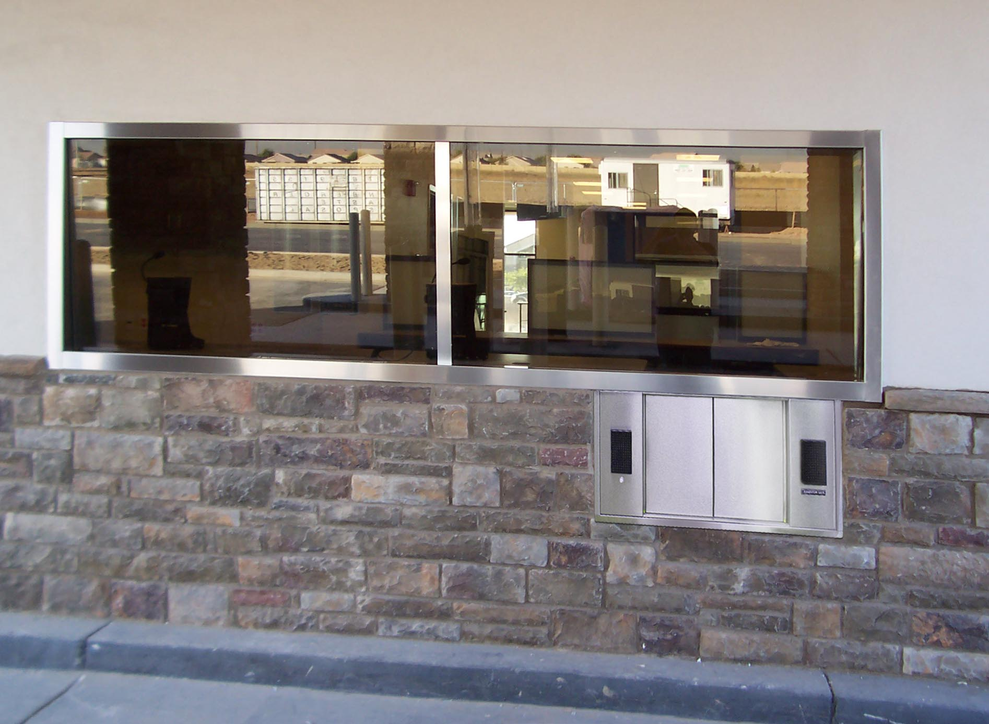
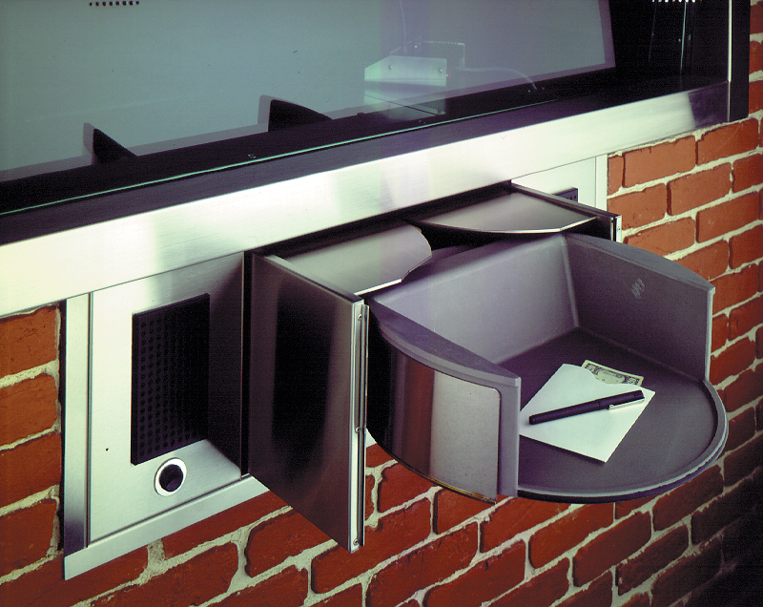
Windows & Deal Drawers
Deal Drawers – The best in the industry….400DD & DCD18
  UL Level 3
  Patented suspension free design is far superior to competitors’ glides
  No “wind tunnel” effect
  Electric with manual option
  Optional Heater
  Adjustable to curb widths for customer
Windows
  UL Listed both the frame and glass
  UL Level 1, 2 or 3 glass
  Hurricane Approved
  5ft, 8ft, 10ft, 12ft, 15ft standard
  Custom sizes
10ft with DCD18
400D

Slide 29
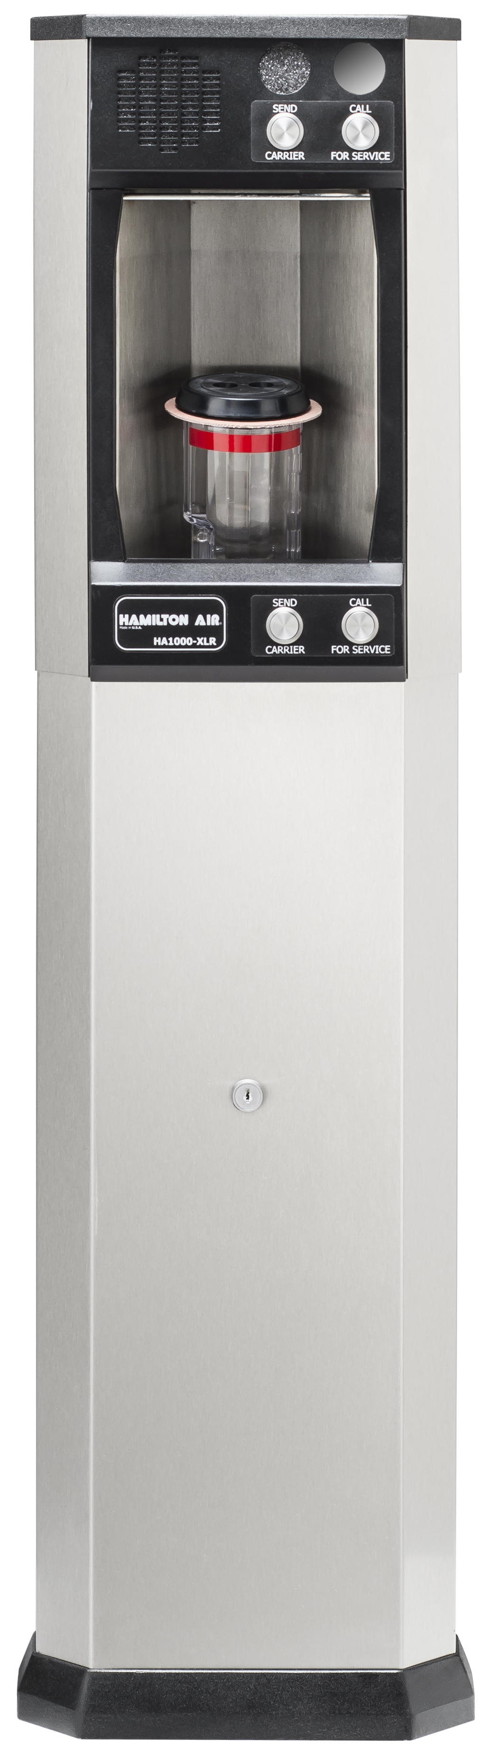
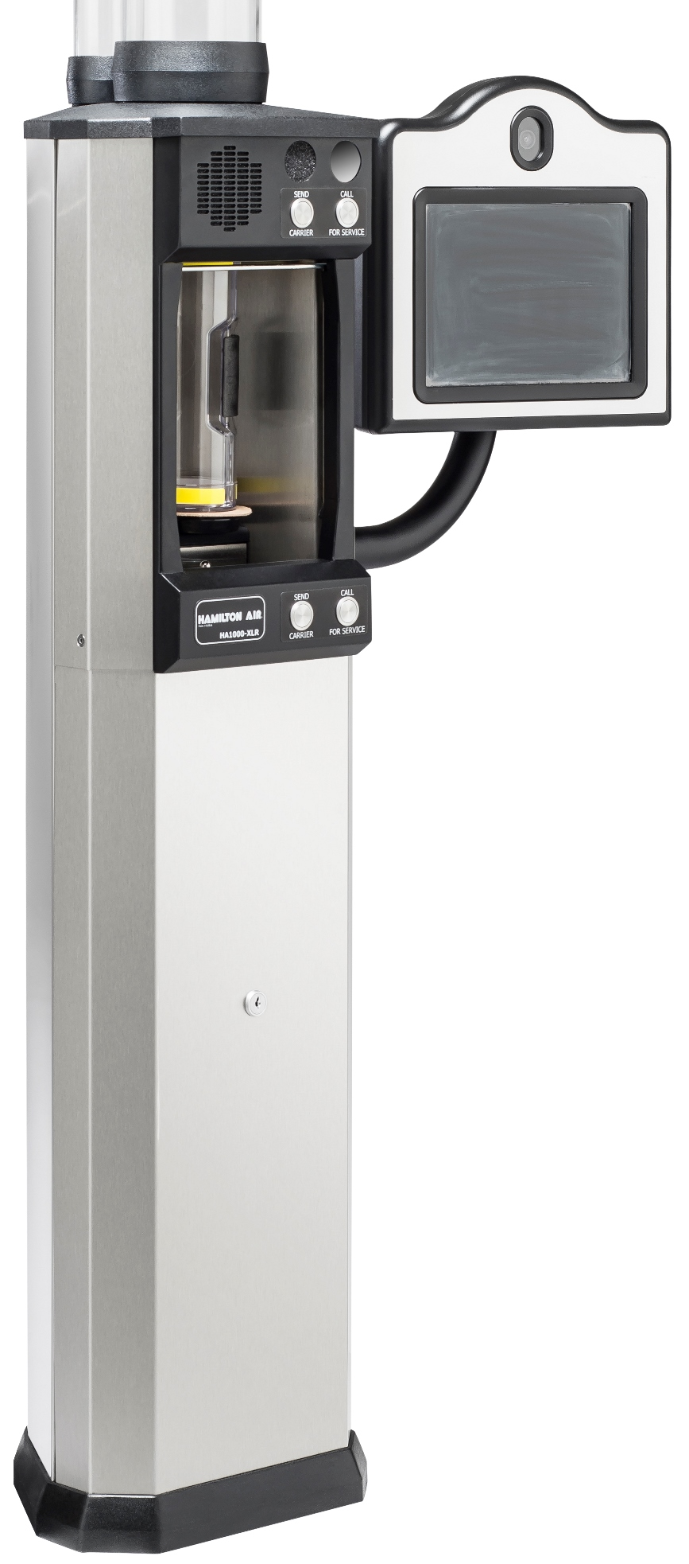
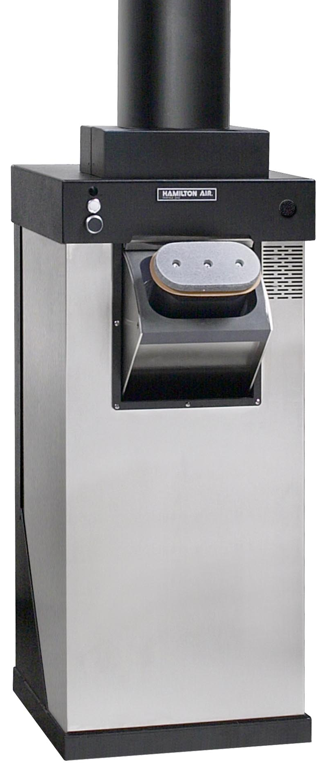
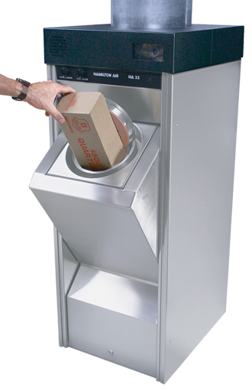
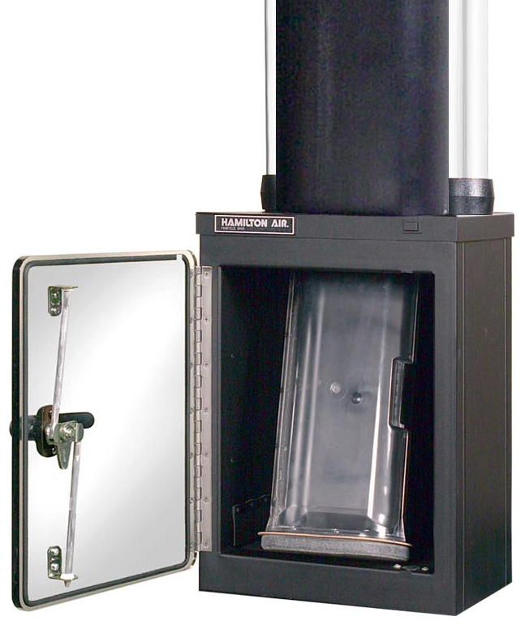
Hamilton Drive-Up Tube Systems
  Complete lineup
XLRD – 4.5” Underground
HA33 – 8” & 10” Overhead
HA47 – 4”x7” Overhead
XLR – 4.5” Overhead

Slide 30
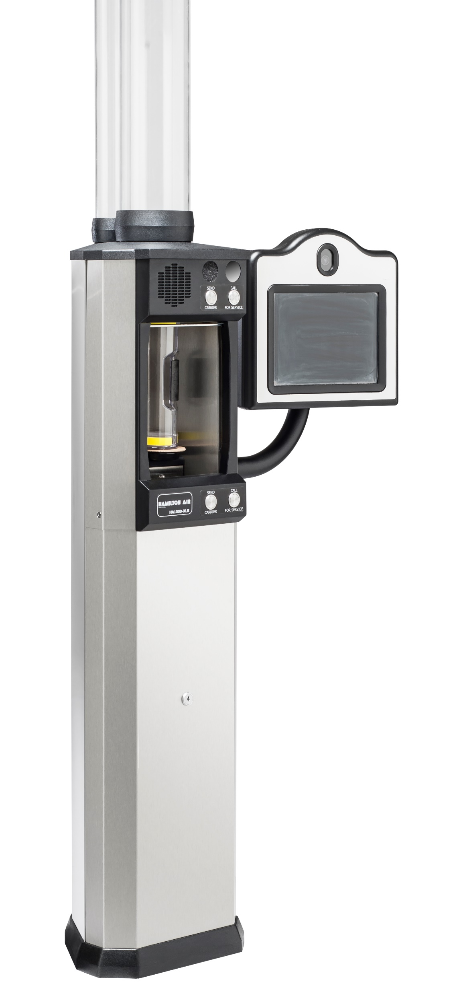

XLR - 4 ½” Drive-Up System
Built upon the legacy of the HA1000!
Both overhead and underground
Stainless Steel body – front and back
Top surround and base are ABS polymer
Service from the front
Two sets of call/send buttons
Integrated tubular design for two-way video
Improved location and housings of speaker and microphone ➔ better audio quality
Optional Heater / Airflow kit (with thermostat)
No Truck Base needed……We will increase the overall height of the frame to accommodate extra height needed
Optional 2-way video
Audio
console

Slide 31
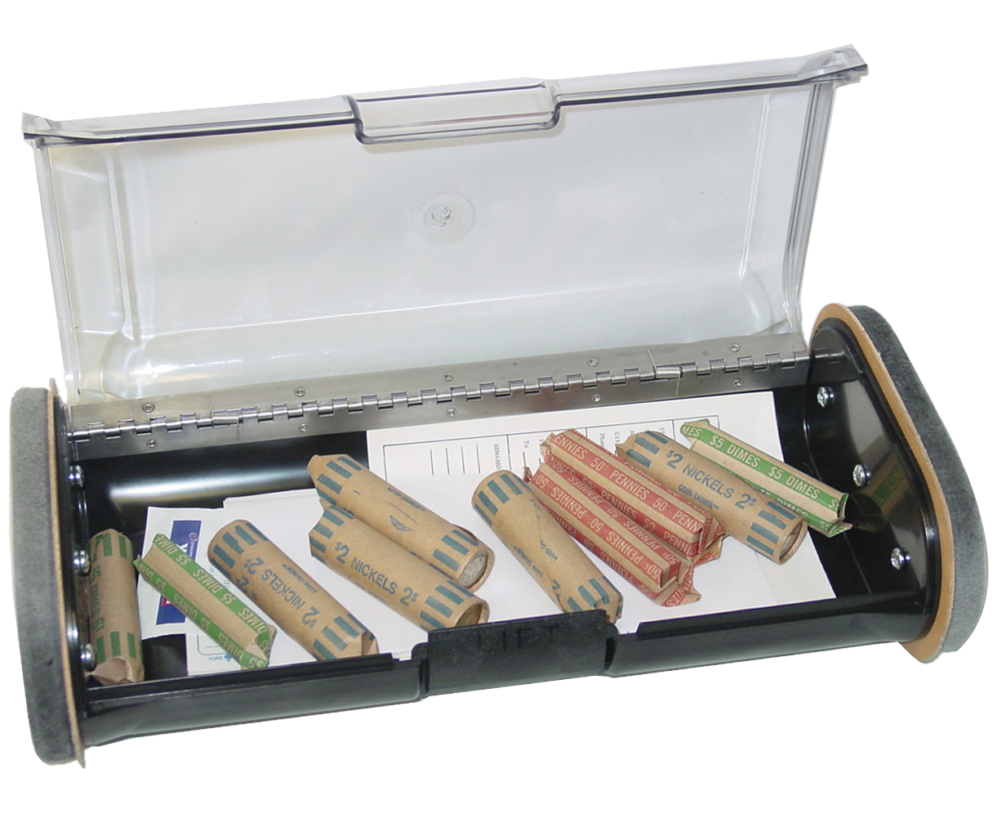
HA47 & HA33
HA47 – Light Commercial Unit
  Can operate as both a retail and a commercial unit
  Transports 12 to 15 pounds
  4x7 type large carrier
  Blowers/motors inside customer unit
  Same control board as in HA33 and XLR
  2-way video can be added as an option
HA33 - Heavy duty commercial unit
  Available in both 8” and 10” units
  Transport up to 25lbs.
  Commercial system used for moving heavier items
  Captive Carrier
  Great for replacing Diebold 8”
  Blowers/motors mounted up in canopy or remote location
  Stainless Steel construction
  Optional 2-way video
HA47
HA33

Slide 32
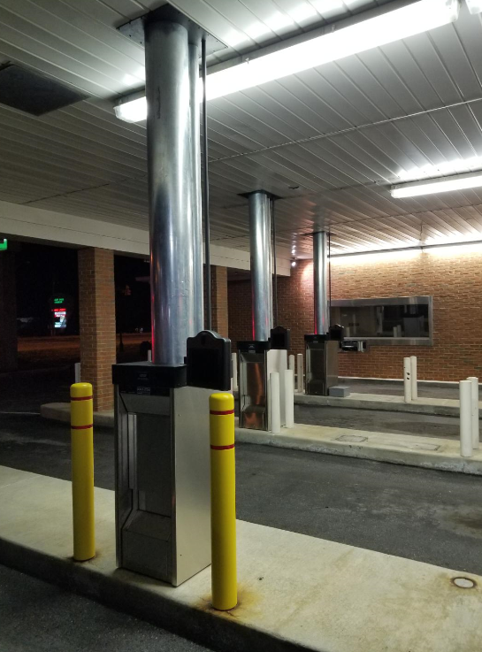
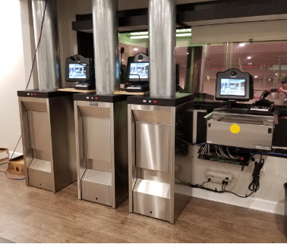
HA33

Slide 33
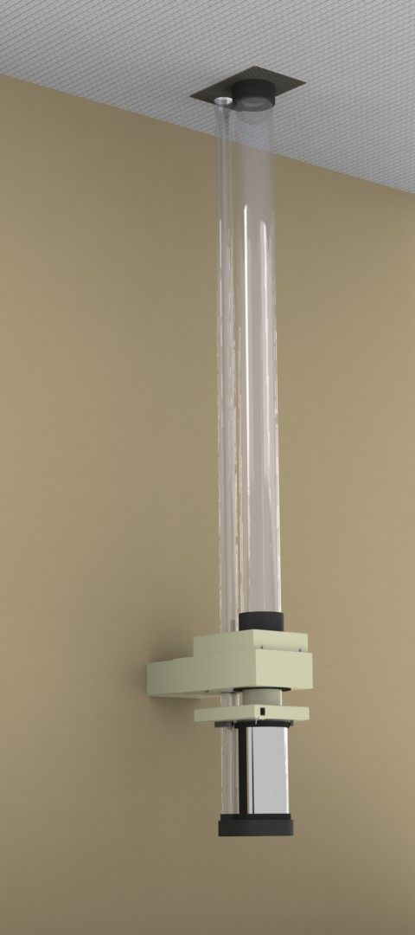
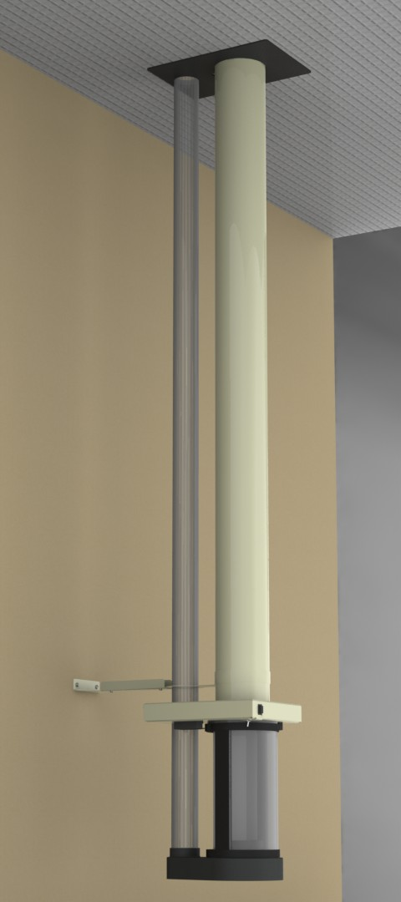
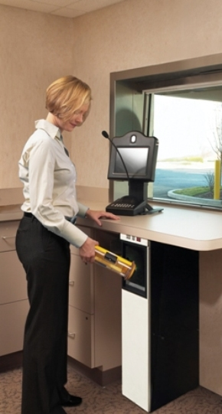
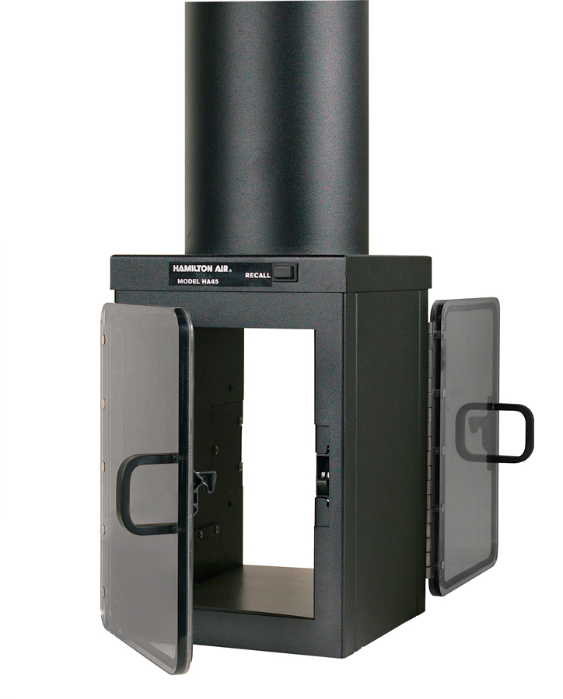
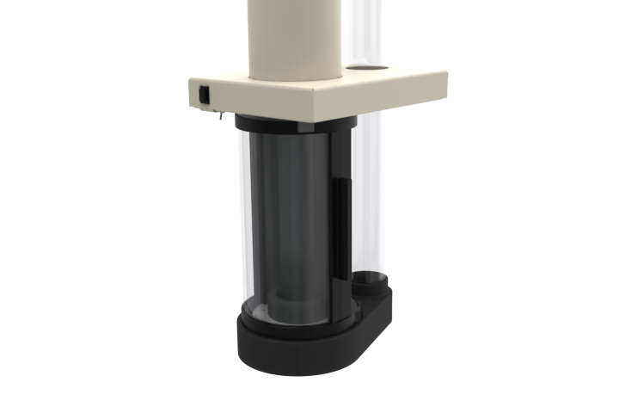
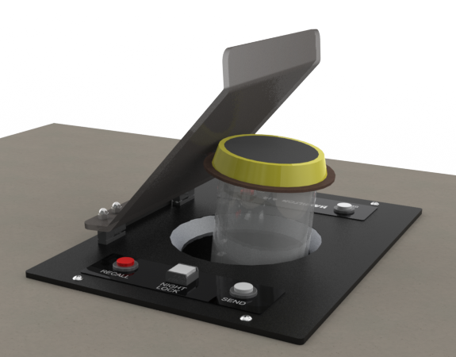
Teller Terminal Options
Double sided teller
Wall mount bracket with clear tube
Downsend
Extended Teller with Stabilizer
Thru the counter
Standard overhead

Slide 34
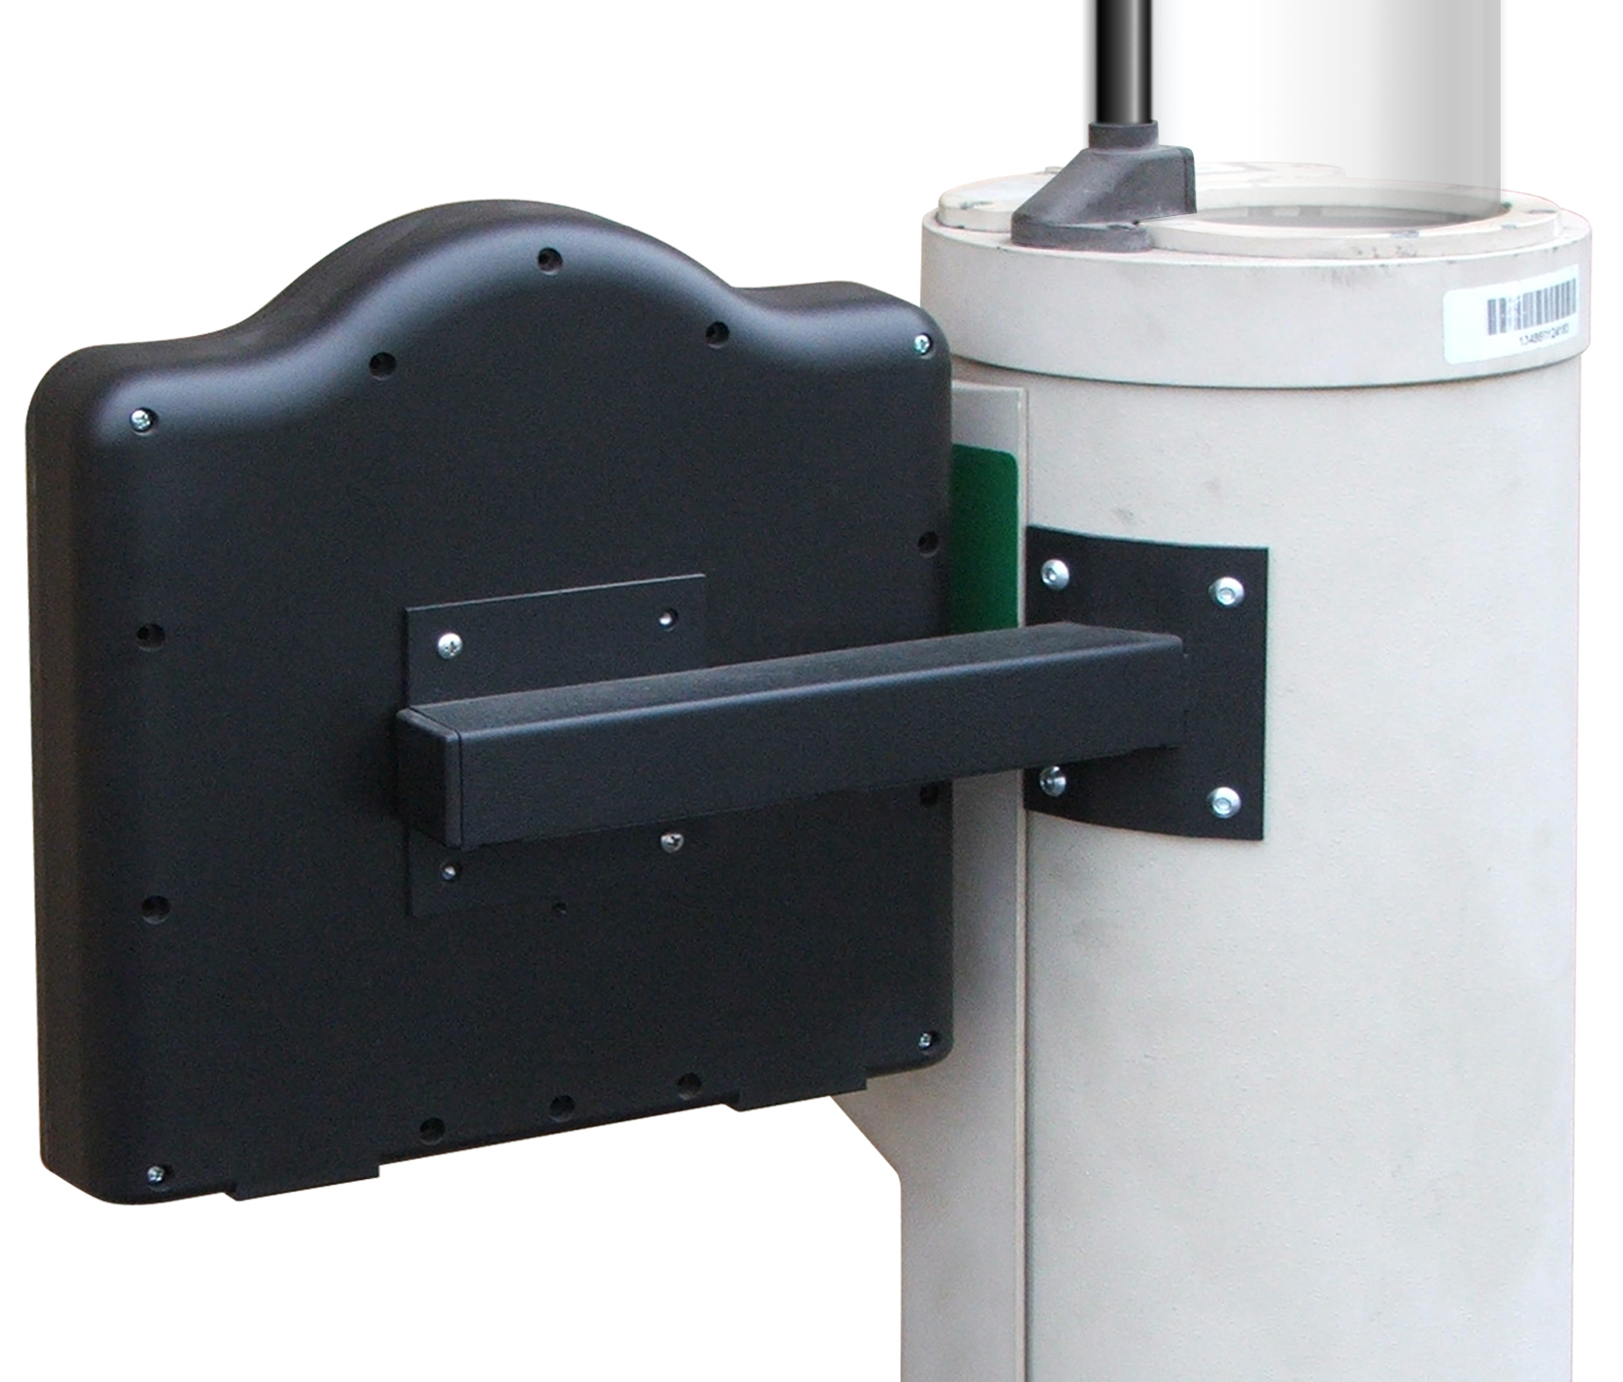





Drive-Up Options
10 inch two-way video
Diverter
Other Options…….
One way video
Teller mount brackets
Overhead conduit kit
Truck height XLR
Truck Base
Riser Plate
Add audio/video to competitors’ equipment
License plate camera – now with IP/Analog
15 inch two-way video

Slide 35

Point to Point Systems
HT-19
HT-15

Slide 36



NEW HA-1000XLR Accessories
Add-on Truck Base
    Designed to fit those units installed that need to be converted to a truck lane
    Part # XLR-ATB for upsend
    Part # XLRD-ATB for downsend
NEW XLR-LED Light Kits for overhead HA1000-XLR to add some pizazz to drive-up.
Various color & flash pattern options
Remote controlled
Night lock mode
Available mid-Q3
New Truck Base

Slide 37
Coming
Soon!
Plus Anti-Bacterial Carriers

Slide 38


XLR Riser Plate
Riser plate to cover footprint when replacing HA1000s & certain competitors’ equipment
Part# XLR-21K

Slide 39


Teller Cash Recycler – Gunnebo TCR7
Four Teller Installation
Gunnebo TCR7

Slide 40


TCR7 – New Design
UL-291 safe rating new rating w/ high tensile steel
New Muted Color Scheme
Reduced width by 3.7” from 20.7” to 17”
No Plastic vacuumed formed parts
10.1” touch screen, largest screen in the industry
Improved outer door locking mechanism
New design does not require any software changes
Can drive the coin dispenser
Serial number tracking on robbery dispense
Will hold 5 robbery dispenses
March Searchlight integration
Track and record TCR interactions
New cleaning cards and kits available
Power and data connection moved within the top cover

Slide 41


Hamilton Activities
Webinars
Updating collateral
  Brochures
  Battlecards
  Drawings
Updated websites

Slide 42
Thank you!
How can we help you to win business?

