Slide 1
Day 2: 2020 Channel Partner Conference

Slide 2
Agenda
Plant Tours
Mason with Mike Mooney
Amelia with Chris Betz
Break
Product Updates with Todd Lefevers
Break
Hamilton United – Jim Mitchell / Mike Mooney / Chris Betz / Todd Lefevers

Slide 3
Product Updates
Presented By: Todd Lefevers

Slide 4
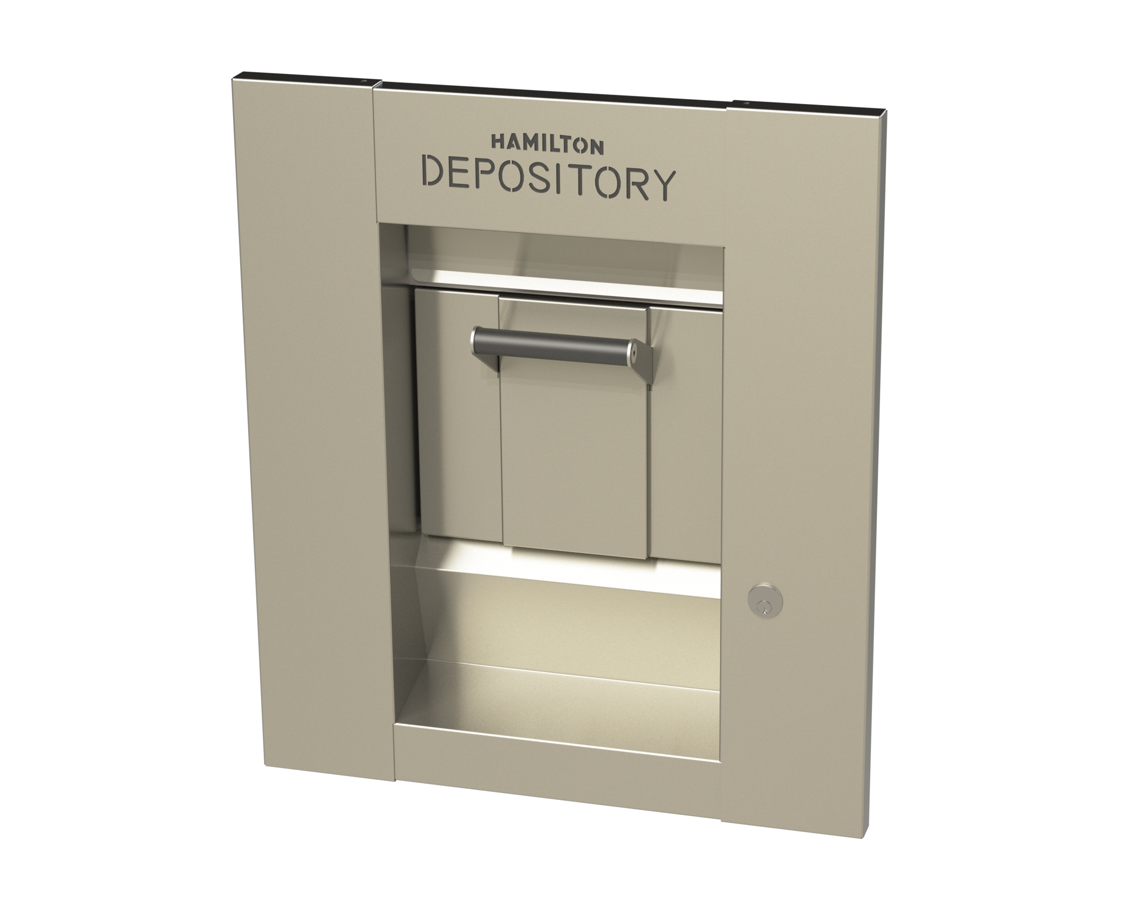
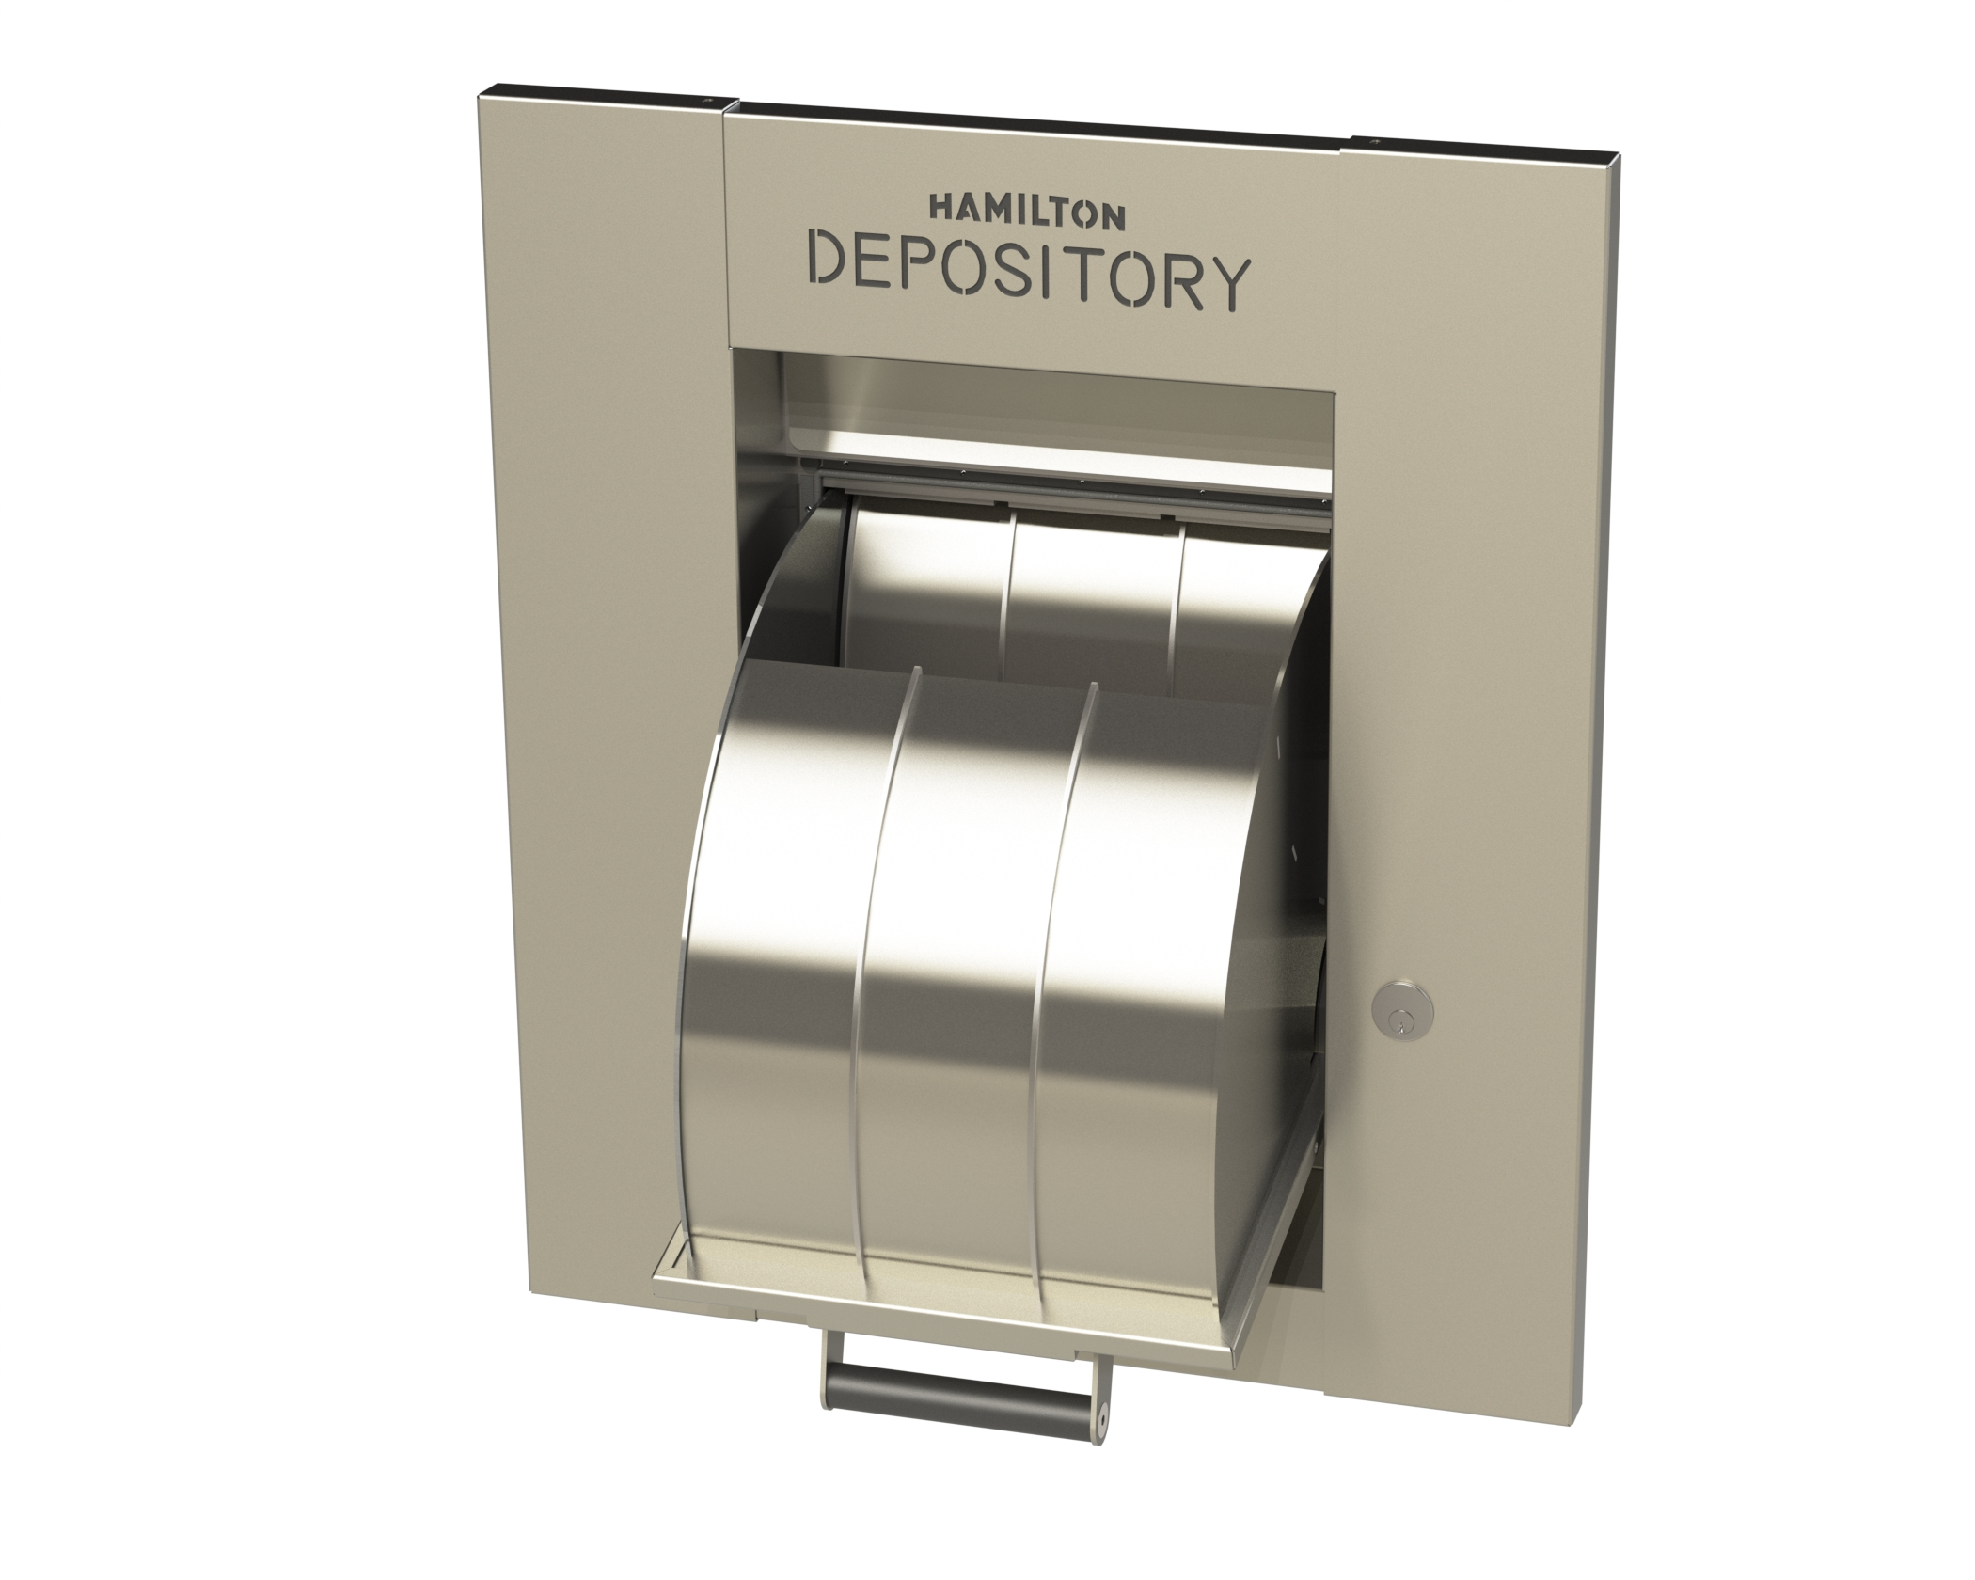
New UL Night Depository
Coming Q1 2021
Notes:
Completely redesigned night depository head. Bucket is made in house allowing Hamilton to control cost, quality, and delivery better.

Slide 5
New UL Night Depository Features
Weather Resistance
Replaceable Bucket Stainless
Built In Bucket Assist
1 ½” Lower Handle Height
Increased Security
Notes:
Weather Seal – Bucket Covers Opening
Smoother Operating Mechanism To Eliminate Forcing Bucket Closed
Built In Bucket Assist
1 ½” Lower Handle Height

Slide 6
New UL Night Depository Features
Envelope Storage
Smoother Operating Mechanism
Thru Axel
Electronic Combination Lock Can Be Used
Stainless Bucket
Notes:
Built In Envelope Storage-New Install Version
Replaceable Bucket Stainless
Thru Axel Better Durability And Less Maintenance
Electronic Combination Lock Can Be Used (IP Solutions)

Slide 7
New UL Night Depository – Standard and Replacement Versions
Notes:
The full line with new install version, standard replacement, and smallest head we can make.

Slide 8
Universal Anchoring System for Most Safe Sizes
Showing Anchor Bolts Inside Safe
Notes:
As criminals become more creative, new methods and tools must be used to protect people and assets. Hamilton gives the advantage back to you. Hamilton technology hinders safe removal by brute force. This very same technology will provide protection for safes and a variety of other security containers.

Slide 9
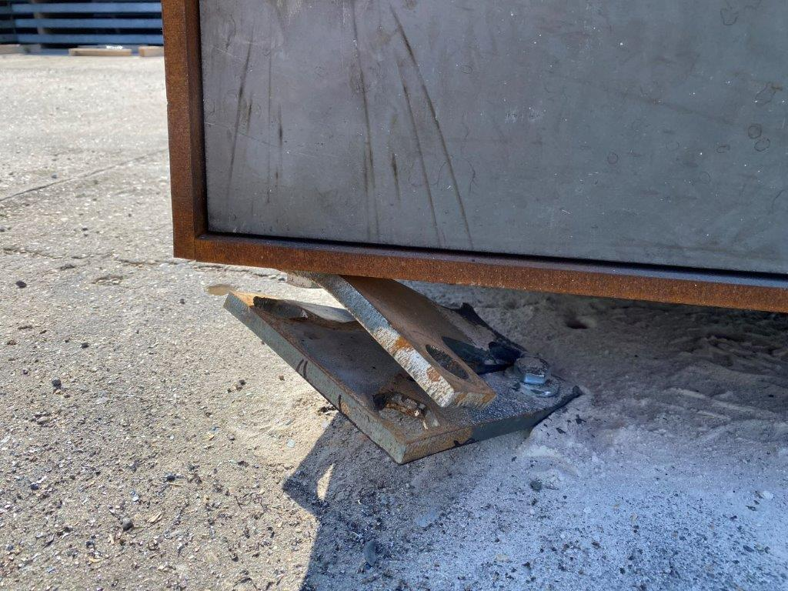
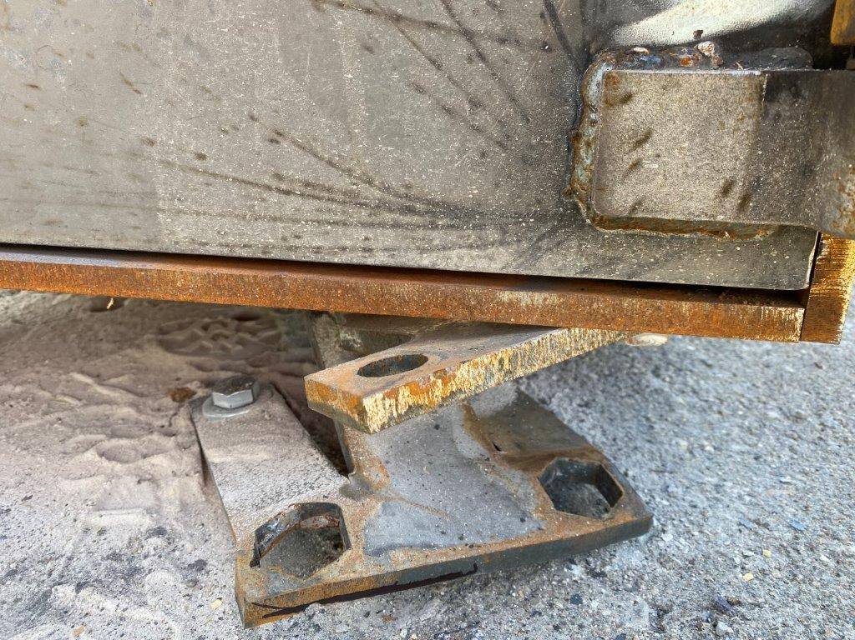
Notes:
Easily handled by one person
Use multiple plates for on larger safe
Not safe model-specific
Mounts under safe

Slide 10
Notes:
Part number SAS-H-KIT

Slide 11
Notes:
Typical safe anchoring bolts fail due to the attack energy forcing the base concrete to shatter. The Hamilton safe anchoring system is designed to absorb and redirect any "attacking force.” Expecting an easy heist, thieves get confused. They leave the site realizing the safe cannot be quickly dislodged.

Slide 12
Notes:
Easy to install
Proven Effective Systems
No electronics involved
Totally hands off protection
Design to slow-down and/or prevent removal by brute force

Slide 13
Notes:
Absorbs attack energy from a vehicle
For new or existing safe installations
Designed for safe or other security containers
No maintenance required
Reusable
Recyclable

Slide 14
Class 5 Door Buck
Media Rooms
Pharmaceutical
Marijuana
Safe Room
Storm Shelter
Notes:
The door buck allows you to install a Class 5 door in non vault rooms. This is versatile solution for many vertical markets

Slide 15
Double-Sided Teller Door Latch Upgrade
Replace the grabber style latch and switch to the new T-Handle latch
More Durable
Metal Turning Handle
Notes:
This kit is already in the field and receiving get feedback from the customer that have it. The metal turning Handle prevents the user from slamming since they have hold the door to shut and turn handle.

Slide 16
Riser Plate Adapter for Old HA-1000 to HA-1000XLR
Fast and easy installation
Height allows space for wires
Clean finished look
Inexpensive solution
Notes:
This is a great way to cover up the existing template and conduts. A clean finishing touch when replace an old HA-1000 with a smaller footprint XLR.

Slide 17
Add-On XLR Truck Base
Add-On
Easy Installation
Maintenance Free
Looks Great
Notes:
I am sure you are all aware we offer a taller XLR for truck use. The point was brought up what happens if you already have the unit installed and you need to make it a truck lane. This was mentioned at the dealer conference and we now offer a add on truck base for the standard XLR and XLRD

Slide 18
Wrench for Drive-Up Overhead Conduit
Input from Channel Partners needing a solution
Simple to use
Custom Made Stainless Wrench for years of service
Notes:
This is a great example of Hamilton listening to our customers. We were ask to help come up with a solution to hold the conduit nut so we did.

Slide 19
Add Airflow Kit to Existing XLR Units Without Air Flow Kit
Program change to only operate in night lock mode
Increase blower motor life
Reduce condensation build up
Notes:
With the new eProm chip installed with the latest program, the airflow operation is suspended when the system is in the normal running mode. This means with the lane is inactive and the door auto-closes (if set to do so), the airflow will not operate. Also, if the carrier is recalled or sent inside, the airflow will not operate. The system must be nightlocked before the airflow will operate. This means the airflow function will only operate when the lane is not being used regularly.
With the thermostat installed, the airflow operation is suspended when temperatures are above the set point. This means the airflow will not operate in warmer temperatures when tube condensation is not an issue. When the temperature drops below the set point, the airflow function is automatically restored to normal operation.
If the temperature is above the set point, the thermostat closes its contacts triggering the “Spare/Teller” input. If the temperature falls below the set point, the contacts open.
When the “Spare/Teller” input LED is lit, the airflow function will not operate.

Slide 20
Add Thermostat to Existing Airflow Kits
The addition of thermostat will save energy
Increase blower motor life
This also includes a program change that only works when the unit is put in night lock mode

Slide 21
Through the Wall/Door Depository
Another choice for deposits
Simple design
Easy install
Limit person to person contact
Low Cost
Notes:
Hamilton has designed a low cost through a door depository. The depositories are being install around the country with great success. The unit is completely painted and with a simple cam lock to prevent tampering.

Slide 22
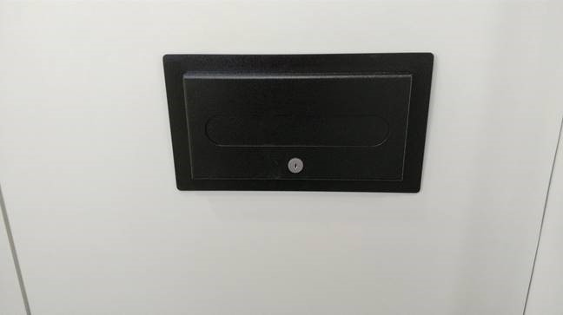
Through the Door/Wall Depository Install Photos
Notes:
A few pictures of actual install going through the wall versus the door.

Slide 23
Thank You

Slide 24
Plant Tours Mason and Amelia

Slide 25
Hamilton United

Slide 26
Topics
Communication
Team Work
One Stop
Technical Support
Future of Operations

Slide 27
Communication
New Operations Meetings
Ops/Customer Service call every morning 8:30
Review Dates
Discuss potential misses or issues
Amelia/Mason parts review call 2:00pm
Review of internal schedules
List of priorities reviewed
Quality issues discussed
Daily GEMBA walks
Mason 9:30am
Amelia 7:30am

Slide 28
Team Work
Operations, Engineering and Purchasing all one team
Purchasing Manager at each location twice a week
Plant Managers visit each other plants on regular basis
Engineering at Amelia 2 days a week
Prints
BOM’s
Technical Support face to face

Slide 29
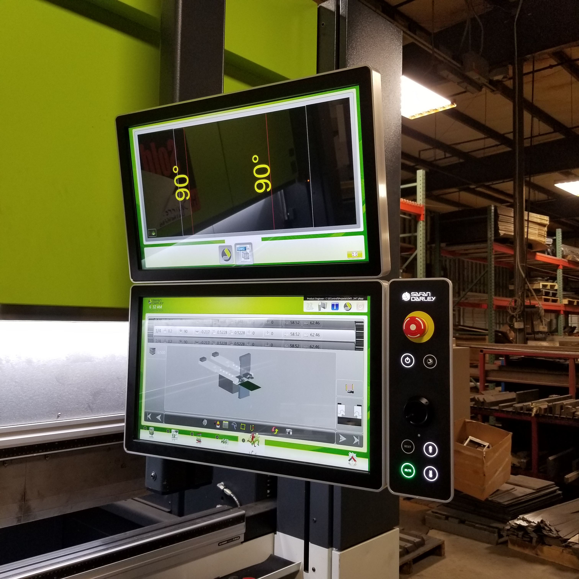
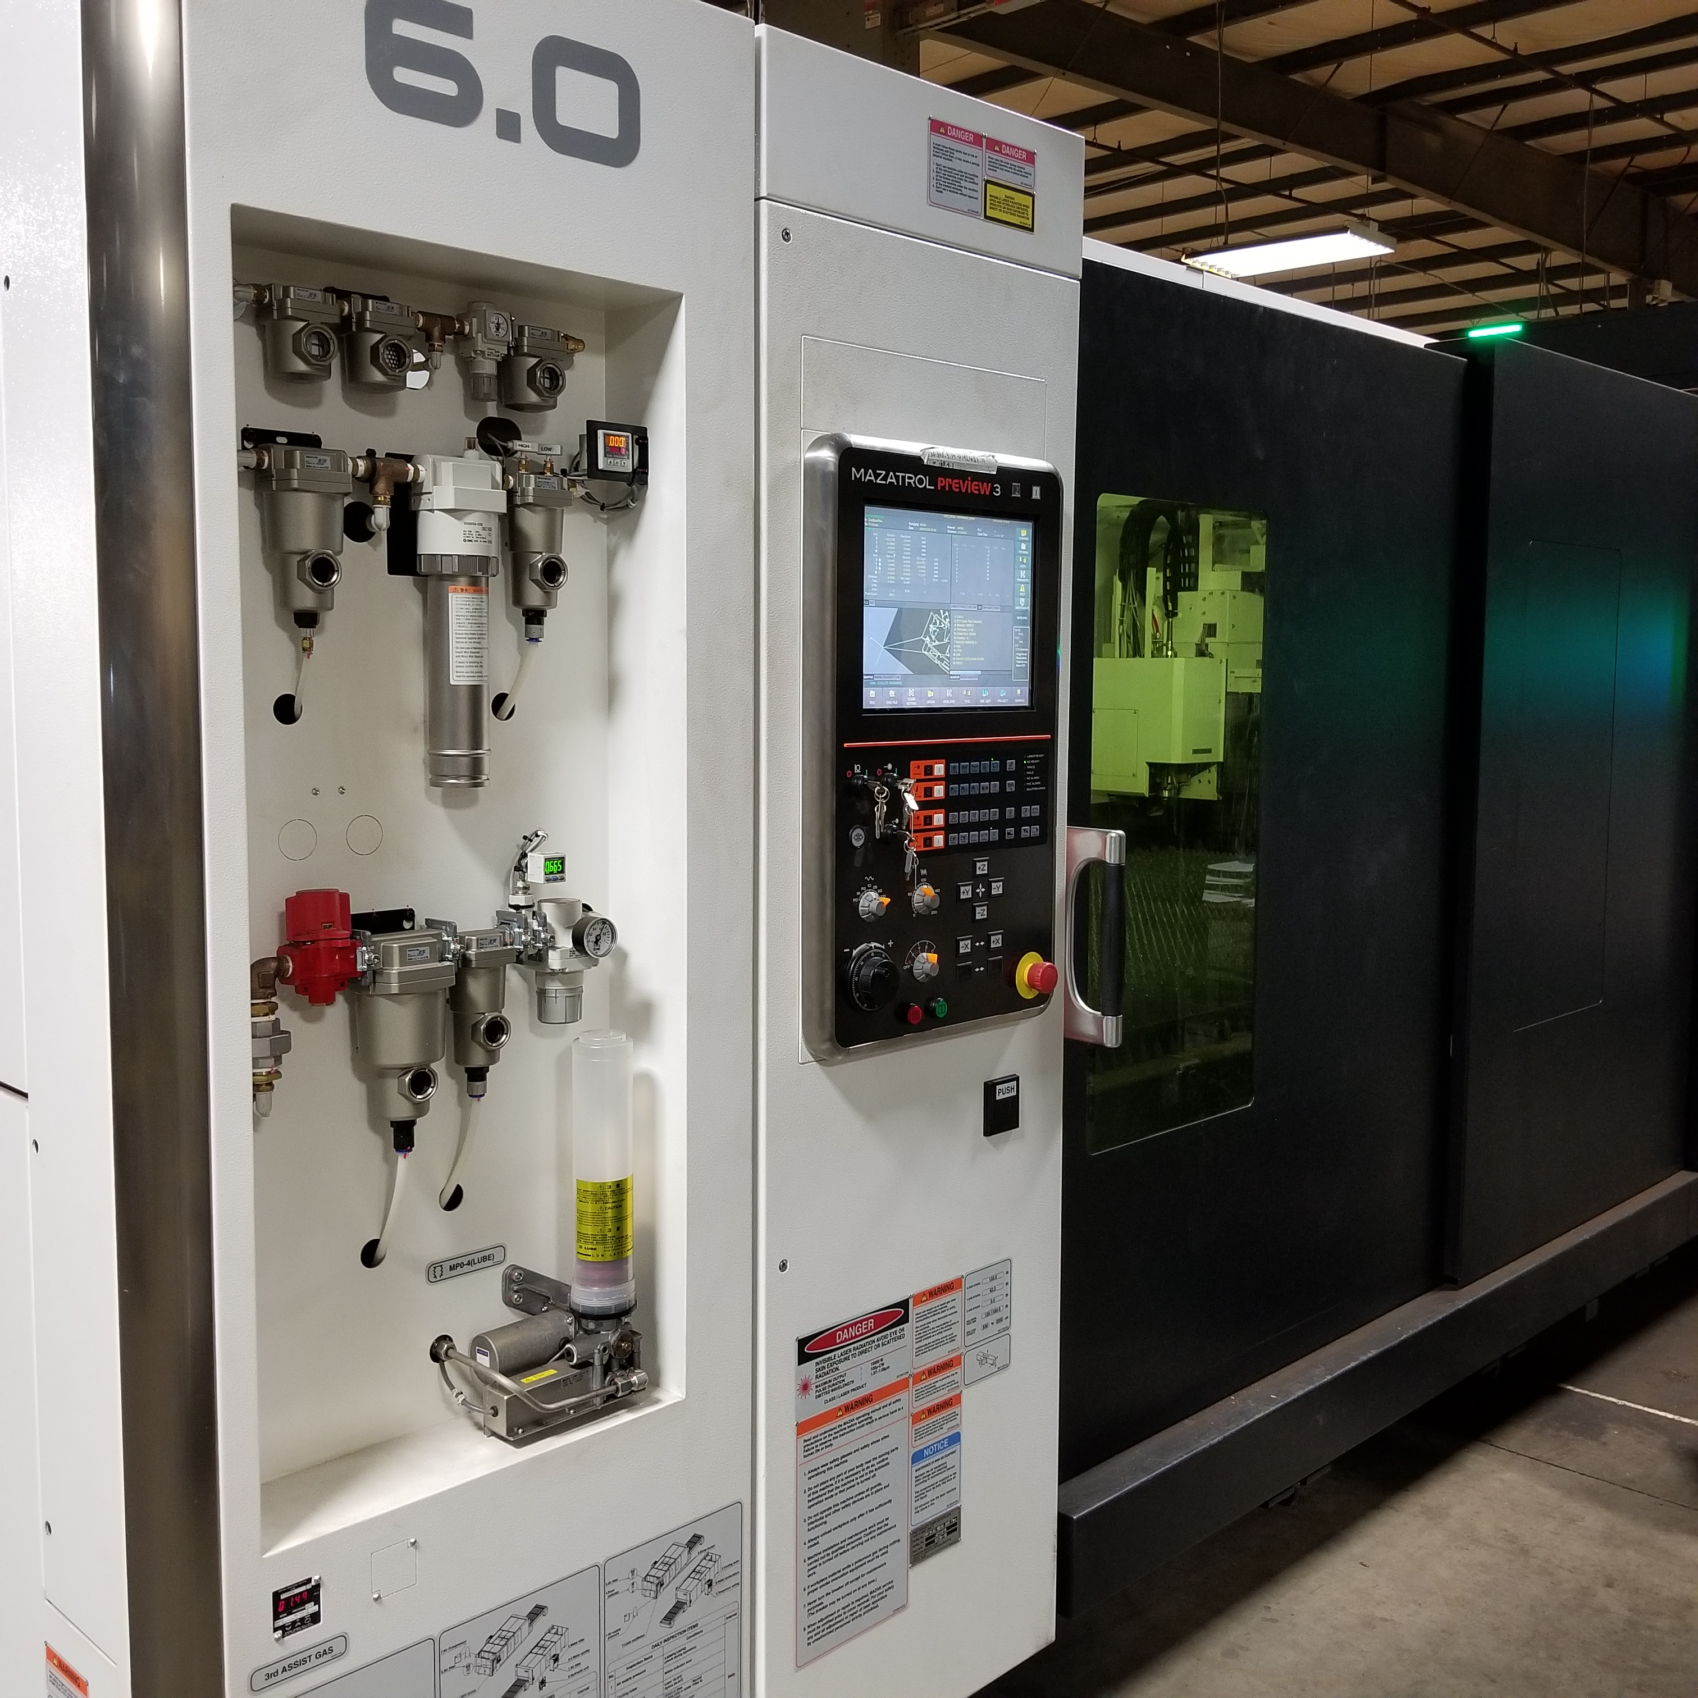
Why Hamilton, we are the one source for all of your needs
We produce all your product’s in house
We have better control on quality
Ability to expedite orders
Technical expertise on site
Tech support have the ability to go out and see the product
Engineering involved in all processes
Design team involved with Manufacturing
We reinvest in the business
New Laser
New Paint Line coming
New turrets coming
New Talent

Slide 30
Technical Support
Video Library
Tech Support
Notification Section
Product Revisions
Tech Support tips
List of Updated Manuals
Tech Support issues with solutions to help you

Slide 31
Future of Operations at Hamilton
Visual Factory
Scheduling Boards
5S in all areas of plant
Defined work instructions
Defined product life cycle
Cross trained employees across all product lines

