Slide 1
Marketing & Communications
Kristy Stagg, Lynn Stefik & Nick Behler

Slide 3
Celebrating 50 Years of

Slide 5
Public Relations
Press releases distributed to business, security and retail media outlets
Corporate and new product announcements
Over 400 news reprints
Notable media coverage on highly trafficked news sites & in targeted trade publications

Slide 6
Tradeshows
10 National & Regional shows
Security
ISC West, ASIS Intl.
Pharmacy
Cardinal Health RBC, McKesson IdeaShare
Cash Management
M-PACT, RILA Asset Protection, NRF Protect, Invest 48, CUNA Sales, Operations & Technology, NACS

Slide 7
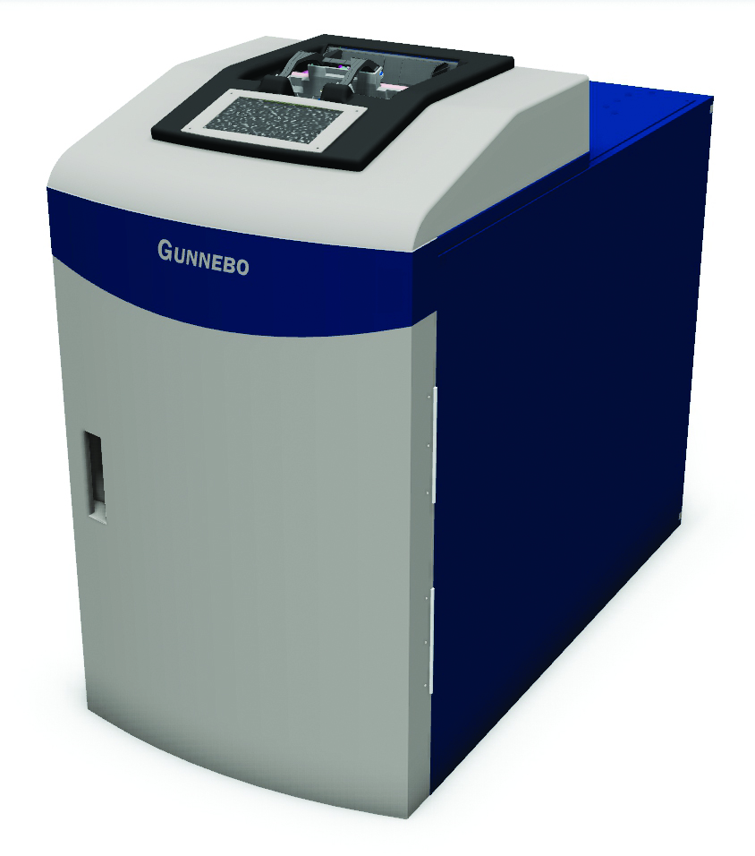
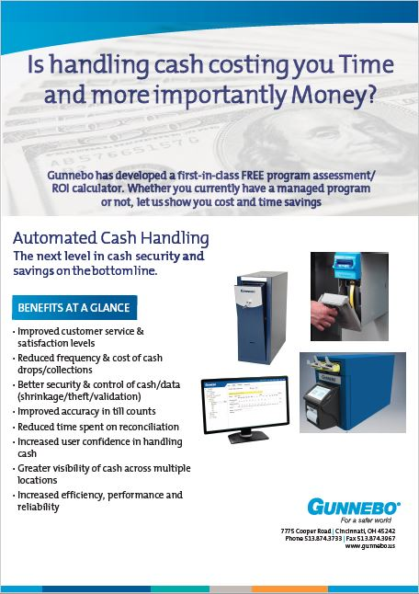
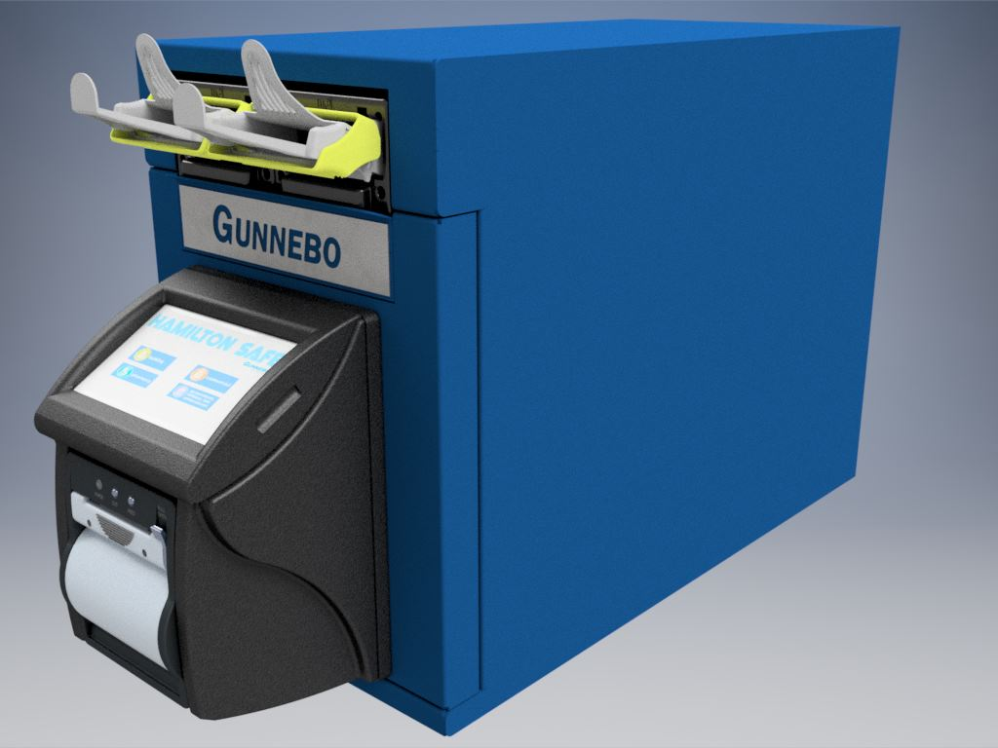
Cash Management
Teller Cash Recycler promotion
CUNA Conference, Phoenix, Oct 1-4 Sponsorship, display table, speed rounds
Cash Deposit Solutions promotion
NACS Show, Chicago, Oct 17-20
Booth, PR, marketing activities
Channel Partner marketing support
Product brochures
Cash management video
Product videos
Credit Union & C-store cutsheets
Case studies, white papers

Slide 8
Websites
New Hamilton and Gunnebo US websites
Drive more traffic to websites
Raise awareness of corporate brands & solutions
Increase quality leads
Solutions-focused, benefit-rich content
Improved navigation and user experience
Channel Partner portal tied to online ordering

Slide 9
New Hamilton
Channel Partner
Portal

Slide 10
Why an Online Ordering System?
Order parts quicker
Automated, secure and convenient
Reduce manual errors
Access to shipping tracking number for instant updates
Instant order acknowledgement

Slide 11
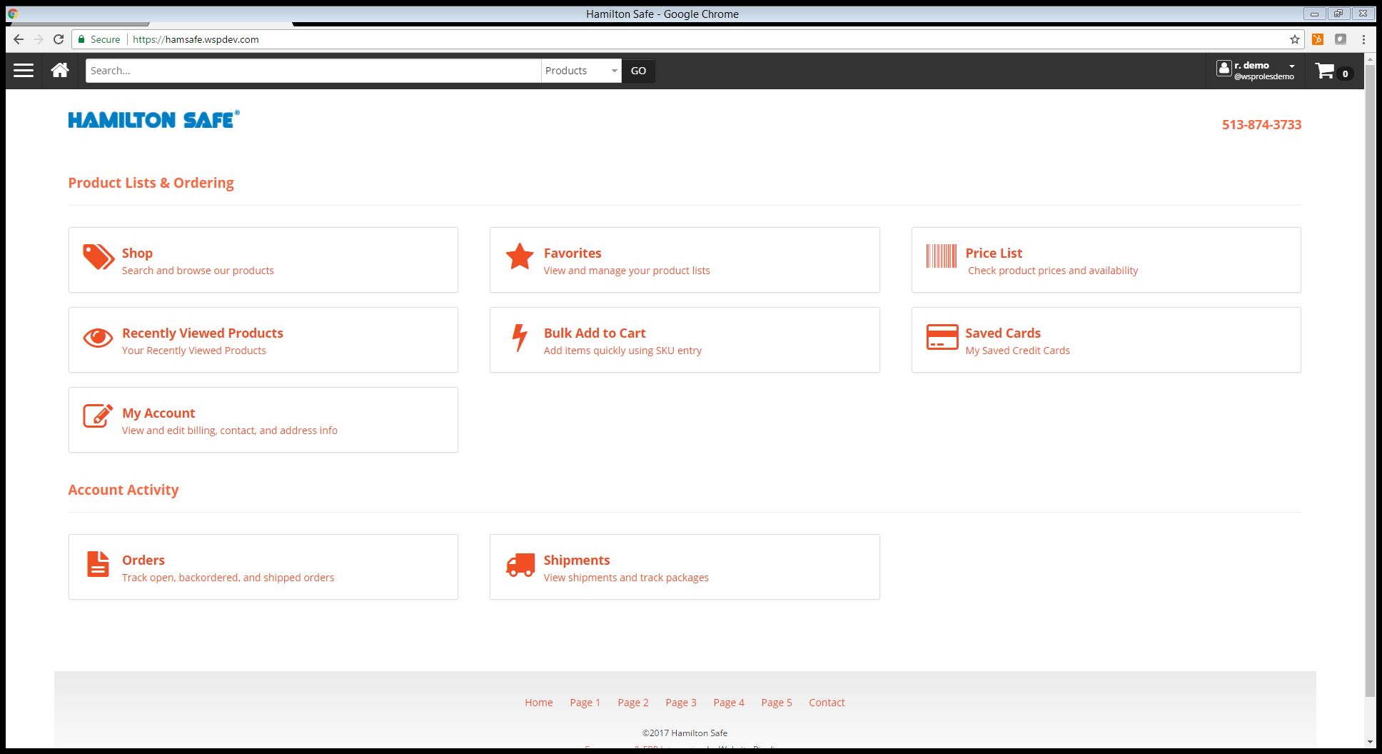

Slide 12
Features & Benefits
Online ordering to reduce steps to process orders (removing a second manual keystroke)
Order acknowledgement created and sent for picking within minutes
Complete price list in real time
Multiple search options
Favorites option for quicker reorder
Real-time tracking

Slide 13
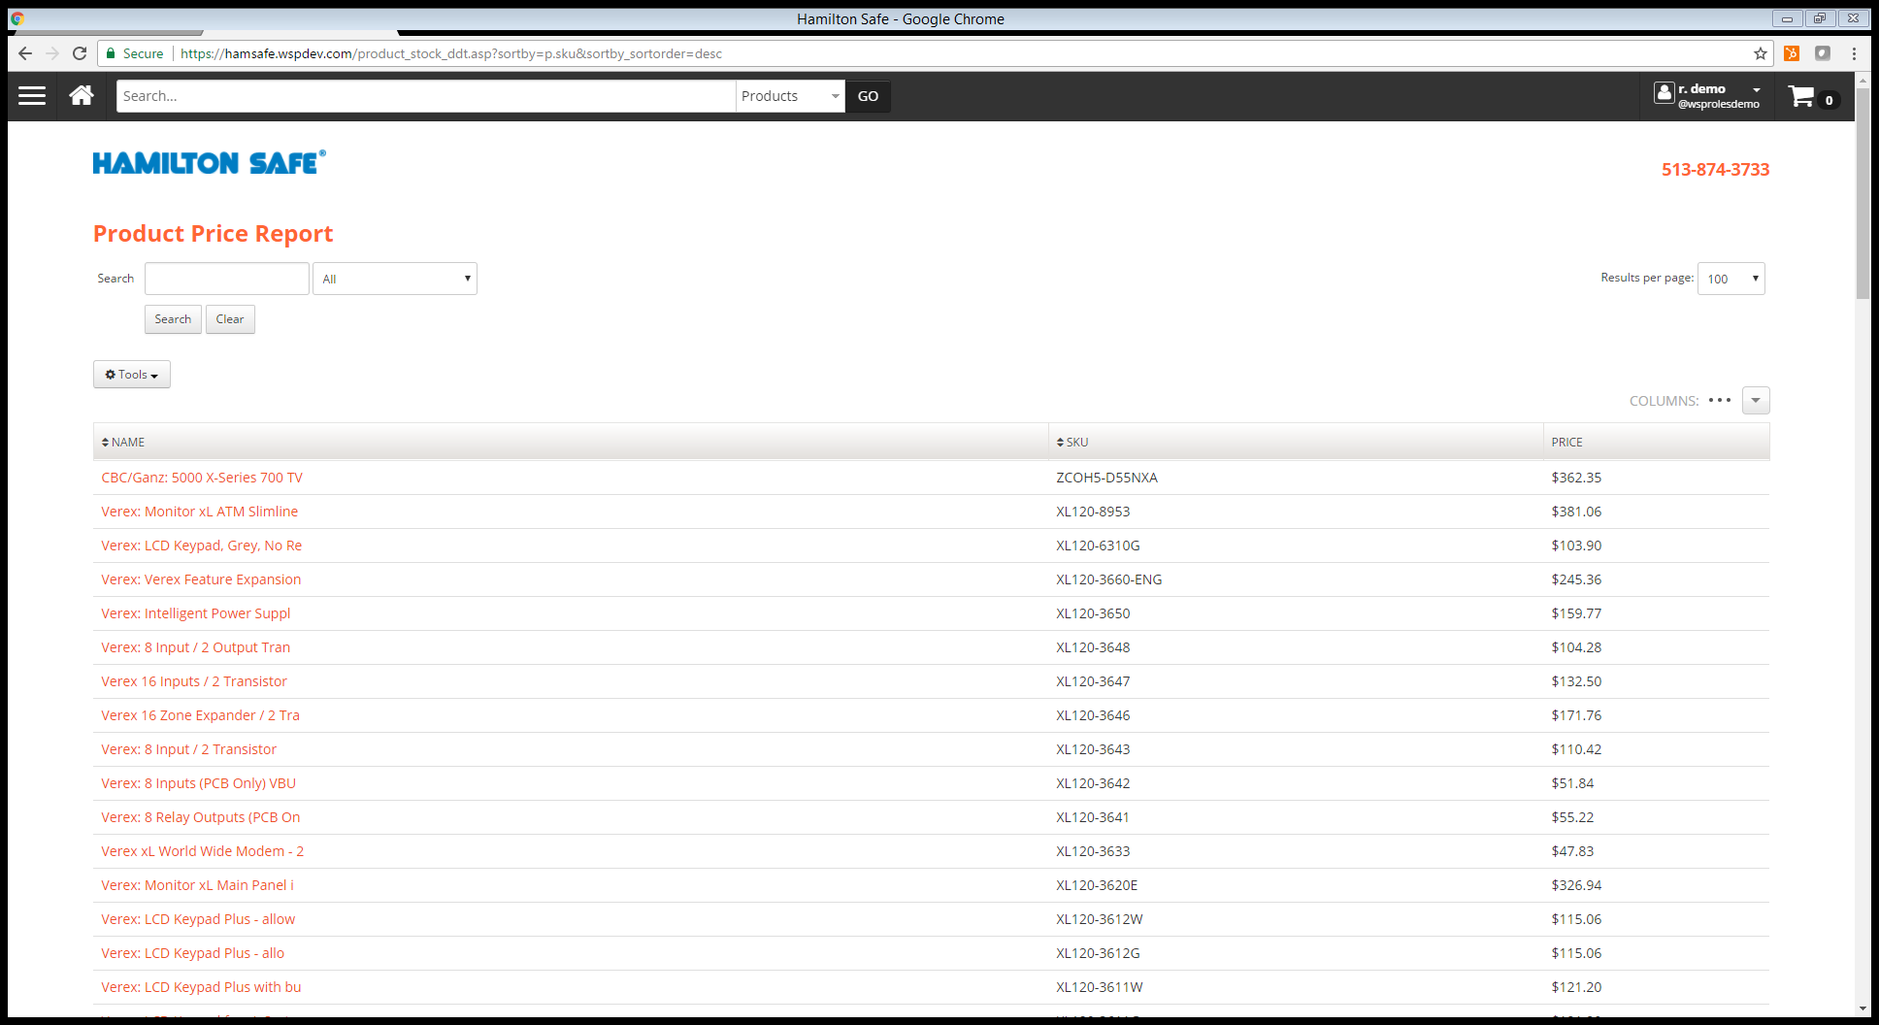
Price List

Slide 14
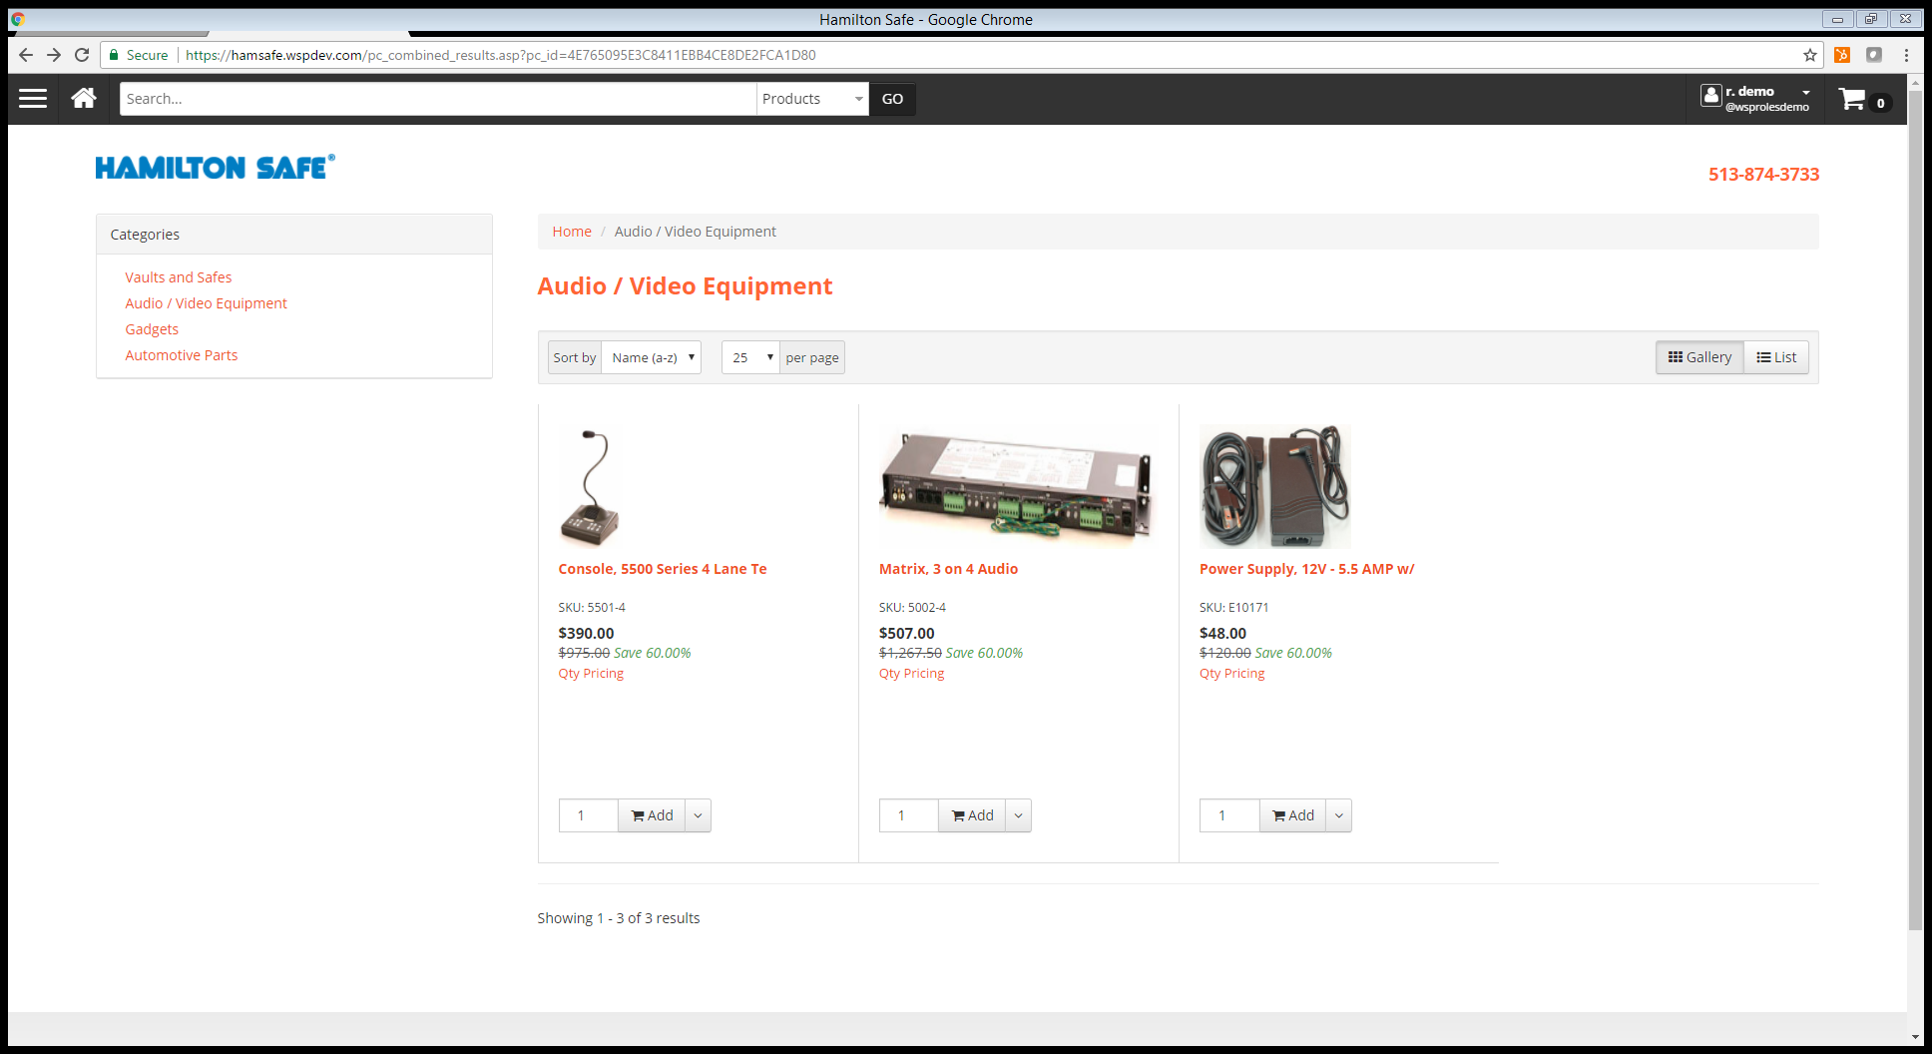
Search by Category

Slide 15
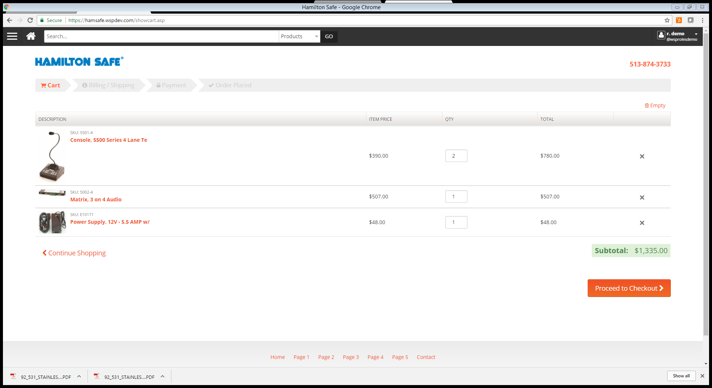
Shopping Cart Review

Slide 16
Questions

Slide 17
Webinar
Intro to the New Portal
July 11, 2017
12:00 pm – 1:00 pm EST
Invitation to come

Slide 18
Recognition

Slide 19
25 Year Club
Allied Fire & Security Bancare, Inc.
Brown Bank Federal Protection
Convergint – Dakota Security Hamilton Safe & Security
Hamilton Safe International Hamilton Safe Products
Hamilton Vaultronics Hunt Enterprises
Midwest Security Monday Security
Oppliger Banking Systems Convergint – Post Browning
Premier Security Rockford Tech Systems
Red Hawk (CA, NY) SEICO Security
Southeast Banking Systems SPC Companies
Wittenbach Business Systems

