Slide 1
Safe and Vaults – Todd Lefevers

Slide 2
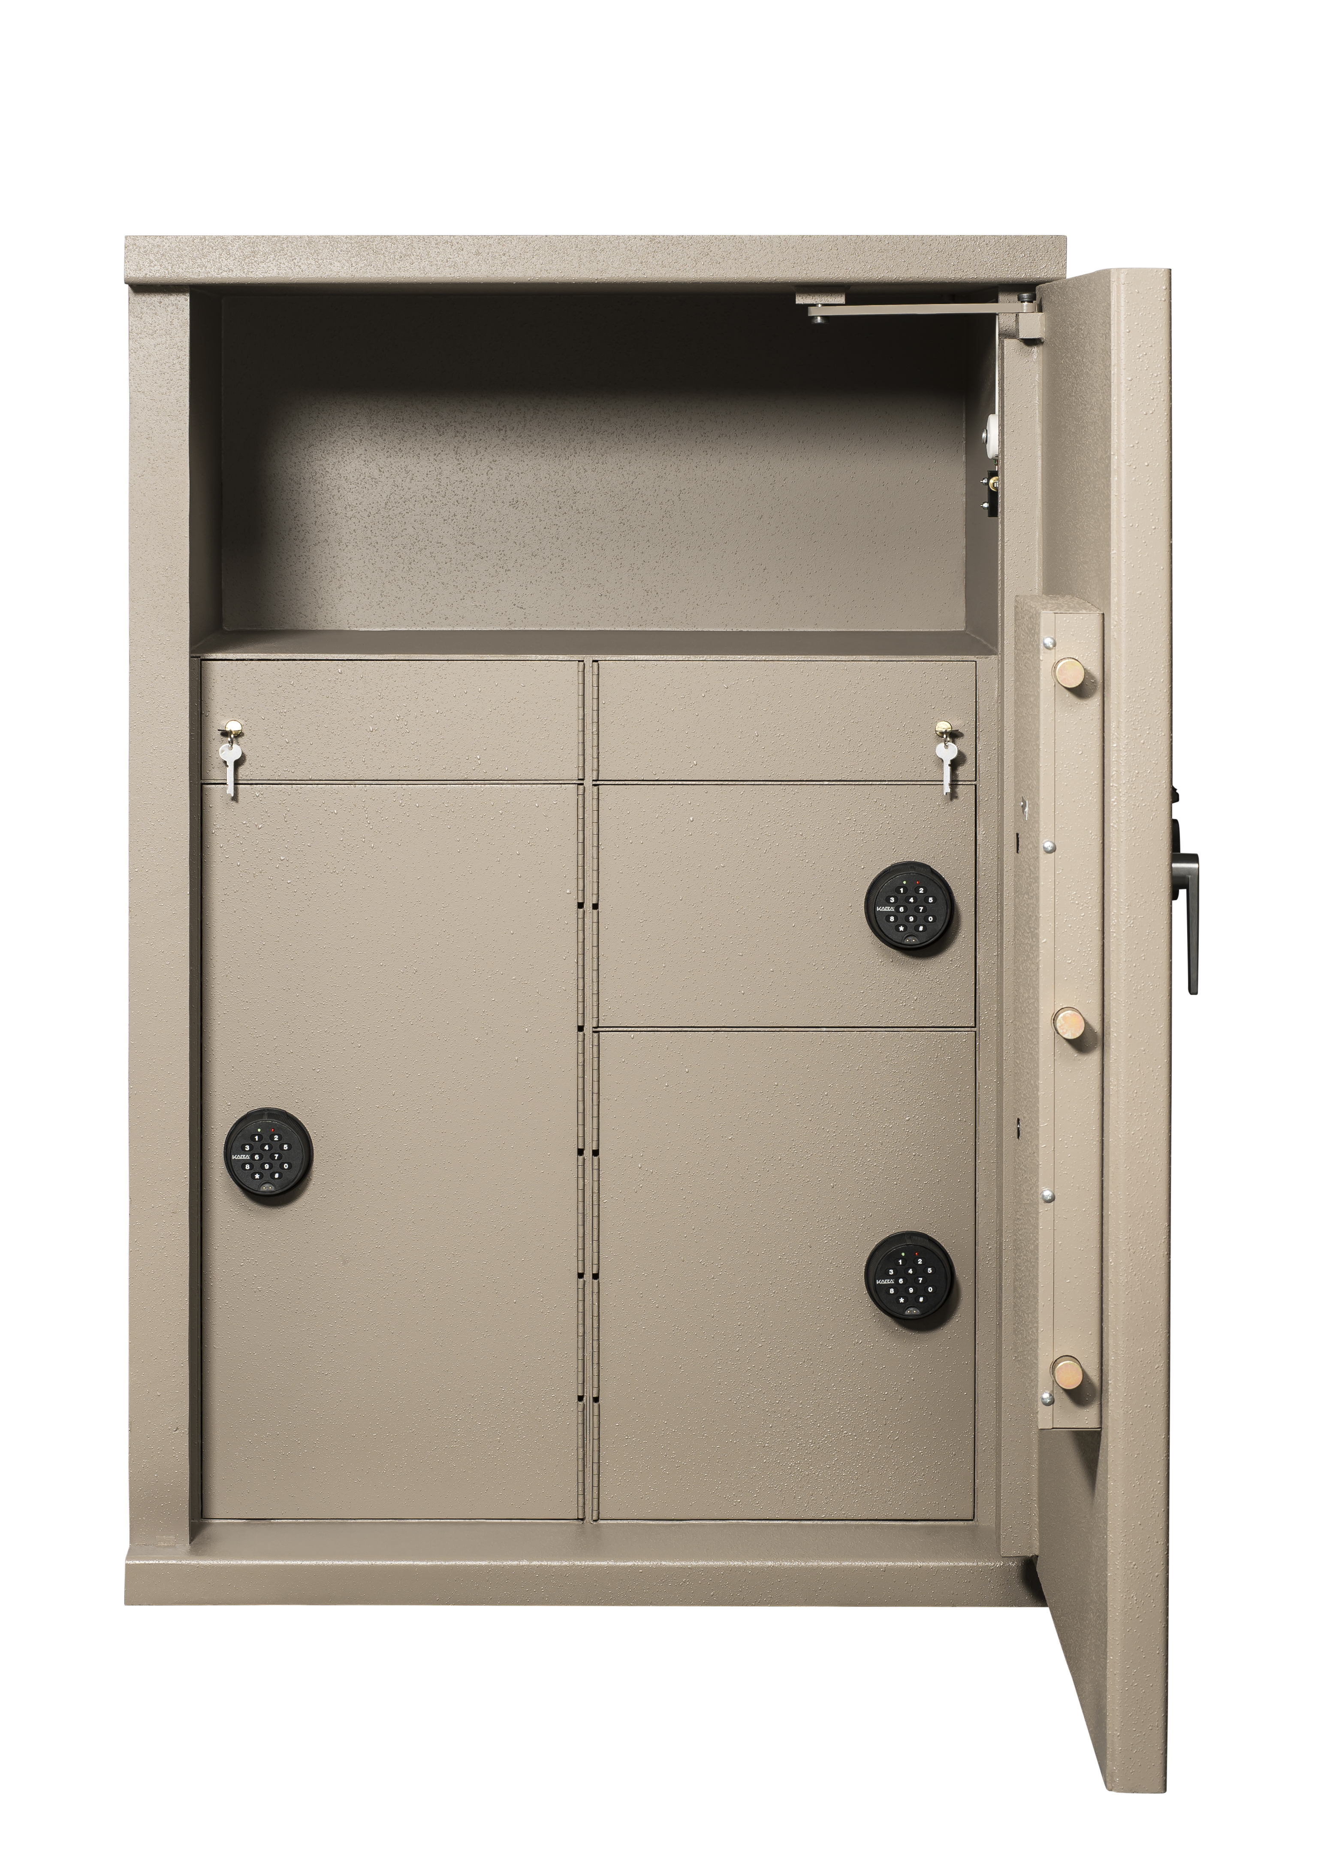
UL Labels currently Available
TL-15 Steel and Composite
TL-30 Steel and Composite
TL-30X6 Composite
TRTL-30 Composite
TRTL-30X6 Composite
UL-291 – 24 Hour Steel
B-Rated Safes (Non-UL Listed)

Slide 3
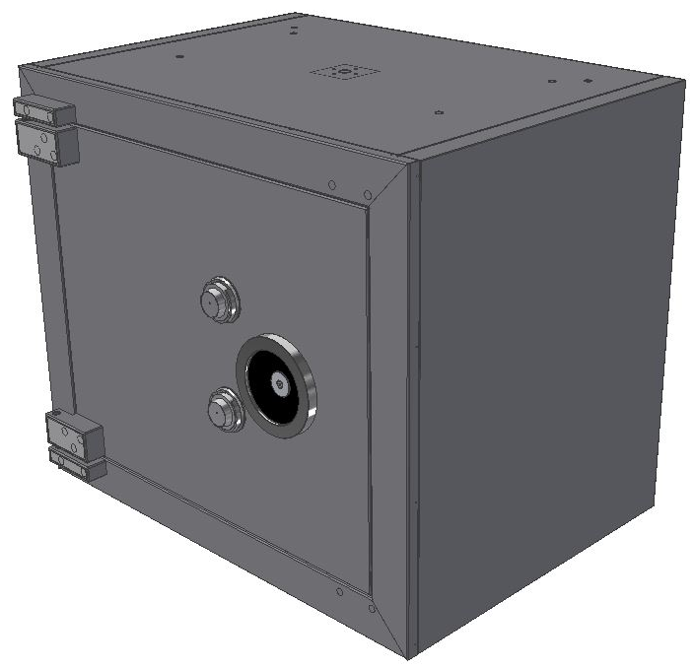
TRTL-30 x 6 Safe Retested 2017
10 % Thickness reductions went from 5” to 4 ½” thick walls
10 % Weight savings
New aesthetically pleasing hinge design common on all composite safes
New body design is also better looking and is common on all composite safes

Slide 4
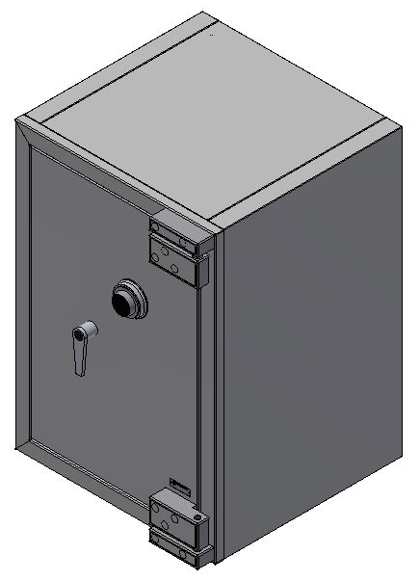
TL-15, TL-30, and TL-30x6 Composite Safes
The doors are changing from full width to inside the body
Composite safes are getting a full steel back
New aesthetically pleasing hinge design common on all composite safes
New body design is also better looking and is common on all composite safes

Slide 5
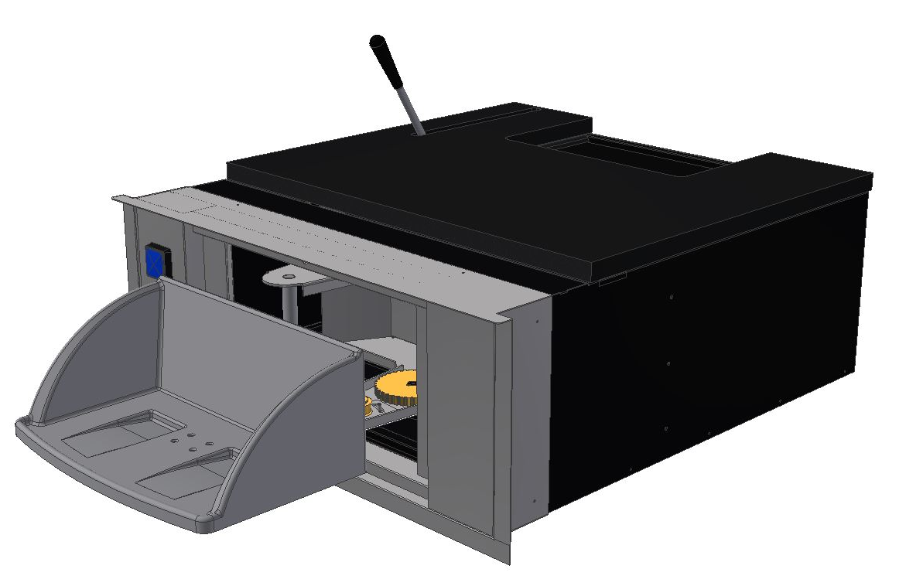
Pharmacy Drawer 2017
Manual operation
Highly visible “PUSH FOR SERVICE” button
Currently being cycled tested
Design is based on the 400DD proven design
Innovation includes easy to change belt design
Larger capacity drawer between the 400DD and DCD-18

Slide 6
Entrance Control System
Benefits
Keeps out the weapons…helps prevent takeover robberies!
Pro-active approach over other security methods
Acts as a deterrent for most criminals
Provides a safe environment
Promotes associate and customer peace of mind – enhances their safety
Can help reduce associate turnover
ROI – Easy payback

Slide 7
Tablet Main User Interface

Slide 8
Security Vestibule Tablet Advantages
Replaces the existing ECS touch-screen monitoring unit and separate audio-only system with the following:
Mobile tablet solution (multiple tablets per installation)
Integrated Audio and in-bound Video (V2IP lane module at the vestibule with camera)
Vestibule Manager not Restricted to a Single Location (Mobile Platform)
Detailed Audit Trail Logs of Tablet Interaction
CAT-5 Wiring
Ease of Software Upgrades

Slide 9
Aluminum ECS

Slide 10
Why Aluminum
Aluminum provides a softer, more appealing storefront façade
Can easily match existing storefront colors and design for better customer appeal
The versatility of aluminum storefront allows us to customize the size to suit your customer’s needs
Miami-Dade Hurricane rated storefront and custom sizes available for Hurricane zones
Aluminum cabins are easier to install and service due to the control box unit being repositioned for possible remote installation

Slide 11
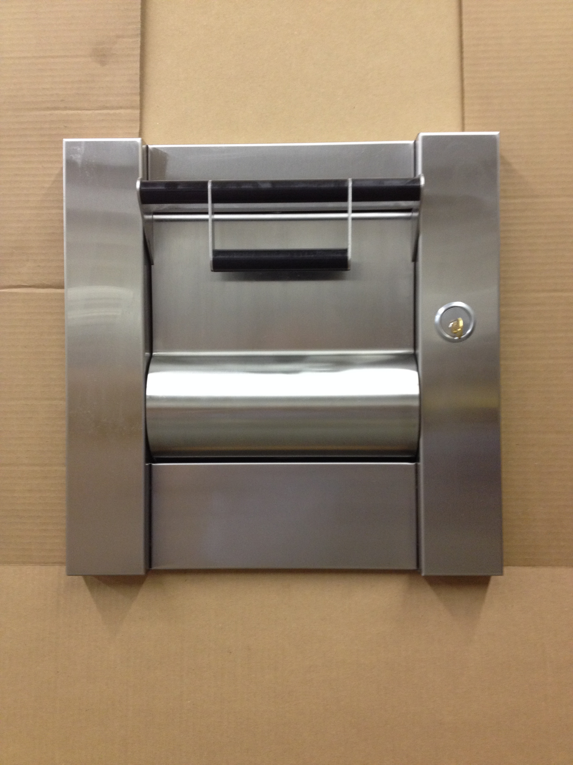
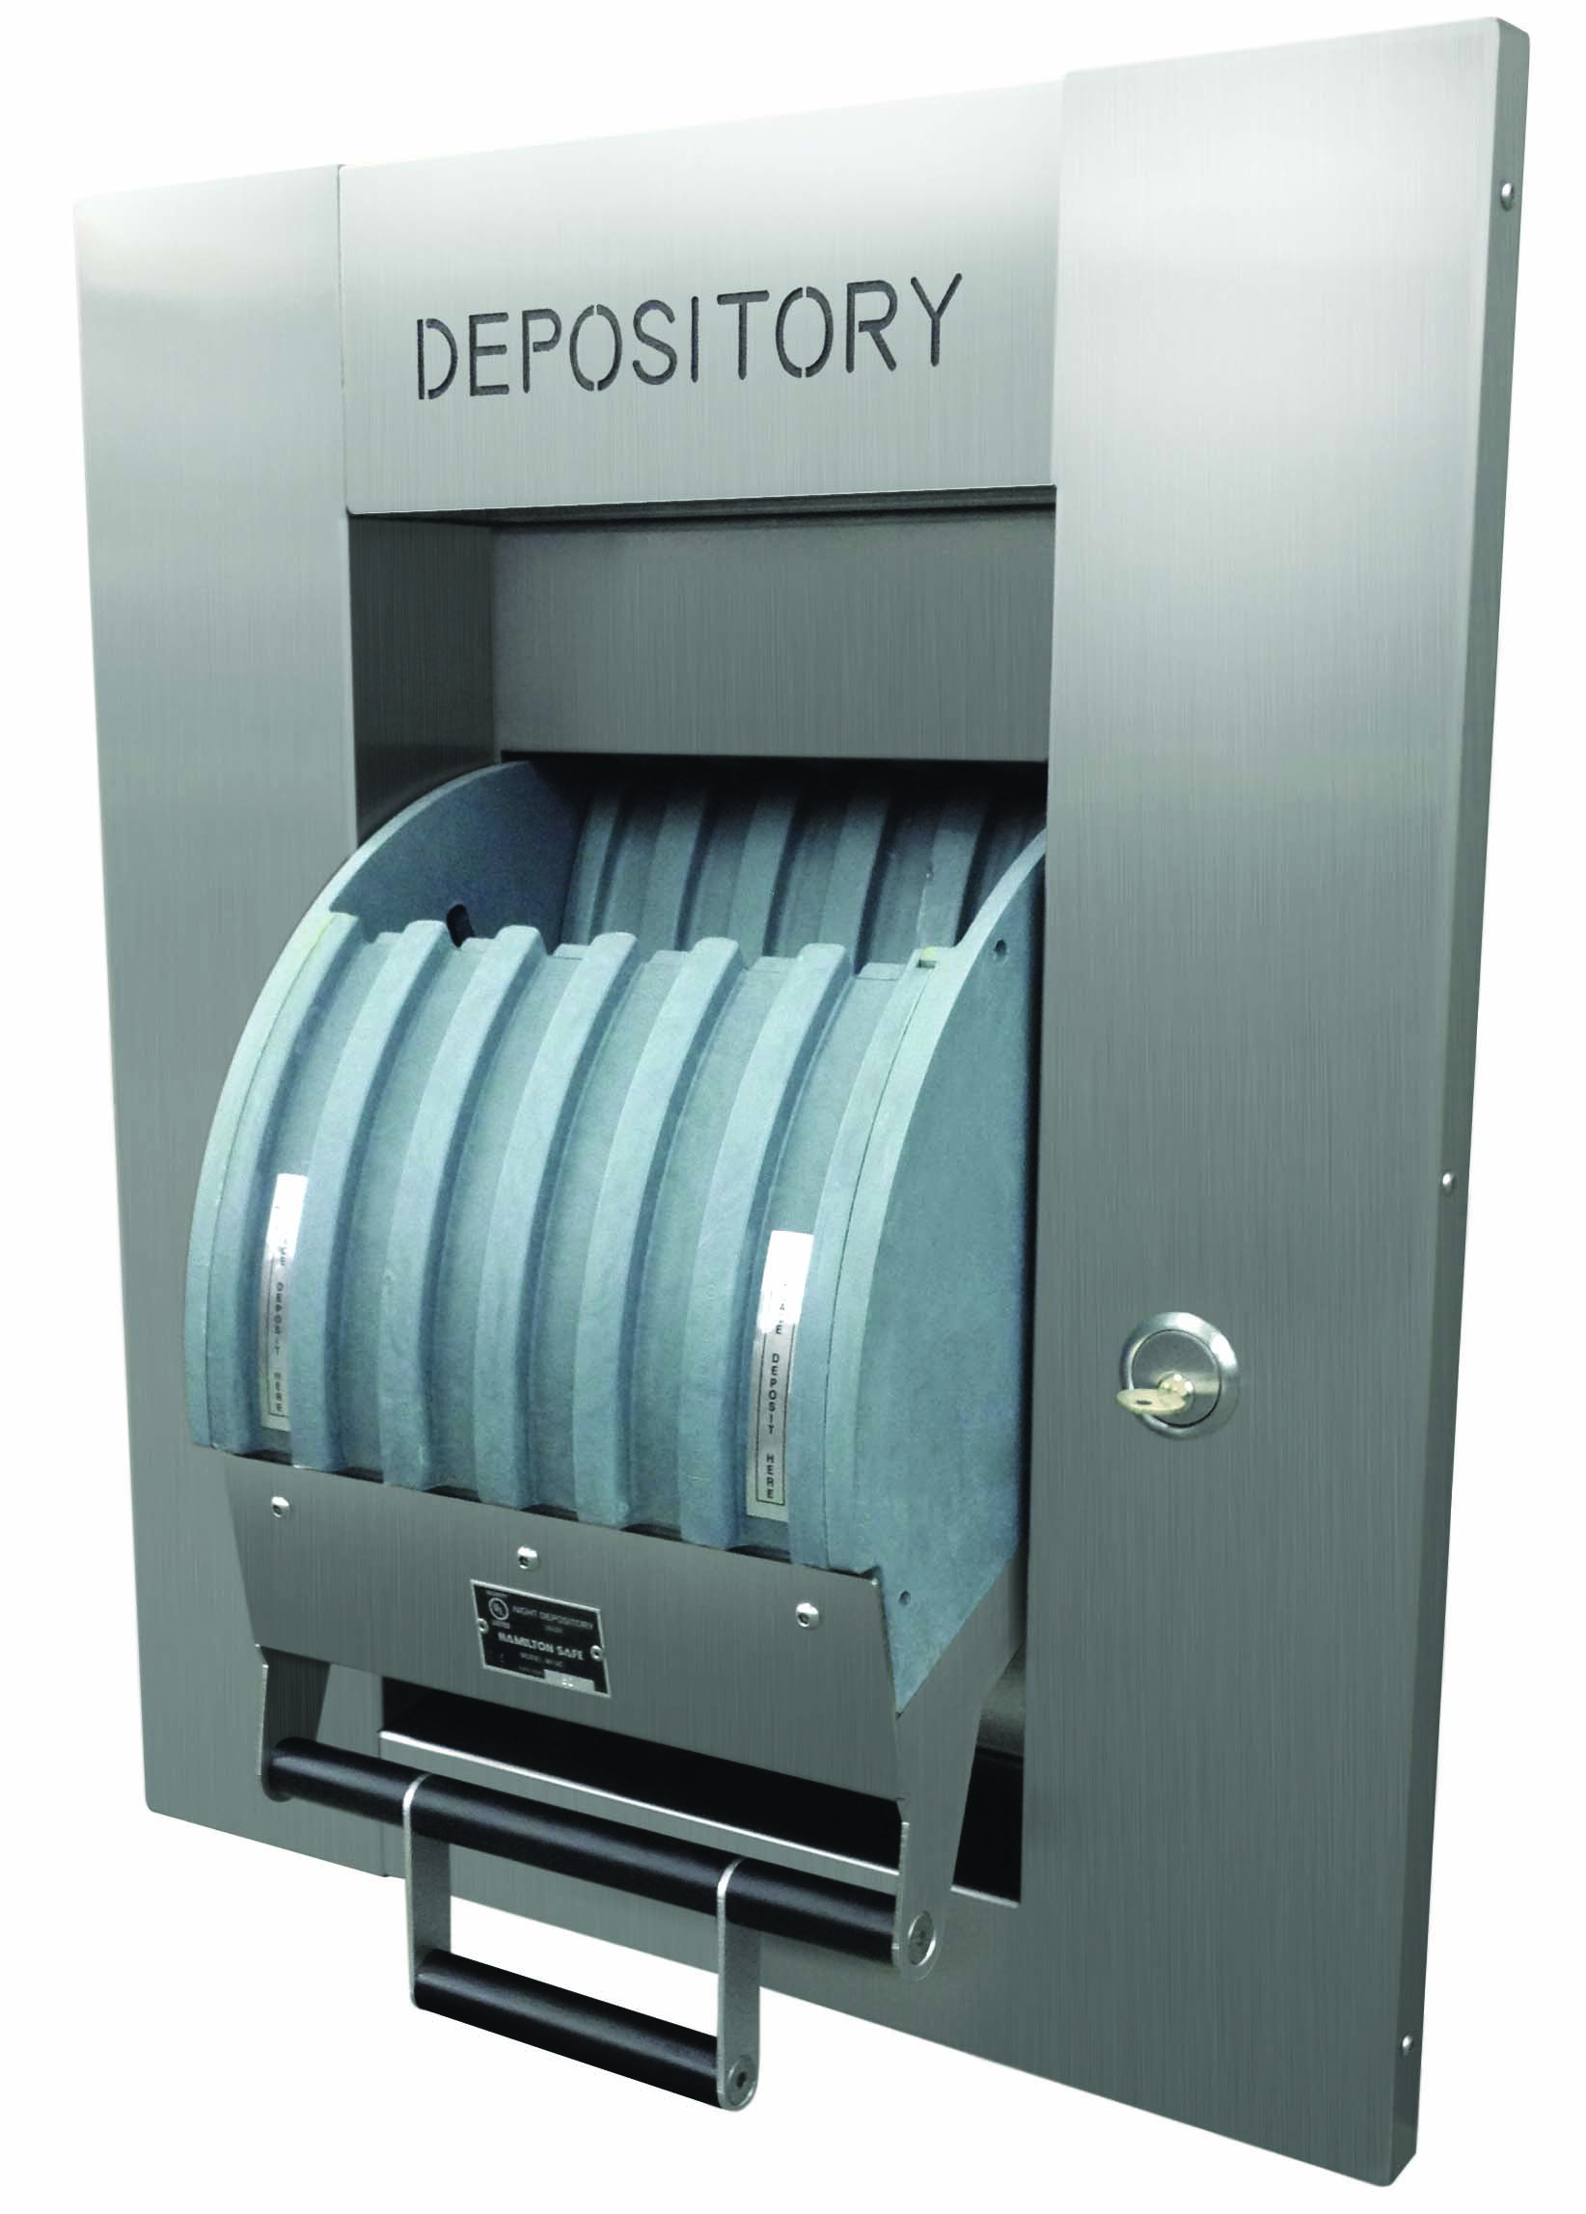
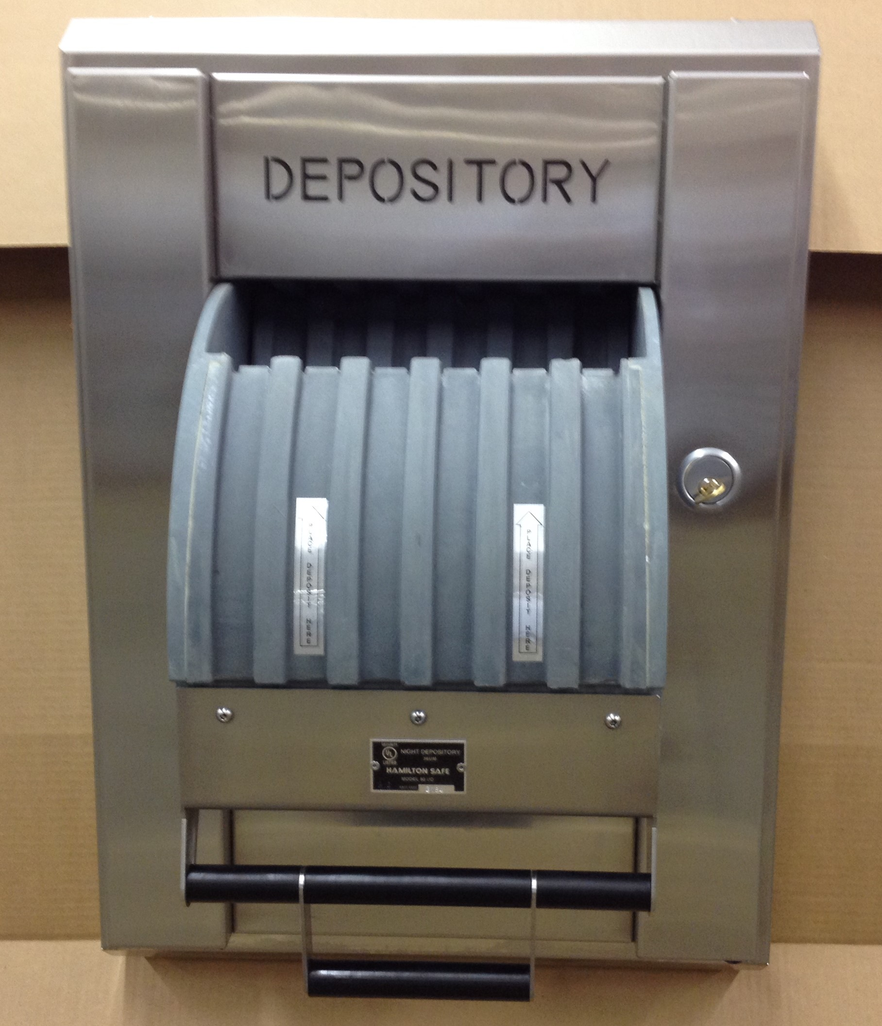
Hamilton UL Listed Night Depository Line
98RH FLAT FACE
80UC
98RH

Slide 12
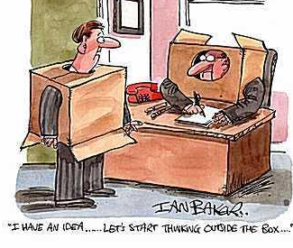
Custom Is What Hamilton Does!

Slide 13
Drive Up – Bill Detherage

Slide 14
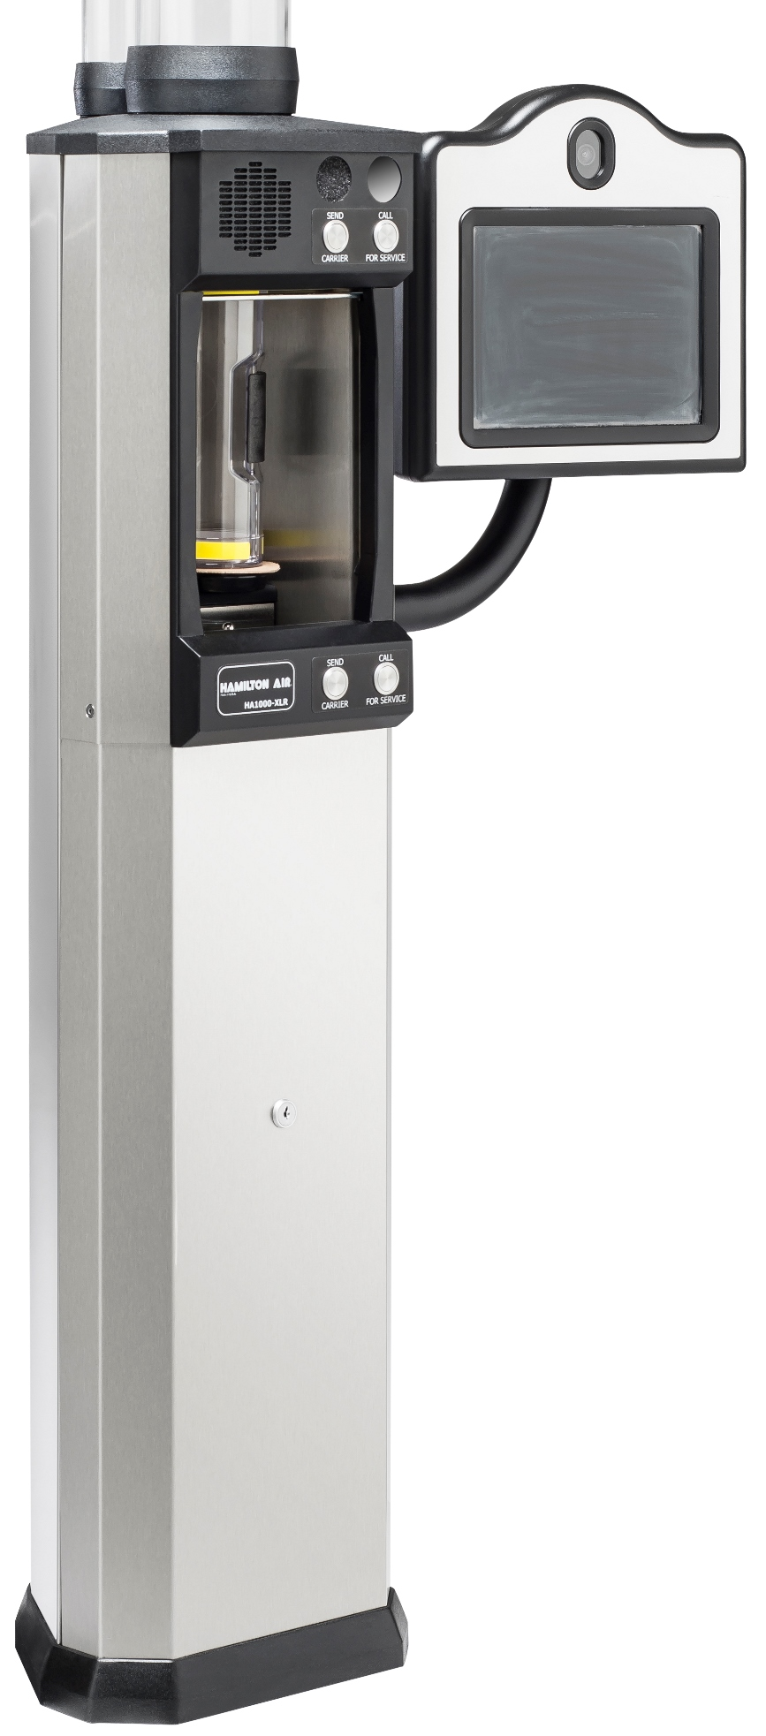
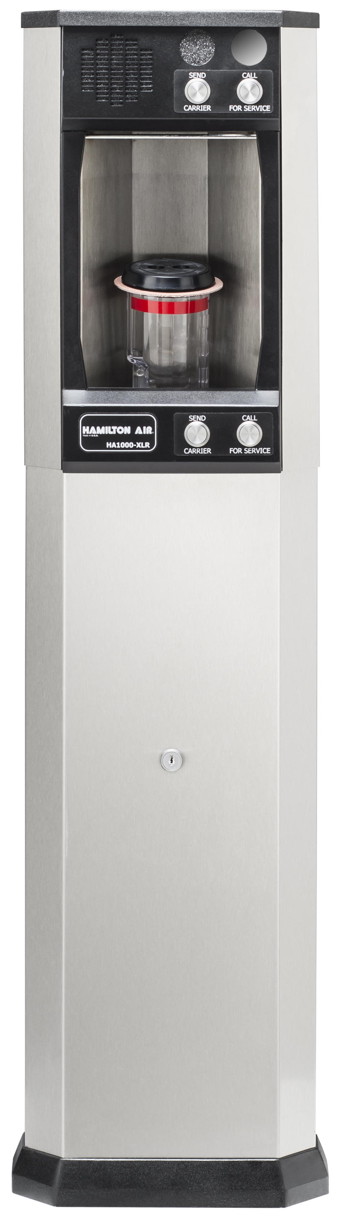
XLRD – 4.5” Underground tubing
Drive-up
Complete lineup of systems
HA33 – 10” Overhead tubing
HA47 – 4”x7” Overhead tubing
XLR – 4.5” Overhead tubing

Slide 15
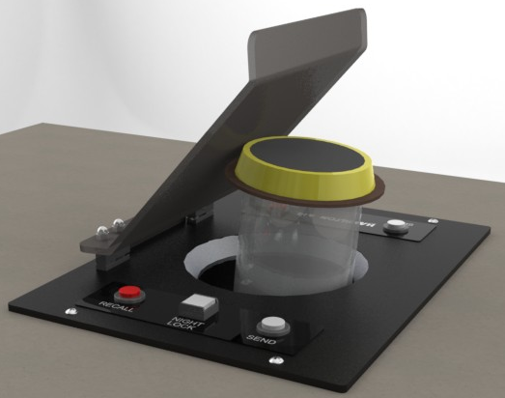
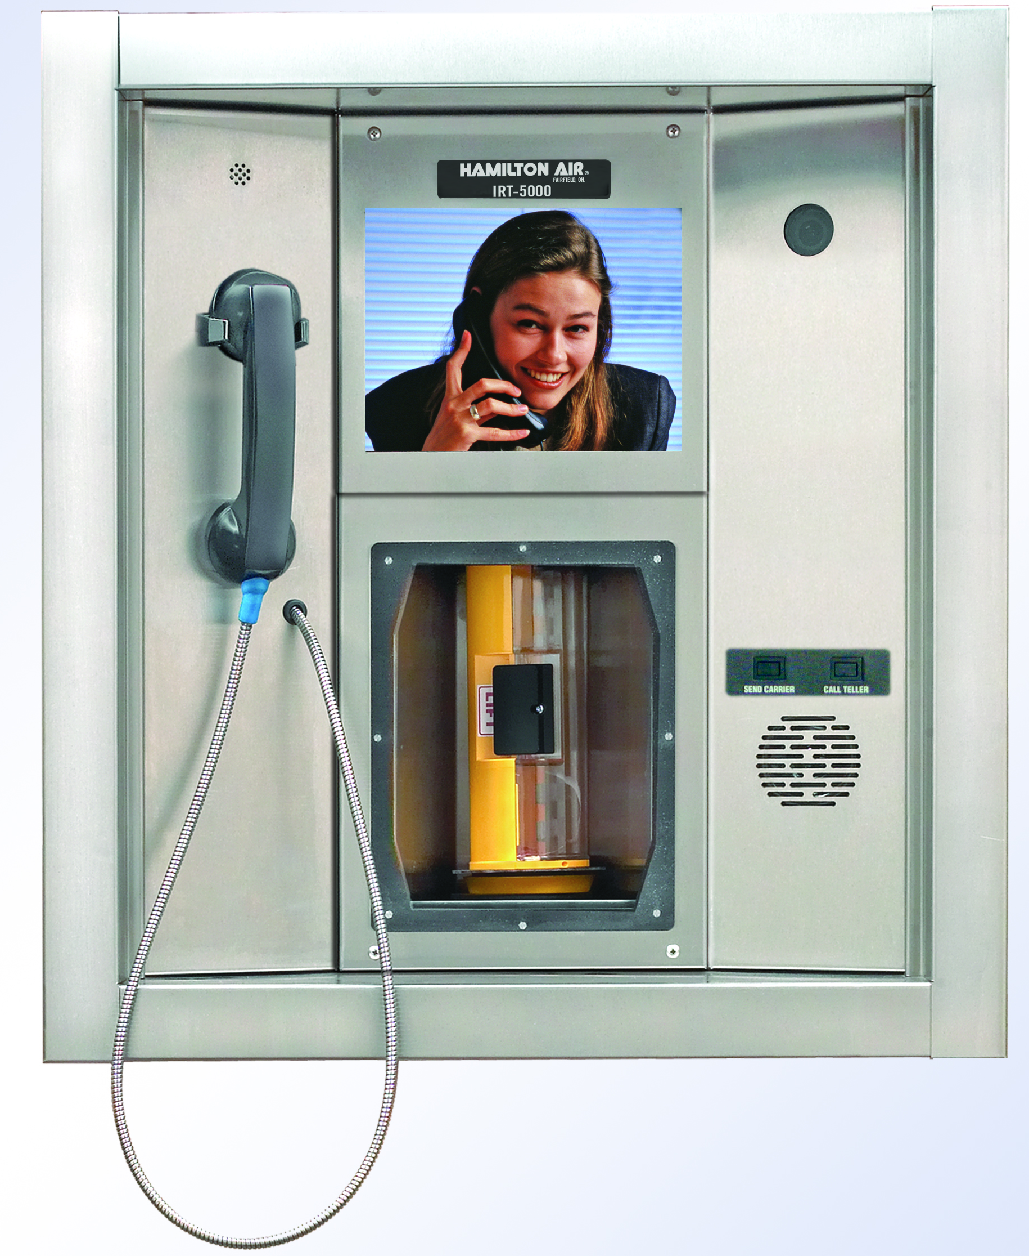
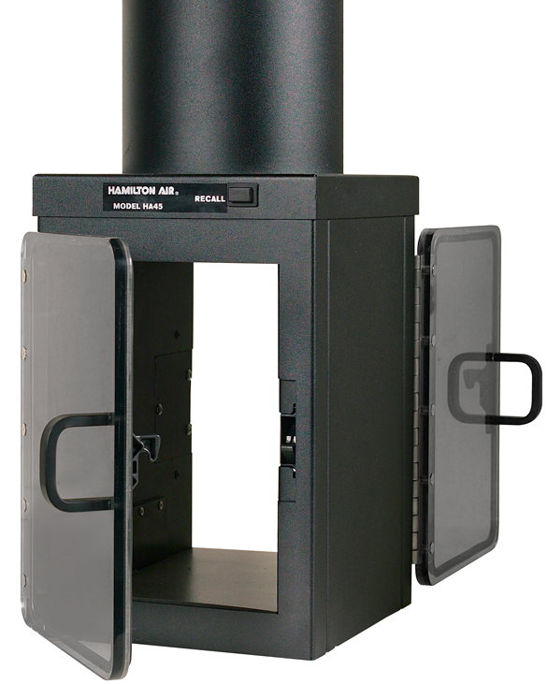
4.5” Through Counter
Drive-up
Specialty units
4.5” Standard OH
HA33 – 10” Overhead tubing
IRT5000 Unit & Kiosk
4.5” Double-Sided

Slide 16
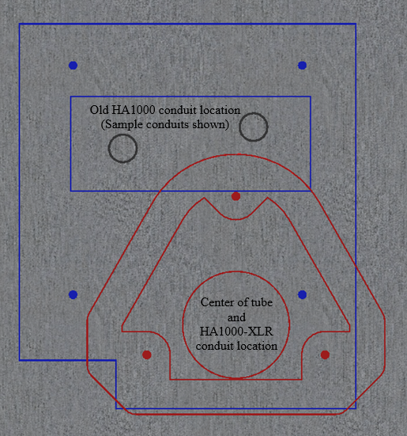
Drive-up Replacement lanes
4”, 4.5”, 4”x7”, 8”, & 10” tube sizes
HA1000-XLR Riser / Adapter
Overhead and Underground replacements

Slide 17
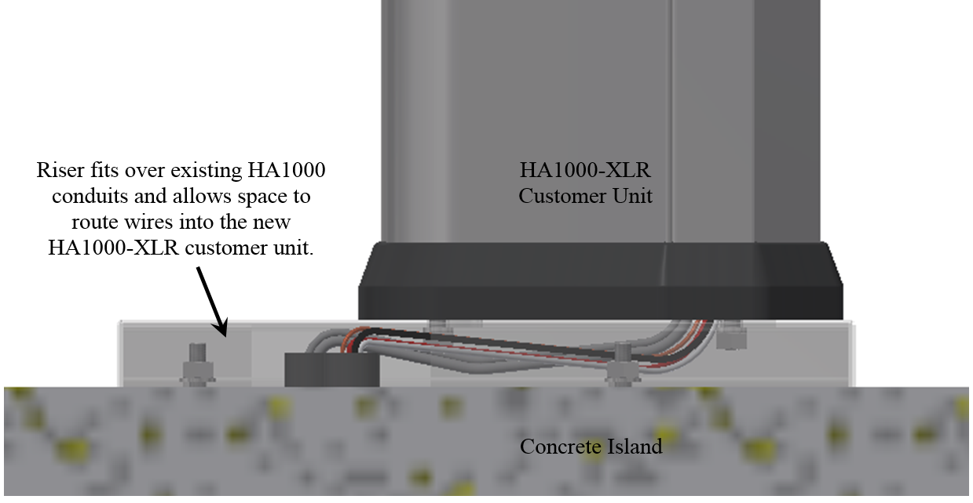
Drive-up
HA1000-XLR Riser / Adapter
Overhead and Underground replacements

Slide 18
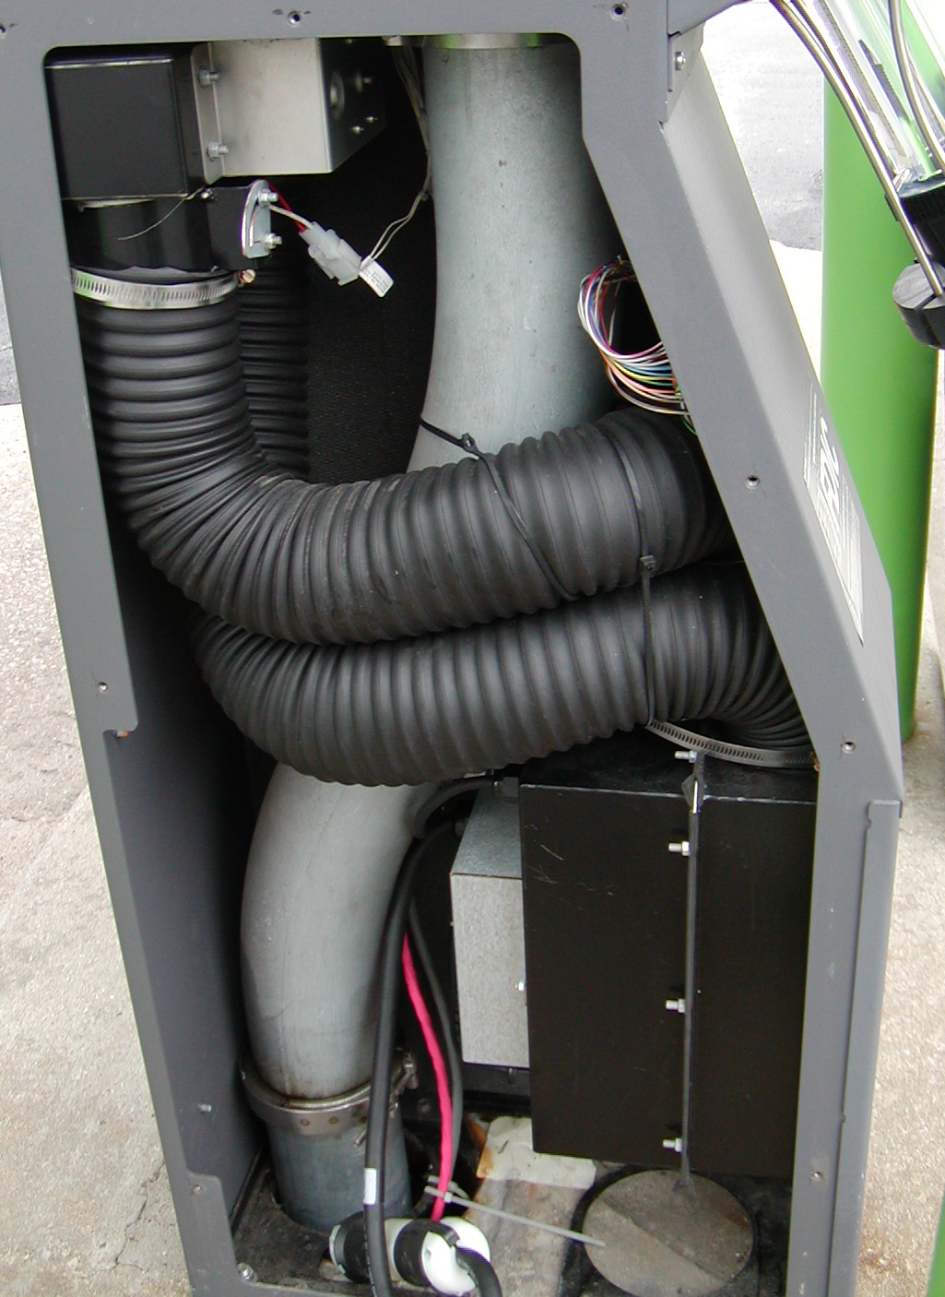
Measure the existing tube locations!!

Slide 19
Drive up
New items coming soon
Testing next generation controls
Simplify wiring
Integrate “Airflow” option
Multi-colored LEDs
7-segment display
Can-bus connectivity
HA1000-XLR
LED pushbuttons
Testing new door position switches
Testing new door safety sensors

Slide 20
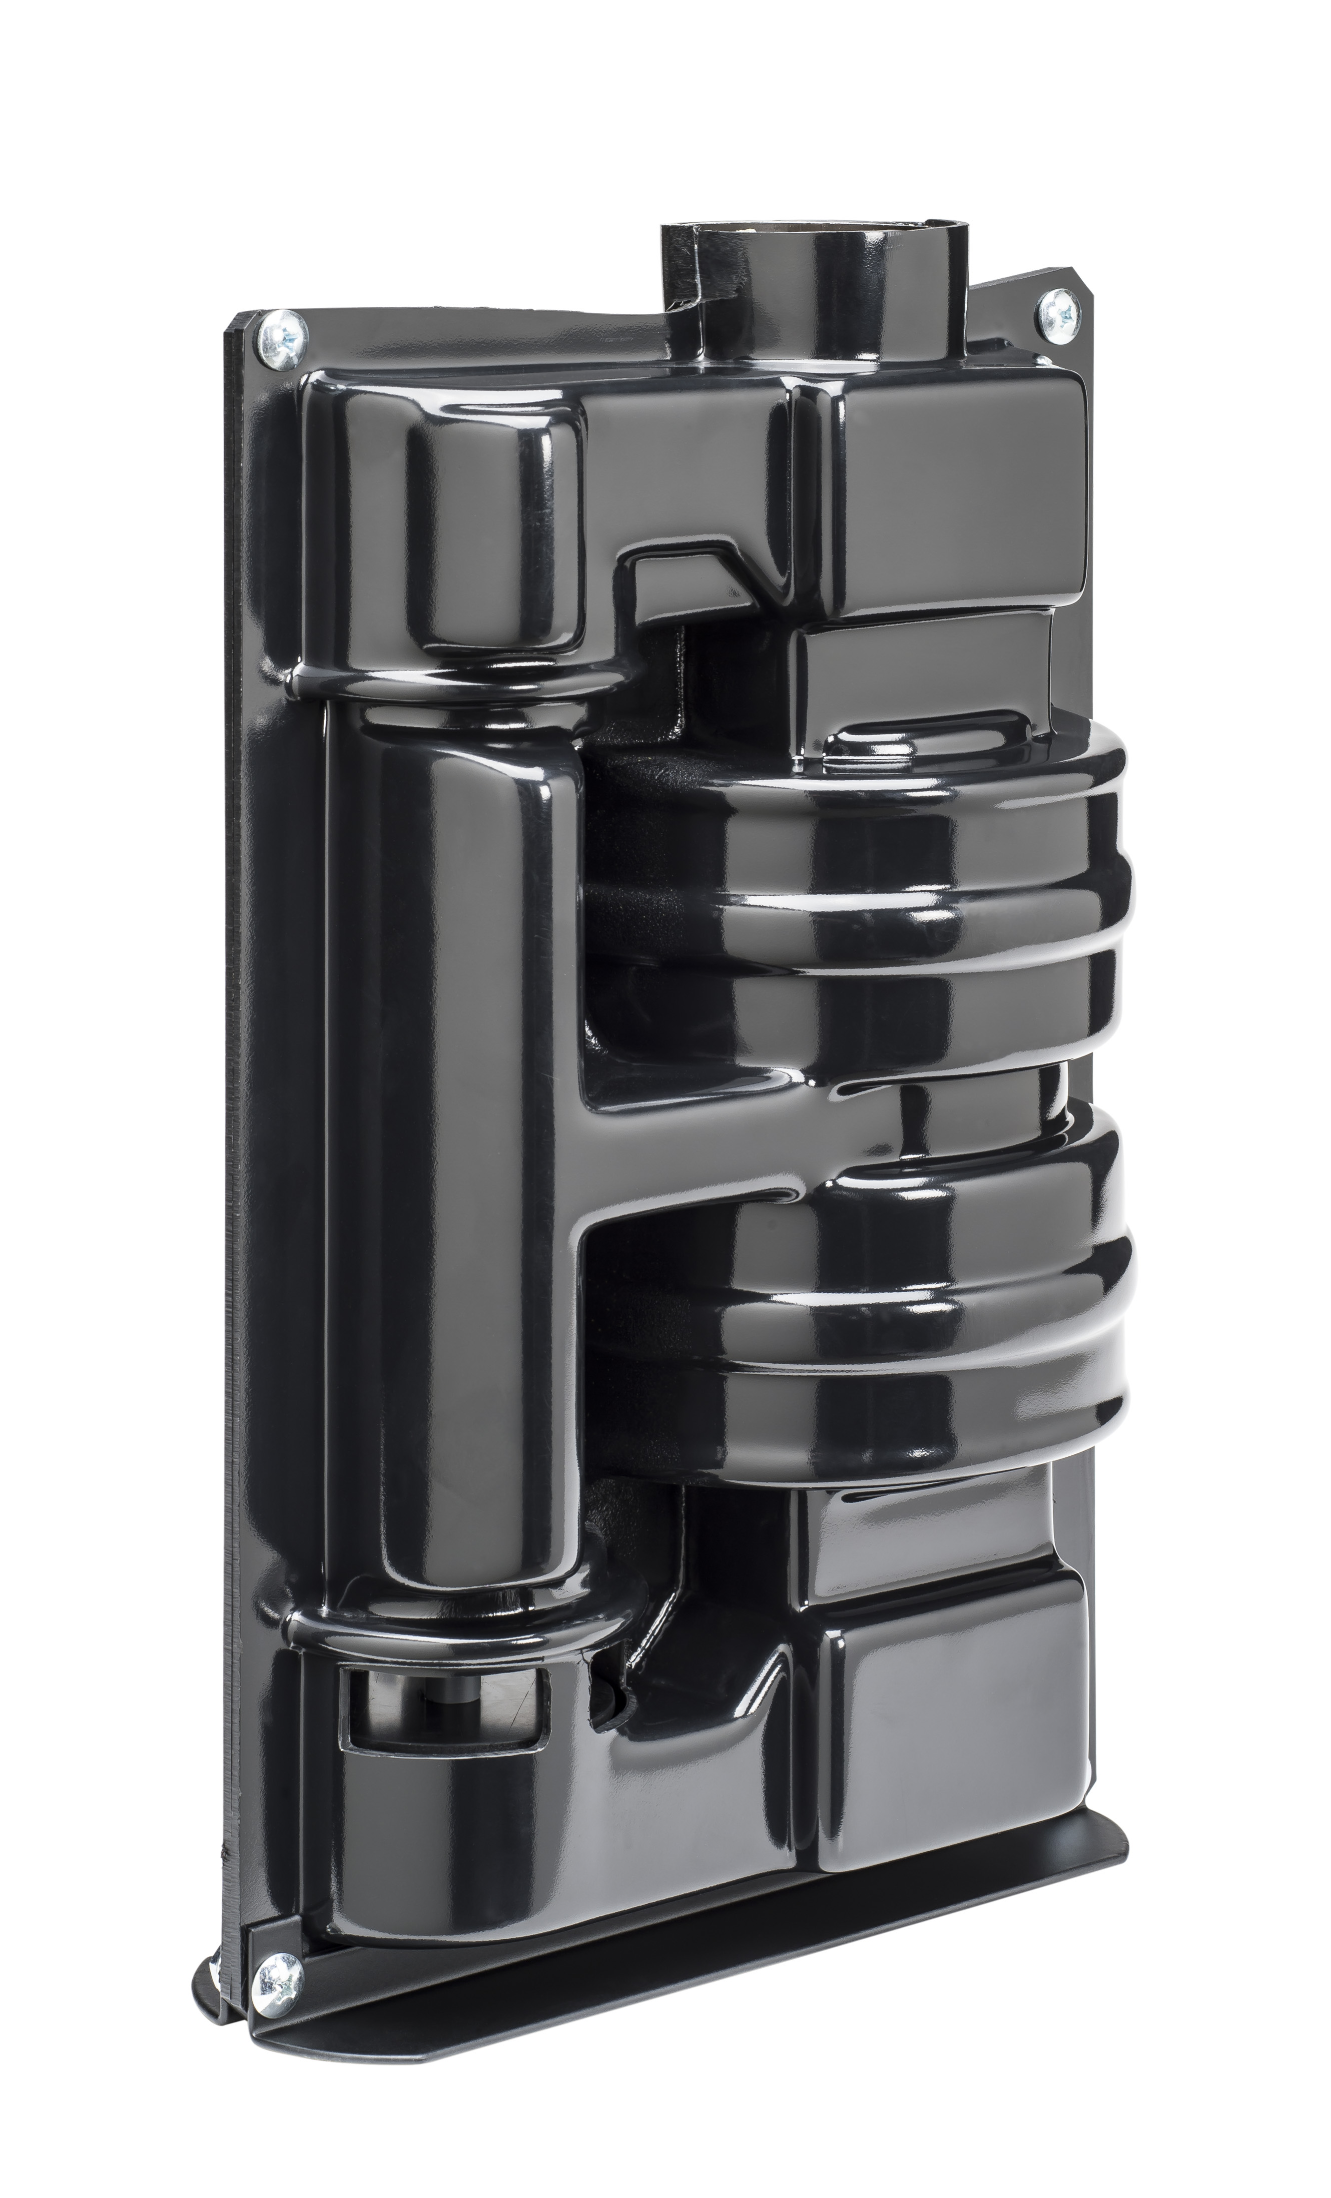
New items continued
Down Send Teller (DST)
Testing prototype design
HA33 turbine
Multi-pack design

