Slide 1
National Accounts – Steve Zamagias

Slide 2
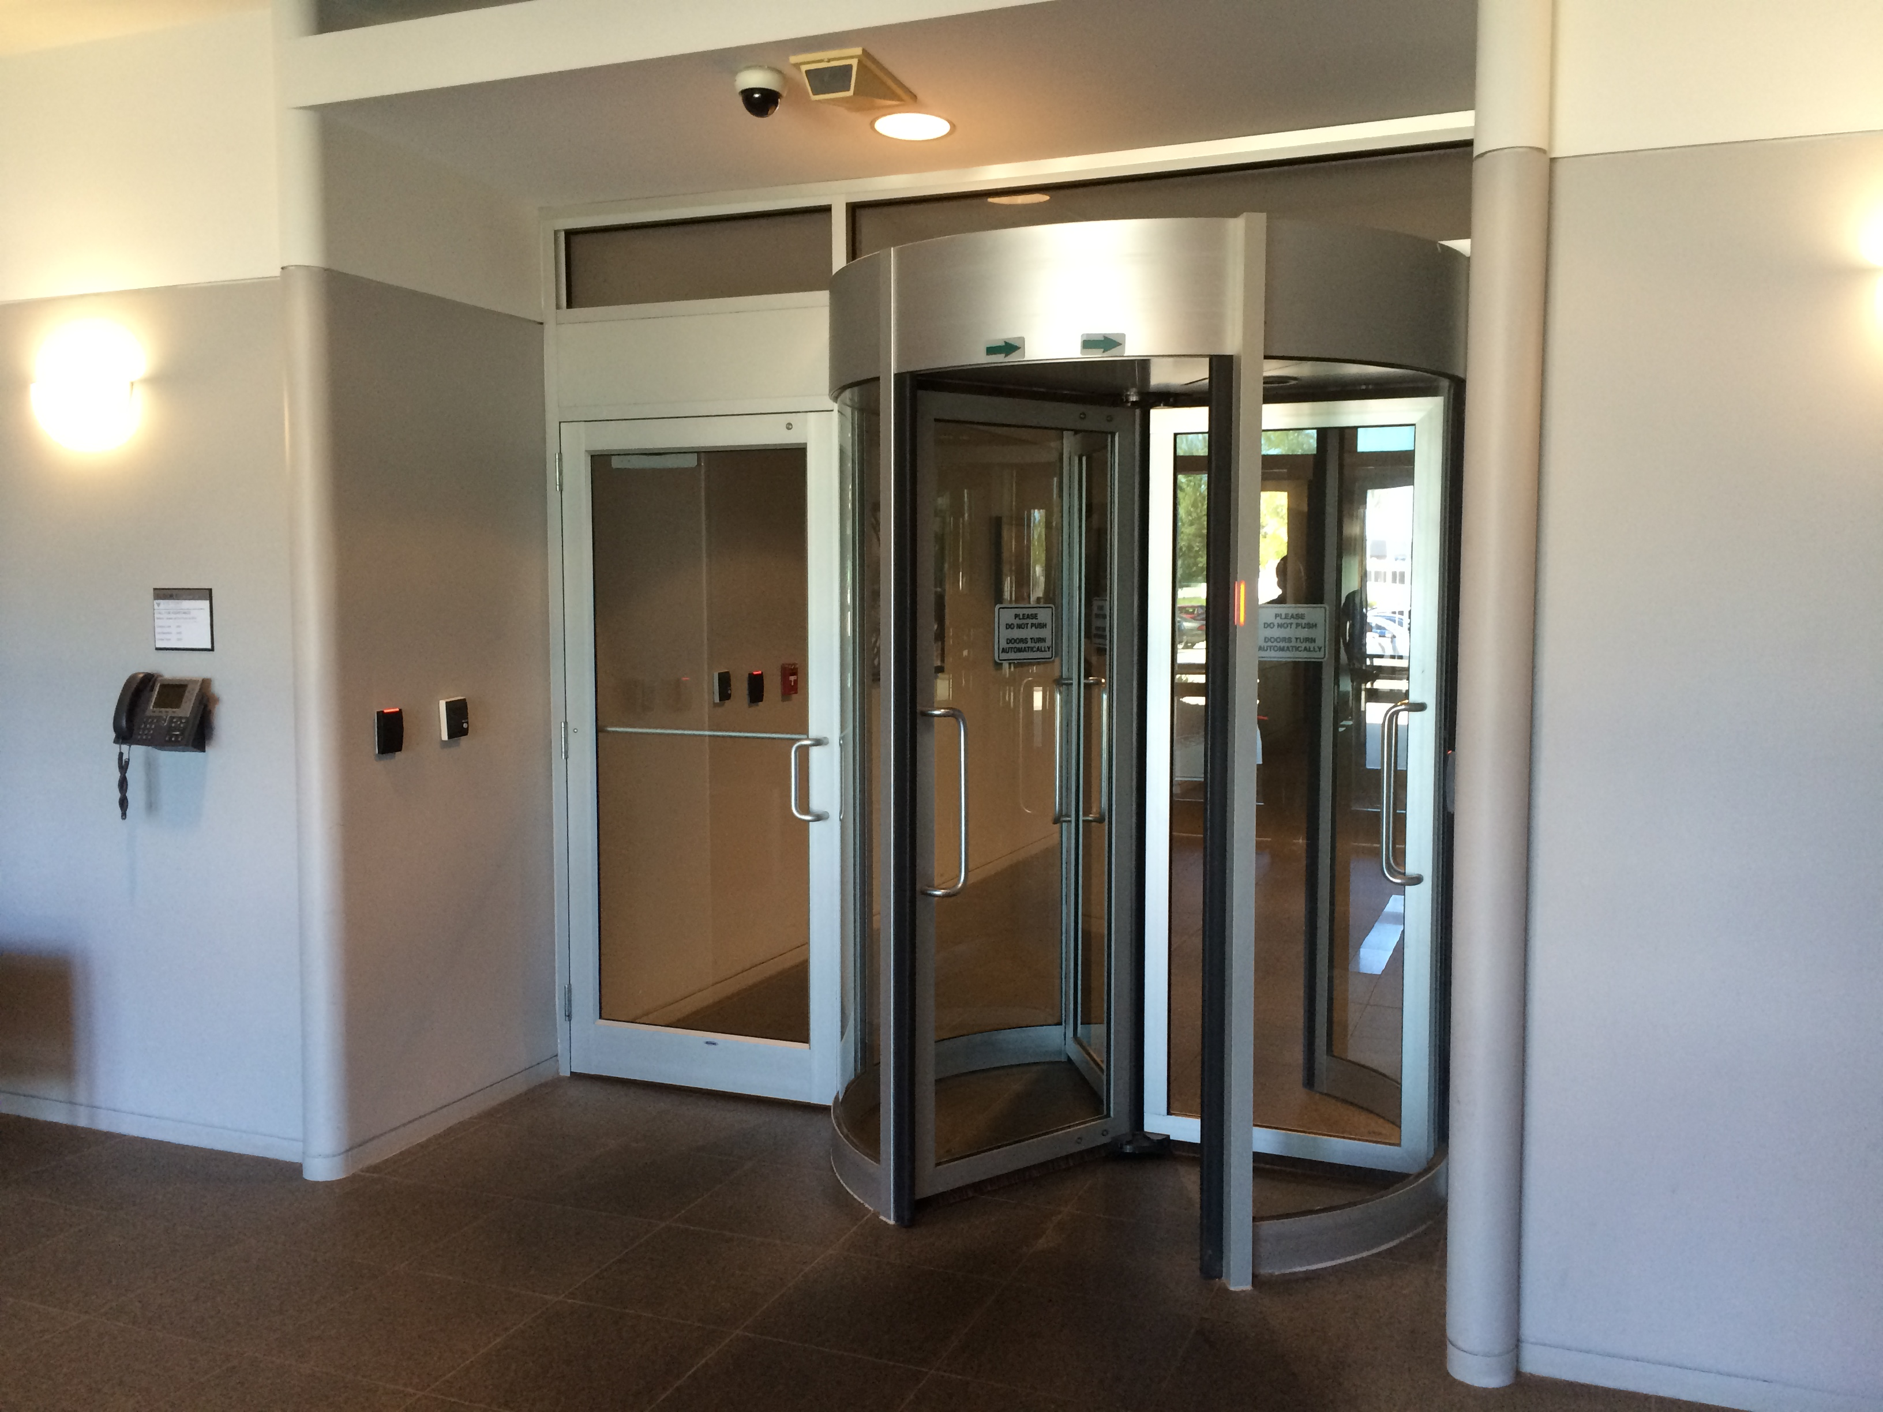
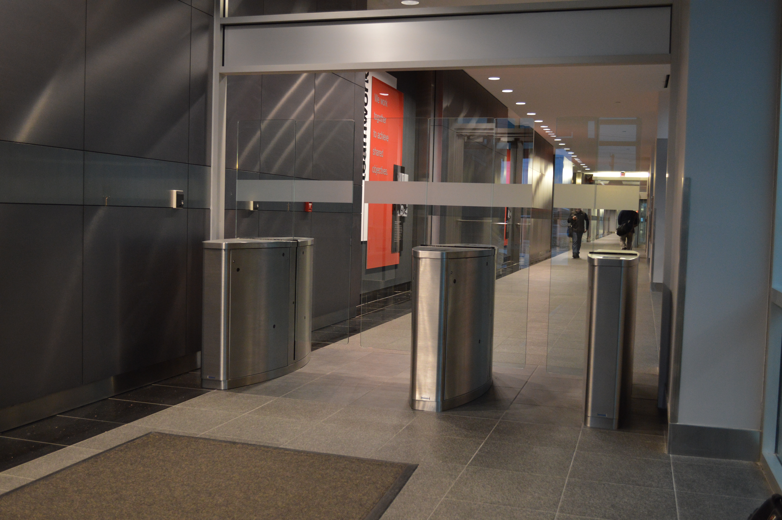
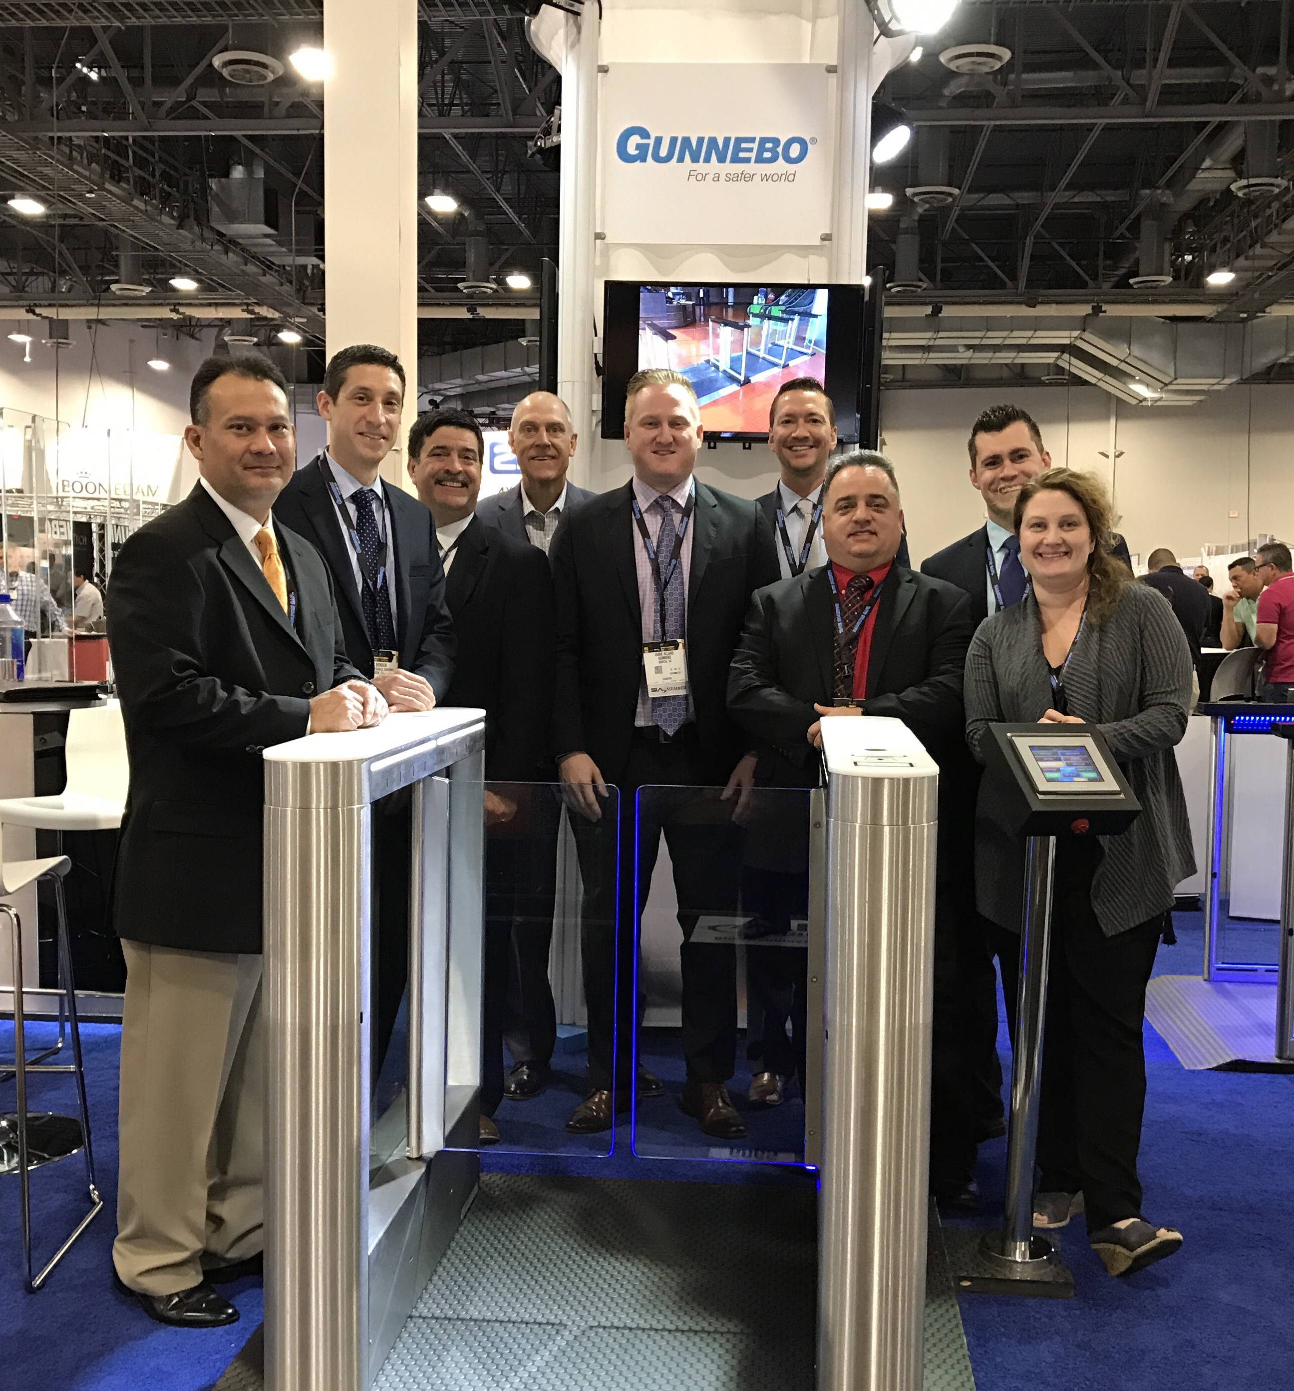
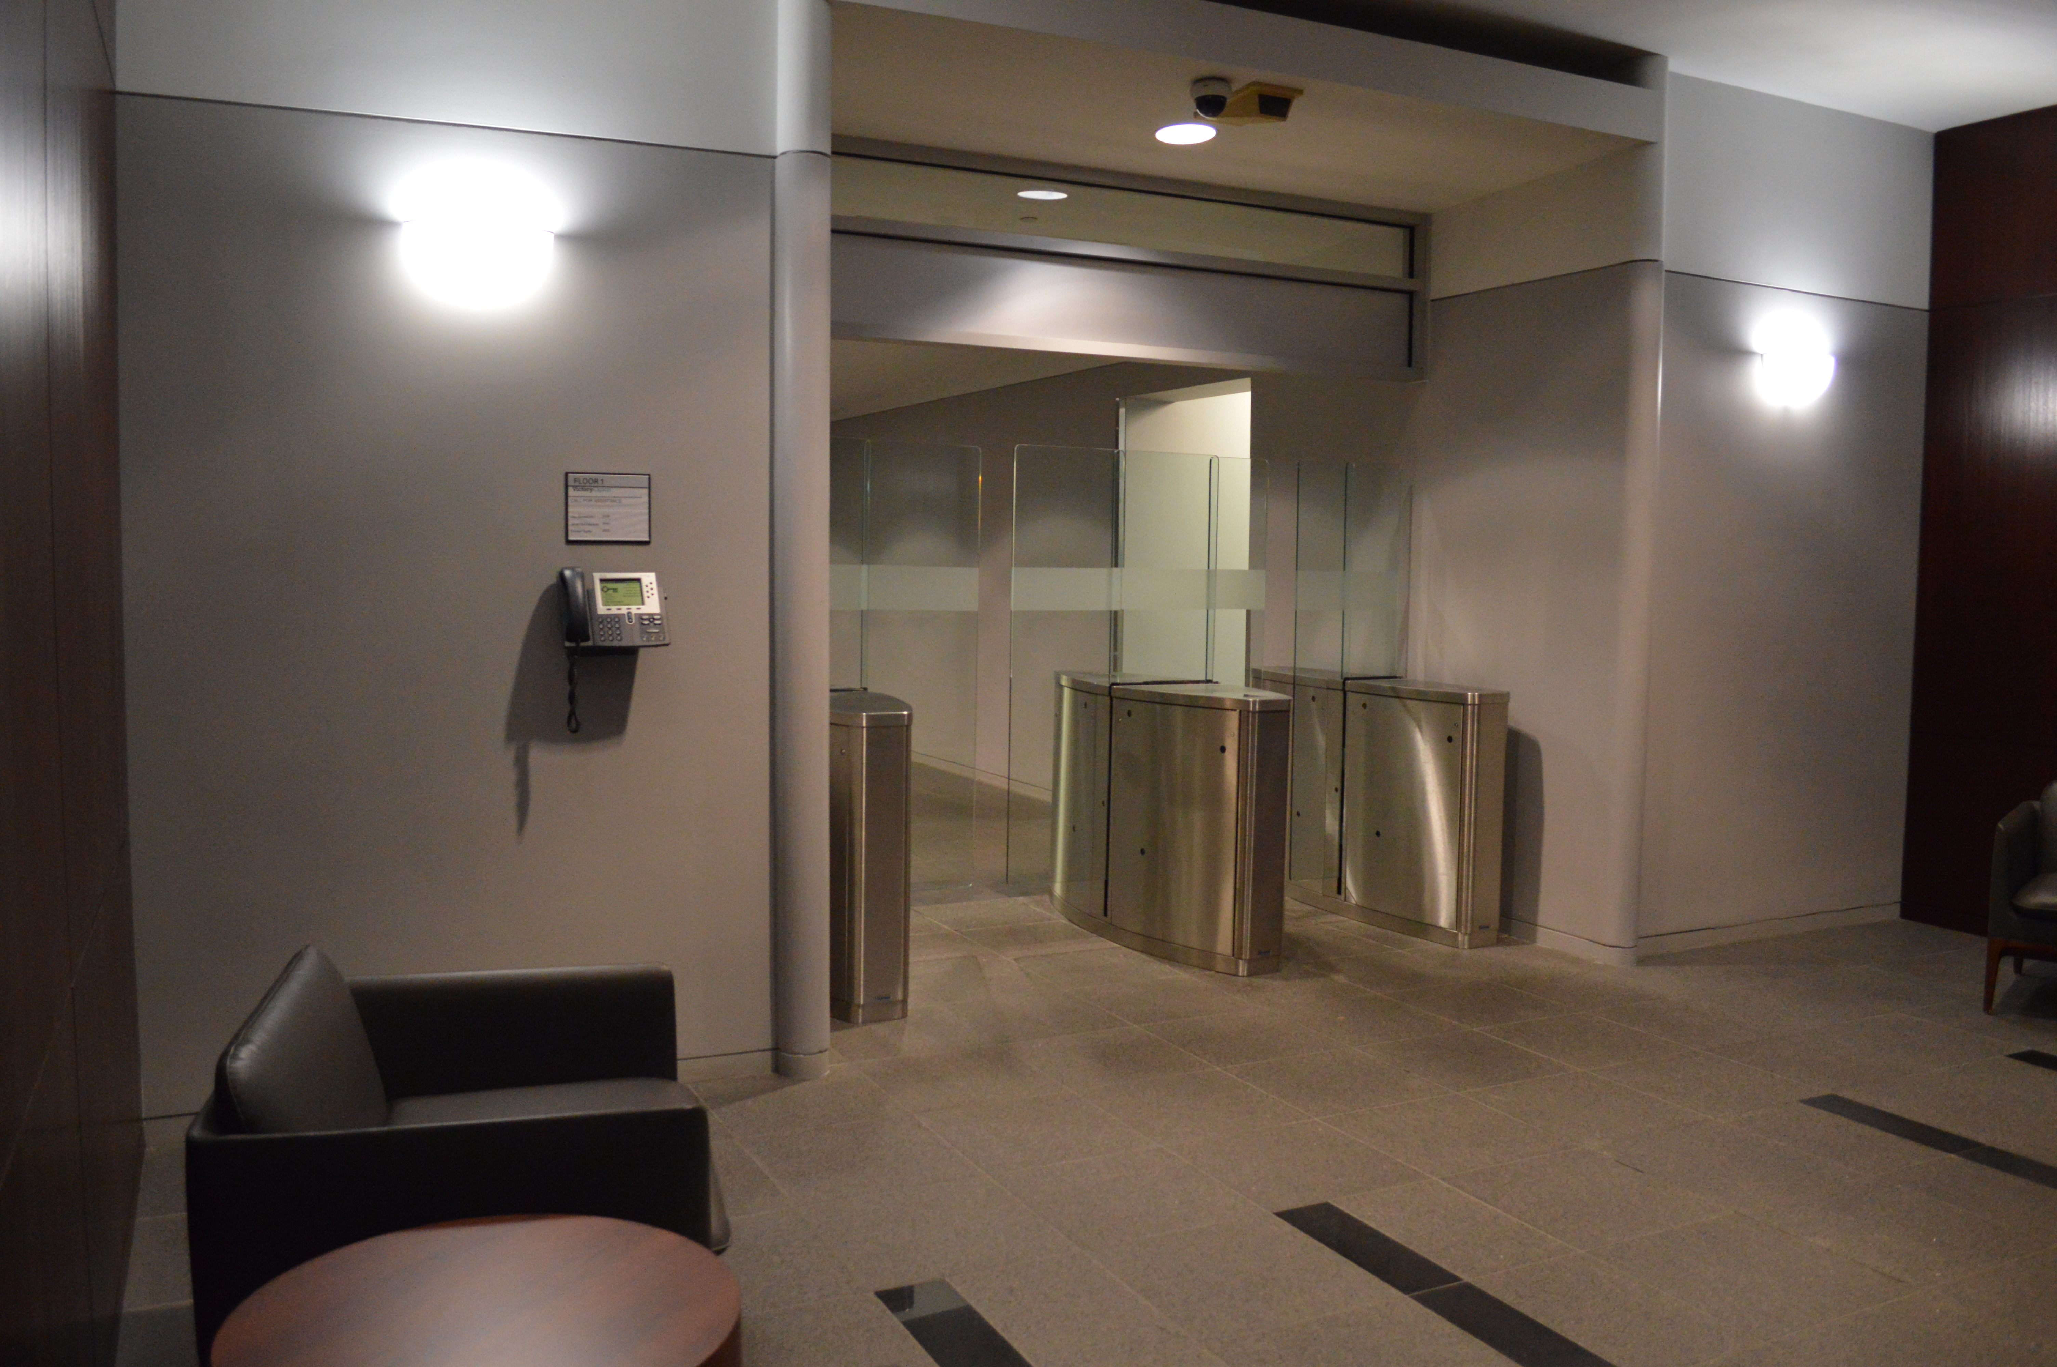
KeyBank Operations Center, Cleveland Ohio
Gunnebo Entrance Control Group
Tom Volpe

Slide 3
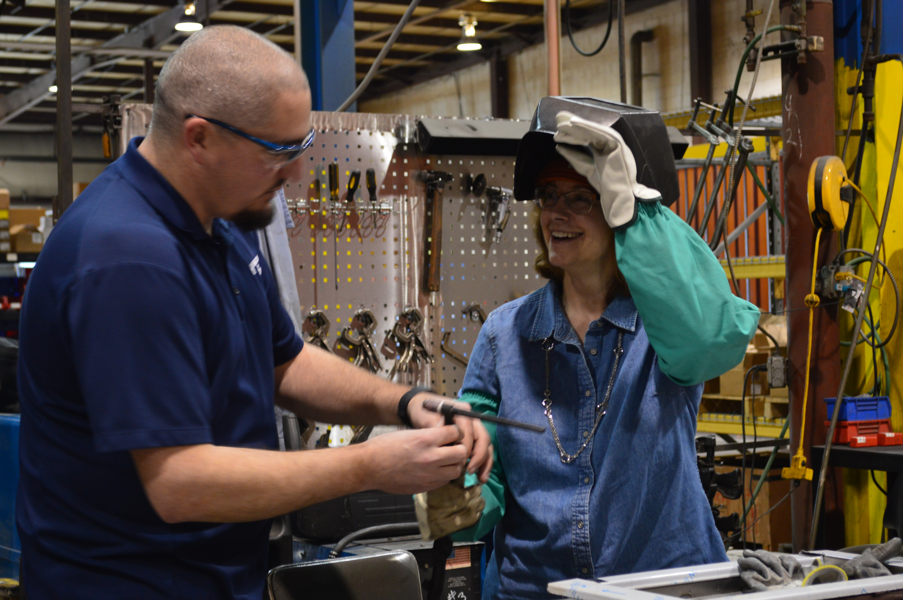
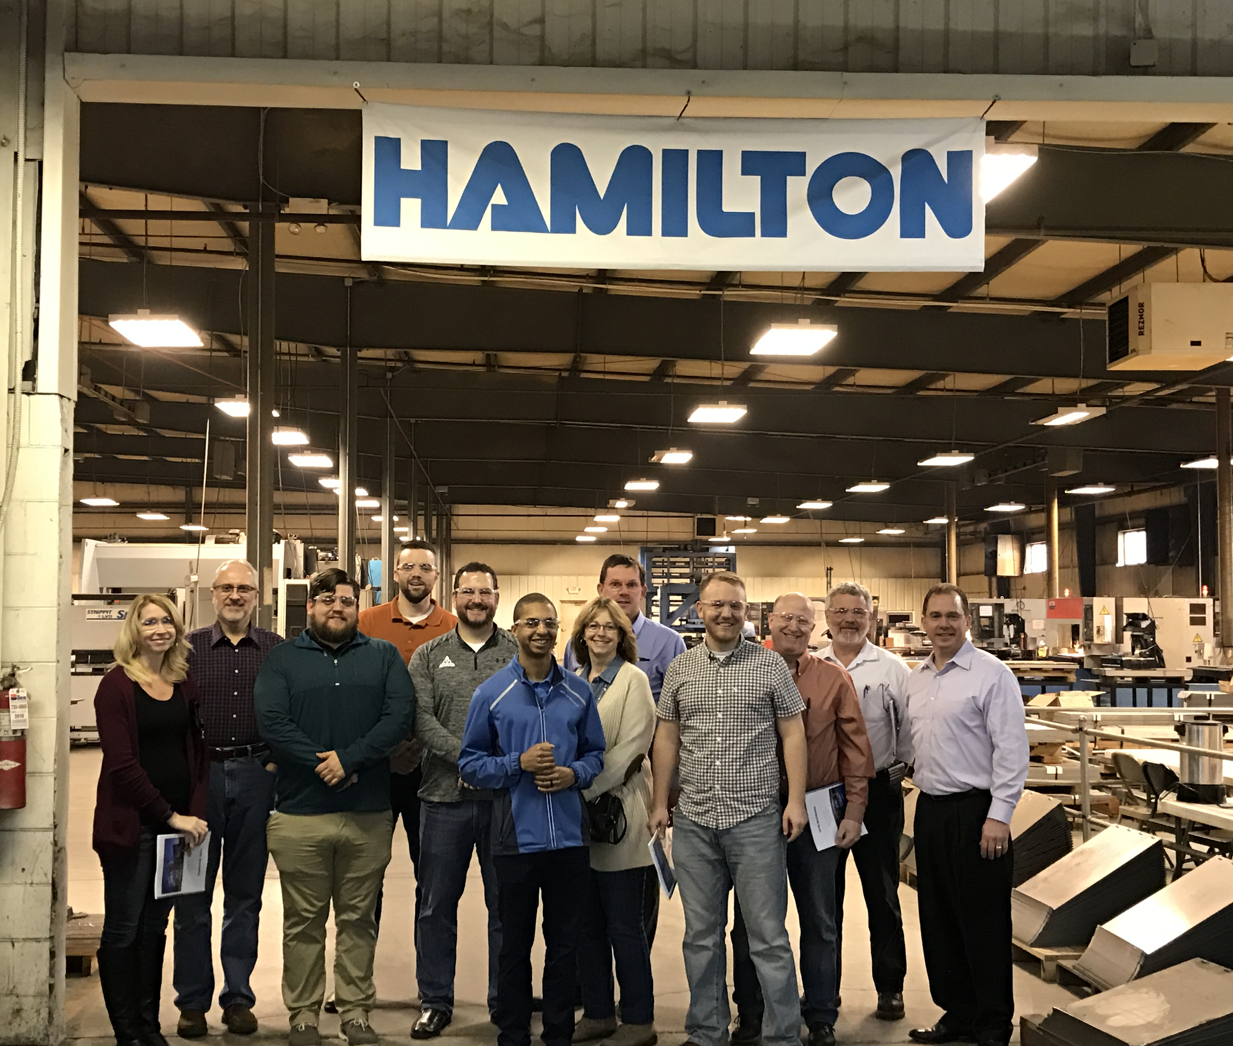
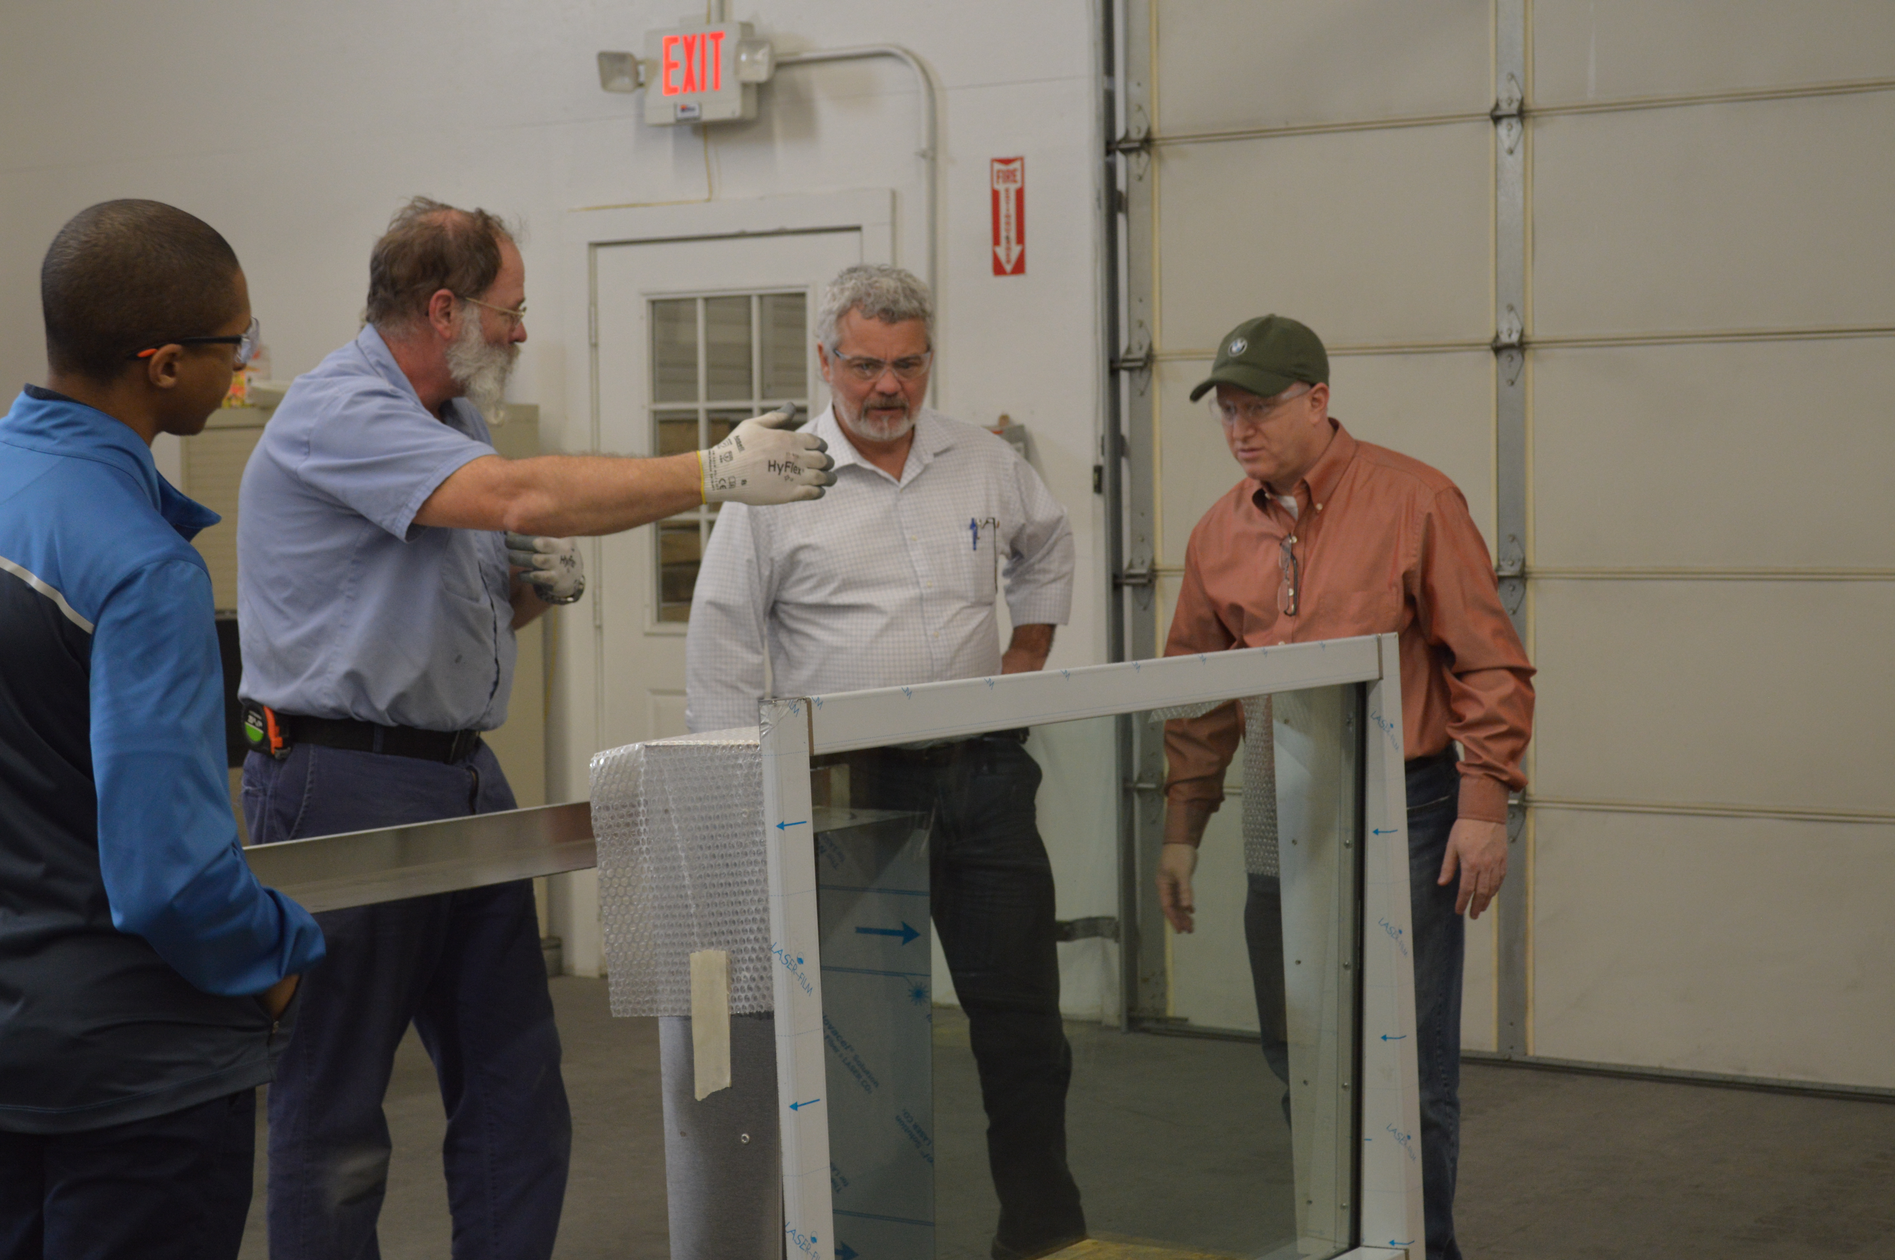
JPMorgan Chase – JLL Plant Tours
Mike Mooney and Lisa learning about our welding process.
Dennis Bubemyre explaining how our drive up window is made and installed to project managers.

Slide 4
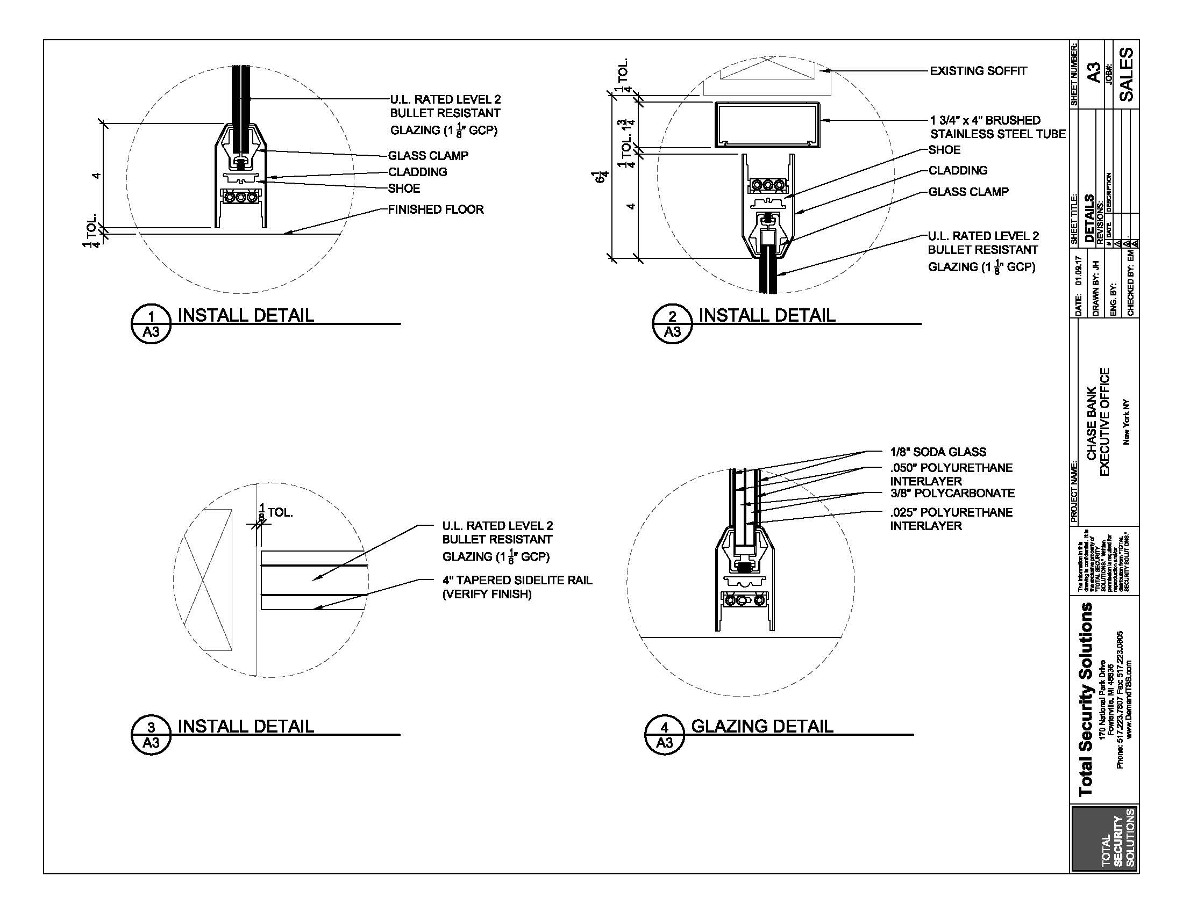
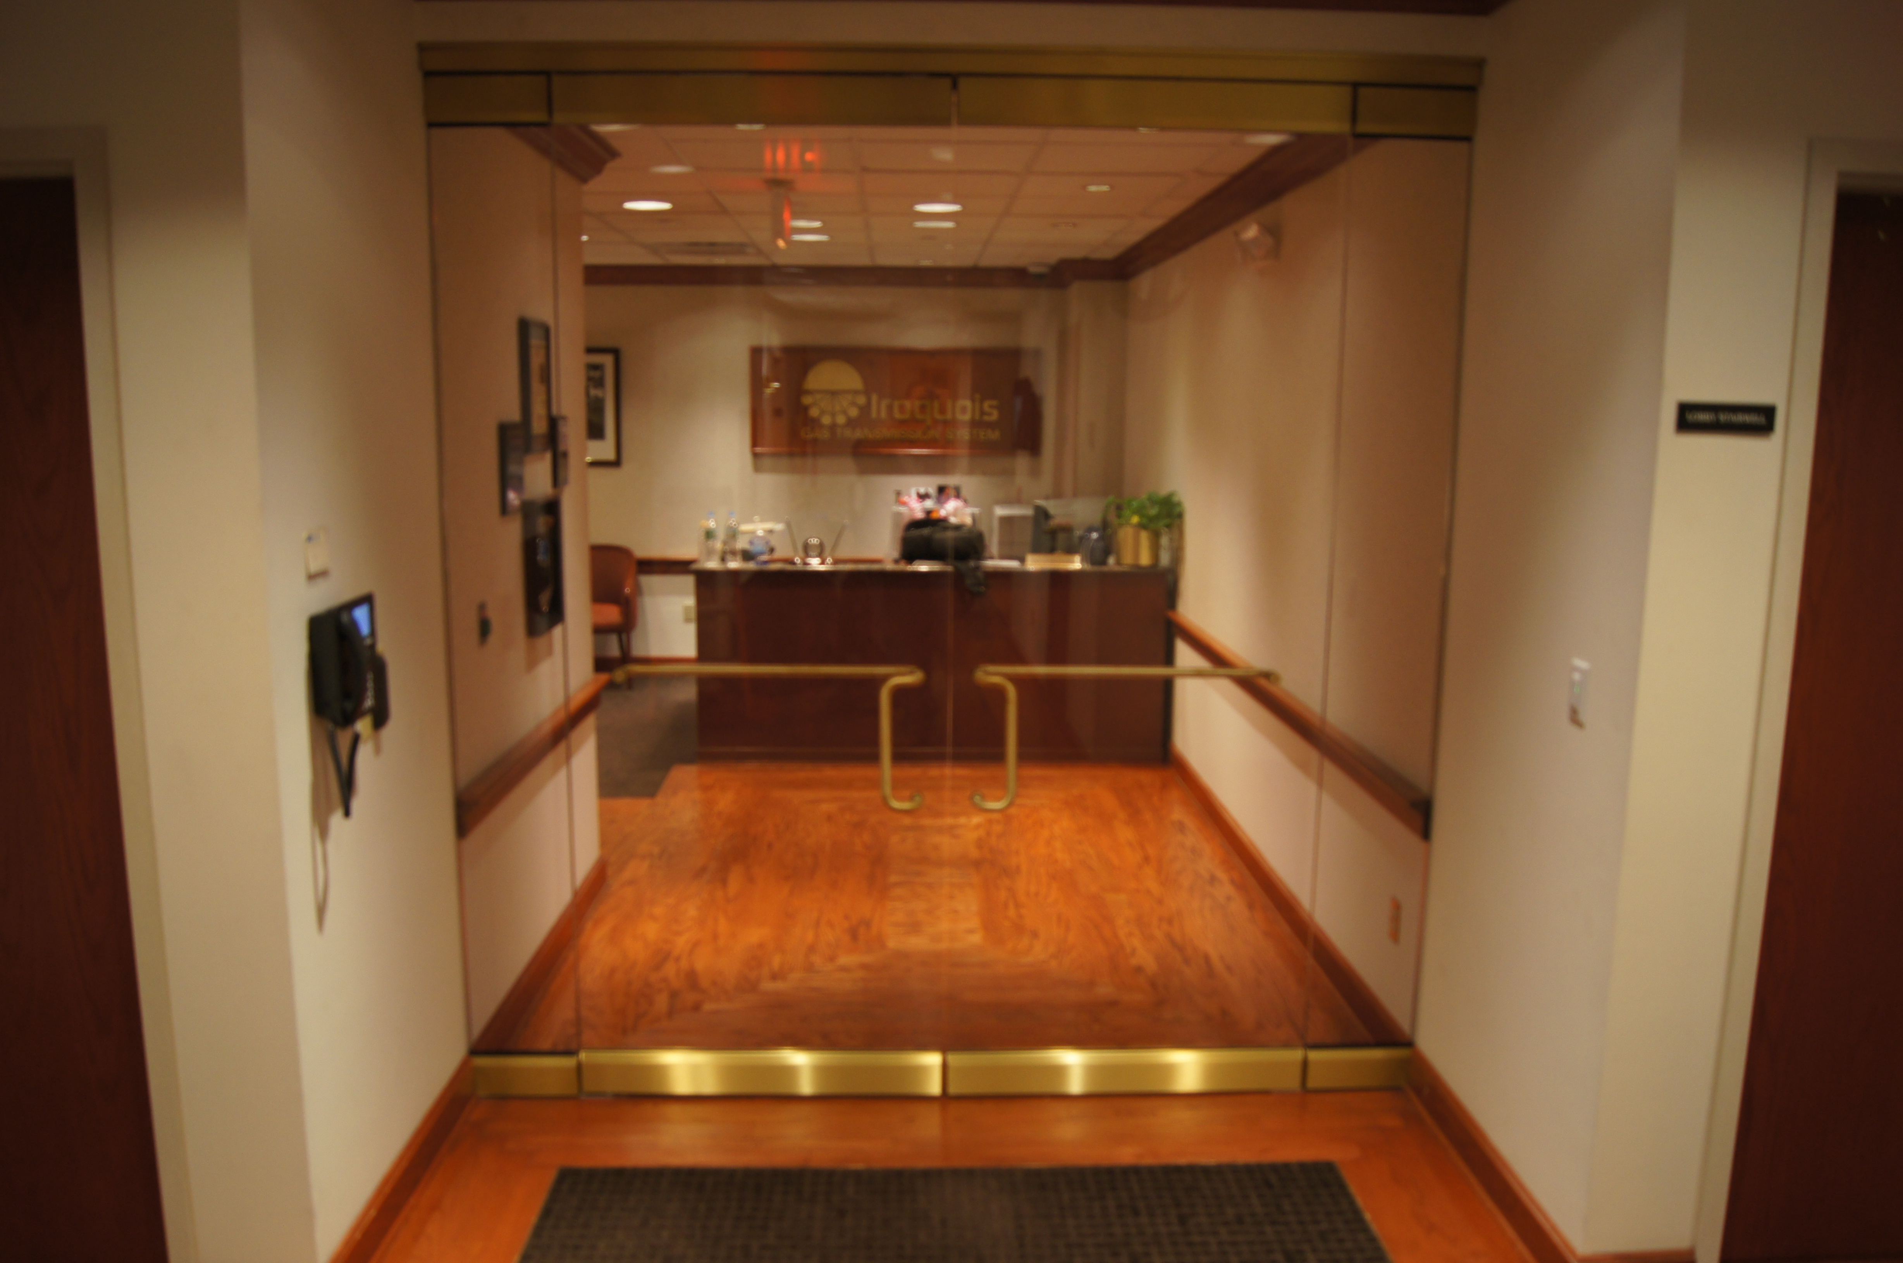
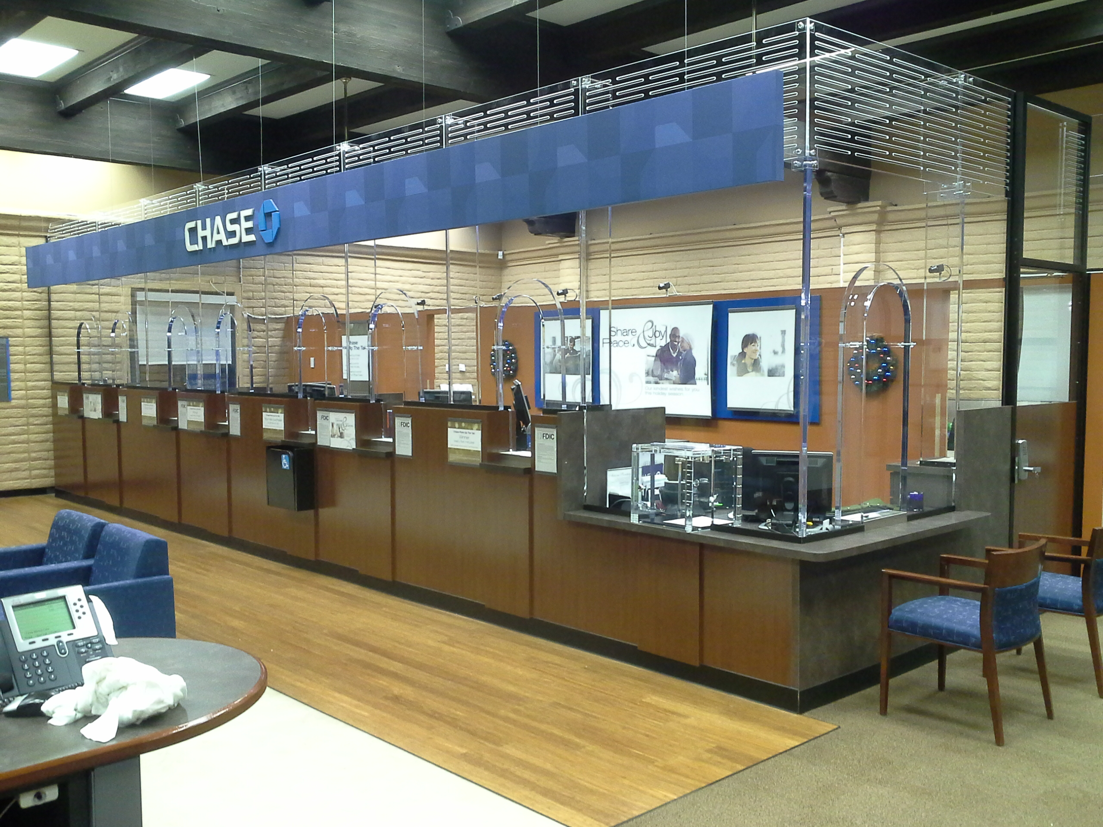
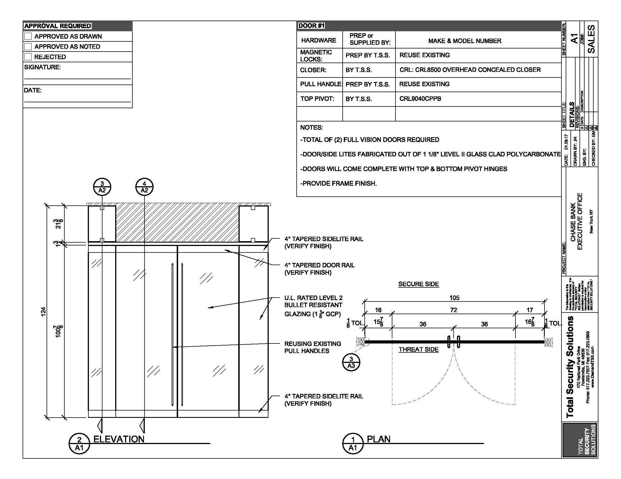
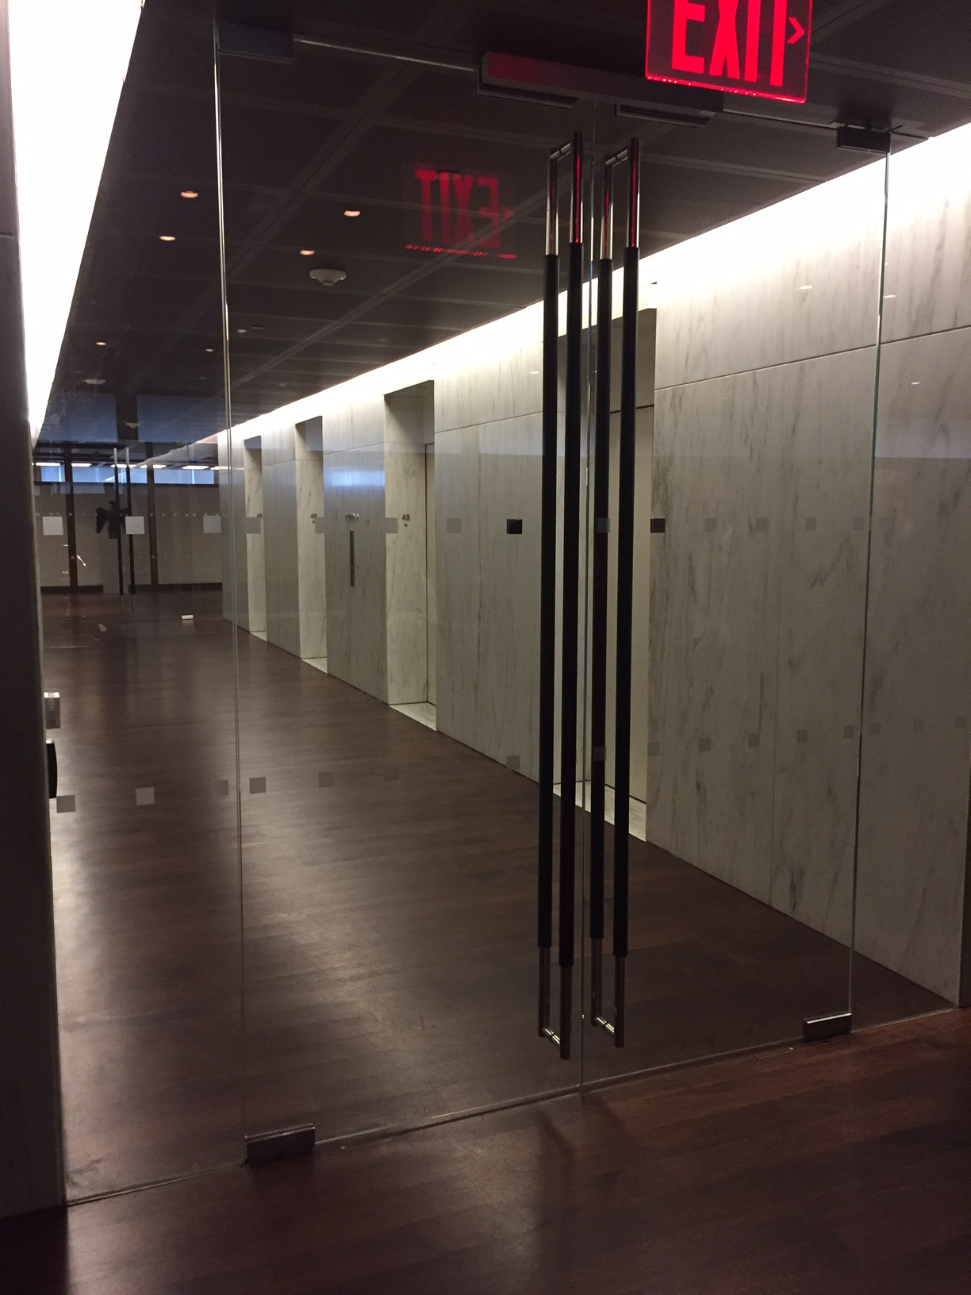
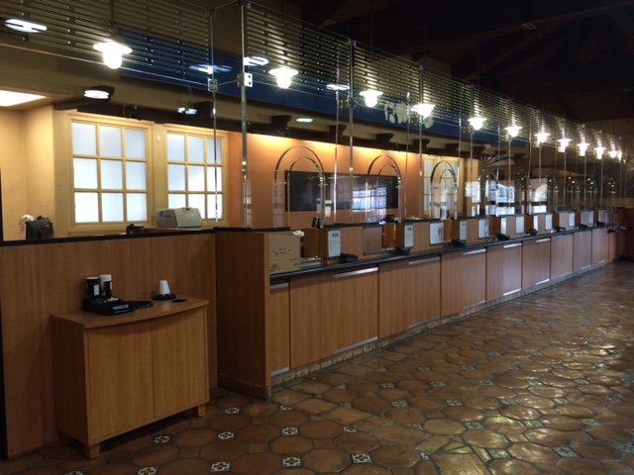
JPMorgan Chase Barrier Protection
Branch Protection
Lara Puckett
National Accounts Program Manager
Total Security Solutions, Inc.
Executive Offices

Slide 5
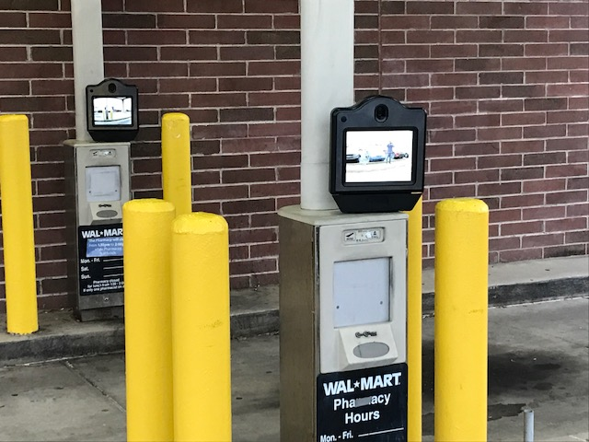
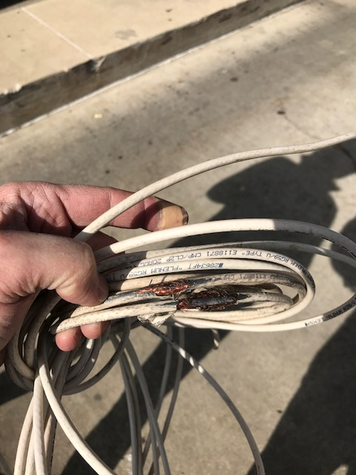
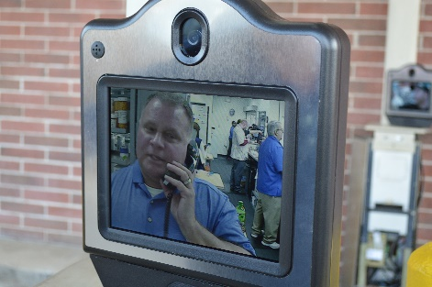
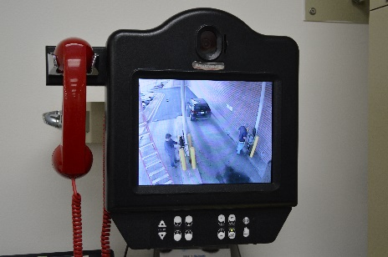
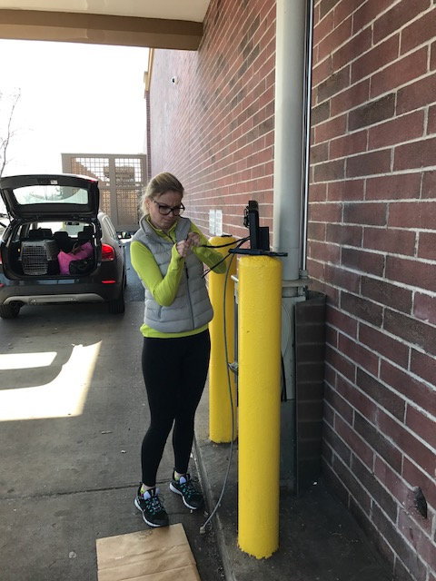
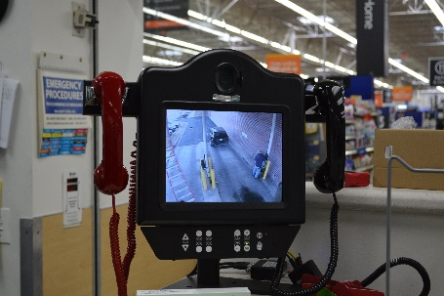
Pharmacy
Audio/Video Replacements
Pneumatic Systems
Storage
Depositories
Security
Design & Consulting Service

Slide 6
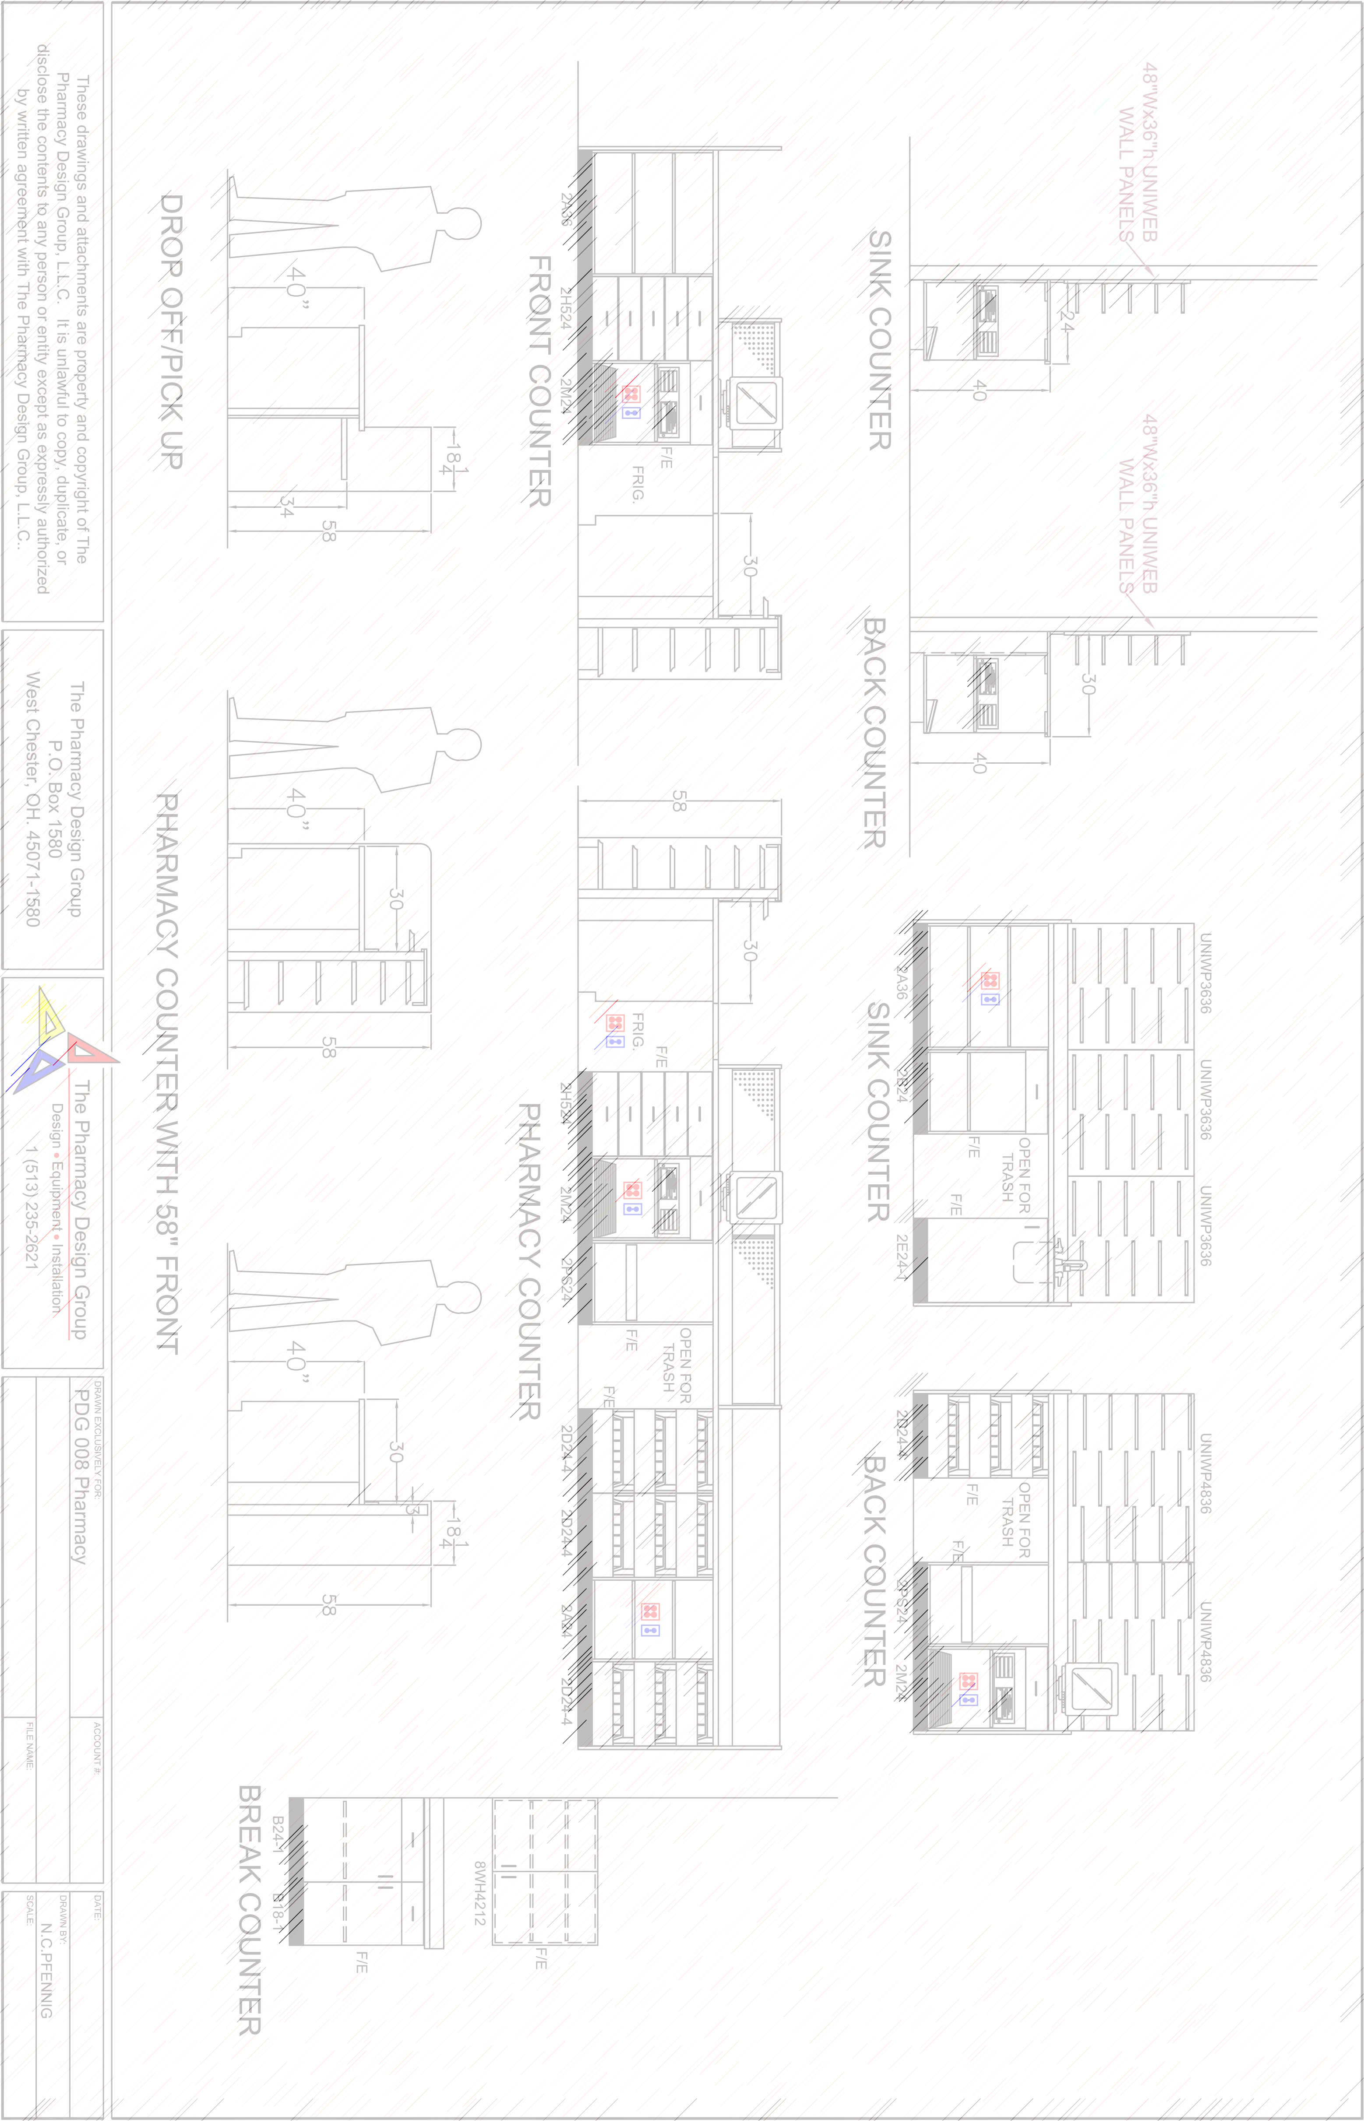

Slide 7
Creating Additional Value Through Partnership
USA
Hamilton Safe acquired in 2012. US’s second largest provider of safes and vaults to banks and government.
Over 70 Authorized Channel Partners
Hamilton production in Cincinnati OH.
North America Call Center is
located in Cincinnati OH.
Canada
In business since 1960s. Originally established under Chubbsafes brand.
14 Branches coast to coast
90 Technicians
Rob Cumming
Gunnebo Canada
Entrance Control
Market leading solutions assembled in Northern California
Mexico Dissamex acquired in 2014 #1 Electronic security services provider to most major national banks.
Brazil
Established in 1990s under Gateway brand. Acquired by Gunnebo in 2012. Today a leading provider of Loss Prevention solutions to retailers.

