Slide 1
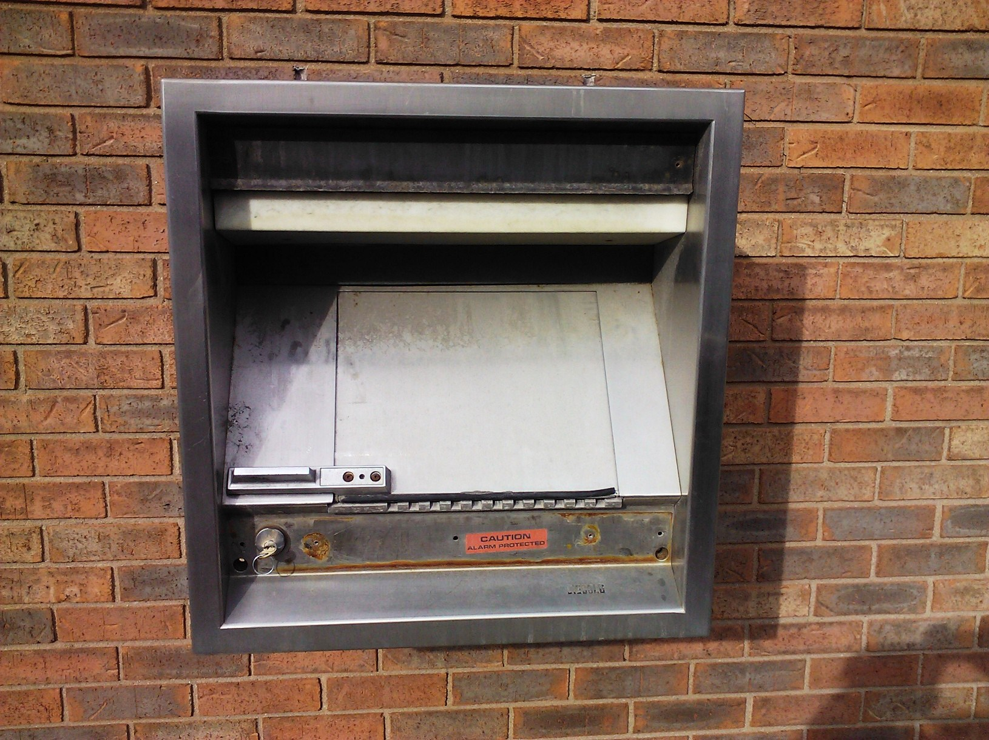
96-757 Diebold Securomatic
98RH20 Head upgrade

Slide 2
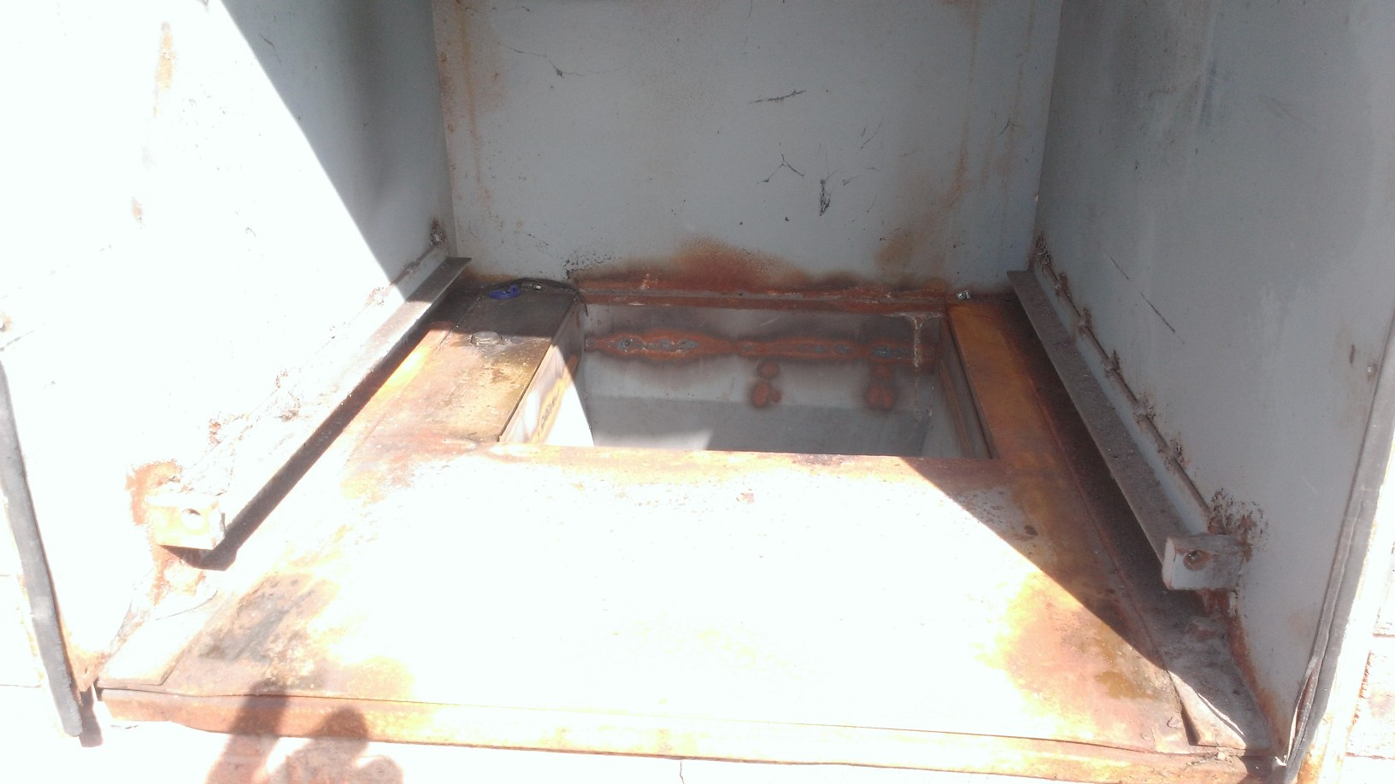
Remove existing Night Head Remove all gaskets and trim around sleeve. These are held on by 8/32 screws

Slide 3
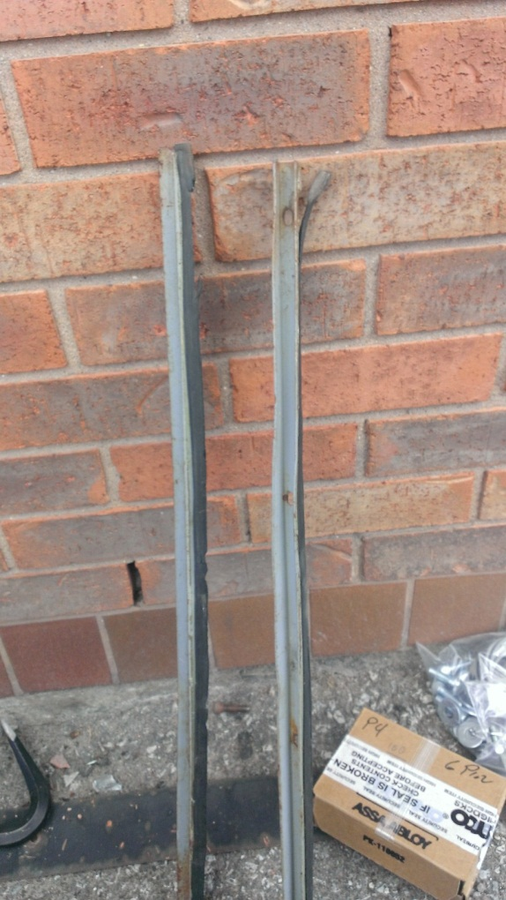
Removed gaskets and discard

Slide 4
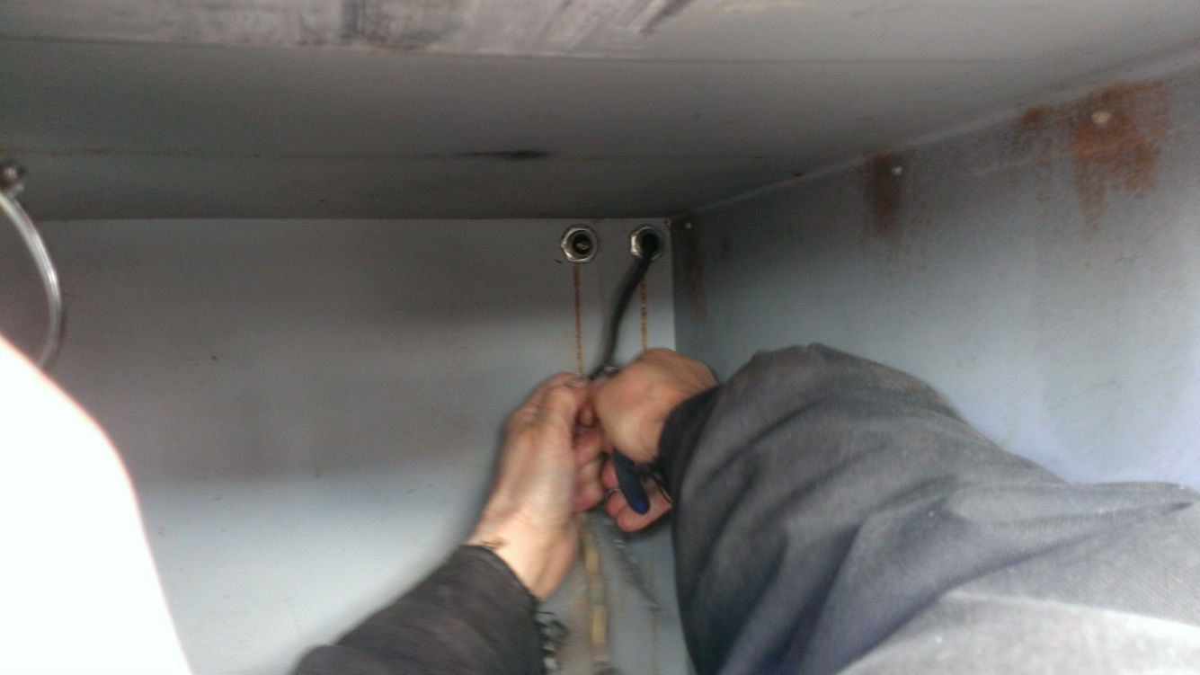
Ideally remove or have removed the existing wiring. (could interfere with install) CAUTION wires could be live.

Slide 5
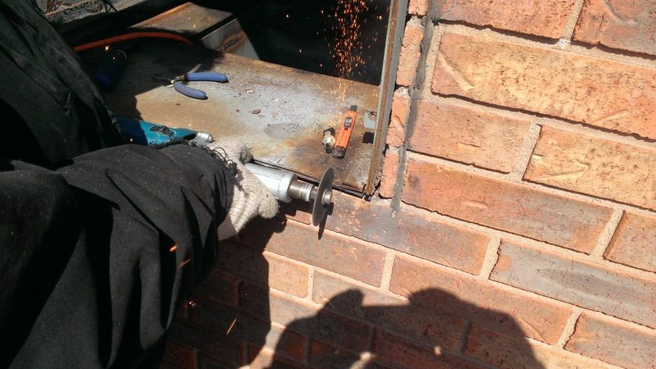
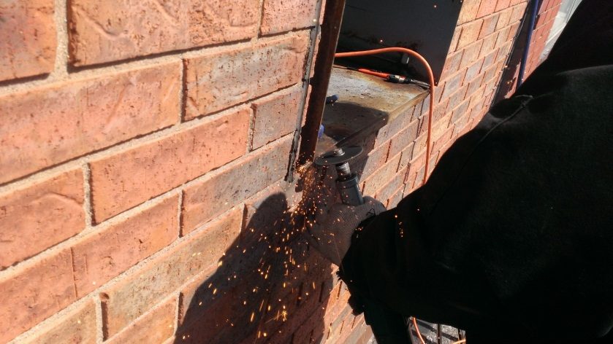
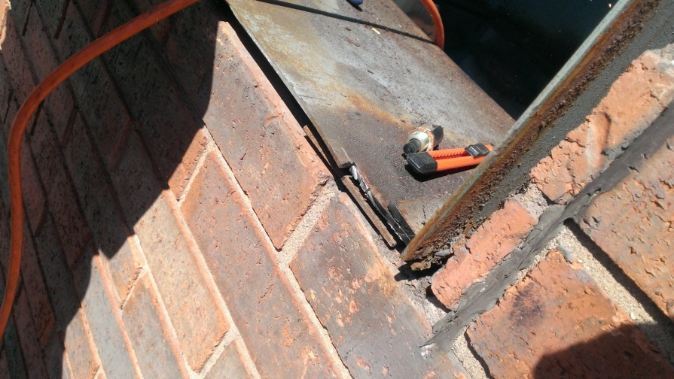
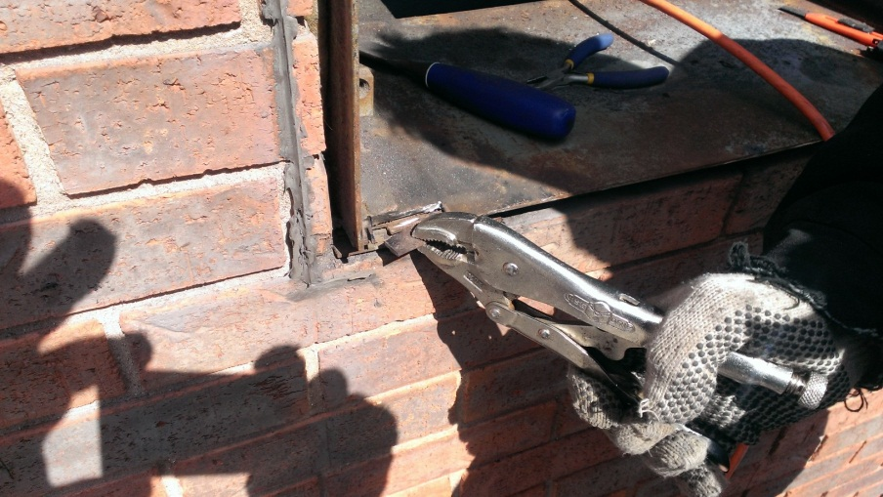
Cut a slot on each side of sleeve back flush with the wall. About 4” long on each side, adjust to fit. This is for the vertical rib on the new fascia.

Slide 6
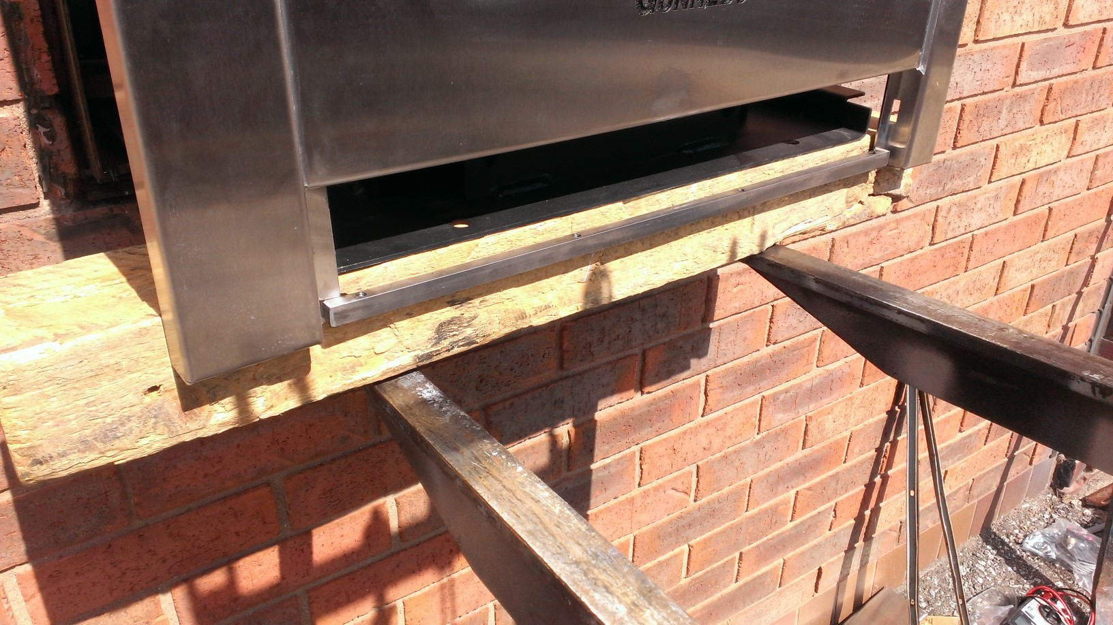
Do a test fit. Slide in the new head and release the locking plunger. Make sure the head is locked in with the plunger. If the plunger hasn’t engaged your head is misaligned or not sitting flat on the wall. Make changes. (There are slotted adjustments between the 98RH20 and the mounting bracket)

Slide 7
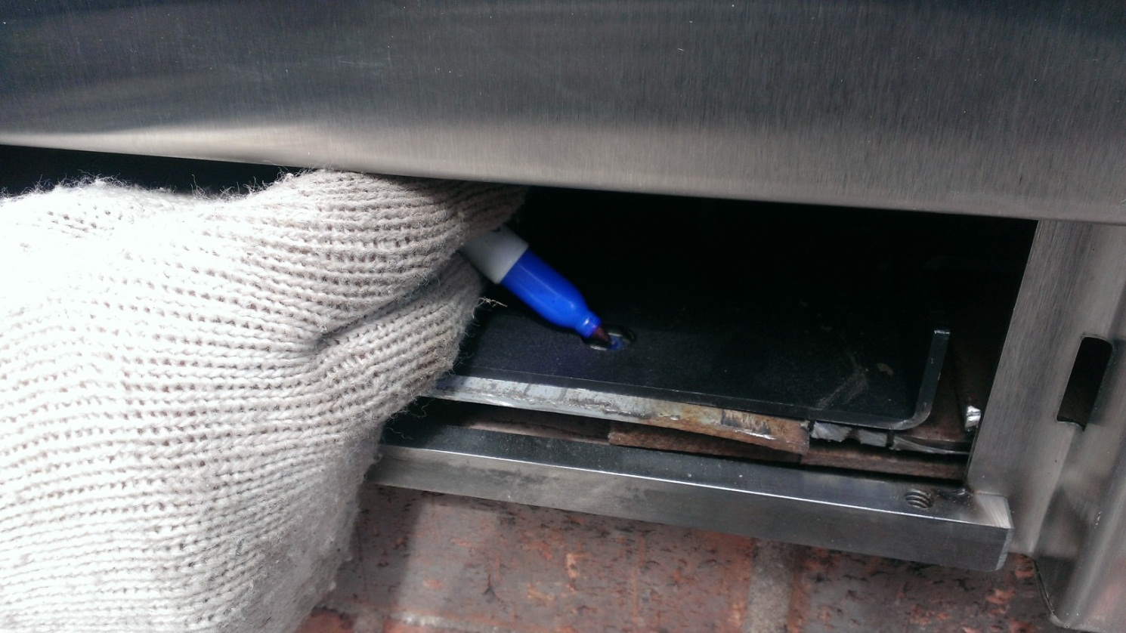
While head is in place mark for attachment (2) bolts. Remove head.

Slide 8
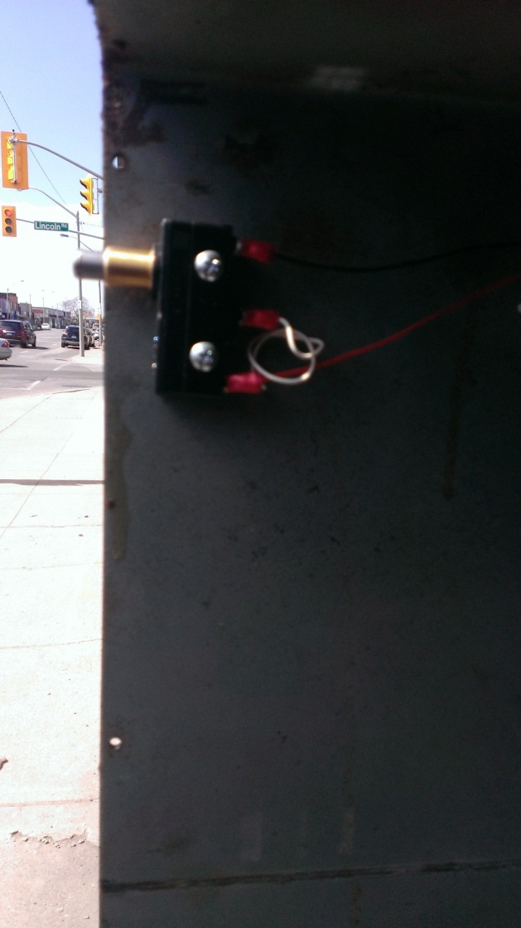
Install new head tamper switch. Check for continuity (open/ closed) and wire to meet the need of the alarm.

Slide 9
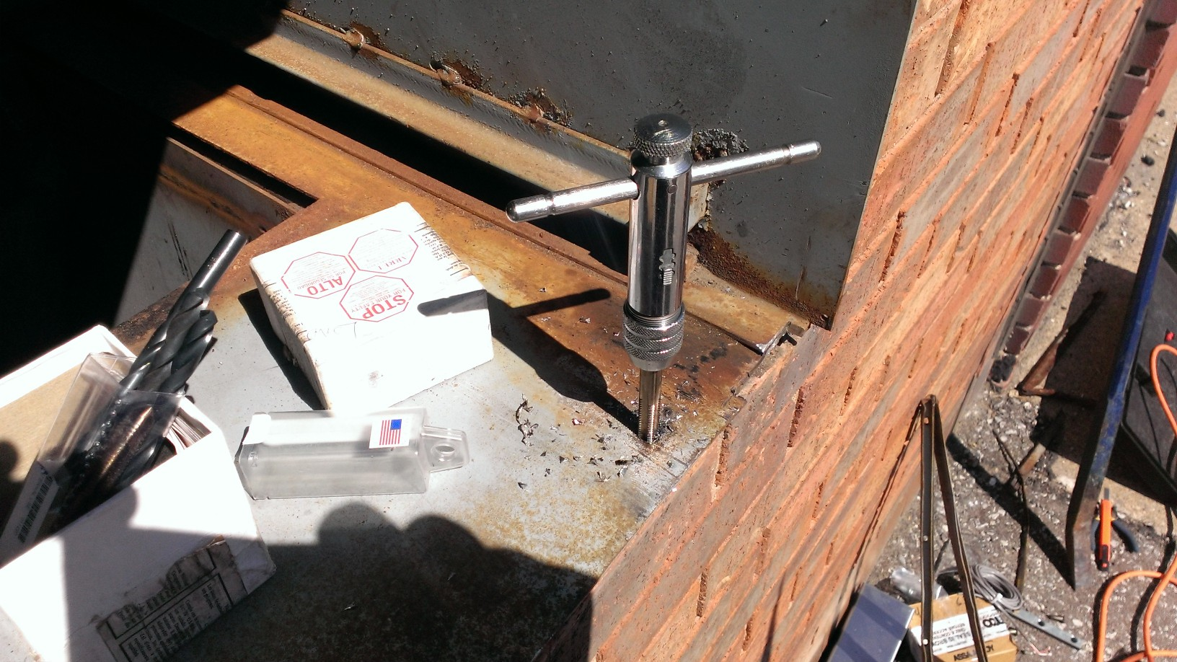
Drill and tap (2) 3/8 – 16 mounting holes

Slide 10
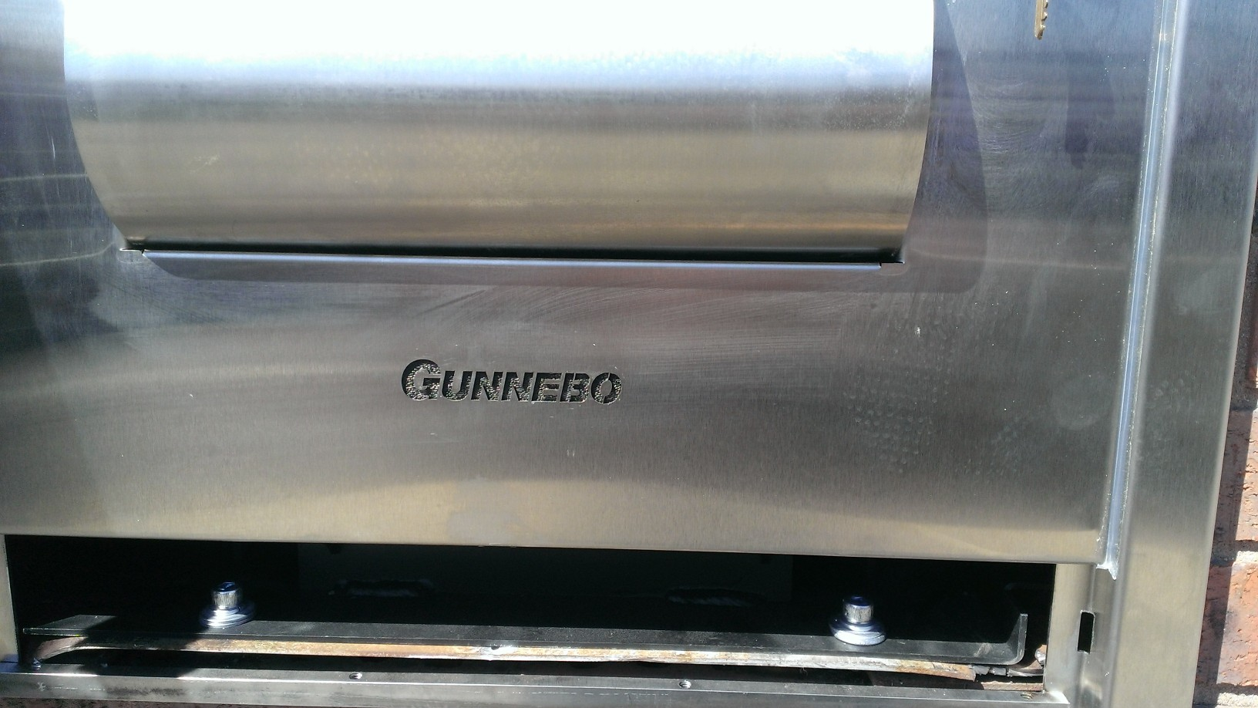
Bolt down and install lower access trim using security screws

Slide 11
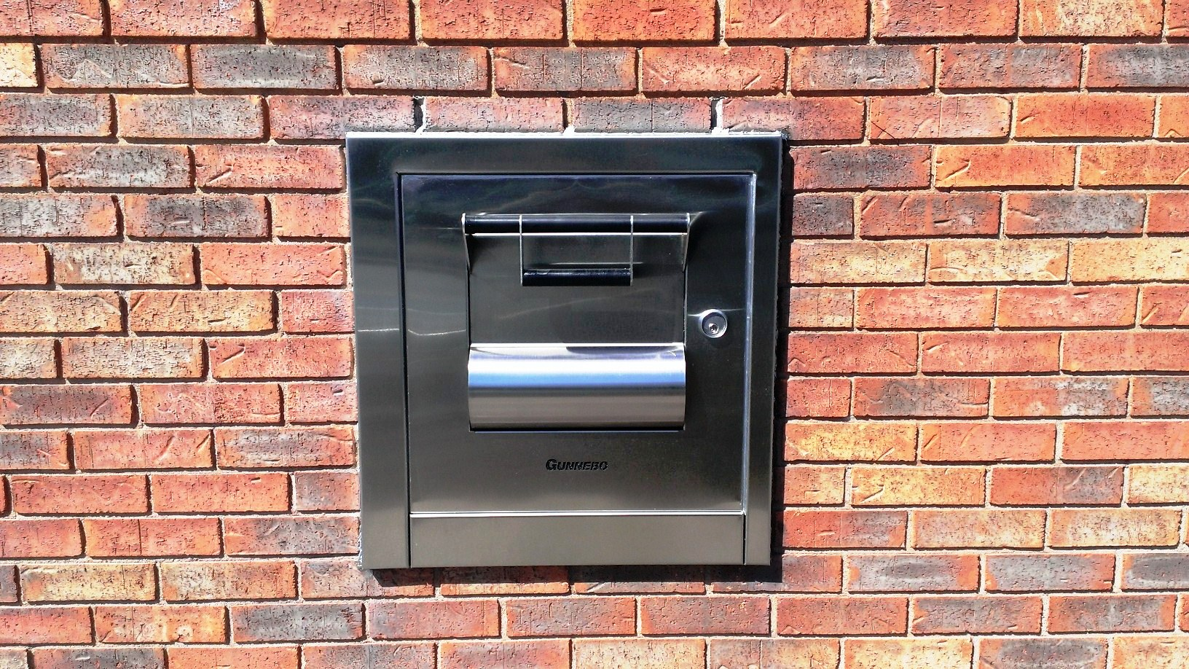
Polish and caulk.

